Slide 1
HomeEats
Ankith Yennu, Steven Morrison, Isabel Kershner, Jack Short, Habib Karaky, Shivani Saboo, Guillermo Saavedra Diaz

Slide 2
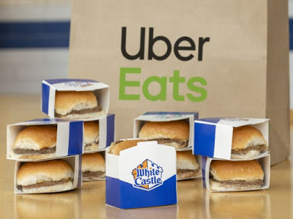

Problem
Unhealthy food options on existing food delivery apps
Sacrificing quality of food for convenience
People who can’t cook still want to be able to consume fresh home cooked meals

Slide 3
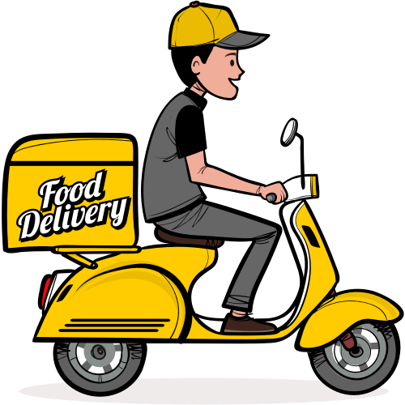
What is HomeEats?
Food Delivery Web Application specifically tailored for freshly prepared home cooked meals
Meals prepared by amateur cooks in your area
Two separate sites built for the cook and customer

Slide 4
Core Requirements - Customer
Create Account/Login
Filter dishes by cuisine, rating, price, distance (chefs)
Live Shopping Cart
Checkout (Cash/Credit Card) with appropriate tax and option to tip
Provide estimated delivery time
Favorite Dishes, Give Reviews/Ratings, communicate special instructions to Chefs
Track your Order History
Edit Profile

Slide 5
Core Requirements - Chef
Create Account by Application (Requires Admin Verification)
Go online/offline in order to take orders
Add Dishes
Cuisine Type
Ingredients
Preparation Time
Set Price
Accept/Reject Orders within a specified time frame
Edit Profile

Slide 6
Core Requirements - Admin
Verify Cook Accounts
Review Orders
View Revenue Reports Over Specified Time
View Cancelled Orders and Reasons for Cancellation

Slide 7
Difficult requirement changes
Initially Optional/Desired:
Messaging System between the cook and the customer
Detailed revenue reports for both the site administrator and chefs
Ordering in Advance (Bulk Ordering)

Slide 8




Technologies/Tools Used
Python
Django
AWS
Postgres
Github
Trello
TravisCI
Slack

Slide 9
Challenges
Trying to map out the entire site and features (iterations with wireframes)
Working on features that are dependent on one another
Coordinating team efforts once the class went virtual (heavy reliance on Zoom & Slack)
Speed of AWS & Django during development and testing

Slide 10

Strengths/Weaknesses
Strengths
Ease of Use
Sleek & Modern UI
Full of content/features
Weaknesses
AWS can be slow
Django can be slow

Slide 11

Future Work
Mobile Application
Integrate with local catering businesses in the area
Website portal for delivery drivers
Sign Up to be a driver
Check Payments
Track Tips
Track jobs
Earn Credit towards Use on Platform
Rewards Program

Slide 12

Demo Time!
Notes:
Create cook account
Get approved by admin
Create a dish, enable/disable dish
Logout
Customer create with Cville address
See all dishes currently unavailable
Login Cook near Cville
Go back to customer and see dishes available
Create order and submit
Back to cook side and go through statuses / go back to customer and show statuses changing
Go to delivered, then see past order on both customer/cook side

