Slide 1
Managerial Roles in the context of Organizational Behavior
Name : Anirban Manna
Roll : 34200121045
Year : 3rd
Semester : 6th
Subject : Human Resource Development and Organizational Behavior
Sub. Code : OEC-IT601 B

Slide 2

Introduction
Welcome to our exploration of Managerial Roles within the realm of Organizational Behavior. In any thriving organization, managers play pivotal roles, encompassing interpersonal interactions, information handling, and critical decision-making. Let's delve into the key aspects that define and shape effective management in today's dynamic business landscape.

Slide 3

Need for Manegerial role
1. Strategic Alignment:
Managers ensure that individual and team efforts align with the organization's strategic goals.
2. Decision-Making Authority:
Managers play a key role in making critical decisions based on their expertise and organizational priorities.
3. Resource Optimization:
Effective managers allocate resources judiciously, maximizing productivity and minimizing waste.
4. Leadership and Motivation:
Managers provide leadership, inspiring and motivating teams to achieve peak performance.

Slide 4
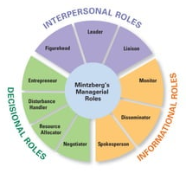
Types of Managerial Role
1
2
3
Interpersonal Roles
Decisional Role
Informational Roles

Slide 5
Interpersonal Roles
Figurehead Role
Leader Role
Liaison Role
Managers act as symbolic leaders and representatives of the organization.
Responsibilities: Performing ceremonial duties, being a symbol of authority, and embodying the organization's values.
Managers guide and motivate their teams to achieve organizational objectives.
Responsibilities: Providing direction, support, and inspiration, and facilitating teamwork and collaboration among employees.
Managers establish and maintain networks and relationships within and outside the organization.
Responsibilities: Building connections, networking with other departments, and managing relationships to gather information or resources.

Slide 6

Informational Roles
Informational roles in the context of organizational behavior are the duties and obligations managers carry out in order to gather, process, and distribute information within an organization. These positions, which center on the manager's function as an information processor and communicator, are an element of Henry Mintzberg's paradigm for management functions.
Monitor: Managers gather information from both internal and external sources to stay informed about developments relevant to their organization.
Disseminator: Managers share information with their subordinates and other stakeholders to ensure everyone has access to necessary knowledge.
Spokesperson: Managers represent their organization to the outside world, communicating its policies, objectives, and decisions to external parties

Slide 7
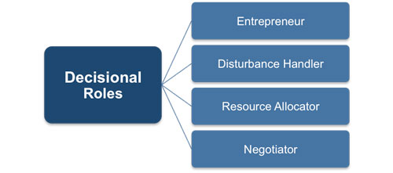
Decisional roles
Decisional roles, as conceptualized by Henry Mintzberg, involve the processes of decision-making and the resolution of conflicts and uncertainties within the organization. Here are three key decisional roles:
Entrepreneur Role:
Managers initiate and drive innovation and change within the organization.
2. Disturbance Handler Role:
Managers address conflicts and crises that may arise within the organization.
3. Resource Allocator Role:
Managers decide on the allocation of resources, including budget, time, and personnel.

Slide 8
Conclusion
In conclusion, the multifaceted nature of managerial roles, encompassing interpersonal, informational, and decisional dimensions, underscores the indispensable contribution of managers to organizational success. Managers serve as the linchpin, aligning strategic objectives, fostering collaboration, and navigating through challenges. From being symbolic figures to information conduits and decision-makers, their dynamic responsibilities are pivotal in steering the organization towards innovation, growth, and sustained excellence. As we reflect on the significance of these roles, let us appreciate the vital role managers play in shaping organizational behavior and propelling it towards a future of resilience, adaptability, and achievement.

Slide 9

References
Shukla, Madhukar: Understanding Organizations – Organizational Theory & Practice in India, PHI
Robbins, S. P. & Judge, T.A.: Organizational Behavior, Pearson Education, 15th Edn.
Luthans, Fred: Organizational Behavior, McGraw Hill, 12th Edn.

Slide 10

Thanks!

