Slide 1
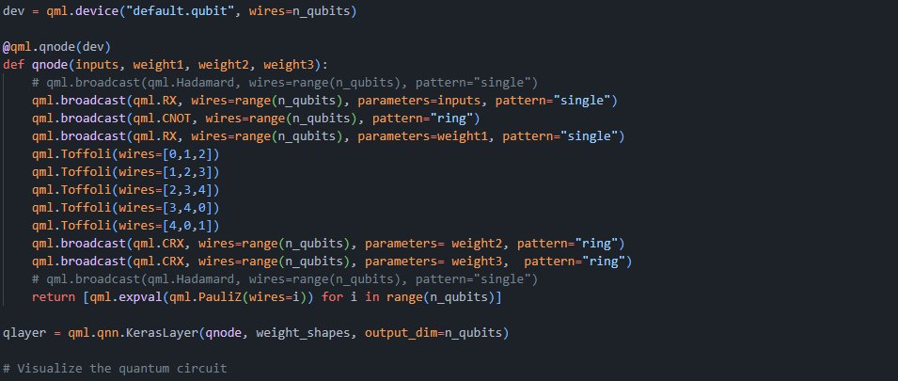
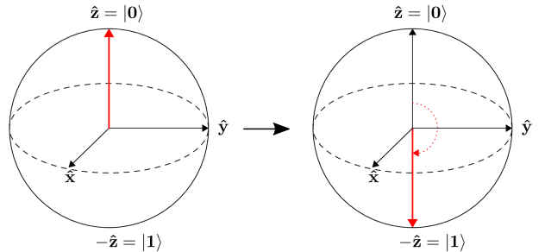
Airfoil self noise prediction with hybrid quantum machine learning
Samuel Lehmköster, Dilara Yildiz
Notes:
Airfoil self-noise refers to the collective sound generated by an airfoil in a smooth, non-turbulent inflow.
caused by interactions between the airfoil blade and self-induced turbulence

Slide 2
Outline
Dataset
Classical Neuronal Network
Hybrid Quantum Machine Learning
Basic Entangling
Toffoli Entangling
Strong Entangling
Quantum Autoencoder
Simple Set-up
Separate Training
Encoder Test
Conclusion

Slide 3
Classical Neural Network & Dataset
Dataset
Nasa Airfoil Self-Noise Data Set by Brooks et. Al
1503 samples
NACA0012 airfoil
Frequency | [Hz]
Angle of attack | [°]
Chord length | [m]
Free-stream velocity | [m/s]
Suction side displacement thickness | [m/s]
Noise pressure level | [dB]

Slide 4
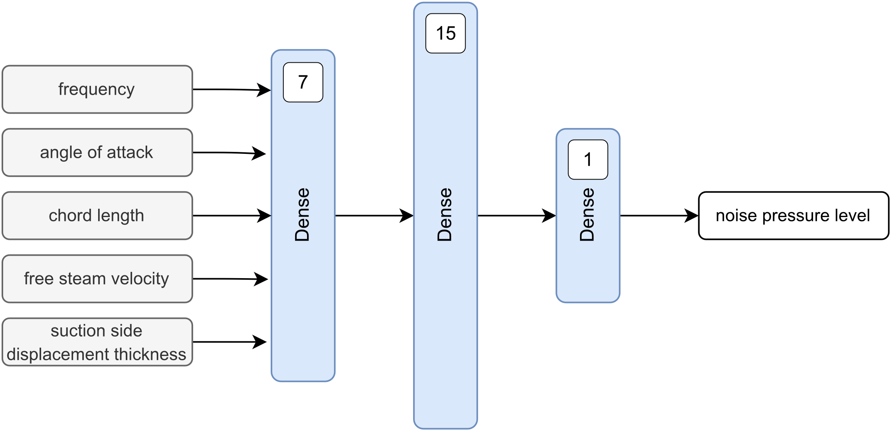
Classical Neuronal Network & Dataset
Neuronal Network Architecture
Network architecture

Slide 5
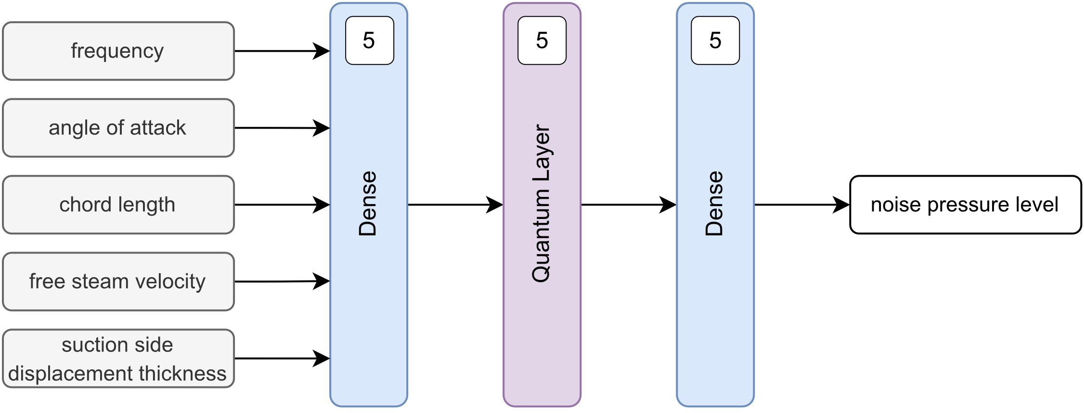
Hybrid Quantum Machine Learning
Architecture
Embedded quantum layer architecture

Slide 6
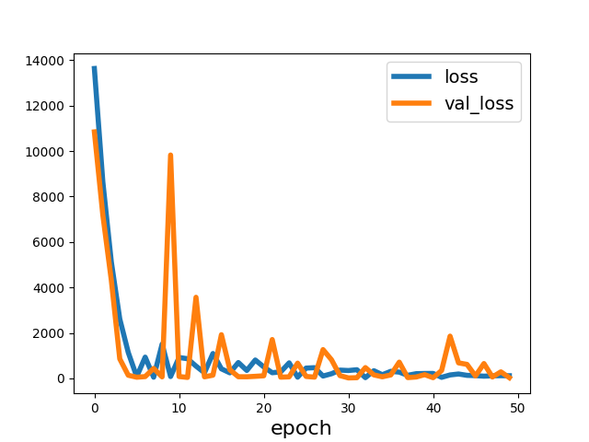
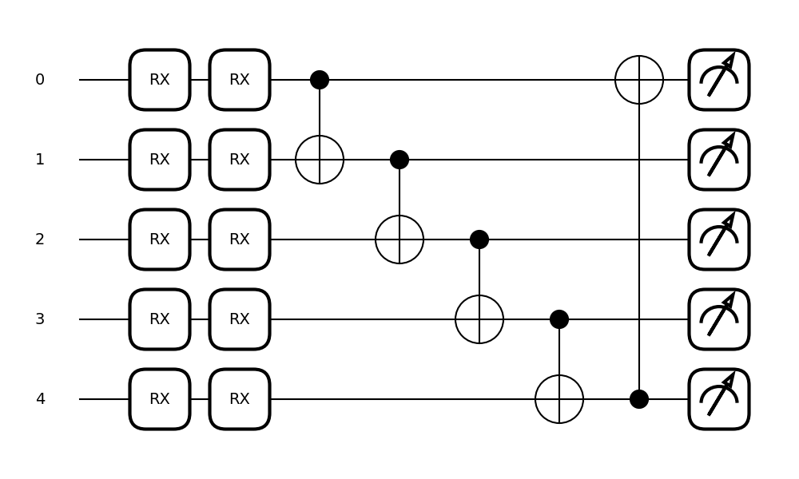
Hybrid Quantum Machine Learning
Basic Entangling Layer
Notes:
oscillations decreased until epoch 15, but still remain at a high level in the loss history.
The stronger oscillations might indicate a more sensitive model to changes of the weights.

Slide 7
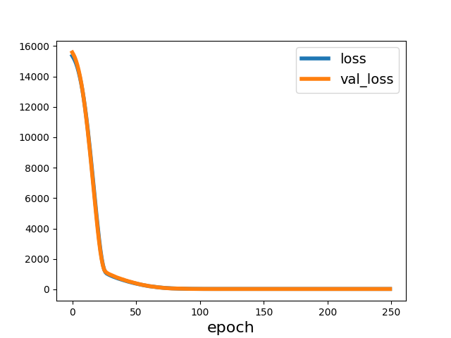
Hybrid Quantum Machine Learning
Basic Entangling Layer

Slide 8
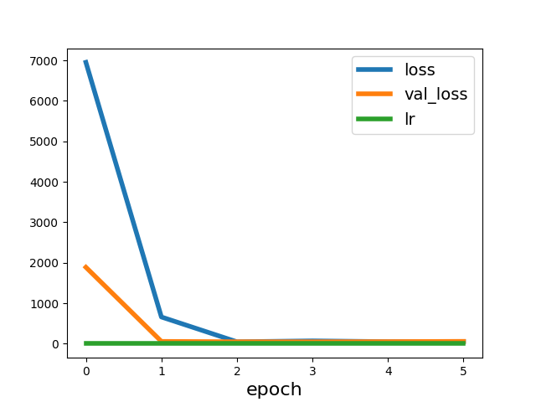
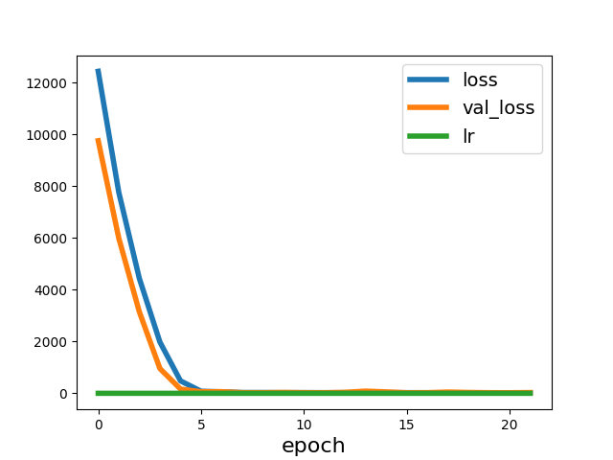
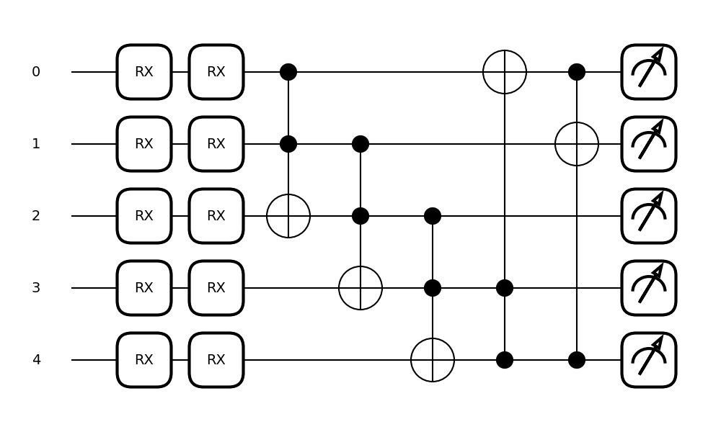
Hybrid Quantum Machine Learning
Toffoli Entangling Layer

Slide 9
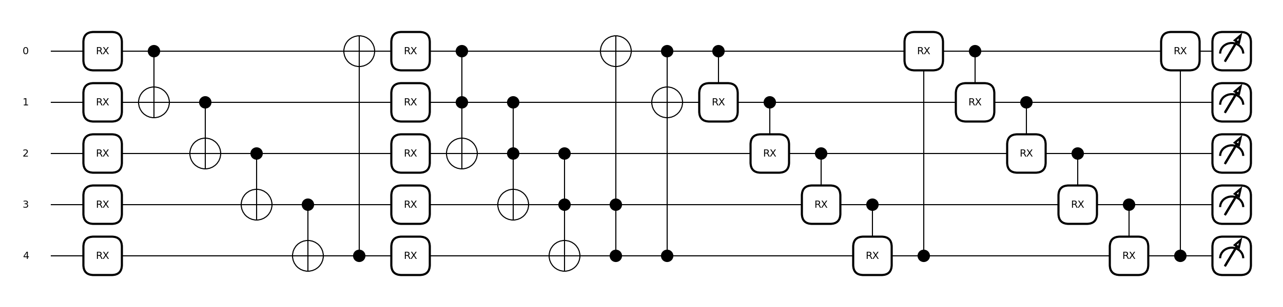
Hybrid Quantum Machine Learning
Strong Entangling Layer

Slide 10
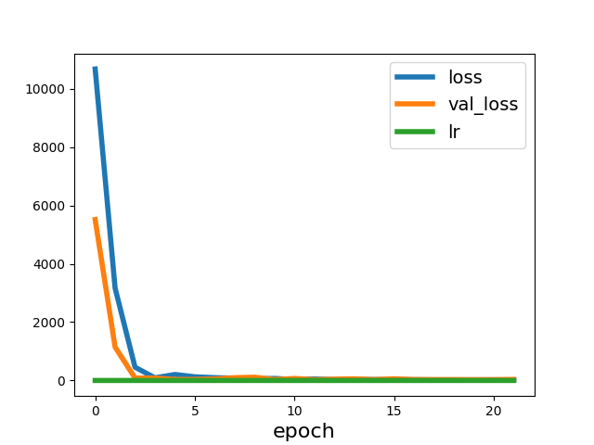
Hybrid Quantum Machine Learning
Strong Entangling Layer

Slide 11
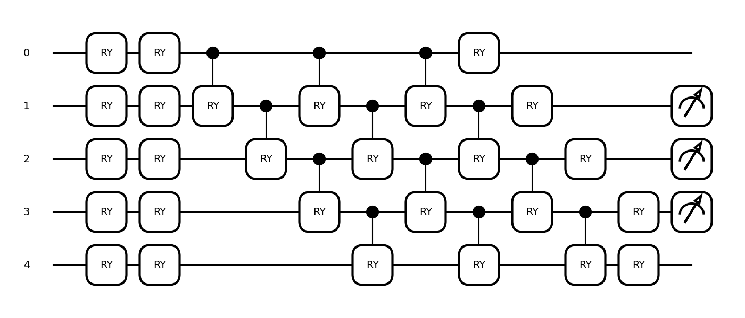
Quantum Autoencoder
1st Set-Up
Decoder is similar except of the input RY-gates and the output measurement are MS
Notes:
Intuitive approach
Qubits in trash space neglected

Slide 12
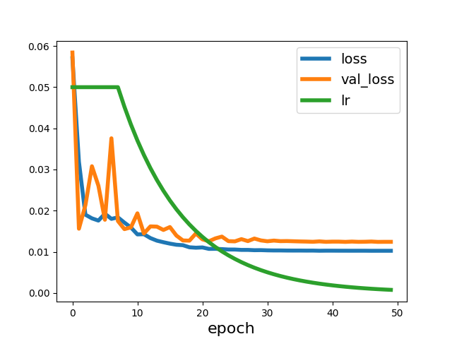
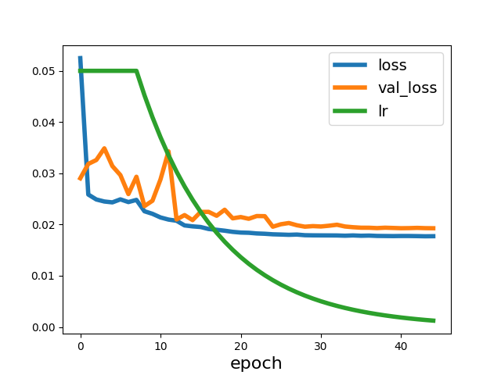
Quantum Machine Learning
1st Set-Up
Classical Autoencoder
Quantum Autoencoder 1
Notes:
What is where
Quan Autoenc is worse about 0.01, not a big difference
Classical autoencoder has the same structure, is comparable
Computational time enorme due to emulation of qubit

Slide 13
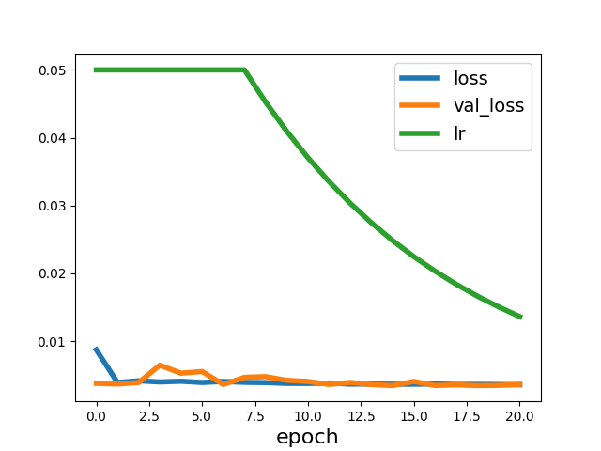
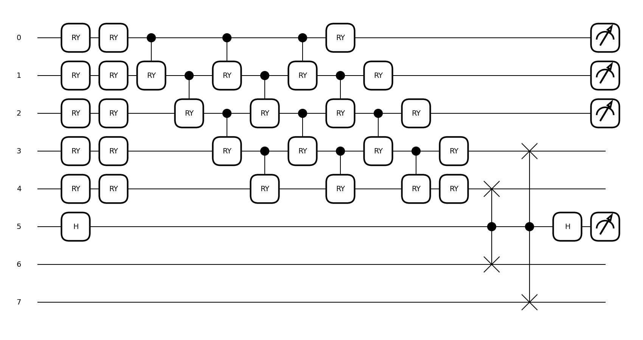
Quantum Autoencoder
Separate training: Encoder / 2nd Set-Up
Notes:
2nd approach, quiskit doc.
SWAP test
Reference qubits, auxiliary Qubit
Force to store all information in latent space

Slide 14
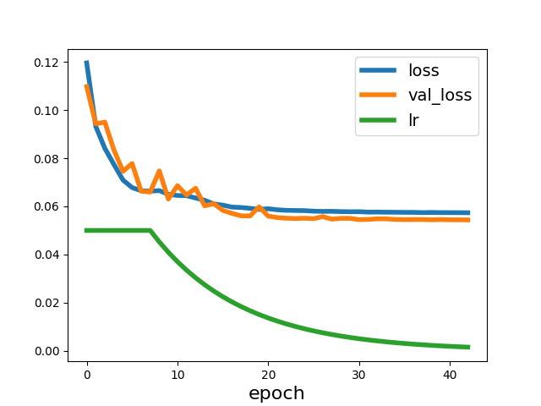
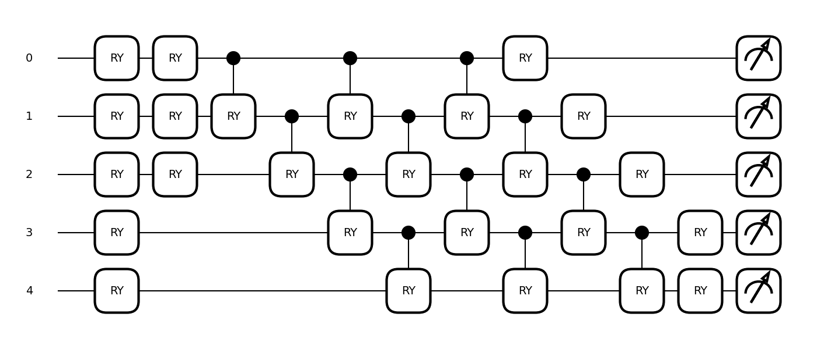
Quantum Autoencoder
Separate training: Decoder / 2nd Set-Up
Notes:
Needing a decoder
No special stuff, result okayish

Slide 15
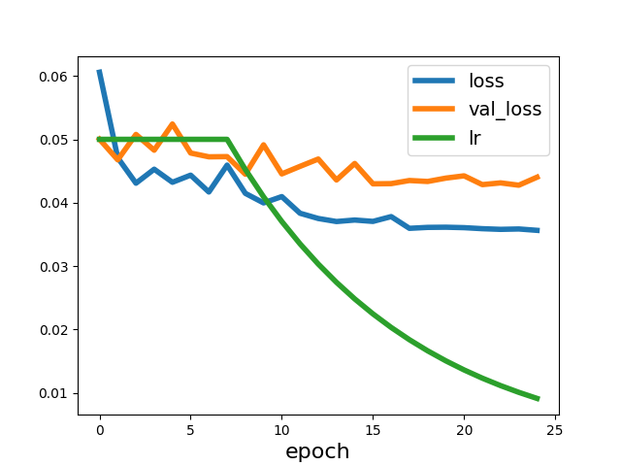
Quantum Autoencoder
Whole 2nd Set-Up in Combination Re-Trained
Classical Autoencoder
Quantum Autoencoder 2

Slide 16
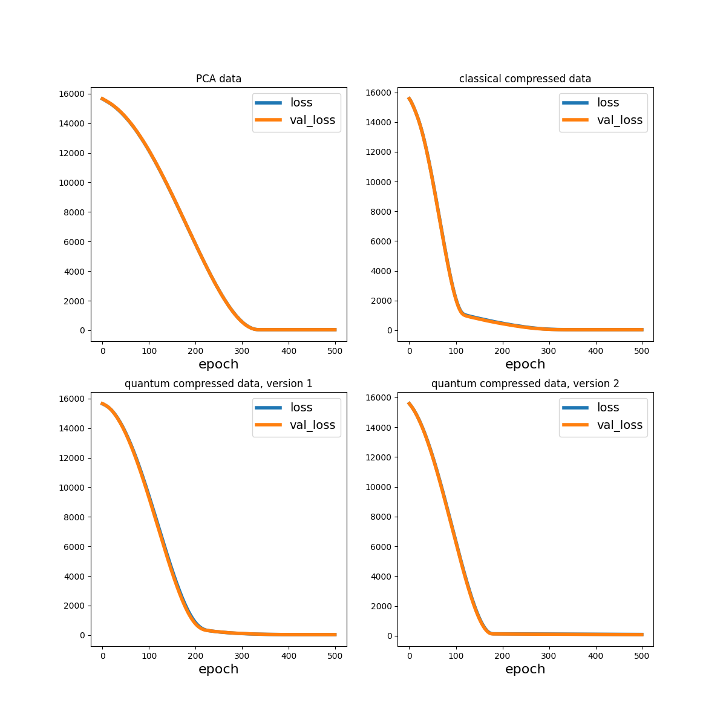
Encoder Test
Notes:
Test the encodings, explain each
Give differences

Slide 17

Encoder Test
The minimal loss is similar for all cases
Convergences behaviour differs:
Normal autoencoder steepest
2nd Quantum autoencoder first full convergence to optimum

Slide 18
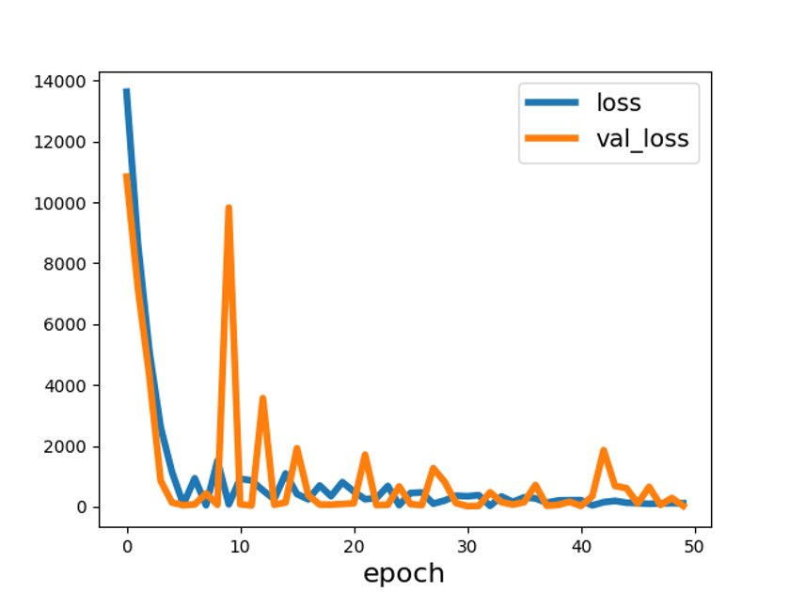
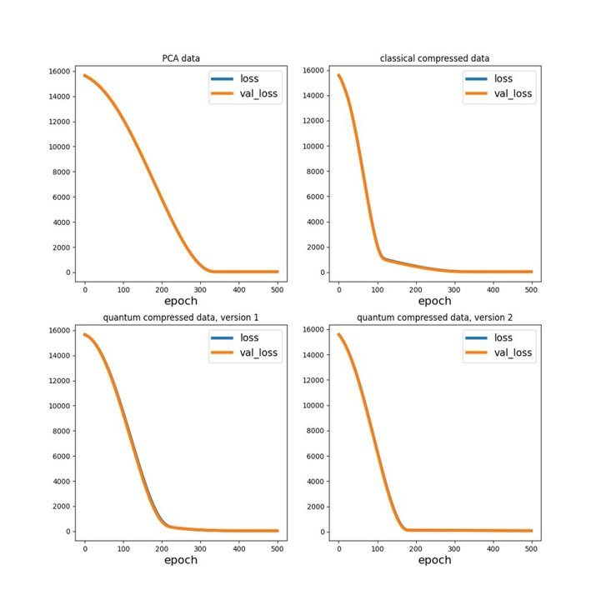
Conclusion
Simple hybrid quantum NNs are more sensitive in training
Simulated quantum ciruits need way more computational time
More complex hybrid quantum NNs seem to find more robust minimum
→Fast convergence regarding the epochs
The training performance of quantum autoencoders is worse compared to the classical ones
Quantum encoder seem to have a slightly better compression of data to the latent space
Notes:
1st: Better result in less epochs, although the emulated qubits consume more computational time. Final result is in the same range but less exact for the QNN
2nd: Also comp. effort for emulated qubits, result is similar to NN
3rd: Differences not really distinguishable but the QENC lead to the better result in less (4) epochs.

Slide 19
Dilara Yildiz & Samuel Lehmköster
E-mail
st149685@stud.uni-stuttgart.de st148230@stud.uni-stuttgart.de
University of Stuttgart
Institute of Structural Mechanics and Dynamics in Aerospace Engineering (ISD)

