Slide 1

Summer Internship 2016
Mentored by – Dr. Amit Chattopadhyay
Marching Cube and Marching Tetrahedron Algorithm
Presented by :-
Samarth Mishra
23 May 2016

Slide 2
Abstract
This algorithm was developed by William E. Lorensen and Harvey E. Cline.
Marching cube is a computer graphics algorithm that was cited in 1987 in a conference called SIGGRAPH (Special Interest Group on GRAPHics and Interactive Techniques).
Objective: extracting polygonal mesh of an isosurface from a three dimensional discrete scalar field (called Voxels)
Applications: Medical Visualization like CT and MRI scan data images, single-photon emission
computed tomography (SPECT)

Slide 3
Marching Cube Algorithm
Algorithm for creating a polygonal surface representation of an isosurface of a 3D scalar field.
Basis: form facets( place faces) approximation to an isosurface through a scalar field sampled on a 3D rectangular grid.
Each possibility is characterised by the number of vertices that have values above or below the isosurface.

Slide 4
V₂
V₁
V₁
V₁
Isosurface
If one vertex is above and another is below then we know isosurface cuts the edge between these two vertices.
Where exactly will the surface touch/cut the edge?
-> It depends on the relationship between the values at V₁ and V₂ and isolevel value. That will give the ratio of the length.

Slide 5
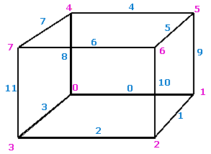
Index Convention
--- Edge Index --- Vertex Index

Slide 6
Total Number of Conditions
We have 8 vertices. Any number of them can lie above and thus the rest will lie below the isosurface.
If we see the total number of combinations we get
⁸C₀+⁸C₁+⁸C₂+⁸C₃+⁸C₄+⁸C₅+⁸C₆+⁸C₇+⁸C₈ = 2⁸ = 256

Slide 7
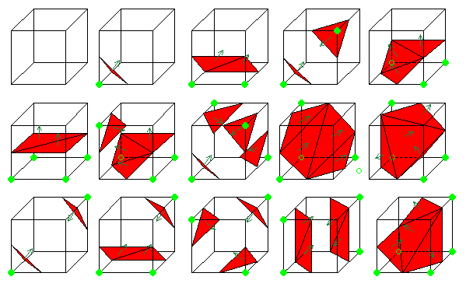
In a 3D space we enumerate 256 different situations for the marching cubes representation. All these cases can be generalized in 15 families by rotations and symetries :

Slide 8
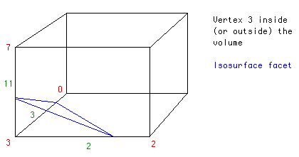
Example
Vertex 3 is below isosurface and others are above.
p
r
q
Now to find points p,q and r. We need to know the relationship between V₃-V₇,V₃-V₂,V₃-V₀

Slide 9
Edge Table
The first part of the algorithm uses a table (edgeTable) which maps the vertices under the isosurface to the intersecting edges. An 8 bit index is formed where each bit corresponds to a vertex.
cubeindex is an 8 bit binary number formed after the following operation. Each bit corresponding to a vertex.
int cubeindex = 0;
if (grid.val[0] < isolevel)
cubeindex |= 1;
if (grid.val[1] < isolevel)
cubeindex |= 2;
if (grid.val[2] < isolevel)
cubeindex |= 4;
if (grid.val[3] < isolevel)
cubeindex |= 8;
if (grid.val[4] < isolevel)
cubeindex |= 16;
if (grid.val[5] < isolevel)
cubeindex |= 32;
if (grid.val[6] < isolevel)
cubeindex |= 64;
if (grid.val[7] < isolevel)
cubeindex |= 128;
V₇ | V₆ | V₅ | V₄ | V₃ | V₂ | V₁ | V₀
Generalized code for ( int i=0 ; i< 8; i++) { if (grid.val[i]<isolevel) //condition check cubeindex = cubeindex|pow(2,i); //OR operation }

Slide 10
Edge Table
Now checking in the edgeTable[ ], it returns a 12 bit number telling which edges are intersected.
Eg:-
cubeindex = 8;
EdgeTable[8] = 1000 0000 1100;
Here it shows E₂,E₃,E₁₁ are intersected by the isosurface.
E₁₁ | E₁₀ | E₉ | E₈ | E₇ | E₆ | E₅ | E₄ | E₃ | E₂ | E₁ | E₀

Slide 11
Edge Table
Now checking in the edgeTable[ ], it returns a 12 bit number telling which edges are intersected.
Eg:-
cubeindex = 8;
EdgeTable[8] = 1000 0000 1100;
Here it shows E₂,E₃,E₁₁ are intersected by the isosurface.
E₁₁ | E₁₀ | E₉ | E₈ | E₇ | E₆ | E₅ | E₄ | E₃ | E₂ | E₁ | E₀

Slide 12
triTable
uses the same cubeindex but allows the vertex sequence to be looked up for as many triangular facets are necessary to represent the isosurface within the grid cell. There at most 5 triangular facets necessary. TriTable[256][16] -> 256 entries and each entry has 16 slots.
in the previous step we calculate the intersecting points along edge 2,3, and 11. The 8th element in triTable is :
8th element :
{3, 11, 2, -1, -1, -1, -1, -1, -1, -1, -1, -1, -1, -1, -1, -1}
9th element :
{0, 11, 2, 8, 11, 0, -1, -1, -1, -1, -1, -1, -1, -1, -1, -1},
This corresponds to 2 triangular facets, one between the intersection of edge 0 11 and 2. The other between the intersections along edges 8 11 and 0.

Slide 13
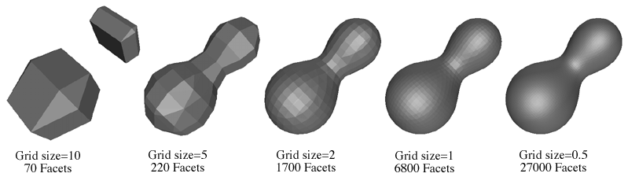
Grid Resolution
Fine approximation to the isosurface to be generated depending on the smoothness required and/or the processing power available to display the surface.
Smaller the size of the grid, the surface obtained is smoother.

Slide 14
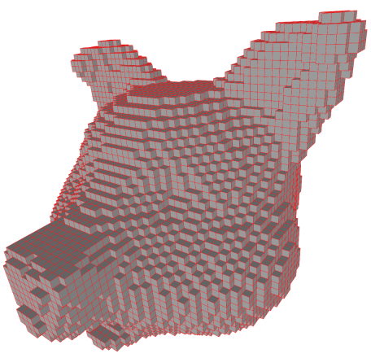
One of the first ideas for visualizing volumes was to draw each voxel as a small cube. If we do that we get something like the result shown below.

Slide 15
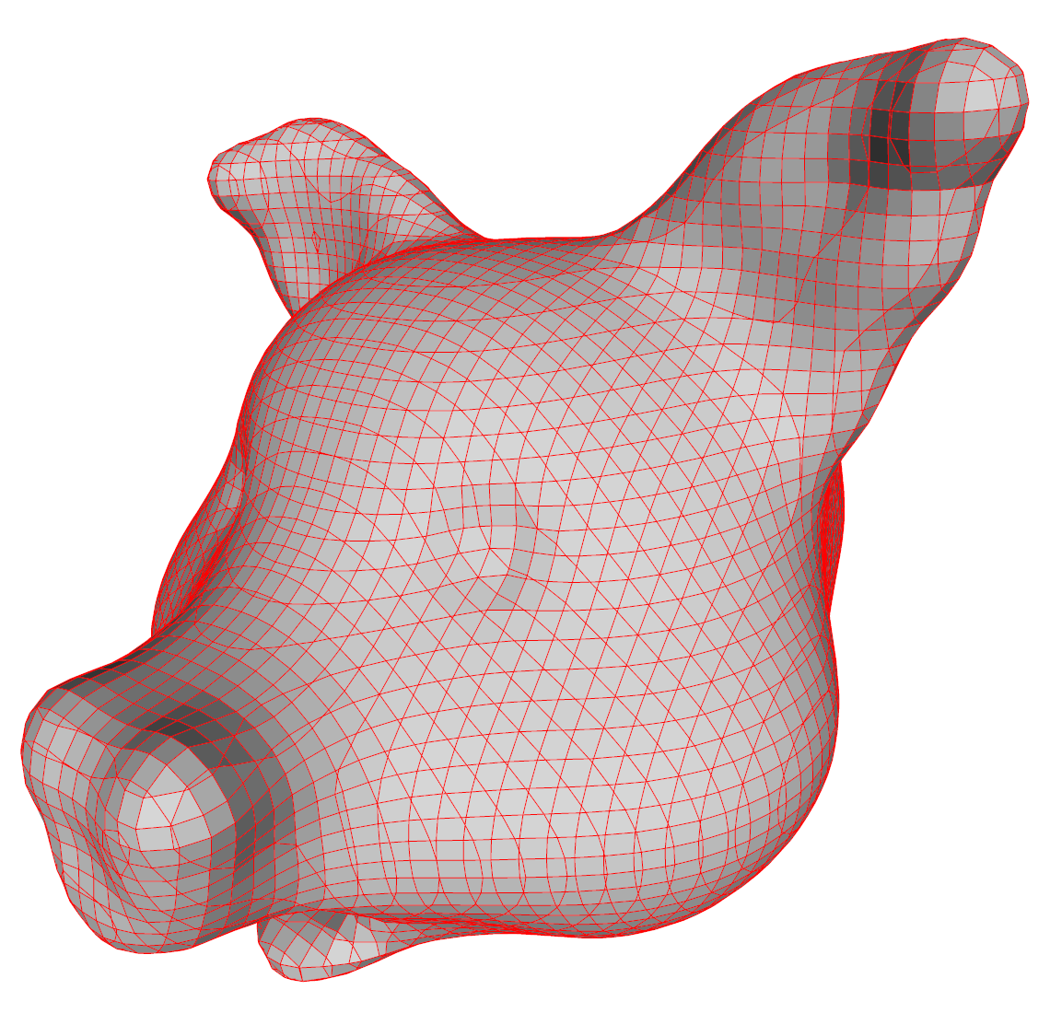
The result which is shown below is, in fact, the precise same result as would have been produced by marching cubes except that the faces have not been polygonized.

Slide 16
Marching Tetrahedron Algorithm
It clarifies a minor ambiguity problem of the marching cubes algorithm with some cube configurations.
The space is sampled at the vertices of a rectangular 3D mesh. Each mesh cell is split into 6 tetrahedrons and passed to the tetrahedron isosurface function.
one could equally sample onto the tetrahedral mesh directly.
The planar facet approximation to the isosurface is calculated for each tetrahedron independently.
The facet vertices are determined by linearly interpolating where isosurface cuts the edges of the tetrahedron.

Slide 17
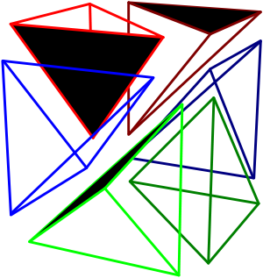
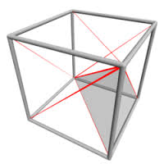
Cube divided in to Tetrahedrons

Slide 18
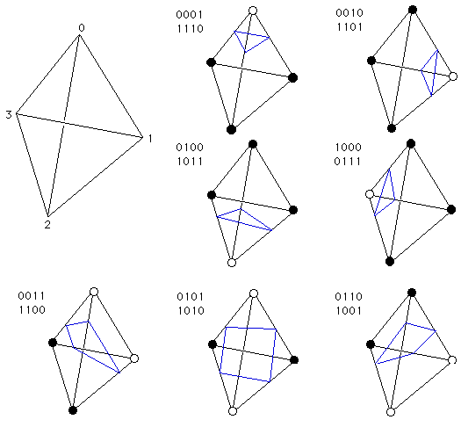
Cases

Slide 19
Advantages of M.T. over M.C.
M.T. does not suffer from the ambiguities in the traditional marching cubes algorithms.
Lesser number of cases in M.T.

Slide 20
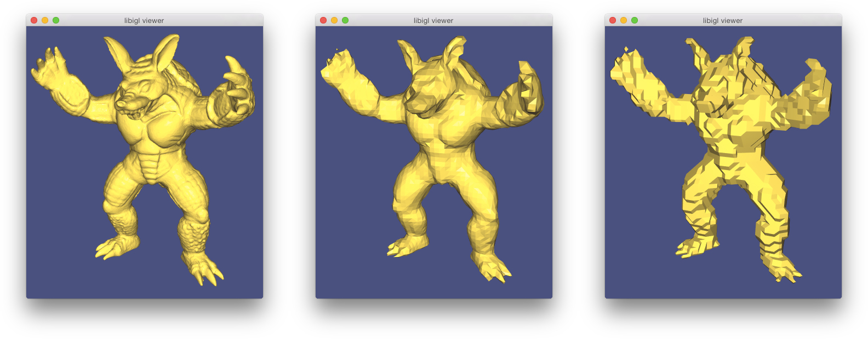
M.T. images

