Slide 1
Sales Are Growing, Margins Are Not
Business scenario
Global Superstore sales keep rising, but profit is not growing at the expected rate. Management asked for an analytical review.
Objective
Use the Experiment 5 and 6 Power BI reports to find strengths, weaknesses and opportunities, and recommend data-driven actions.
Dataset
Global Superstore (Kaggle), orders from 2014 to 2017
Integration of Advanced Analytics with BI Reports using Microsoft Power BI
Business Intelligence Lab | Unit 2 | Session 7 | Experiment 7
Notes:
Introduce the scenario: sales are rising but profitability is not keeping pace. Our role is BI consultant; the evidence comes from the existing Power BI file from Experiments 5 and 6.

Slide 2
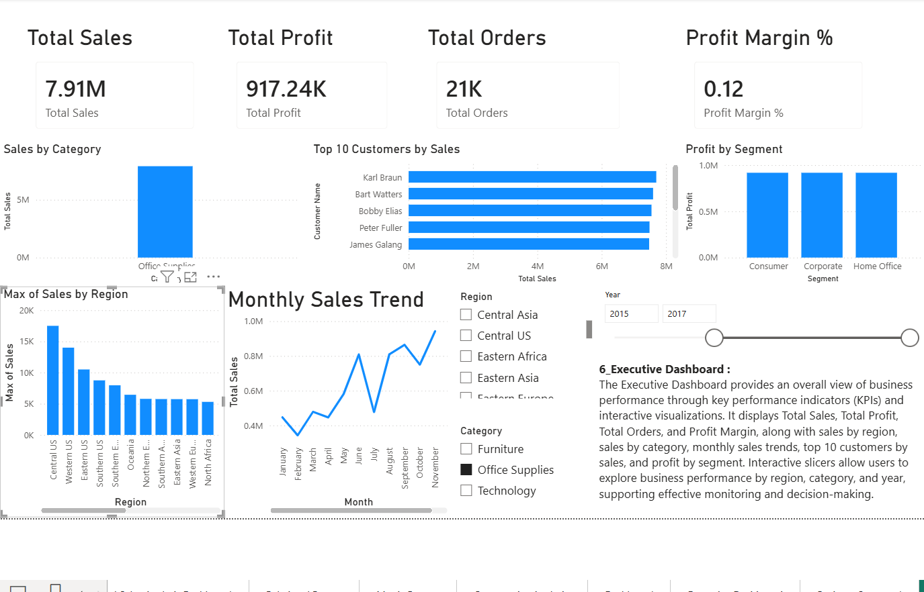
Dashboard Overview: 9.60M Sales at an 11.5% Margin
9.60M
1.10M
Total Sales
Total Profit
~25.7K
11.5%
Total Orders
Profit Margin
All years, 2014 to 2017
KPIs: Sales, Profit, Orders, Profit Margin
Charts: region, category, monthly trend, top customers, segment
Slicers: Region, Category, Year
Executive Dashboard, Year slicer 2015 to 2017
Notes:
The Executive Dashboard from Experiment 6 is the starting point. Overall the business earned 1.10M profit on 9.60M sales, an 11.5% margin. The screenshot shows the 2015 to 2017 view: 7.91M sales, 917K profit.

Slide 3
Key Findings: Revenue Nearly Doubled, Margin Stayed Flat
+94%
Sales growth 2014 to 2017
From about 1.69M to 3.27M, with yearly growth of 20%, 28% and 26%.
10.9% → 11.6%
Profit margin barely moved
2014 vs 2015 to 2017. Profit grows only because volume grows.
150.5K
Western Europe leads
Highest sales (1.29M) and highest profit of any region.
Notes:
Main message: growth is volume-driven. Sales nearly doubled, but margin stayed at 11 to 12%, which is exactly why management sees profit lagging. Yearly values are read from the Sales Trend by Year chart. Monthly trend: November peak, February weakest.

Slide 4
Business Issues: Four Regions Hold Profit Back
S
Strengths
Steady 20 to 28% yearly sales growth; Western Europe, Central America and Southern Asia deliver strong profit.
W
Weaknesses
Western Asia (-39.6K) and Western Africa (-37.3K) lose money; SE Asia and South America earn under 4% on 1.12M sales.
O
Opportunities
Small markets earn 22 to 28% margins (Central Africa, Canada); November peak, February low.
Category, Segment and Customer visuals show identical totals, so the data model relationships must be fixed before product-level analysis.
Notes:
Red bars lose money, amber bars earn under 5% despite high sales. Southeastern Asia is 4th in sales (665K) but earns only 22.4K. The two loss-making regions remove about 7% of total profit. Also flag that the category, segment and customer charts all show the grand total, which is a relationship problem in the model.

Slide 5
Recommendations: Fix Margins Before Chasing Volume
ISSUE
ACTION
KPI
EXPECTED GAIN
Stop the losses
Western Asia and Western Africa lose 76.9K
Drill down to loss-making products and orders; cap discounts; reprice or drop lines
Region Profit
+76.9K at break-even
1
Lift low-margin regions
SE Asia 3.4%, South America 3.9% on 1.12M sales
Review discounts, shipping costs and product mix
Profit Margin %
+88.7K at 11.5% margin
2
Manage for margin
Margin flat while sales doubled; scorecard targets 367% to 515% achieved
Add margin targets to the scorecard; fix model relationships for product and customer analysis
Margin % by Year
Profit grows faster than sales
3
+165.6K profit about 15% more than today's 1.10M, without selling anything extra
Notes:
Actions 1 and 2 are estimates: break-even in the two loss-making regions adds 76.9K; bringing SE Asia and South America to the 11.5% company average adds about 54.0K and 34.8K. Also consider targeted growth in high-margin small markets and seasonal planning around the November peak.

Slide 6
Profitable Growth, Not Just More Growth
Assessment
A growing, profitable business: 9.60M sales, 1.10M profit, sales nearly doubled since 2014.
Main issue
Margin stuck at 11 to 12%, dragged down by two loss-making and two low-margin regions.
Conclusion
Priorities
Stop losses, lift low margins, add margin targets, and fix the BI model for product-level insight.
Role of Power BI
KPIs, trends and region comparisons pinpointed the problems and give a KPI to track each action.
Business Intelligence Lab | Unit 2 | Session 7 | Experiment 7
Notes:
Close with the key message: the company does not need more volume to grow profit; it needs to fix where it loses margin. Power BI made each issue measurable.

