Slide 1

TITLE:TASK SCHEDULER TO DO MANAGER
Group Members:
S. Ansika Reddy - 2510040071
D. Sreenidhi Reddy - 2510030010
S. Shruthi - 2510080028
GUIDED BY:Dr.Mahesh Babu Arrama

Slide 2
Introduction
This project is a task scheduler that helps users manage daily tasks efficiently.
Helps users manage daily tasks efficiently
Allows adding ,updating and deleting tasks
Improves productivity and time management
Simple and user friendly system

Slide 3
Project Overview
• Add tasks
• Delete tasks
• Mark tasks as completed
• Simple and user-friendly interface

Slide 4
How It Works
User opens the Task Scheduler To-Do Manager application
User enters a task in the input field
The system stores the task in memory/database
All tasks are displayed in a list format
User can:
✔ Add new tasks
✔ Mark tasks as completed
✔ Delete tasks
The system updates the task list in real-time
Completed tasks are visually differentiated for better tracking

Slide 5
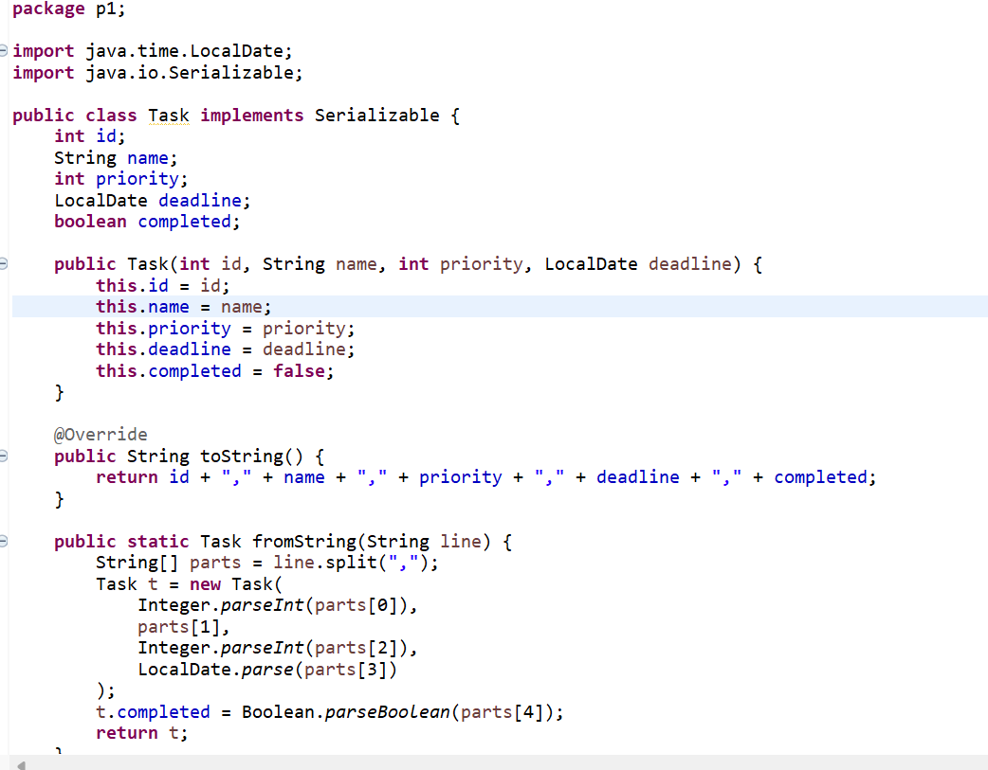
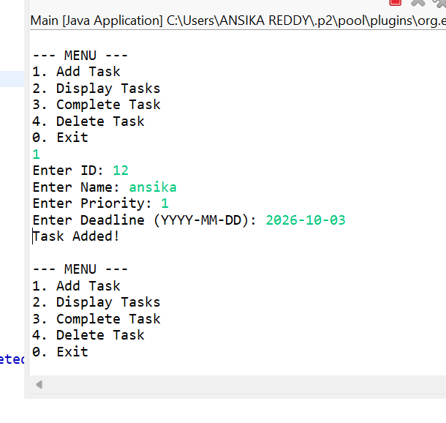
Task Code Screenshot and Output:

Slide 6
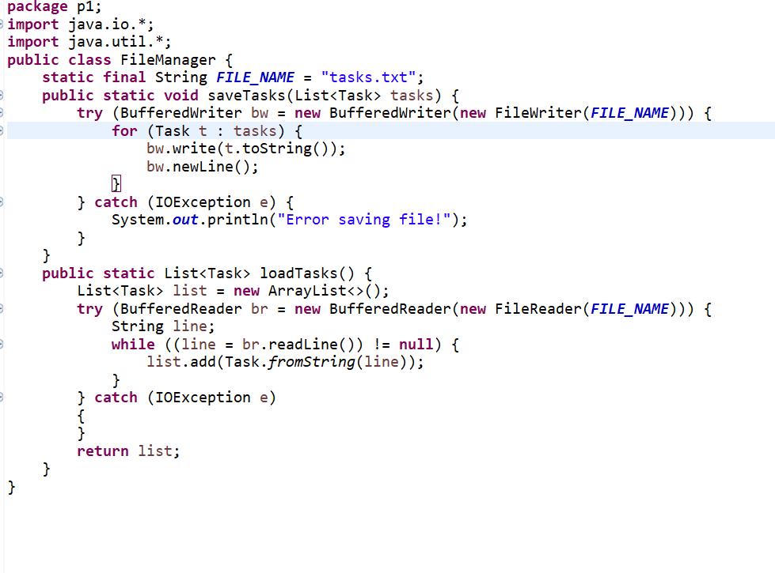
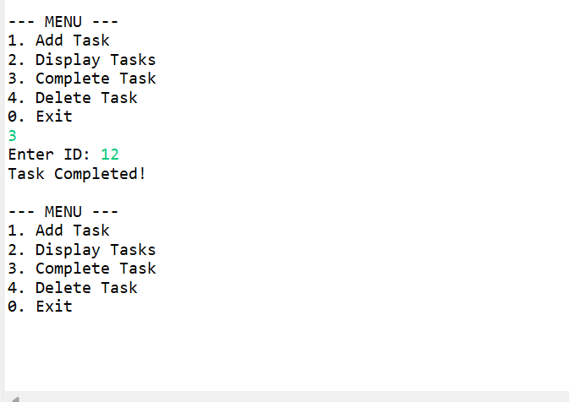
File Manager Code Screenshots and Output:

Slide 7
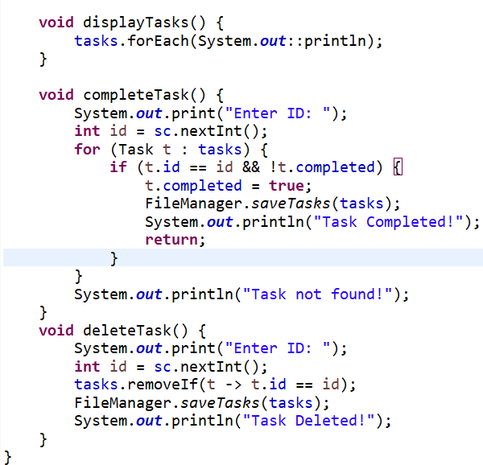
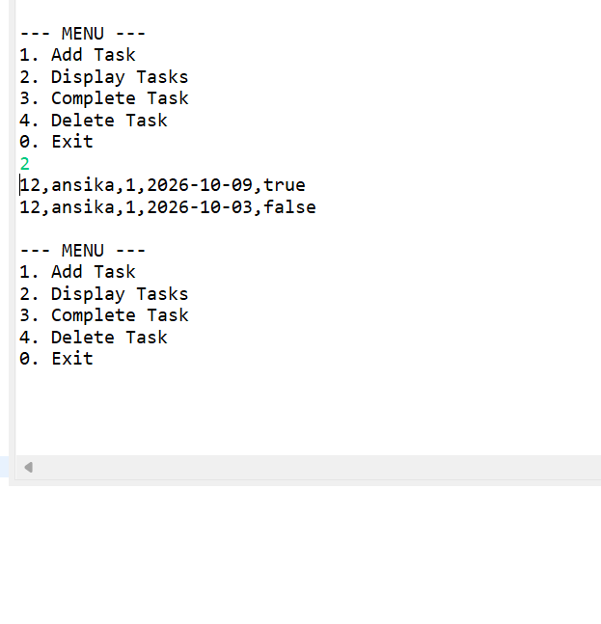
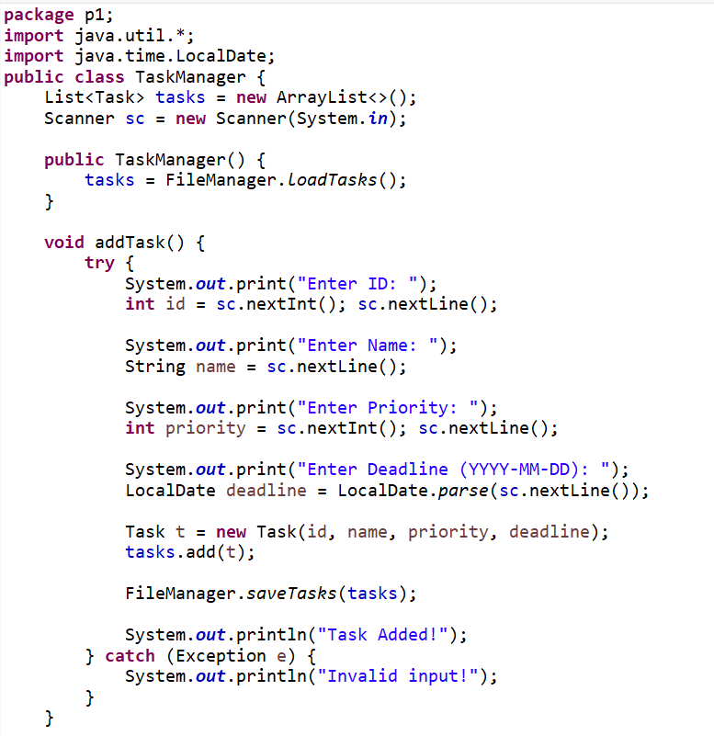
TaskManager Code screenshots and output:

Slide 8
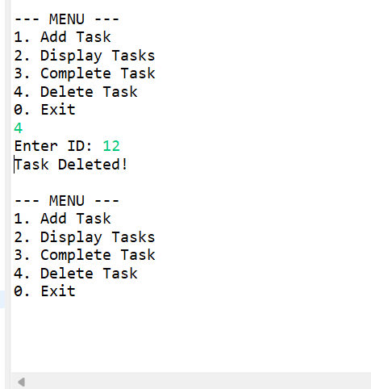
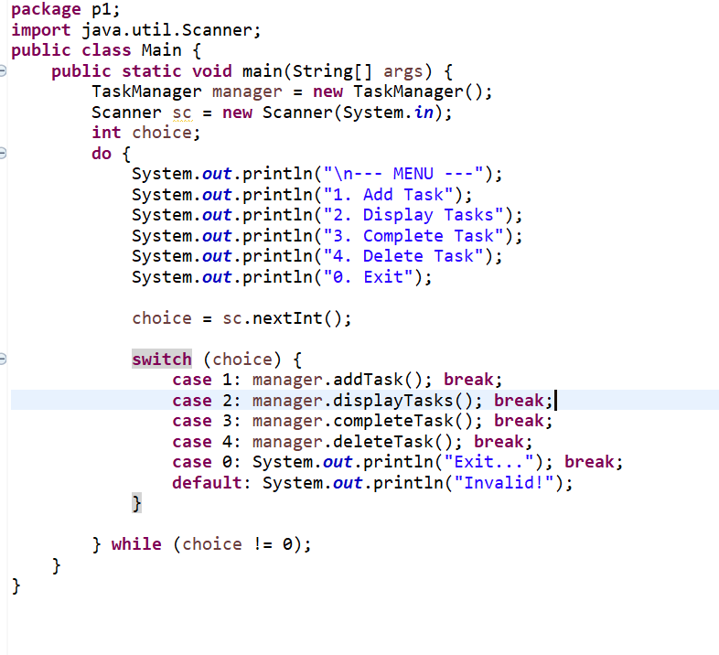
Main code Screenshots and output:

Slide 9
Conclusion
Helps manage tasks efficiently
Improves productivity
Easy to use system
Can be enhanced with more features

Slide 10
THANKYOU
-ANSIKA -SREENIDHI -SHRUTHI

