Slide 1
Consumer Complaint Resolution Analysis
Binary Brains
Diptesh Saha & Samapan Kar
May 23, 2024

Slide 2
What?
Proposes a machine learning-driven approach for complaint classification and prioritization.
Leverages natural language processing (NLP) techniques to extract insights from complaint texts.
Collects and pre-processes complaint data from consumer forums and social media platforms.
Aims to develop robust models for complaint categorization based on product/service type and issue severity.
Aims to enhance efficiency and effectiveness of complaint resolution processes, improving customer satisfaction and fostering stronger consumer-company relationships.

Slide 3
Why?
Crucial for resolving customer issues and boosting sales.
Understanding customer mindset is key to addressing complaints.
Companies strive to resolve complaints, but not all customers can be satisfied.
Data analysis and algorithms help classify customer categories for predictive testing.

Slide 4
Literature Review
Pramod Kumar Naik et al. utilized Multinomial Naive Bayes model with 79.82% accuracy etc.
They are planning to develop an automatic financial complaint classification system that automatically deals with the customer complaints by segregating the data & routing it to the right department.
Companies try their best to resolve the complaints that they receive. However, it might not always be possible to appease every customer.
We will utilize various algorithms to analyze data and classify customer categories, aiming to predict potential disputes.

Slide 5
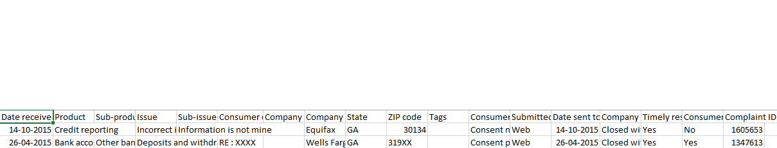
Data Description
Target variable: Bank Disputes. Two groups with and without bank issues.
Product: Different bank products.
Issue: Customer complaints.
Submitted via: Different platforms.
Company public response: Company's response to consumer complaint.
Date sent to company: The day complaint was registered.
Timely response: Yes/No.
Other columns are Sub-product, Date of complaint, Company name, State, Zip code.

Slide 6
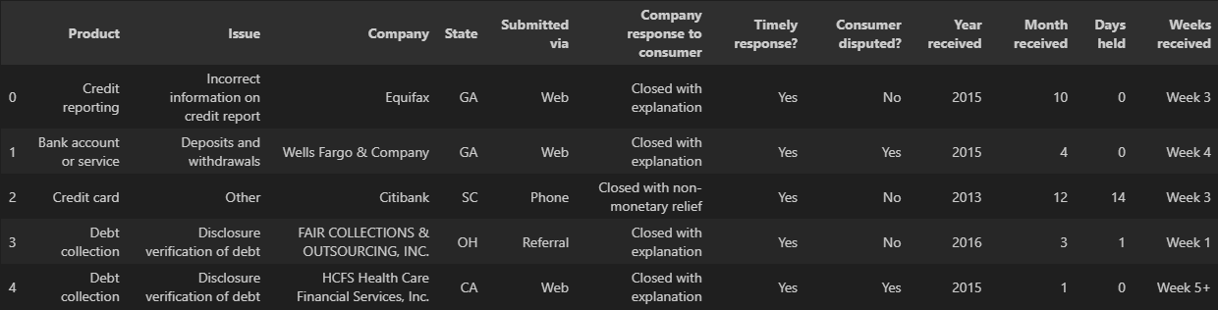
How?
After data preprocessing and removing unnecessary columns, come up with modified dataset.

Slide 7
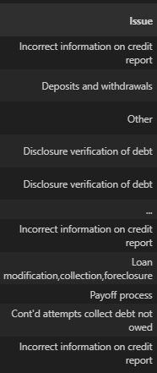
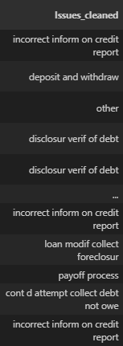
How?
Text Pre-processing: Tokenize the Issues of the customers using Natural Language Processing for classification purpose.
Lemmatizing using WordNet algorithm.
Stemming using Porter algorithm.
After using TF-IDF vectorization method
total number of columns increased
to 201 for training dataset.

Slide 8
How?
Feature Selection: Scaling the datasets and make feature selection using Principal Component Analysis up to 80% of the information.
The train dataset was splitted into 75% training dataset and 25% test dataset.
After data preprocessing and feature engineering come up with the final dataset.
Models implemented: Logistic Regression, Decision Tree Classifier, Random Forest Classifier, AdaBoost Classifier, Gradient Boosting Classifier, KNN Classifier, XGB Classifier.
No improvement in accuracy after hyperparameter tuning.

Slide 9
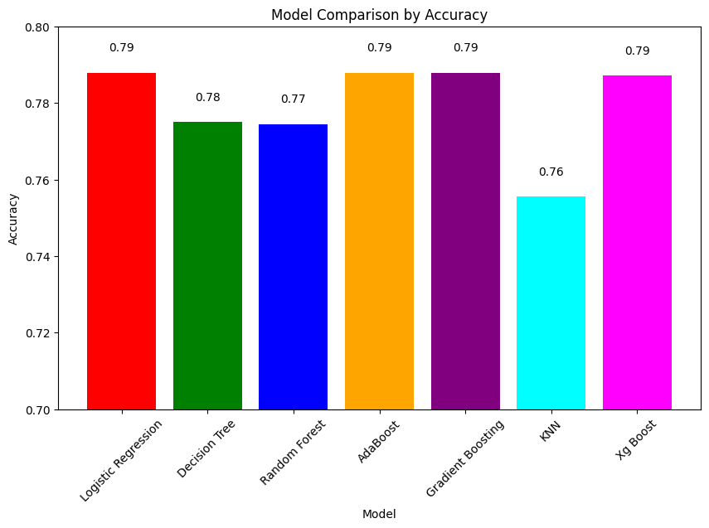
Result
Model | Accuracy
Logistic Regression | 0.7879223
Decision Tree Classifier | 0.7750019
Random Forest Classifier | 0.774511
AdaBoost Classifier | 0.7879112
Gradient Boosting Classifier | 0.787905
KNN Classifier | 0.755515
XGB Classifier | 0.787130

Slide 10
References
Nitin Indurkhya and Fred J Damerau. Handbook of natural language processing. Chapman and Hall/CRC, 2nd edition, 2010.
Daniel Jurafsky and James H. Martin. Speech and Language Processing. Prentice Hall PTR, 2nd edition, 2008.
Mehryar Mohri, Afshin Rostamizadeh, and Ameet Talwalkar. Foundations of Machine Learning. The MIT Press, 2nd edition, 2018.
Pramod Kumar Naik, Sandesh Balan, et al. Consumer complaints classification using machine learning & deep learning. International Research Journal on Advanced Science Hub, 5(05S):116-122, 2023.
Thank you

