Slide 1
YogaFeed: Real time pose assessment and improvement
Presented by: YogaVision
Diptesh Saha, Parimal Bera & Samapan Kar

Slide 2
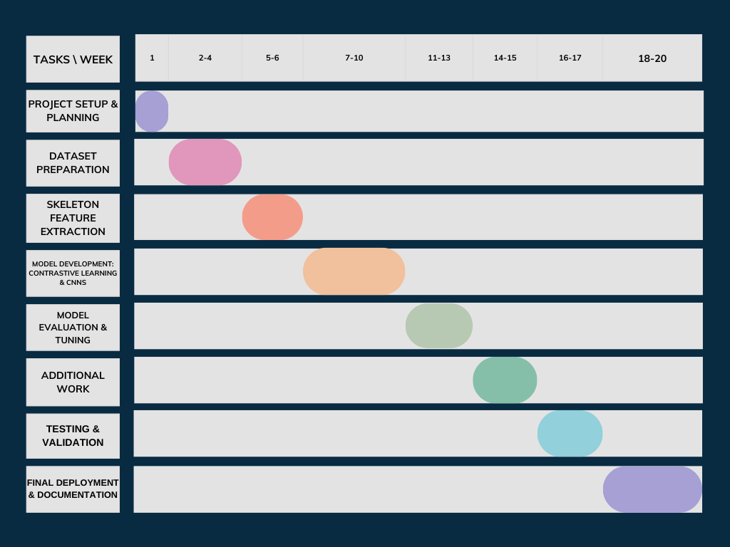
Timeline

Slide 3
Motivation
Real-time feedback enhances physical and mental well-being while minimizing injuries.
Self-guided training for users without professional instructors.
Utilizes cutting-edge deep learning and computer vision techniques.
Ensures safe yoga practices through accurate pose assessment.
Makes yoga more accurate and accessible for all.

Slide 4
Objective
Create a computer vision & Deep learning based system to evaluate and improve yoga postures.
Offer precise feedback and actionable insights to help users correct their poses.
Minimize injury risks by guiding users toward better pose alignment.

Slide 5
Related Papers
M. Verma, S. Kumawat, Y. Nakashima and S. Raman, "Yoga-82: A New Dataset for Fine-grained Classification of Human Poses," 2020 IEEE/CVF Conference on Computer Vision and Pattern Recognition Workshops (CVPRW), Seattle, WA, USA, 2020, pp. 4472-4479, https://doi.org/10.1109/CVPRW50498.2020.00527
Wu, Y.; Lin, Q.; Yang, M.; Liu, J.; Tian, J.; Kapil, D.; Vanderbloemen, L. A Computer Vision-Based Yoga Pose Grading Approach Using Contrastive Skeleton Feature Representations. Healthcare 2022, 10, 36. https://doi.org/10.3390/healthcare10010036
Yadav, S.K., Singh, A., Gupta, A. et al. Real-time Yoga recognition using deep learning. Neural Comput & Applic 31, 9349–9361 (2019). https://doi.org/10.1007/s00521-019-04232-7
Chen, HT., He, YZ. & Hsu, CC. Computer-assisted yoga training system. Multimed Tools Appl 77, 23969–23991 (2018). https://doi.org/10.1007/s11042-018-5721-2
Kale, Geetanjali & Patil, Varsha & Munot, Mousami. (2021). A novel and intelligent vision-based tutor for Yogāsana: e-YogaGuru. Machine Vision and Applications. 32. 10.1007/s00138-020-01141-x.

Slide 6
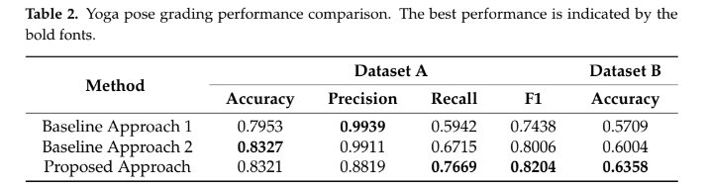
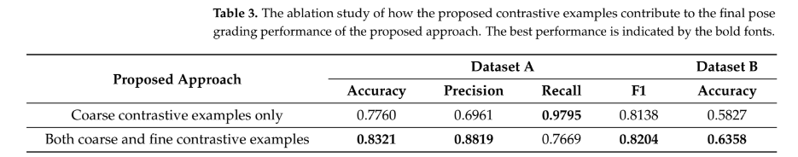
Literature Review
Wu, Y.; Lin, Q.; Yang, M.; Liu, J.; Tian, J.; Kapil, D.; Vanderbloemen, L. A Computer Vision-Based Yoga Pose Grading Approach Using Contrastive Skeleton Feature Representations. Healthcare 2022, 10, 36. https://doi.org/10.3390/healthcare10010036

Slide 7
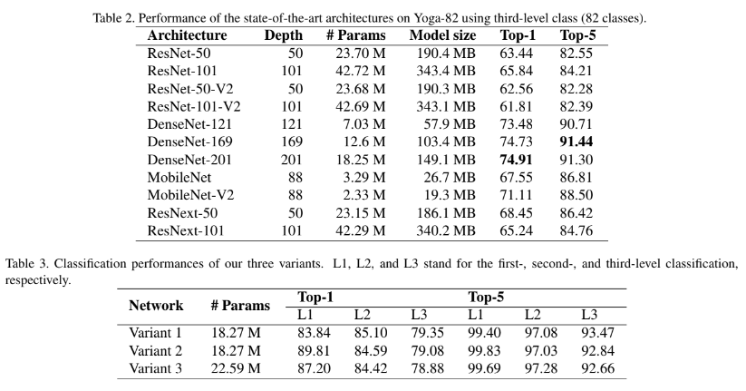
Literature Review
M. Verma, S. Kumawat, Y. Nakashima and S. Raman, "Yoga-82: A New Dataset for Fine-grained Classification of Human Poses," 2020 IEEE/CVF Conference on Computer Vision and Pattern Recognition Workshops (CVPRW), Seattle, WA, USA, 2020, pp. 4472-4479, https://doi.org/10.1109/CVPRW50498.2020.00527

Slide 8
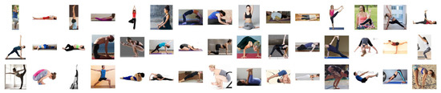
Dataset
Dataset: https://www.kaggle.com/datasets/shrutisaxena/yoga-pose-image-classification-dataset
This is the yoga pose classification image dataset adopted from Kaggle , where 107 categories and 5994 images are selected. In this dataset, images are captured with various resolutions and diverse backgrounds.

Slide 9
Data Handling
Keypoint Extraction: Used MoveNet for detecting human body keypoints (e.g., shoulders, elbows, knees). Extracted (x, y) coordinates for pose representation.
Feature Engineering: Converted key points into feature vectors. Added derived features like angles between keypoints for better pose characterization.
Data Splitting: Divided the dataset into:
Training Set: 70%
Validation Set: 20%
Testing Set: 10%

Slide 10
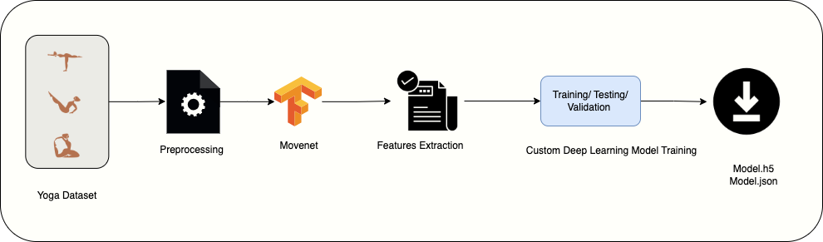
Model Pipeline

Slide 11
Methodology
Pose Classification Model
Model Architecture:
Sequential Neural Network with dense layers (ReLU activation) and dropout layers to prevent overfitting.
Softmax for pose classification into predefined categories.
Training:
Adam optimizer, sparse categorical crossentropy loss, trained for 60 epochs.
Model saved in JSON and HDF5 formats for integration.

Slide 12
Methodology
Real-Time Pose Detection
Pose Estimation:
MoveNet extracts keypoint coordinates from live webcam input.
Feature Engineering:
Joint angles and cosine similarity calculated for pose alignment evaluation.
Pose Classification:
Pre-trained model classifies detected poses, displaying results on-screen.

Slide 13
Methodology
Feedback Generation
Feedback Rules:
Custom rules for misalignment detection (e.g., Downdog hand positioning).
For example, in the Downdog pose, if the user's hands were too far from their feet, the feedback was “Move hands closer to feet”.
Real-Time Feedback:
Personalized corrective instructions displayed on-screen.

Slide 14
Methodology
Interactive Interface
GUI:
User-friendly PySimpleGUI interface for pose selection and feedback display.
Webcam Integration:
Real-time video input with pose keypoints and feedback overlay.
Visualization:
Live pose alignment and corrective instructions for seamless experience.

Slide 15
Methodology
Evaluation and Testing
Performance Metrics:
Accuracy evaluated using confusion matrix, precision, recall, and F1-score.
User Feedback:
Tested with yoga practitioners to validate feedback effectiveness and usability.

Slide 16
Experimental Settings
Hardware and Software:
AMD Ryzen 5 3500U with Radeon Vega Mobile Gfx 2.10 GHz.
TensorFlow (2.x), OpenCV, PySimpleGUI for GUI, and Python 3.8.
Model Training Parameters:
Optimizer: Adam
Learning rate: 0.01
Loss function: Sparse Categorical Crossentropy
Batch size: 32
Epochs: 60

Slide 17
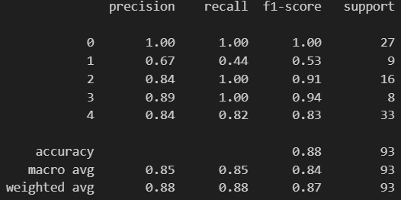
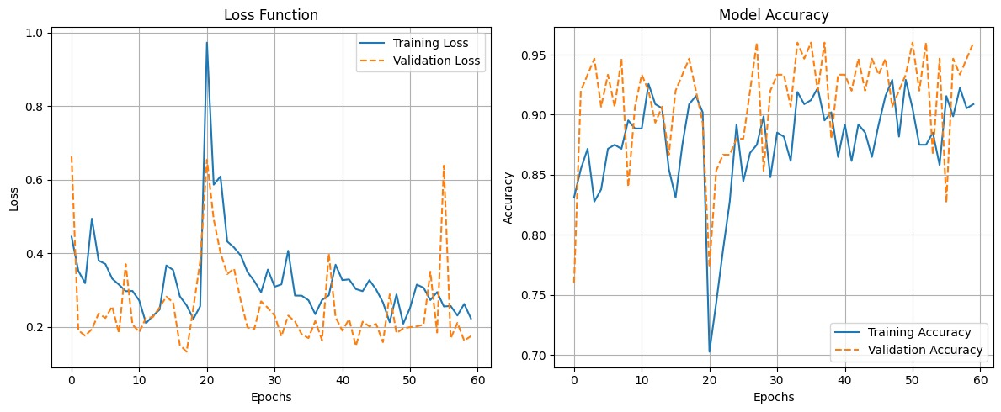
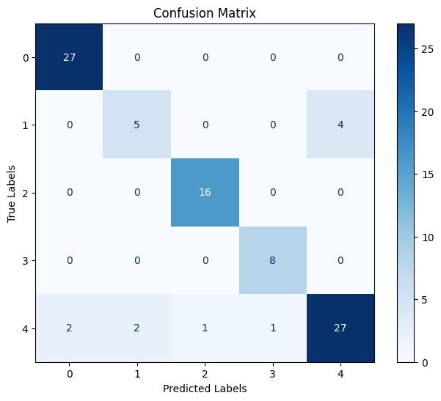
Results

Slide 18
Time Complexity
Pose Classification:
Processes a single input in approximately 15-25 milliseconds.
Achieves real-time inference at 8-10 FPS.
Pose Estimation:
MoveNet detects keypoints in 25-35 milliseconds per frame.
Overall System Performance:
Combined pose estimation and classification achieve approximately 8-10 FPS, suitable for live applications on CPU (AMD Ryzen 5 3500U).

Slide 19
Future Works
Improve the real-time demo by optimizing latency, adding smoother visualizations, and integrating interactive features like live pose correction overlays and user progress tracking.
Incorporate user-specific body metrics (e.g., height, flexibility) for personalized pose recommendations.
Create a larger and more diverse dataset with additional yoga poses and practitioner variations.

Slide 20
DEMO!

