Slide 1
Predicting Football Match Outcomes Using Neural Networks
Abhinav Reddy Sama

Slide 2
Project Goal
Football match outcomes are unpredictable but influenced by key performance factors. Machine learning can uncover hidden patterns in historical match data.
Engineer team-based features to capture performance trends.
Design and optimize a neural network model.
Evaluate model performance using cross-validation.

Slide 3
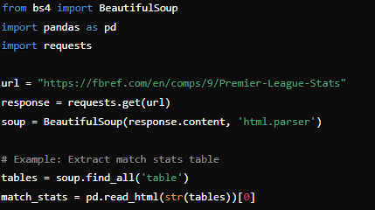
Web Scraping and Data preprocessing
To collect match history data for two full past seasons of the Premier League, I used the BeautifulSoup and Pandas libraries. The data was scraped from the FBref website, which provides detailed football statistics.
We first scrape HTML pages using BeautifulSoup to extract match data tables.
Then we use Pandas to parse and clean the tables.
Aggregate key statistics such as Goals for, Goals Against, Venue, and Result.

Slide 4
Dataset Overview and Feature Engineering
Key Dataset Information:
Columns: Goals For (gf), Goals Against (ga), Venue, Result.
Number of matches and data points.
List of Engineered Features:
Average goals scored (avg_gf).
Average goals conceded (avg_ga).
Goal difference (avg_goal_diff).
Win rate, recent form score, recent goals scored, recent goals conceded.

Slide 5
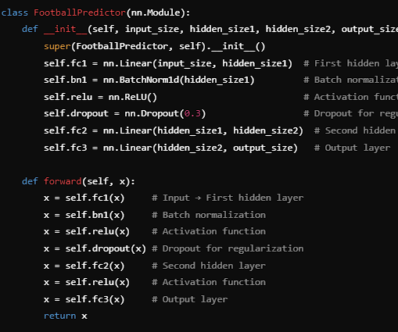
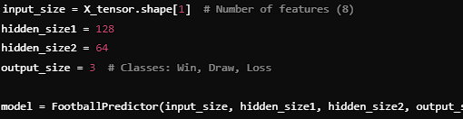
Neural Network Design
Network:
Input Layer: 8 features.
Hidden Layers:
First: 128 neurons (Batch Normalization, Dropout).
Second: 64 neurons (ReLU activation).
Output Layer: 3 neurons (Win, Draw, Loss).
List of Design Choices:
Activation Function: ReLU.
Dropout Regularization: 0.3 to prevent overfitting.
Loss Function: CrossEntropyLoss.
Optimizer: Adam.

Slide 6
Cross-Validation and Hyperparameter Tuning
Key Methods:
Stratified K-Fold Cross-Validation: Ensures balanced splits across all result classes.
Hyperparameter Grid Search:
Hidden Layer Sizes: [64, 128] and [32, 64].
Learning Rates: [0.001, 0.0005].
Batch Sizes: [16, 32].
Grid Search Results: Show a table summarizing the parameters tested and their accuracies.
Example:
Hidden Size 1 | Hidden Size 2 | Learning Rate | Batch Size | Accuracy(%)
128 | 64 | 0.001 | 16 | 51.02

Slide 7
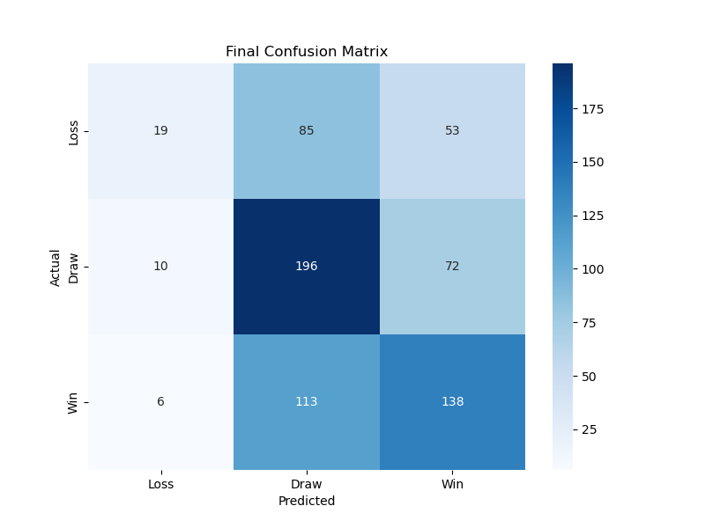
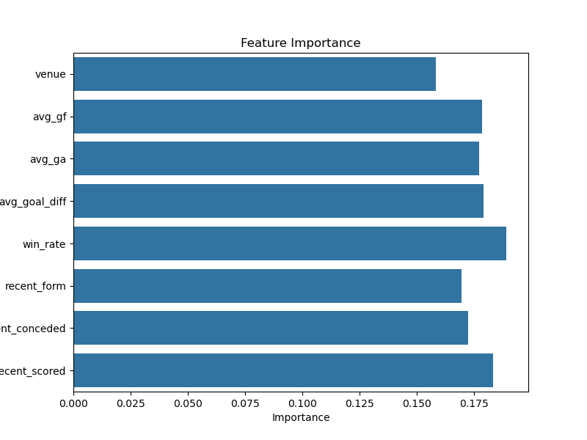
Results
Final Accuracy: “The best-performing model achieved a cross-validation accuracy of 51.02%.
Confusion Matrix:
Add the confusion matrix plot (final_confusion_matrix.png).
Briefly interpret it: “The model performs well for Draws but struggles with Losses and Wins.”
Feature Importance:
Add the feature importance plot (final_feature_importance.png).
Highlight that recent form and goals scored were the most important features.

Slide 8
Challenges
Challenges:
Football matches are influenced by unpredictable factors like player injuries or weather.
Imbalanced dataset (more draws than wins/losses).
Future Improvements:
Include external data: Player statistics, weather conditions, and team rankings.
Use ensemble models like XGBoost or Random Forest for improved predictions.
Address class imbalance using oversampling techniques or weighted loss functions.

Slide 9
Conclusion
In this project, I successfully built a neural network to predict football match outcomes using advanced feature engineering and cross-validation. While the accuracy was 51%, the results demonstrate the importance of recent team performance in match predictions.
With additional data and advanced techniques, this model could further improve, providing valuable insights for sports analytics.

Slide 10
THANK YOU!

