Slide 1
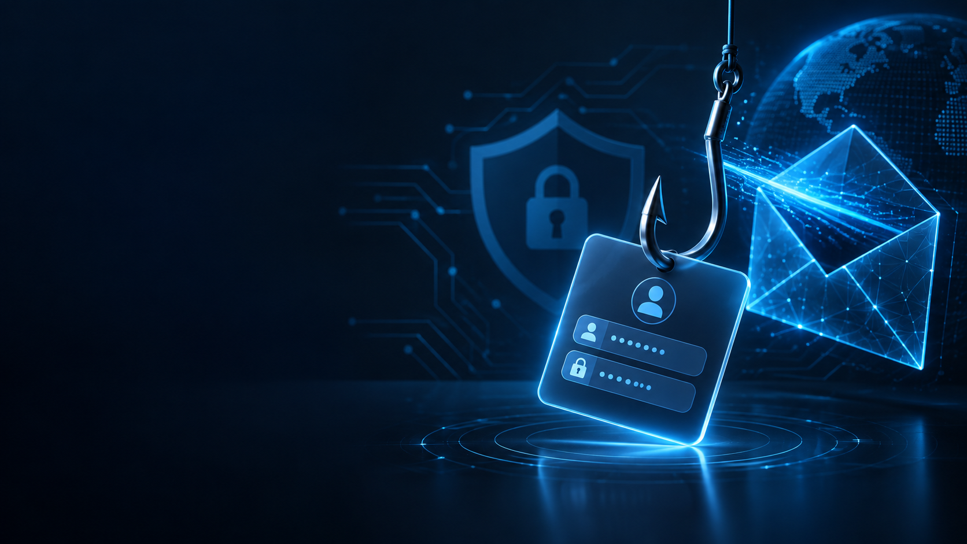
TASK 2 • CYBERSECURITY INTERNSHIP
PHISHING
AWARENESS
TRAINING
Recognize. React. Report. Prevent.
Submitted by
Samaa Fatima
For CodeAlpha
Professional Cybersecurity Awareness Presentation

Slide 2

AWARENESS FIRST
CODEALPHA • TASK 2
Phishing Awareness Roadmap
The goal is not to memorize every scam. It is to build a repeatable safety habit for any suspicious message.
01
02
03
04
05
06
UNDERSTAND
RECOGNIZE
PAUSE
VERIFY
REPORT
PRACTICE
Know what phishing is and what attackers want.
Notice pressure, impersonation, links, attachments and fake domains.
Do not let urgency or fear make the decision for you.
Check the request through a trusted, independent channel.
Tell the right team or service before deleting the message.
Use the same safety routine every time — even when a message looks polished.
AWARENESS HABIT
Stop → Check → Verify → Report → Protect
This simple sequence is the main theme of the training.
CISA — Secure Our World

Slide 3
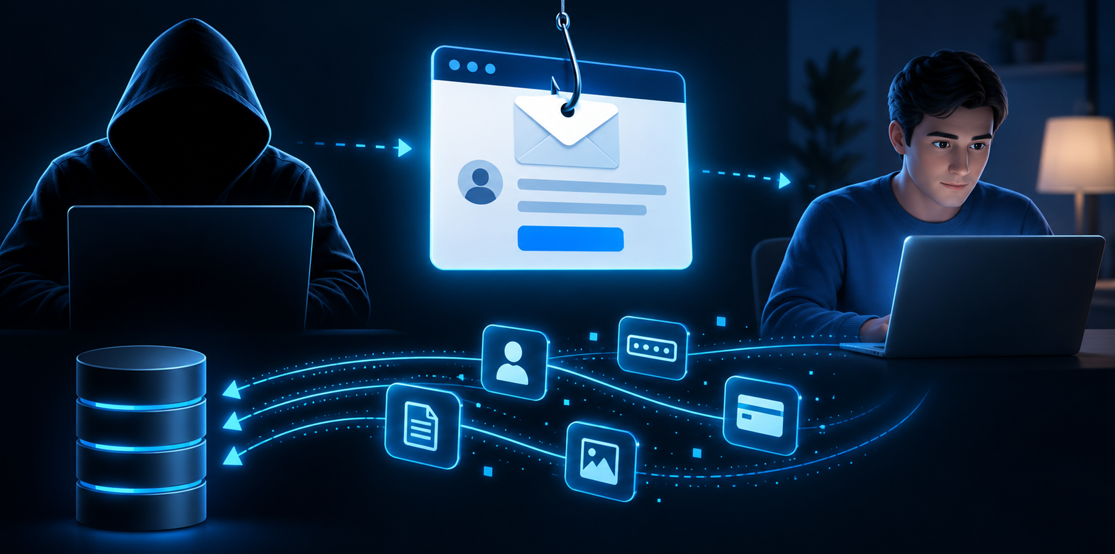
UNDERSTAND THE THREAT
CODEALPHA • TASK 2
What is phishing?
Phishing is a social engineering attack where an attacker pretends to be trusted to make someone reveal sensitive information or take an unsafe action.
ATTACKER
MESSAGE
VICTIM
IMPACT
Pretends to be trusted
Looks convincing
Reacts quickly
Data or access may be lost
FICTIONAL EXAMPLE
Why it works: the message creates urgency and fear, so the person may click before checking who actually sent it.
“Your account will be suspended today. Verify your account now.”
FBI — Spoofing & Phishing • NIST — Phishing

Slide 4
WHY AWARENESS MATTERS
CODEALPHA • TASK 2
Phishing by the numbers
Recent reports show why phishing awareness must cover people, messages, mobile channels and business email compromise.
60%
425,808
+40%
+88%
Human element
Phishing attacks
Smishing growth
Wire-transfer BEC
of breaches analyzed in Verizon’s 2025 DBIR involved some kind of human element.
tallied by APWG in June 2026 — the highest monthly total since April 2023.
increase in SMS/text phishing from Q1 to Q2 2026.
increase in observed wire-transfer BEC attacks from Q1 to Q2 2026.
Verizon DBIR 2025
APWG Q2 2026
APWG Q2 2026
APWG Q2 2026
Important: statistics describe trends — they do not mean every suspicious message is phishing. Verify each situation on its own evidence.
Verizon — 2025 DBIR • APWG — Q2 2026 Phishing Activity Trends

Slide 5
UNDERSTAND THE MOTIVE
CODEALPHA • TASK 2
Why do attackers use phishing?
The message is only the bait. The real goal is what comes after the click, reply, call, scan, or login.
Credentials
Unauthorized access
Steal usernames, passwords or session access.
Enter email, cloud, social or business systems.
Financial fraud
Malware delivery
Trick people into paying or changing bank details.
Convince a user to open a harmful file or installer.
PHISHING
Personal data
Business secrets
Collect identity, contact or account information.
Steal invoices, documents, contacts or internal data.
Identity theft
Use stolen information to impersonate the victim.
FBI — Business Email Compromise • NIST — Phishing Guidance

Slide 6
UNDERSTAND THE HUMAN FACTOR
CODEALPHA • TASK 2
Phishing + social engineering + human psychology
Phishing often targets human decision-making, not just technical weaknesses.
PSYCHOLOGICAL TRIGGER
EMOTIONAL REACTION
UNSAFE DECISION
Urgency, fear, authority…
“I need to act now.”
Click • reply • pay • share
URGENCY
FEAR
AUTHORITY
“Your account expires in 30 minutes.”
“Suspicious activity has been detected.”
“This is your manager. Do this now.”
Time pressure reduces careful checking.
Fear pushes the victim to react quickly.
People tend to obey trusted authority.
CURIOSITY
REWARD / GREED
TRUST
“See who viewed your profile.”
“Congratulations! You won a prize.”
“Message from your bank / university.”
Curiosity makes the message hard to ignore.
A reward can override normal caution.
Familiar names lower suspicion.
Key idea: the attacker tries to create a feeling first — because feelings can make us skip verification.
NIST — Social Engineering / Phishing • Google Security Blog — Why phishing works

Slide 7
RECOGNIZE THE CHANNELS
CODEALPHA • TASK 2
Types of phishing
The delivery channel changes — the deception stays the same.
Email Phishing
Spear Phishing
Whaling
Smishing
Mass fraudulent emails sent to many people.
A targeted message built for one person or team.
Targeted phishing aimed at senior leaders.
Phishing delivered through SMS or text messages.
Example: “Reset your mailbox now.”
Example: fake HR request using your name.
Example: fake legal notice sent to a CEO.
Example: “Package issue — confirm address.”
Vishing
Clone Phishing
Quishing / QR Phishing
Voice phishing through calls or voice messages.
A copied legitimate-looking message is altered.
A QR code sends the victim to a fraudulent page.
Example: fake bank security call.
Example: same invoice email, changed attachment.
Example: “Scan for your free voucher.”
SMS = SMISHING
VOICE = VISHING
QR CODE = QUISHING
Targeting a specific person = SPEAR PHISHING
FBI — Spoofing & Phishing • NIST — Phishing Guidance

Slide 8
RECOGNIZE THE PATTERN
CODEALPHA • TASK 2
Real-world phishing scenarios
All examples below are fictional and safe. Learn the pattern, not the brand.
EMAIL
SMS
PHONE CALL
QR CODE
Microsoft 365
Password expires today
Your package could not be delivered. Update your address:
Verify now to keep access.
BANK SECURITY
parcel-update.example
“We need to verify your account. Please tell me the code sent to your phone.”
VERIFY
“Scan to receive your free voucher.”
Why suspicious?
Why suspicious?
Why suspicious?
Why suspicious?
• Unexpected password request
• Urgent “today” deadline
• Unexpected delivery issue
• Link asks for personal data
• Unsolicited verification call
• Requests a one-time code
• Unexpected reward
• Destination hidden in the QR code
Pattern to notice: unexpected contact + pressure + request for information, money, login, download, or scan.
FBI — Spoofing & Phishing

Slide 9
RECOGNIZE EMAIL RED FLAGS
CODEALPHA • TASK 2
How to recognize a phishing email
Can you spot the red flags?
Inbox › Account Security
RED FLAGS
From
Microsoft Account Team <account-update@micr0soft-support.example>
1
1
Look-alike sender domain
To
samaa.student@example.com
Subject
URGENT: Verify Your Account
2
Generic or unusual greeting
2
3
Urgency / threat language
Hello User,
We detected unusual activity. Your account will be locked in 30 minutes. Verify now to keep access.
4
Unexpected verification request
3
5
Suspicious or mismatched link
4
VERIFY ACCOUNT
6
Unexpected HTML attachment
Link preview: https://login-micr0soft365.example/verify
5
6
Security_Update.html
Good grammar ≠ safe. Modern phishing can look polished and professional.
FBI — Spoofing & Phishing • NIST — Phishing Guidance

Slide 10
RECOGNIZE WEBSITE RED FLAGS
CODEALPHA • TASK 2
How to recognize a fake website
A page can look professional and still be fake. Verify the domain and the context before you type credentials.
1
https://login-micr0soft365.example/security-check
CHECK BEFORE YOU LOGIN
2
Lookalike / misspelled domain
MICROSOFT 365
Security verification required
Unexpected login request
Your session expires in 03:00
3
Strange URL or unusual redirect
Email address
Asks for unnecessary information
samaa.student@example.com
To continue, confirm your mobile number and date of birth.
Branding or layout inconsistencies
4
Password
Pressure, countdown, or threat
••••••••••••
HTTPS / a padlock does NOT prove the site is trustworthy. It only protects the connection.
FBI — Spoofing & Phishing • CISA — Secure Our World

Slide 11
WHY AWARENESS MATTERS
CODEALPHA • TASK 2
A major real-world case: vendor impersonation BEC
U.S. federal prosecutors described a business email compromise scheme that caused two U.S.-based internet companies to transfer more than $120 million.
1 Copycat supplier identity
A company was registered with the same name as a real hardware supplier.
2013–2015
>$120M
transferred to accounts controlled by the fraudster
2 Fraudulent phishing emails
Emails impersonated the supplier and changed where legitimate payments should be sent.
Two victim companies
3 Wire transfers redirected
Employees followed the fake instructions and transferred funds to controlled accounts.
A multinational technology company and a multinational social-media company.
4 Forged documents + laundering
Forged invoices, contracts and letters supported transfers; funds were moved internationally.
2019 outcome
Guilty plea followed by a 60-month prison sentence.
Lesson: independently verify payment changes. Never rely on email alone for unusual transfer instructions.
U.S. DOJ — SDNY, Dec. 19, 2019 • FBI — Business Email Compromise

Slide 12
REACT CORRECTLY
CODEALPHA • TASK 2
What To Do If You Suspect Phishing
Your safest move is to slow the situation down. Do not investigate by interacting with the suspicious message.
STEP 1
STEP 2
STEP 3
STEP 4
STEP 5
Pause & Inspect
Don't Interact
Verify Independently
Report It
Remove / Block
Check the full sender address, context and destination of links without clicking.
Do not click links, open attachments, reply with data, scan a QR code, or call a number in the message.
Use the official app, website, saved contact or a known phone number to verify the request.
Use the report-phishing option or notify the appropriate IT/security team or service.
After reporting, delete the message and block the sender when appropriate.
ALREADY CLICKED OR ENTERED DETAILS?
Change the password from the official site, enable MFA, sign out other sessions, and contact IT/security or your bank if financial information may be at risk.
CISA — Secure Our World • FBI — Spoofing & Phishing

Slide 13
STAY PROTECTED
CODEALPHA • TASK 2
Prevention Best Practices
Strong habits reduce the chance of a bad click; technical safeguards reduce the damage if one happens.
Personal Habits
Technical Safeguards
Think before you click — slow down on urgent messages
Turn on multi-factor authentication (MFA) wherever available
Verify unusual requests through a known, trusted channel
Keep operating systems, browsers and security tools updated
Check the sender’s full email address and the real domain
Use spam filters and built-in phishing protection in email
Never share passwords, recovery codes or OTPs through unsolicited requests
Use a password manager to avoid reused passwords
Report anything suspicious as soon as possible
Back up important files so malware or ransomware causes less damage
Best habit: when a message creates pressure, create distance — pause, verify independently, then act.
CISA — Secure Our World • CISA — Turn on MFA

Slide 14
TAKE ACTION
CODEALPHA • TASK 2
How To Report Phishing
Reporting a suspicious message can protect other people from seeing or trusting the same attack.
Use the Report Button
Notify IT / Security
Inform the Real Company
Secure Your Account
Use “Report phishing” / “Report spam” in your email or messaging app when available.
Forward or submit the suspicious message using your organization’s approved process.
If a brand is being impersonated, report it through the company’s official website or support channel.
If you clicked or entered details, change the password from the official site and enable MFA.
REMEMBER
Reporting is not “over-reacting.” Security teams need suspicious messages reported so they can protect other users and systems.
CISA — Recognize & Report Phishing • FBI — Spoofing & Phishing

Slide 15
PRACTICE YOUR JUDGMENT
CODEALPHA • TASK 2
Spot the phish — quick quiz
Choose the safest response. The answer key is at the bottom — do not peek too early.
SCENARIO 1 — SMS
SCENARIO 2 — EMAIL
SCENARIO 3 — QR
Your bank account will be blocked unless you verify it immediately through a link.
A message from “your manager” asks you to buy gift cards right now and send the codes by email.
A random poster says “Free Wi-Fi — scan here” and the page asks for your work email password.
A. Click immediately
A. Buy them quickly
A. Enter the password
B. Reply with your information
B. Verify the request using a known contact method
B. Try a second work account
C. Contact the bank through its official app/number
C. Reply asking for more codes
C. Share the QR with coworkers
D. Forward your OTP
D. Send your card details first
D. Use the official network instructions instead
ANSWER KEY • 1: C • 2: B • 3: D
All scenarios are fictional.

Slide 16
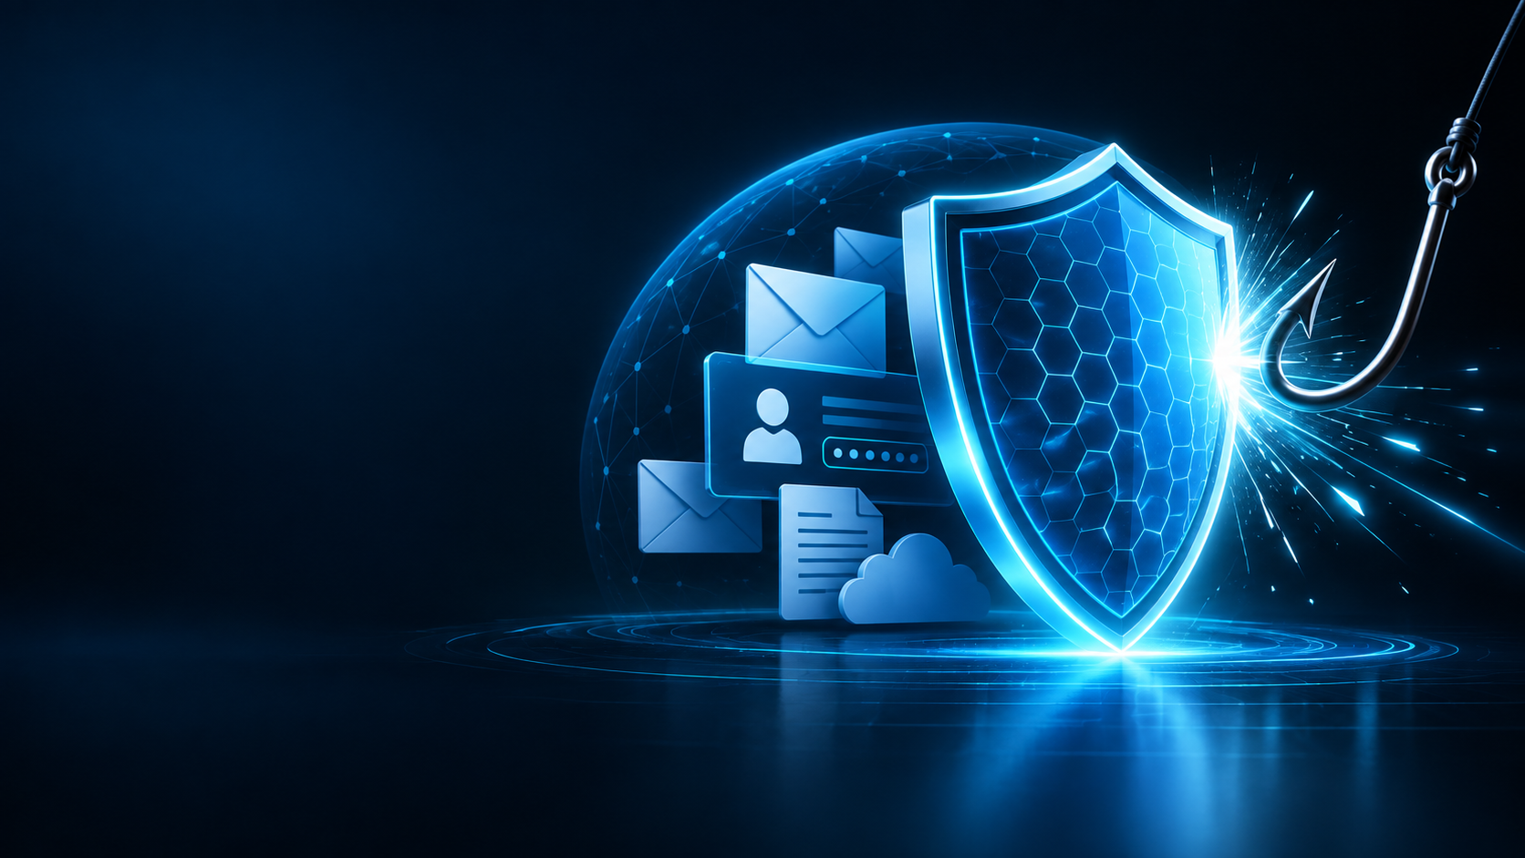
FINAL TAKEAWAY
THINK BEFORE
YOU CLICK
Phishing succeeds when deception creates a quick reaction.
Pause. Verify. Report. Protect.
STOP
Do not react immediately.
VERIFY
Confirm the sender or request independently.
PROTECT
Keep accounts, credentials and information secure.
Prepared by: Samaa Fatima
Cybersecurity Internship — CodeAlpha • Task 2: Phishing Awareness Training • Awareness-first edition

