Slide 1
TIME SERIES ANALYSIS
Cairo Weather Data, 2025
Exploratory analysis of daily temperature: trend, seasonality, stationarity, and correlations

Slide 2
DATASET
Data Preparation
Source file
cairo 2025-01-01 to 2025-12-31.csv — daily weather records for Cairo across 2025
Indexing
The datetime column was parsed and set as the DataFrame index
Columns removed
severerisk and preciptype were dropped from the dataset
Key variables used
temp, precip, humidity, windspeed
Cairo Weather Time Series — 2025
2

Slide 3
SUMMARY STATISTICS
Temperature & Precipitation
AVERAGE TEMP
TEMP RANGE
DAYS WITH NO RAIN
MAX PRECIPITATION
23.4°C
11.2° – 34.7°C
75%+
1.1 mm
across 2025
min to max
of the year
highest single day
Temperature followed normal seasonal changes throughout the year
Rainfall stayed very low and infrequent — consistent with Cairo's dry climate
Cairo Weather Time Series — 2025
3

Slide 4
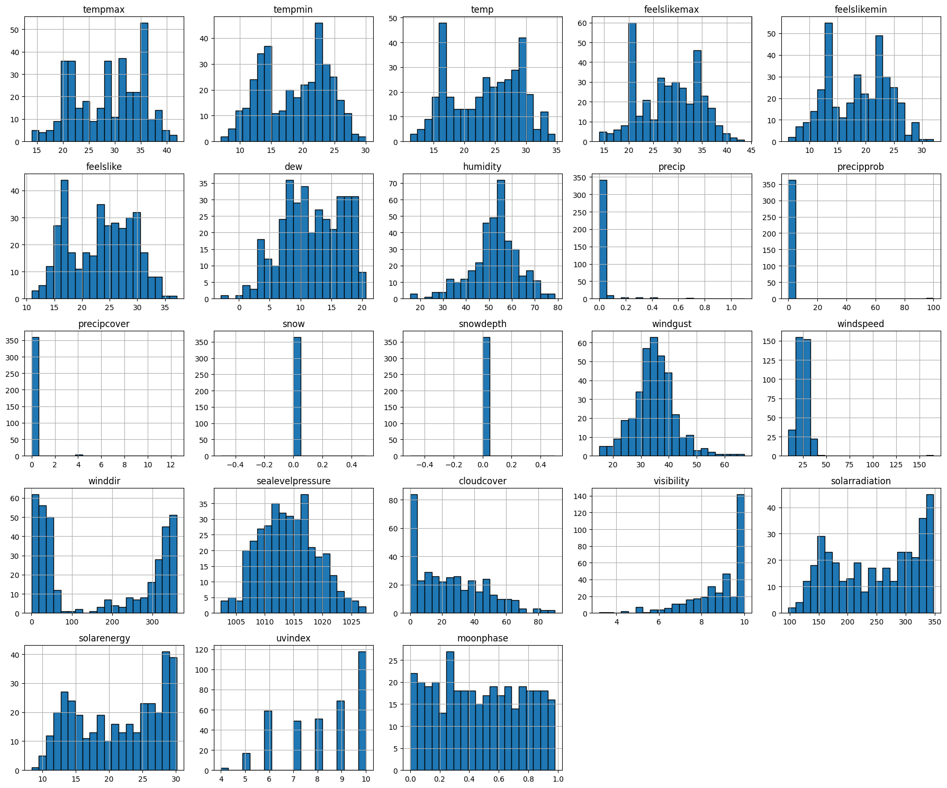
EXPLORATORY DATA ANALYSIS
Distribution of Numeric Variables
Histograms of all numeric weather variables for 2025
temp shows a fairly normal, spread-out distribution
precip is heavily skewed near zero — most days had no rain
Cairo Weather Time Series — 2025
4

Slide 5
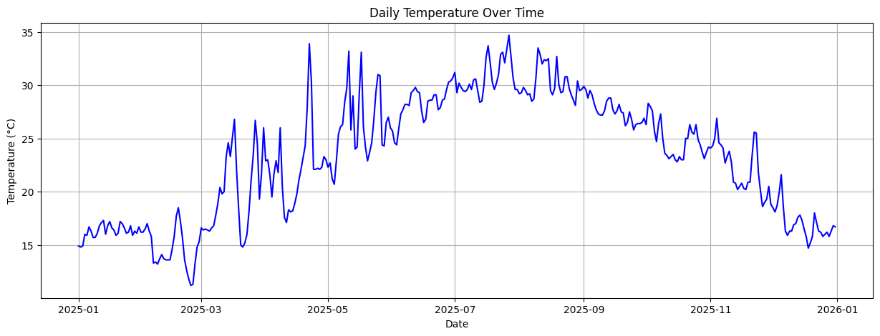
TIME SERIES
Daily Temperature Over Time
Rises from winter into summer, peaking in July and August
Gradually falls toward the end of the year
Clear seasonal pattern, with normal daily fluctuations
Cairo Weather Time Series — 2025
5

Slide 6
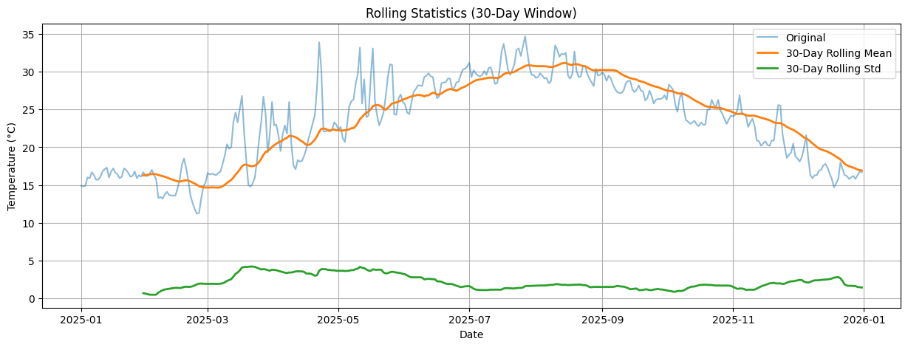
TIME SERIES
Rolling Statistics (30-Day Window)
The 30-day rolling mean smooths daily temperature to reveal the seasonal trend
The rolling standard deviation shows how variability changes across the year
Some periods are more stable than others
Cairo Weather Time Series — 2025
6

Slide 7
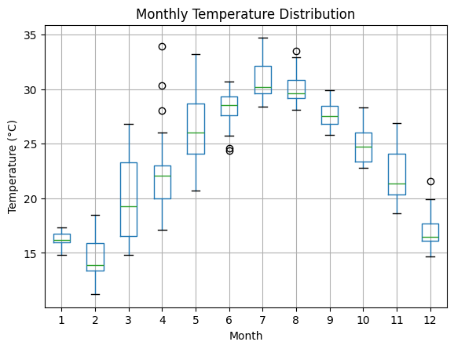
TIME SERIES
Monthly Temperature Distribution
Winter months show the lowest temperatures
Summer months — especially July and August — show the highest
The spread of temperatures also varies month to month
Cairo Weather Time Series — 2025
7

Slide 8
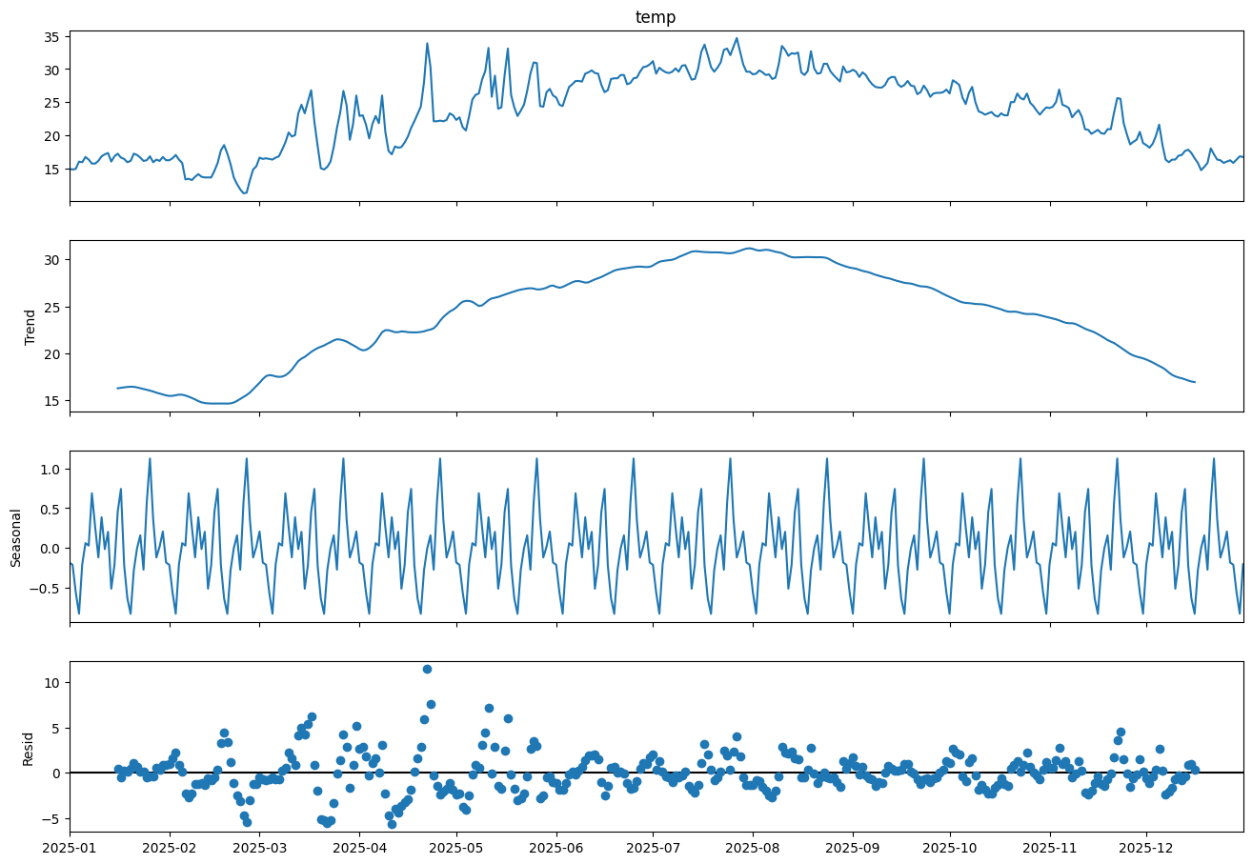
DECOMPOSITION
Trend, Seasonality & Residual
Trend rises from winter to summer, then falls toward year end
Seasonal component shows a repeating annual pattern
Residuals stay mostly centered around zero — most variation is explained by trend and seasonality
Cairo Weather Time Series — 2025
8

Slide 9
STATIONARITY
Augmented Dickey-Fuller Test
Non-Stationary
ADF Statistic
-0.997
p-value
0.754
Critical value (1%)
-3.449
p-value is greater than 0.05 → the series is non-stationary
Expected, since the data shows both a clear trend and seasonal variation throughout the year
Critical value (5%)
-2.870
Critical value (10%)
-2.571
Cairo Weather Time Series — 2025
9

Slide 10
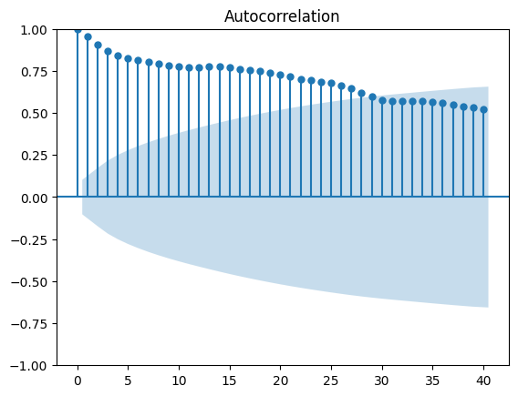
AUTOCORRELATION
ACF — Autocorrelation Function
Strong positive autocorrelation across many lags
Correlation decreases gradually rather than dropping quickly
Temperature values are highly related to previous days — consistent with a non-stationary series
Cairo Weather Time Series — 2025
10

Slide 11
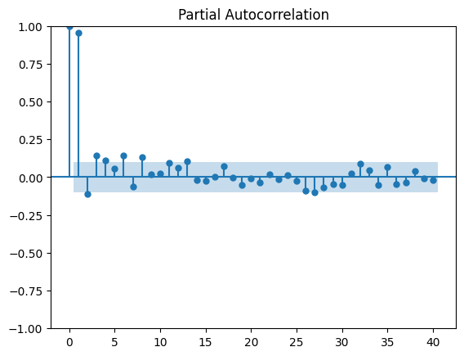
AUTOCORRELATION
PACF — Partial Autocorrelation Function
Strong direct correlation at lag 1
Remaining lags are weak or insignificant
Today's temperature is mainly influenced by the previous day's, with little direct effect from earlier days
Cairo Weather Time Series — 2025
11

Slide 12
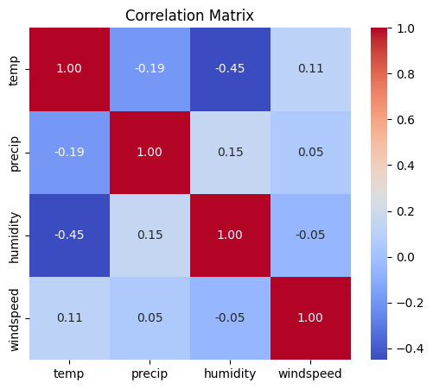
RELATIONSHIPS
Correlation Matrix
temp vs humidity
-0.45
moderate negative — higher humidity, lower temperature
temp vs precip
-0.19
weak negative
temp vs windspeed
+0.11
very weak positive
These variables have only a small influence on temperature in this dataset
Cairo Weather Time Series — 2025
12

