Slide 1



Traffic flow prediction Time
Series Forecasting
REPORT!
Team Members:
Sama Alharbi
Rahab Almahadawi
Raghad Almoqhim
26-8-2024

Slide 2
Table of contents
01
02
03
04
05
06
Introduction
Dataset
EDA
Methodology
Results
Conclusion

Slide 3
Introduction
Developing a predictive model for traffic flow

Slide 4

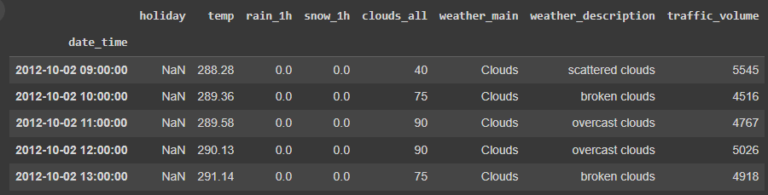
Dataset
Metro traffic volume
48175
Columns
Records
8

Slide 5
Methodology
Data collection
Data preprocessing
Results
1
3
5
EDA
Builds models
(RNN,LSTM AND GRU)
2
4

Slide 6
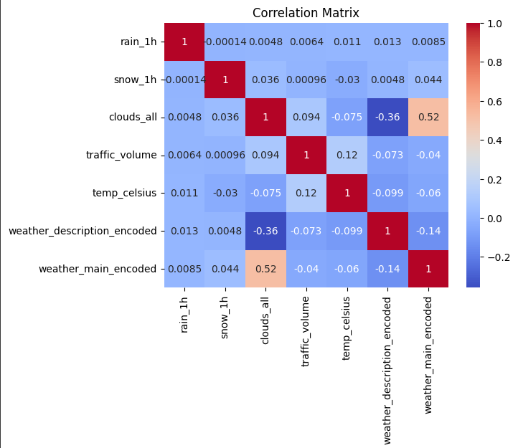
Exploratory Data Analysis
Correlations Matrix

Slide 7
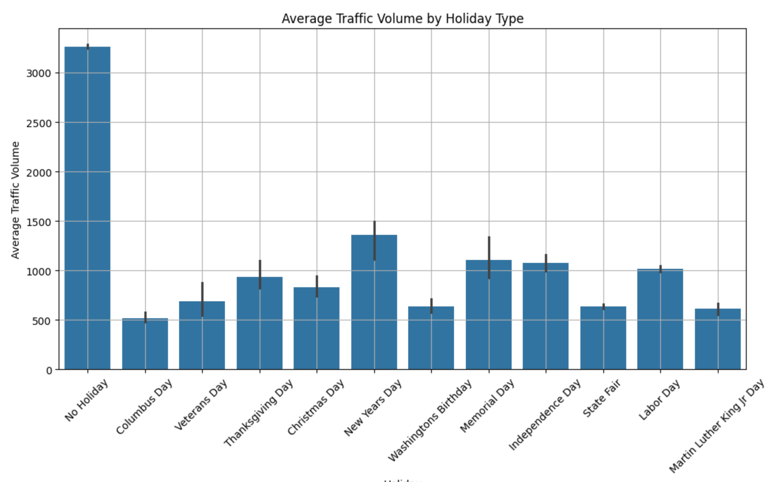
Exploratory Data Analysis
Analyzing Traffic Volume by Holiday Type

Slide 8
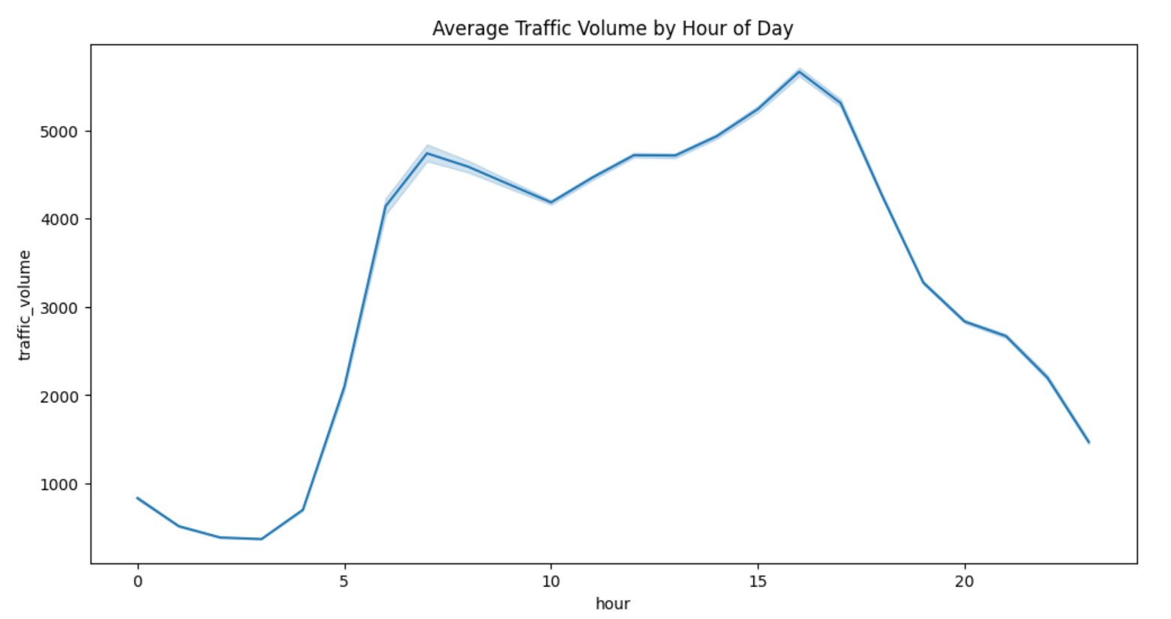
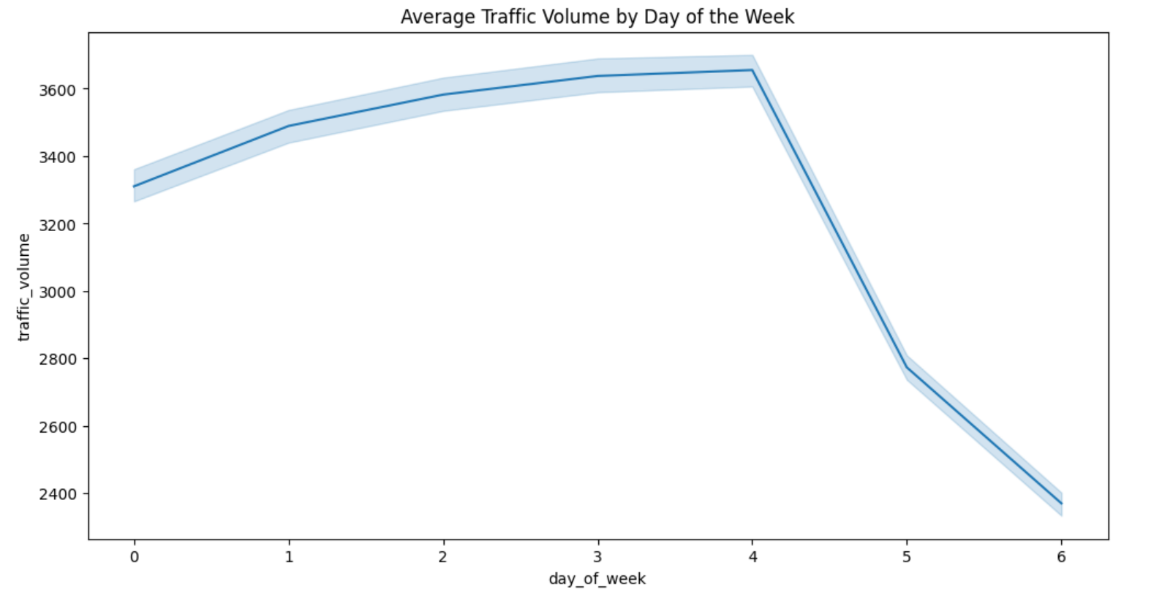
Exploratory Data Analysis
Seasonal Trend

Slide 9
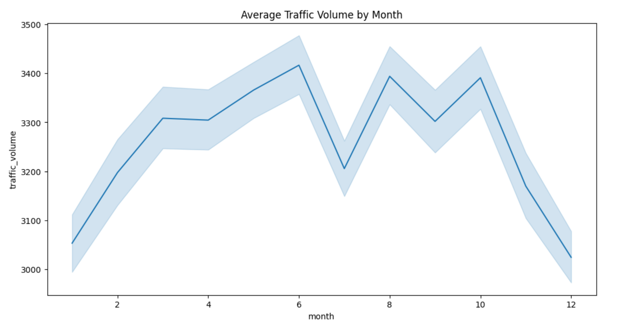
Exploratory Data Analysis
Cyclic Trend

Slide 10
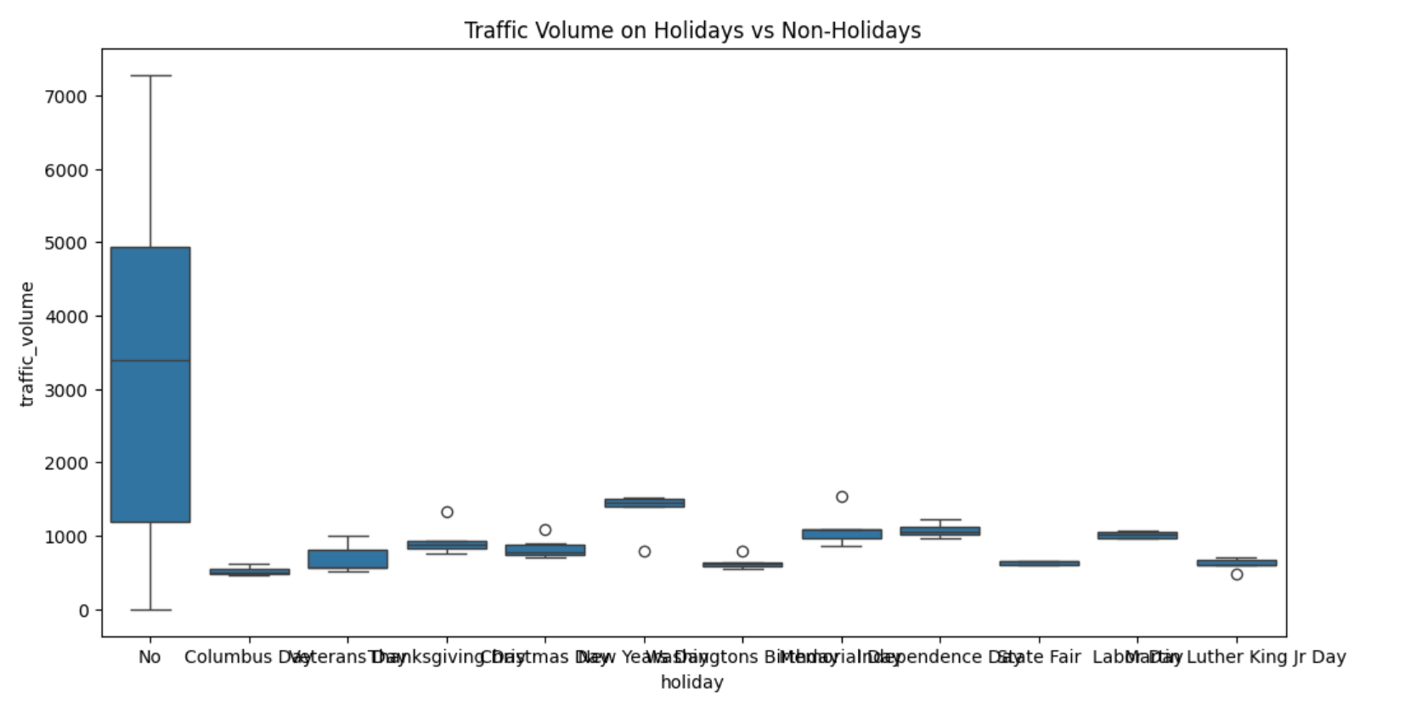
Exploratory Data Analysis

Slide 11
Builds Models
RNN
LSTM
GRU

Slide 12
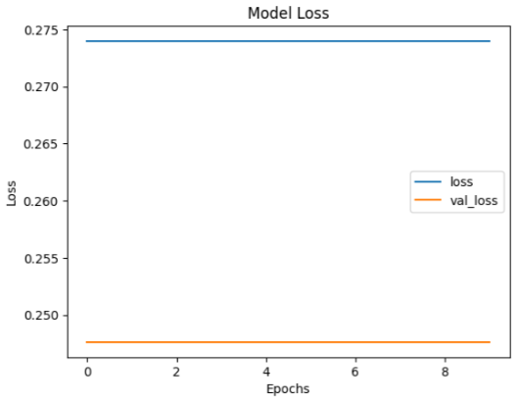
Results
RNN

Slide 13
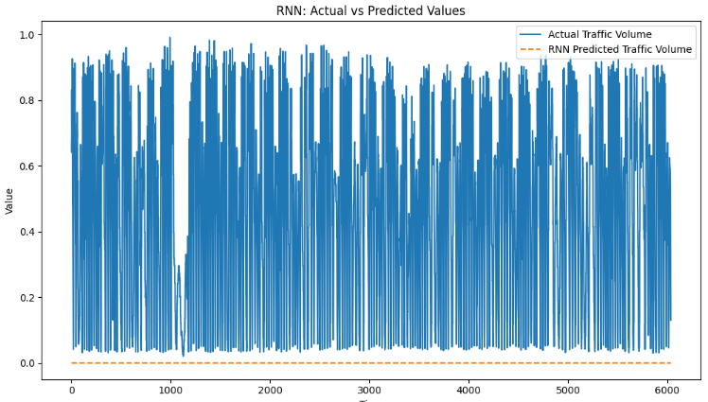
Results
RNN

Slide 14
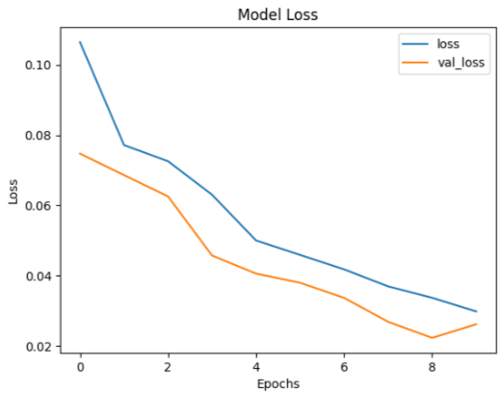
Results
LSTM

Slide 15
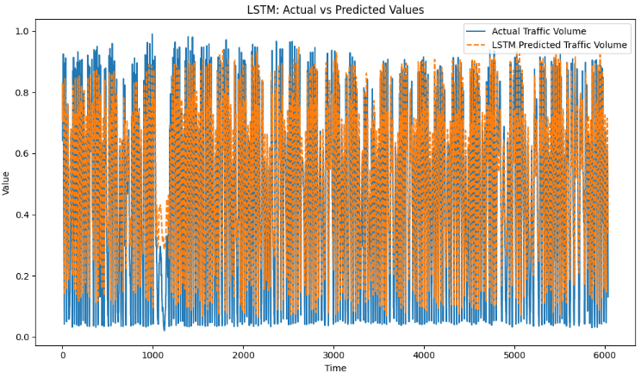
Results
LSTM

Slide 16
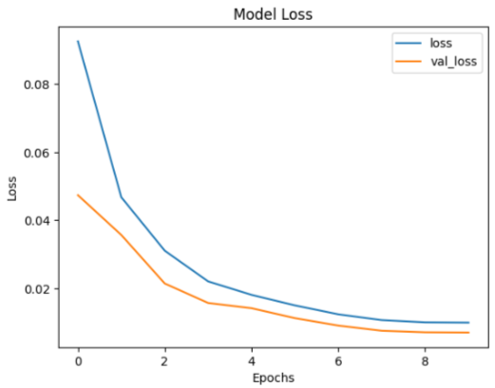
Results
GRU

Slide 17
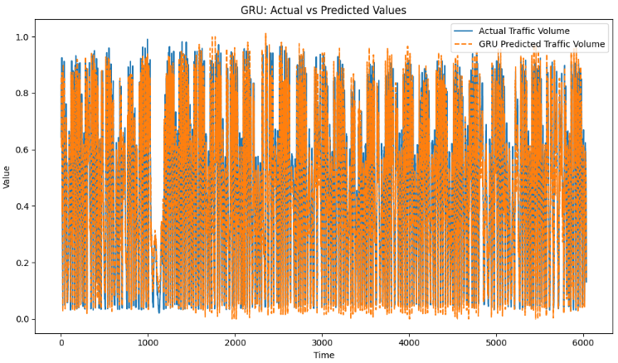
Results
GRU

Slide 18
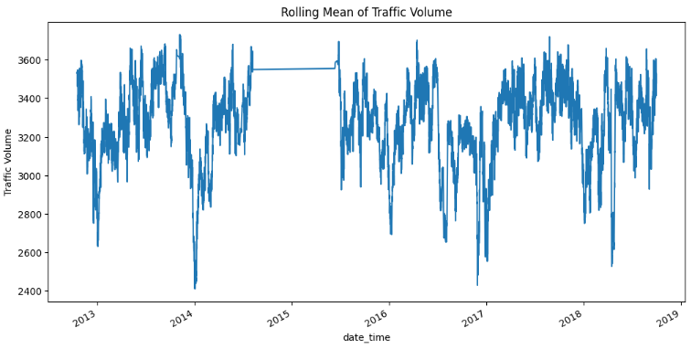
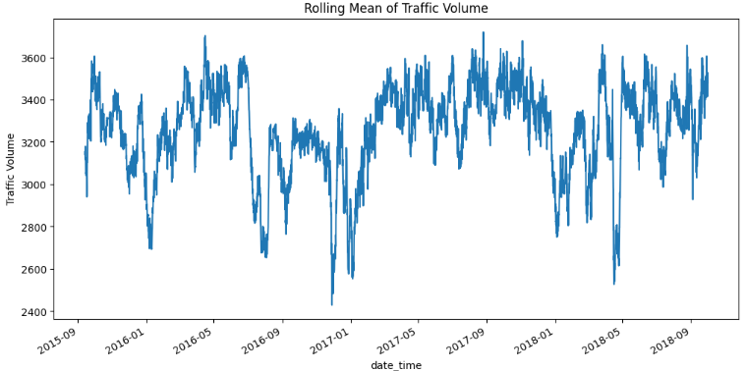
Challenges

Slide 19
Conclusion
Key Insights:
By analyzing the data and building models, we were able to identify seasonal and cyclical patterns in traffic.

Slide 20
THANKS
Do you have any questions?

