Slide 1
ETL-Project-Group-1
Quacquarelli Symonds (QS)
World University Rankings 2017-2022
Team Members:
Anh Huong, Daniela Cornea, Aravind Sama, Mino Peric

Slide 2
Project Introduction
QS World University Rankings
Annually published by UK company Quacquarelli Symonds (QS)
Comprises the top 1,300 universities from around the world
The ranking reflects: academic and employer reputation, student ratio and other factors
One of the three most-widely read university rankings in the world
Sources of data
Dataset from Kaggle:
6 CSV files for the period 2017 - 2022 and
A combined CSV file with data for the whole period
A word cities csv file
Data sources URLs:
https://www.kaggle.com/prasertk/qs-world-university-rankings-2021?select=QS+World+University+Rankings+combined.csv
https://www.kaggle.com/juanmah/world-cities
https://www.topuniversities.com/

Slide 3
Project Scope
Each member of the team worked with at least one CSV file
Use Jupyter Notebook, PgAdmin and Excel to
Extract data from the dataset
Transform the data in a form that can be easily analyzed
Load data into a relational database
Perform data analytics on QS University Ranking

Slide 4
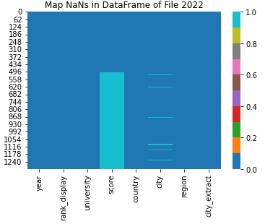
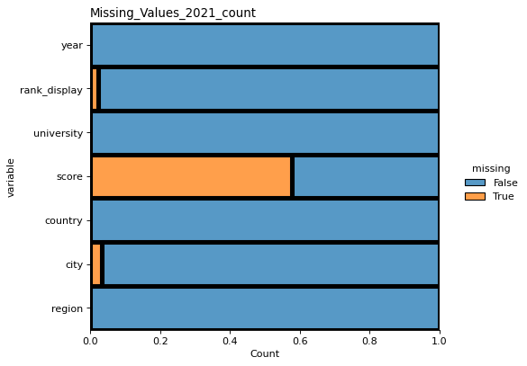
Extract, Transform, Load and Validate
Extract data from csv files into pandas dataframes
Techniques applied for transformation of the data to ensure no data loss:
Visualise the “dirty data” of the entire data frame by using seaborn
Locate the “dirty data” by using raw python
Clean the “dirty data”:
Validate the data (e.g. city name, university in multiple cities)
Look up and fill the missing strings from the another data source
Strip, drop, remove and filter the required data
Data conversion
Split/ Slice into sub data frames (prepare for the data load)
Load the cleaned data into postgresql database:
Created database with 2 or 3 tables by using pgAmin4
Load data to the database by using pandas
Validate the data load and data loss (from the ETL process) with SQL queries

Slide 5
Analysis
2017-2021; Massachusetts Institute of Technology (1st), Stanford University (2nd), Harvard University (3rd)
2022; Massachusetts Institute of Technology (1st), University of Oxford (2nd), Stanford University (3rd)
OECD-member countries; including USA, UK, Switzerland
Positive correlation between high-university standards and high-income economies

