Slide 1
Prosjektoppdatering
22.10.2024

Slide 2
Finne endring i ECM parametre
Har 5 degraderingssteg → 5 Nyquist plots jeg kan tilpasse ECM til
Velger den ECM som gir gjennomsnittlig minst feil til datasettene
Se hvordan parametre endrer seg fra steg til steg (1- 5)

Slide 3
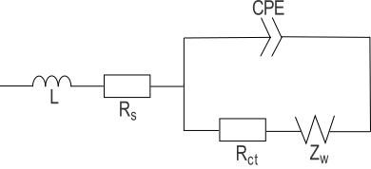
1. Randles circuit
(with inductance, non-ideal capicitance and non-ideal Warburg)

Slide 4
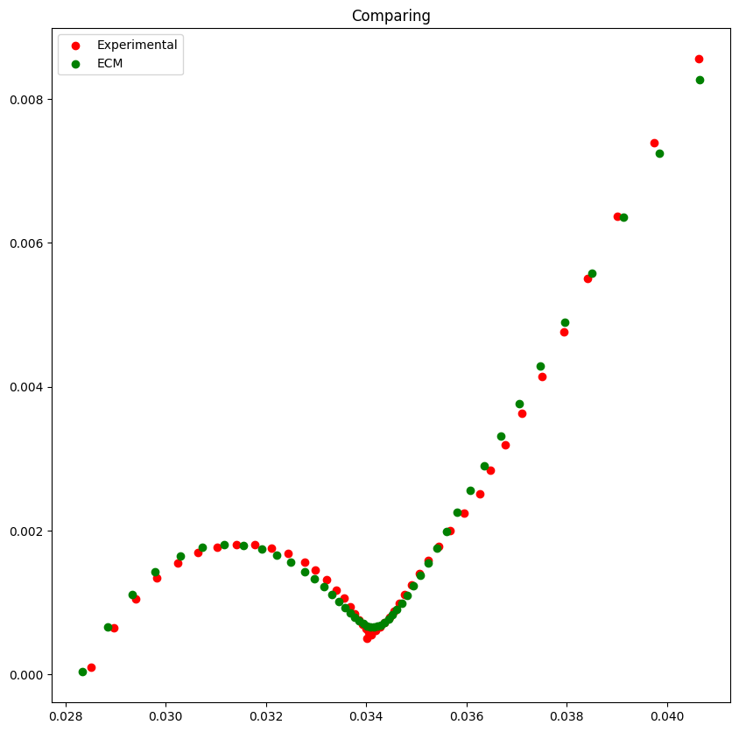
Average error: 1.1 e-05

Slide 5
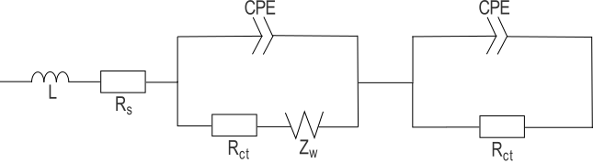
2. Randles circuit + circuit with R and CPE in parallell
(with inductance, non-ideal capicitance and non-ideal Warburg)

Slide 6
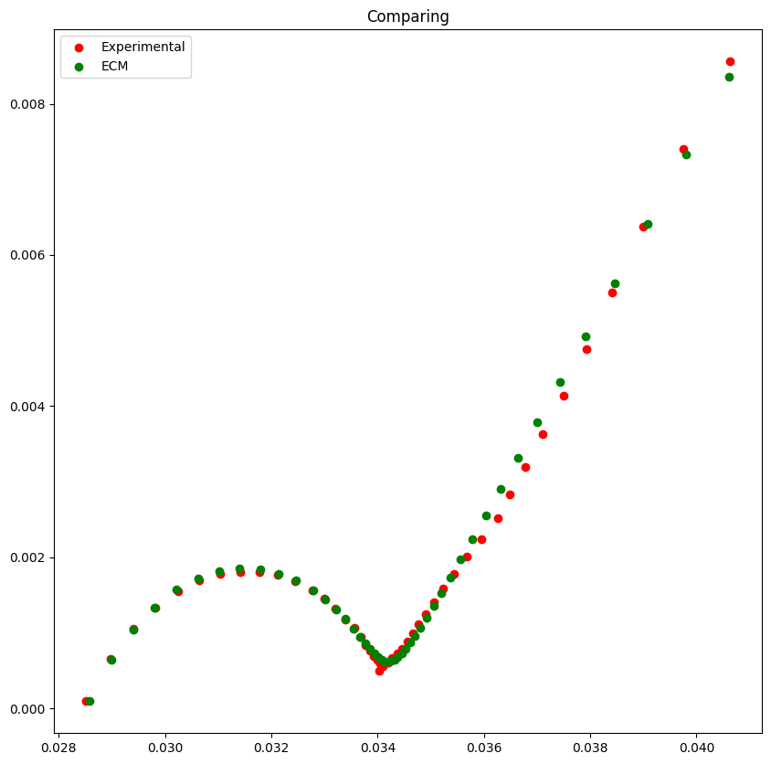
Average error: 2.0 e-06

Slide 7
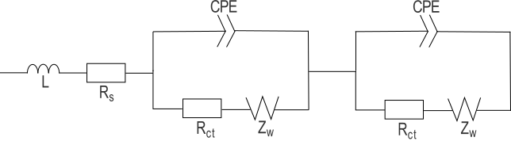
3. Two Randles circuits in series
(with inductance, non-ideal capicitance and non-ideal Warburg)

Slide 8
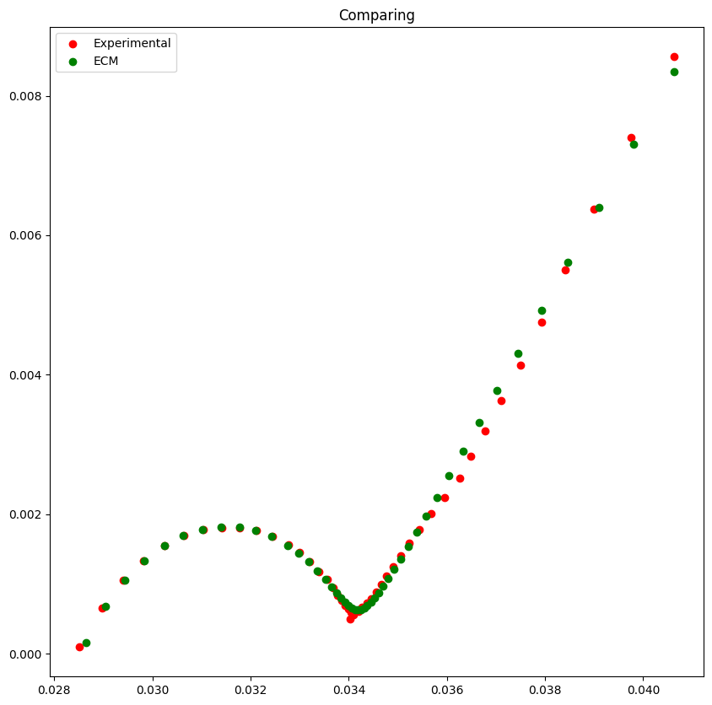
Average error: 1.8 e-06

Slide 9
Conclusion
The ECM model 3 gives the lowest sum of square difference --> lowest error

