Slide 1
Prosjektoppdatering
08.10.2024

Slide 2
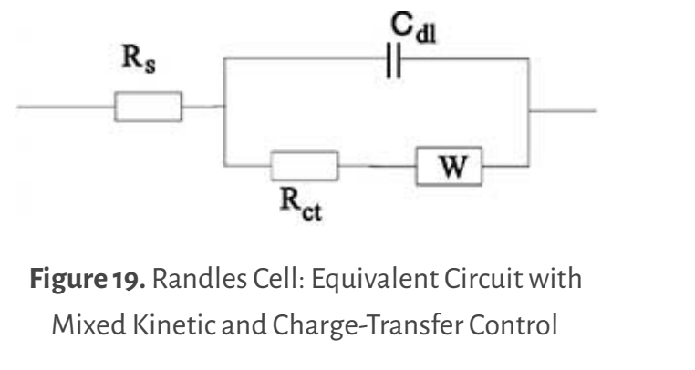
Equivalent Circuit Modelling
Randles circuit (with inductance in series to slightly better describe the cell at higher frequencies)
The optimized Randles parameters work as an estimate for modifying the simulation parameters

Slide 3
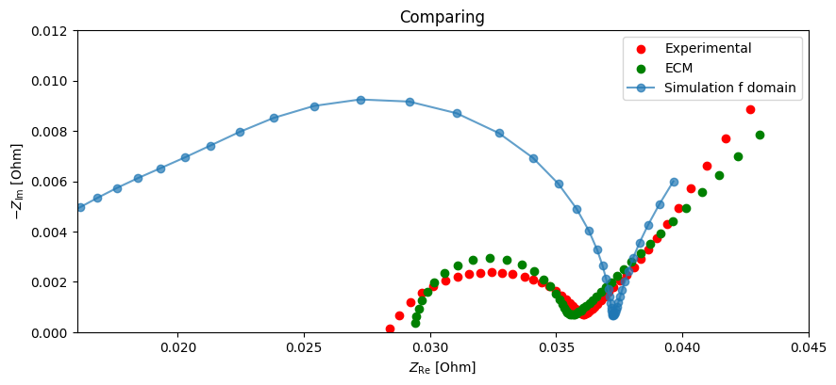

Slide 4
Exchange current density
Increasing exchange current density → decreasing the charge transfer resistance → reducing the size of the semicircle
Observing that it works, the semicircle dramatically decreases → just have to modify the code, that is optimizing the anodic and cathodic exchange current density so that the simulation best fits the experimental data ☺
Graphite exchange current density function from Chen2020 parameter in Github
Cathode exchange current density function from an example in pybammeis documentation on Github.
Find out how the exchange current density functions directly relates to the charge transfer resistance! (as it is the charge transfer resistance I found an estimate on in the Randles ECM).

