Slide 1
Prosjektoppdatering
15.10.2024

Slide 2
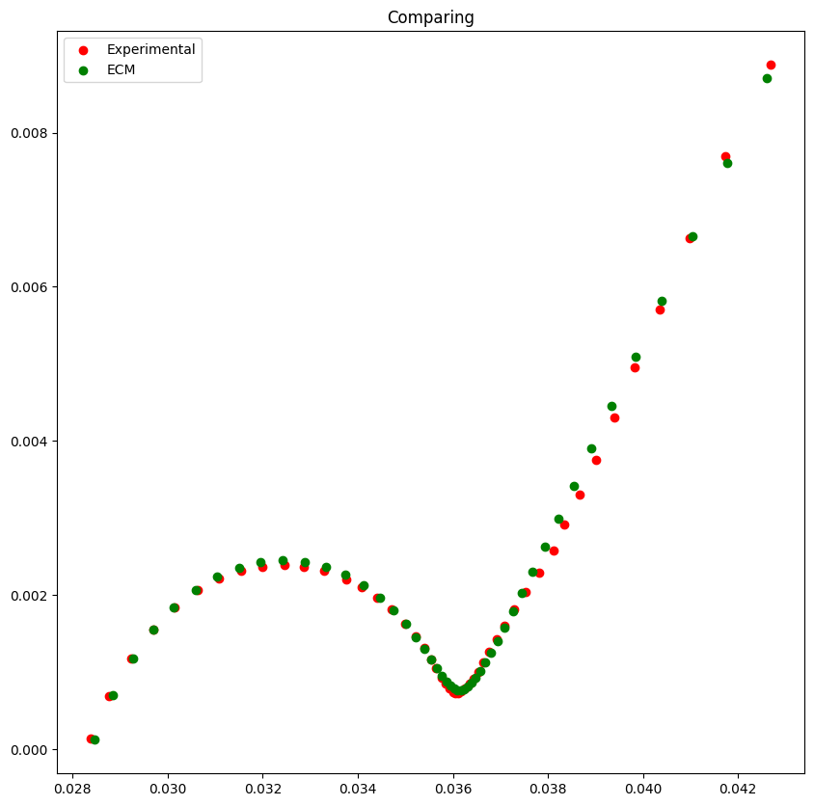
Updated Randles circuit
Two Randles Circuits in series on the form:
Z = R_el + Z(L) + Z1 + Z2
(Z2 without Warburg)
Non-ideal capacitance (CPE) and warburg with alpha parameter
Best error I get (with scipy.minimize) is ca. 3.3e-7

Slide 3
Optimized ECM parameters: estimation for simulation parameters
Negative/Positive electrode double-layer capacity [F.m-2]: CPE/area(electrode)
Area(electrode) = Electrode height [m]*Electrode width [m]
Negative: CPE = Q2
Positive: CPE = Q1
Negative/Positive electrode exchange-current density [A.m-2]: i0 = (R*T)/(n*F*resistance(electrode))
(from small overpotentials and assuming a symmetrical charge transfer process)
Negative: resistance(electrode) = R_ct2
Positive: resistance(electrode) = R_ct1
Electrolyte conductivity [S.m-1]: 1/(thickness(separator)*resistance(electrolyte))
Negative/Positive electrode conductivity [S.m-1]: thickness(electrode)/(resistance(electrode)*area(electrode))
Negative: resistance(electrode) = R_ct2, thickness(electrode) = anode_thick,
Positive: resistance(electrode) = R_ct1, thickness(electrode) = cathode_thick
Electrolyte/Positive particle/Negative particle diffusivity [m2.s-1]: ((R*T)/(n*F*area*A))^2
Negative: area = e_height*anode_thick, A = A2?
Positive: area = e_height*cathode_thick, A = A1
Electrolyte: area = e_height*s_thick, A = A2?

Slide 4
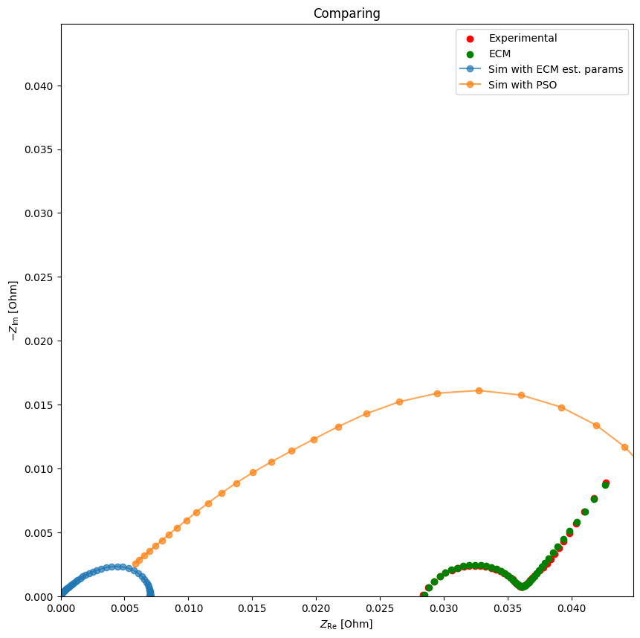
Have I described the electrolyte diffusivity correctly?
- Why A2 in electrolyte to get a meaningful result for example?

