Slide 1
Prosjekt-oppdatering
17.09.2024

Slide 2
Generating EIS Simulation
Assumptions:
DFN model
Same parameters as Amund used in the MJ01 cell
Input parameter SOC = 45%
Then used pybamm-eis example to calculate the initial concentration in the positive and negative electrode (updating these parameters)
25 degrees Celcius
Applying an AC current!
Sinus current applied in the time domain =
Using a numerical frequency domain method (I used prebicgstab)
Have included a plot where I compare these methods
Did not include the option: surface integral to generate the semicircle.

Slide 3
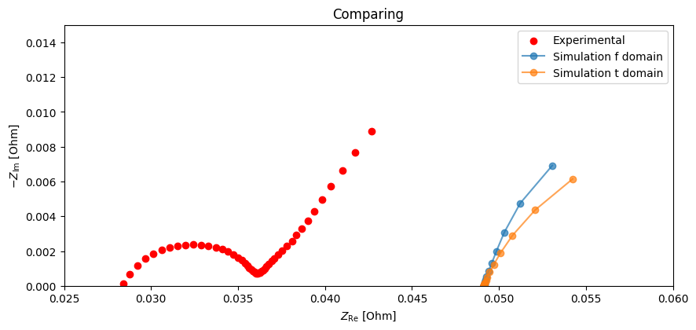
Comparing exp. and sim. Nyquist plot
Observations:
Basically the same if you apply a sinus curve in the time domain or use a numerical method in the frequency domain! Takes shorter time with the latter.
Same ish angle? Simulation shifted to the right? What do you think? Road ahead?

Slide 4
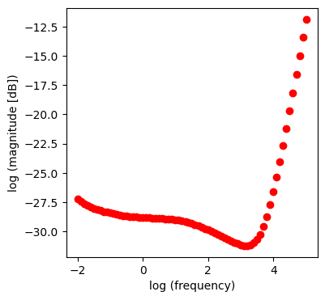
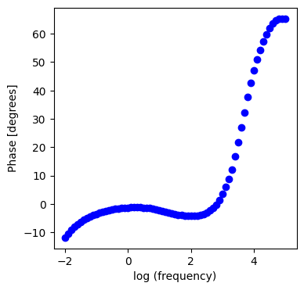
MJ02 Bode plot
Comments:
Have not found out how I can extract magnitude and phase data from the simulation (and generate Bode plot from this)
Used the same frequency range in the simulation!

