Slide 1
AI PDF Chatbot NLP-Powered Document Assistant
Presented by Samaa Sabry

Slide 2
Table of contents
01
02
03
04
05
06
Introduction
Architecture
Model Selection
Problem Statement & project goal
High-level diagram & Tech stack
NLP & AI model selection approach
Workflow
Deployment & Usage
Live Demo
How Document upload & generating responses are handled
Running instructions
Demonstration of chatbot app in action

Slide 3
01
Introduction
Problem Statement & Solution

Slide 4
Problem Statement

Slide 5
Problem Statement
Many organizations deal with large PDF documents containing valuable information.
Searching for specific details in these documents is time-consuming and inefficient.
Traditional search tools are limited to keyword matching, lacking contextual understanding.

Slide 6
Solution

Slide 7
Solution
An AI-powered chatbot that allows users to upload PDFs and ask questions to extract relevant information.
Uses NLP & vector search to provide accurate, context-aware answers.
Provides a user-friendly interface for seamless interaction.

Slide 8
02
Architecture
High level Architecture & Tech Stack

Slide 9
High-level Architecture

Slide 10
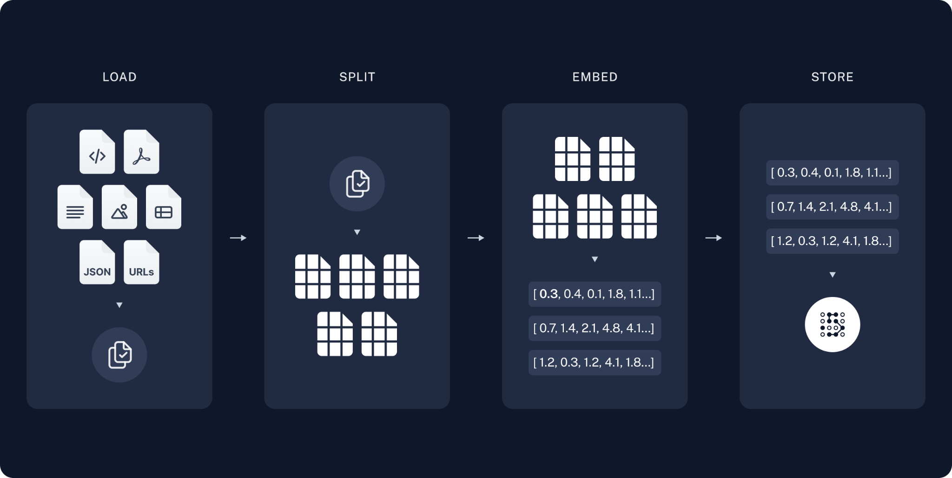
High-level Architecture

Slide 11
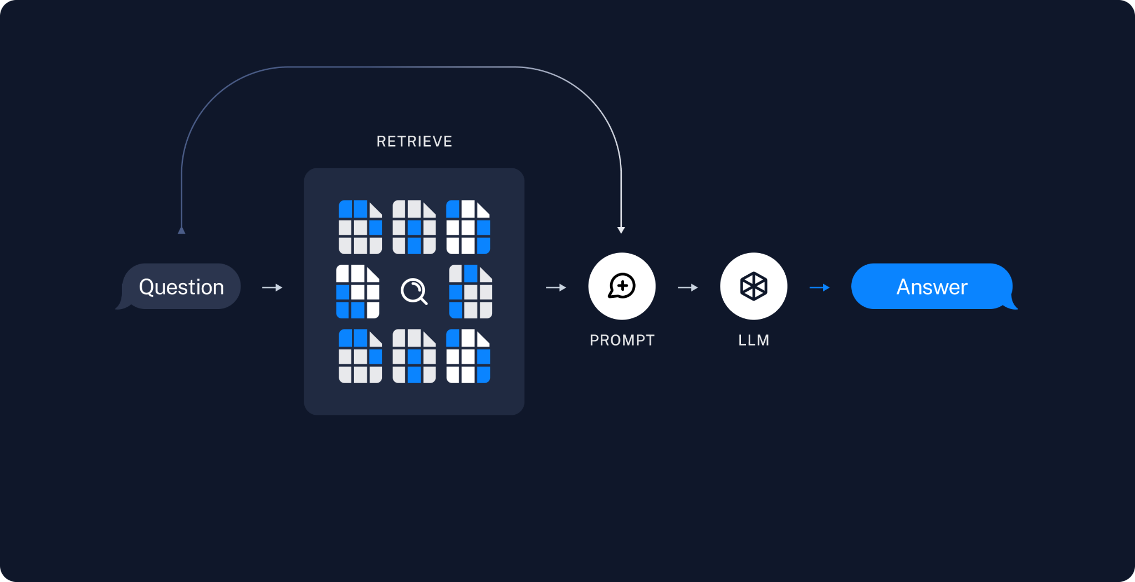
High-level Architecture

Slide 12
High-level Architecture
User Uploads PDF → Extracts text
Embeddings Stored in FAISS → Enables fast document retrieval
User Asks Question → Finds relevant text chunks
LLaMA3 Generates Response → Uses context to provide an answer
Response Sent to User → Through the Streamlit UI

Slide 13
Tech Stack

Slide 14
Tech stack
Languages & Frameworks:
Python – Core language
FastAPI – Backend API
Streamlit – Frontend UI
FAISS – Vector search
LangChain – NLP processing
LLaMA3 (Groq API) – AI response generation
Docker – Deployment

Slide 15
03
Model Selection
NLP & AI Model Selection approach

Slide 16
Why LLama 3?

Slide 17
Llama 3
State-of-the-art NLP model for generating responses.
Optimized for chat applications with strong contextual understanding.
Efficient inference via the Groq API.

Slide 18
Why FAISS?

Slide 19
FAISS
Scalable vector storage for fast retrieval.
Efficient for large datasets.
Improves chatbot accuracy with relevant context.

Slide 20
04
Workflow
NLP & AI Model Selection approach

Slide 21
Document Processing flow

Slide 22
Document Processing flow
User uploads a PDF.
Text is extracted using PDFPlumberLoader.
Text is split into chunks.
Embeddings are generated using HuggingFaceEmbeddings.
Stored in FAISS for retrieval.

Slide 23
Chatbot Workflow

Slide 24
Chatbot Workflow
User enters a question.
Query embedding is generated.
FAISS retrieves relevant text chunks.
LLaMA3 processes the question with context.
Response is displayed in chat UI.

Slide 25
05
Deployment & Usage
Step-by-step instruction

Slide 26
Deployment & Usage
Manual Setup:
Clone the repository and navigate to the project directory.
Install the necessary dependencies using pip install -r requirements.txt.
Set up the environment variable for the Groq API key.
Start the FastAPI backend using uvicorn backend:app --reload.
Start the Streamlit frontend using streamlit run main.py.

Slide 27
Deployment & Usage
Docker Deployment:
Build and run the Docker containers using docker-compose up --build.
Stop the containers using docker-compose down.

Slide 28
06
Live Demo

Slide 29
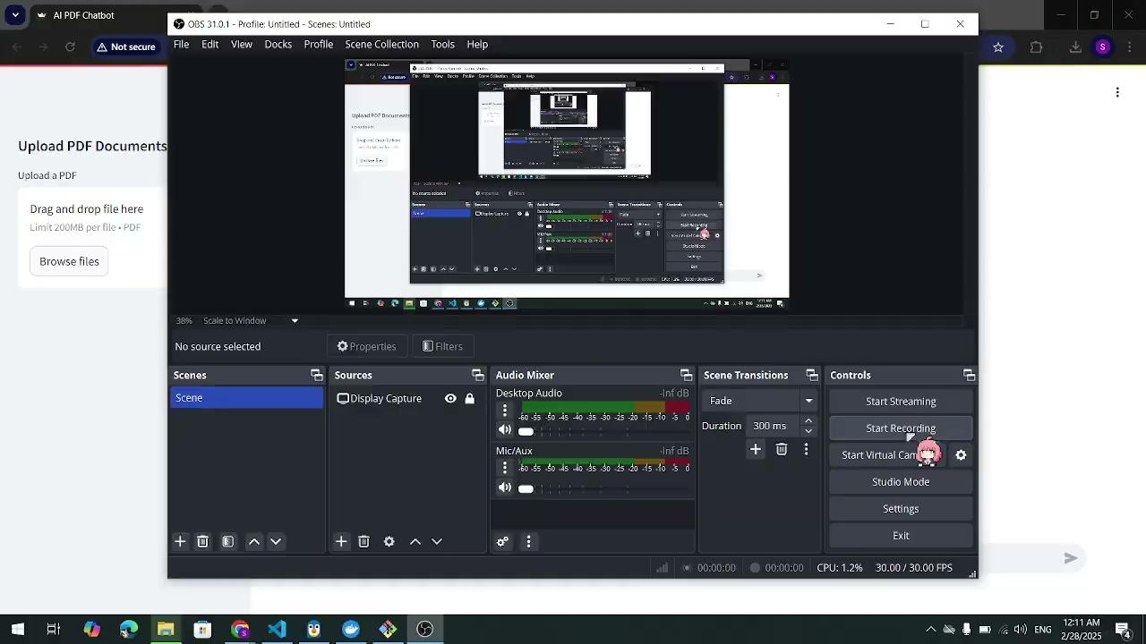

Slide 30
Thanks!

