Slide 1



Smart Career Guidance & Recruitment System
An intelligent system using AI, NLP, and Machine Learning to match students with optimal career paths and job opportunities through automated CV analysis
AI Analysis
NLP Processing
ML Models
CV Analysis
Deployment

Slide 2




Problem Statement
Students and job seekers face significant challenges in today's competitive employment landscape:
Career Path Confusion
Difficulty identifying suitable career paths aligned with skills and interests
Information Overload
Overwhelming number of job options and requirements to navigate
Skills Mismatch
Gap between academic knowledge and industry-required skills
Increasing Competition
Rising number of qualified candidates for limited positions
Manual Recruitment Processes
Traditional CV screening methods are time-consuming and often subjective

Slide 3



Proposed Solution Overview
The Smart Career Guidance & Recruitment System leverages advanced technologies to create personalized career recommendations:
AI-Powered Analysis
Intelligent processing of resumes and job descriptions using machine learning algorithms
Natural Language Processing
Advanced text analysis to extract skills, experiences, and qualifications from unstructured documents
Multi-Model Architecture
Classification, clustering, and similarity matching techniques working together for optimal results
Smart Recommendations
Data-driven career path suggestions and job opportunity matching with confidence scores
Interactive Web Platform
User-friendly-Streamlit-based application for resume upload, analysis, and recommendation review
System Components
Multi-Format CV Ingestion
PDF, DOCX, TXT, Images via OCR
NLP Text Processing & Analysis
Tokenization, Lemmatization, TF-IDF
Machine Learning Classification & Clustering
SVM, Logistic Regression, K-means
Recommendation Engine
Similarity Matching, Career Path Prediction
Engineered to bridge the gap between student capabilities and industry requirements

Slide 4








System Architecture
Key Components
CV Ingestion Layer
Supports multiple file formats (PDF, DOCX, TXT, images with OCR)
Resume/CV
PDF, DOCX, TXT,
Images
Preprocessing Engine
Text cleaning, normalization, tokenization, lemmatization
CV Ingestion & Parser
Multi-format support with OCR capability
NLP Analysis Module
Feature extraction, TF-IDF vectorization, semantic analysis
ML Model Stack
Classification (SVM, LogReg), Clustering (K-means)
Preprocessing Engine
Cleaning, Normalization, Tokenization, Lemmatization
Recommendation Engine
Cosine similarity matching, career path prediction
Web Interface
Streamlit application with interactive dashboard
NLP Module
Feature Extraction, TF-IDF, Word Frequencies
ML Processing
Classification & Clustering Models
Streamlit Web Application

Slide 5

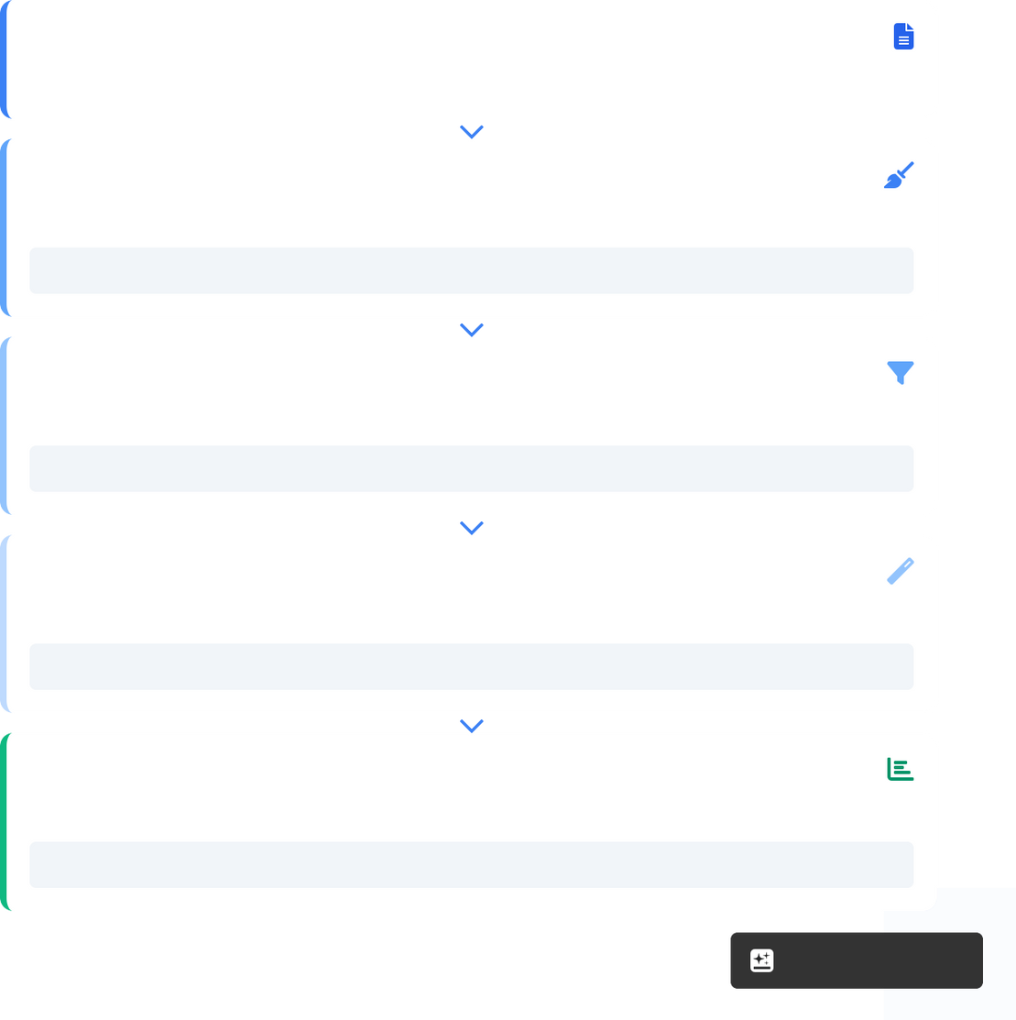

Data Processing & Cleaning Workflow
Our system implements a comprehensive text preprocessing pipeline to extract meaningful features from unstructured CV data:
Data Ingestion
Support for multiple file formats (PDF, DOCX, TXT) and OCR for image-based CVs
Text Normalization
Converting to lowercase, removing URLs, mentions, special characters, and excessive whitespace
Tokenization & Stopword Removal
Breaking text into tokens and filtering common words that don't add meaning
Lemmatization
Converting words to their base form using WordNetLemmatizer
Vectorization
Converting clean text into TF-IDF numeric features for model input
Why it matters: Quality preprocessing ensures accurate skill extraction, relevant feature representation, and improved model performance for career path recommendations.
Raw Resume Text
Unprocessed text with varied formats, URLs, special characters
Text Cleaning
Regex patterns for standardization
cleantxt = re.sub(r'http\S+\s', ' ', cleantxt)
Tokenization & Filtering
Breaking text into meaningful units
tokens = nltk.word_tokenize(cleantxt)
Lemmatization
Converting words to base form
lemmatizer.lemmatize(word) for word in tokens
TF-IDF Vectorization
Final feature representation for ML models
X = tfidf.transform(df['cleaned_resume'])
Made with Genspark

Slide 6



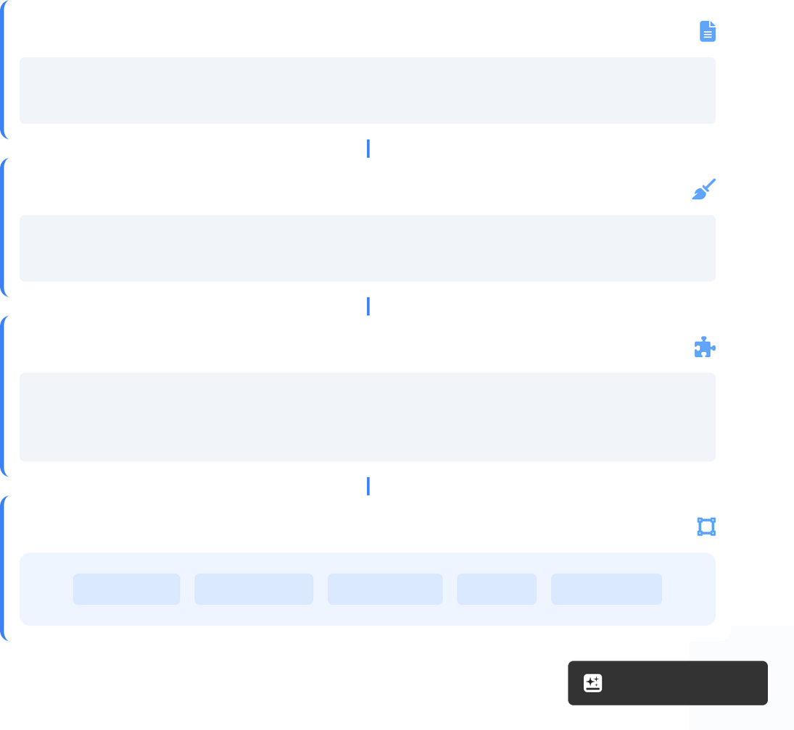



Natural Language Processing Techniques
Our system employs advanced NLP techniques to extract valuable insights from resumes and job descriptions:
NLP Processing Pipeline
Text Tokenization
Converting resume text into individual tokens using NLTK's tokenizer to identify words, phrases, and sentences
1. Raw Text Input
Stopword Removal
Eliminating common words (e.g., "the", "and", "is") that don't carry meaningful information
"10+ years Python experience, led machine learning projects at Tech Corp. Proficient in SQL, Pandas, scikit-learn. PhD in Computer Science."
Lemmatization
Reducing words to their base form using WordNetLemmatizer to standardize vocabulary
2. Cleaning & Normalization
"years python experience led machine learning projects tech corp proficient sql pandas scikit learn phd computer science"
Regex Cleaning
Using regular expressions to remove URLs, mentions, hashtags, punctuation, and special characters
3. Tokenization & Lemmatization
Feature Engineering
Converting processed text into TF-IDF vectors to capture keyword importance and context
["year", "python", "experience", "lead", "machine", "learning",
"project", "tech", "corp", "proficient", "sql", "pandas", "scikit", "learn", "phd", "computer", "science"]
4. Feature Extraction (TF-IDF)
python: 0.23
machine: 0.19
learning: 0.18
sql: 0.15
pandas: 0.14
Made with Genspark

Slide 7
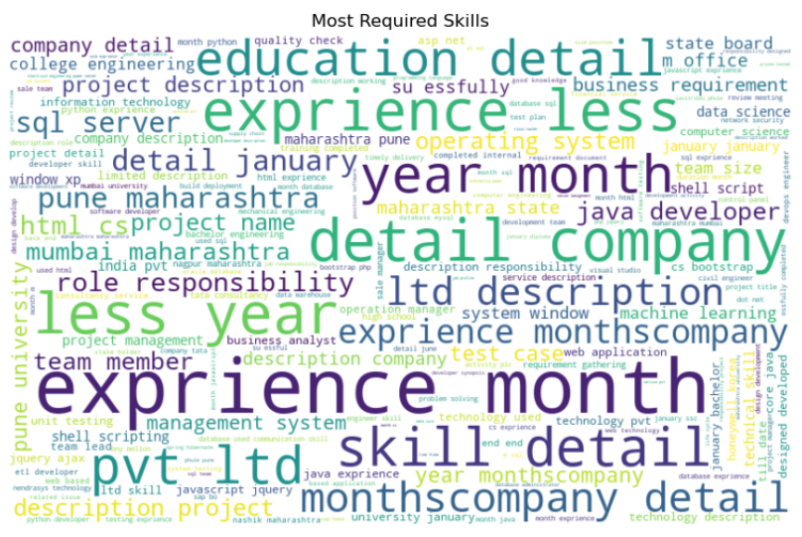

Exploratory Data Analysis :
Most Required Skills:
The word cloud highlights the most frequent terms in the job descriptions.
Larger words represent higher frequency.
For example, terms like experience, company, detail .

Slide 8
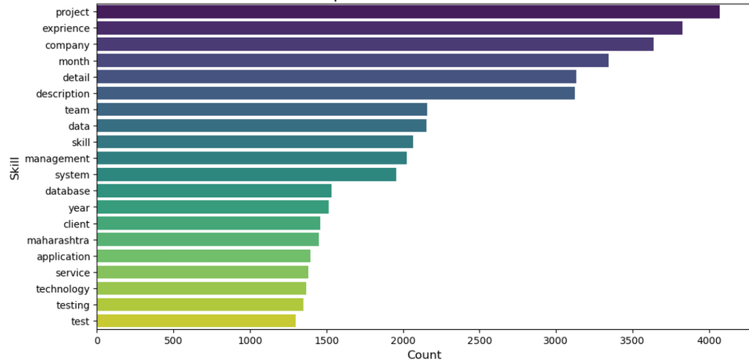

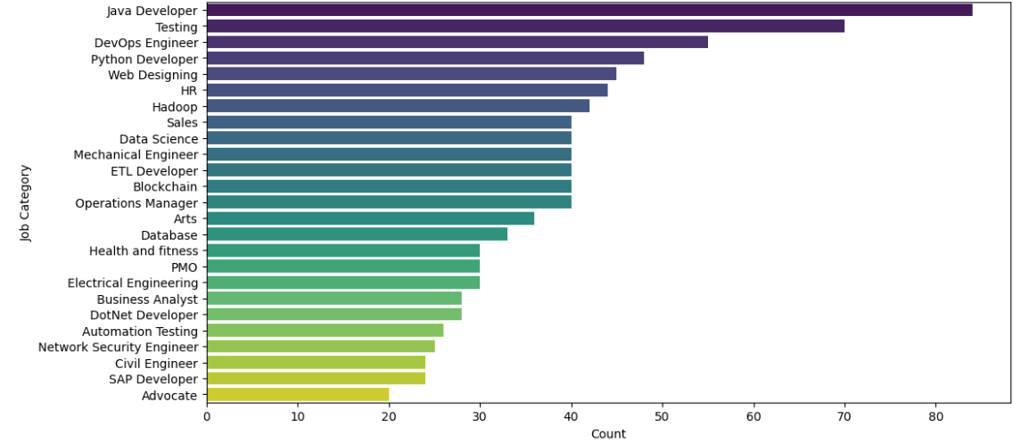
Exploratory Data Analysis :
Top 20 Most Common Skills:
The bar chart provides a clearer quantitative view of the top 20 most frequent skills.
It shows the exact count of each skill, making it easier to compare their importance.
The most mentioned skills include project, experience, company, month, detail
Distribution of Jobs by Category:
The bar chart shows the count of resumes in each job category.
It is clear that the highest categories are Java Developer, Testing, DevOps Engineer.
This makes it easy to compare which fields have the largest number of resumes.

Slide 9

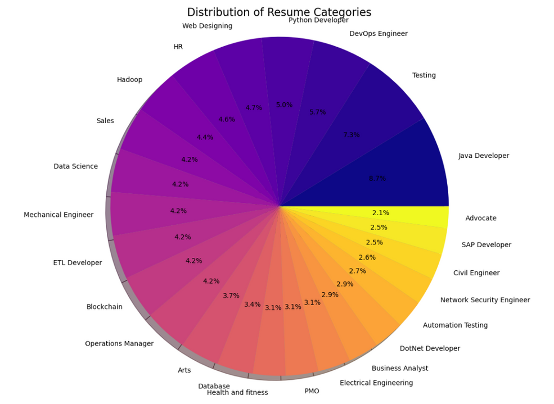
Exploratory Data Analysis :
Distribution of Resume Categories:
The pie chart shows the same data but in percentage form.
It provides a quick overview of the proportion of each job category within the dataset.

Slide 10

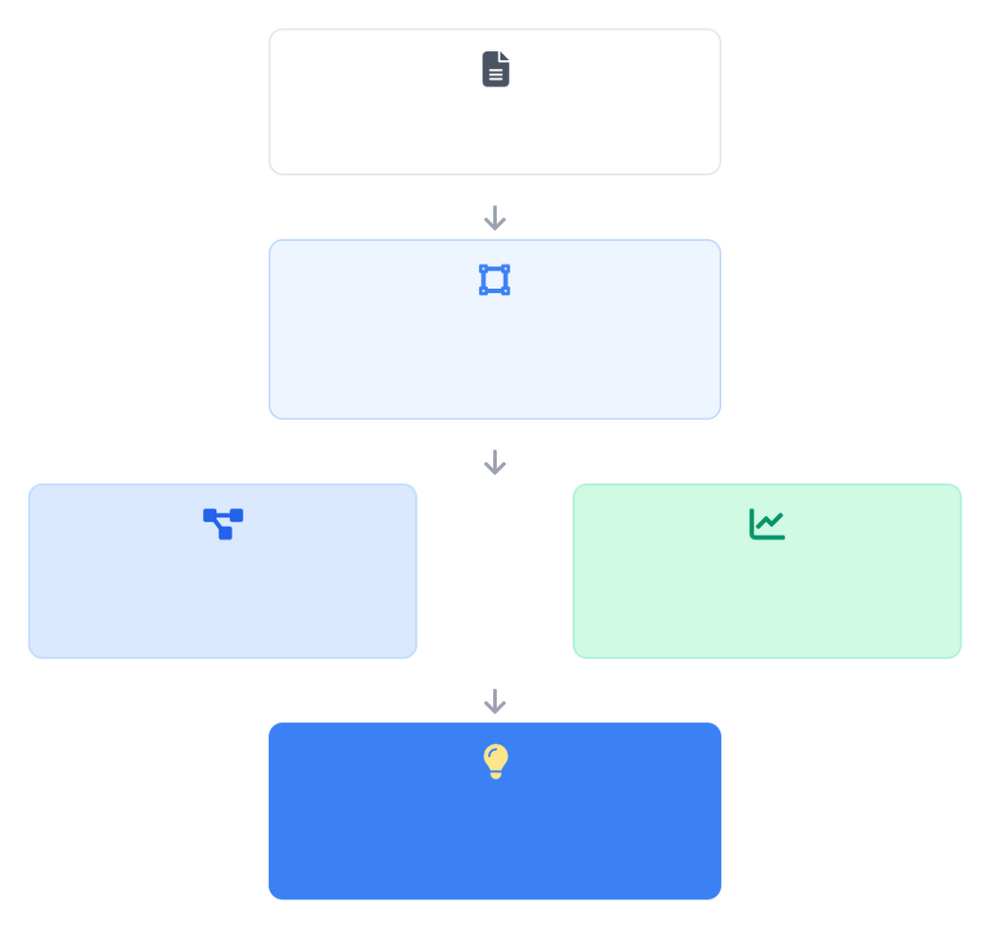
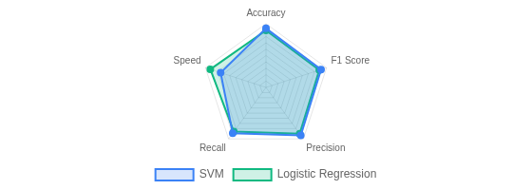
Machine Learning Models
Our system utilizes two powerful machine learning models for career path prediction, with TF-IDF vectorization to convert resume text to numerical features:
ML Pipeline Architecture
Support Vector Machine (SVM)
Resume Text
Linear kernel with probability output for confidence scoring
Decision boundaries optimize for maximum margin between classes
Handles high-dimensional sparse data effectively (ideal for TF-IDF)
Accuracy: 99.48% F1 Score: 0.99 Precision: 0.83~1
TF-IDF Vectorization
Converting text to numerical features
Logistic Regression
SVM Classifier
High accuracy
OR
Logistic Regression
Balanced performance
Balanced class weights to handle uneven category distribution
L2 regularization to prevent overfitting on training data
Computationally efficient with large datasets (4000 max iterations)
Accuracy: 99.48% F1 Score: 0.99 Precision: 0.83~1
Career Path Prediction
With confidence scores
Made with Genspark

Slide 11

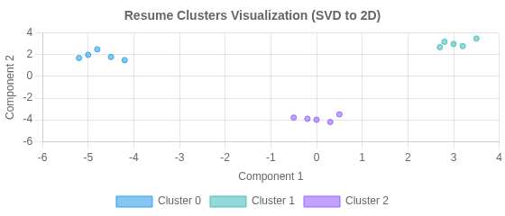


Resume Clustering Analysis
Our system employs unsupervised learning to group similar resumes, revealing patterns and enhancing job recommendations:
K-means Clustering
Groups similar resumes based on TF-IDF vectorized text features
Dimensionality Reduction
TruncatedSVD reduces feature space to 100 components while preserving semantic relationships
Optimal Cluster Selection
Silhouette scoring determines the optimal number of clusters (k=15)
Sample Clusters & Dominant Terms
Top Terms Extraction
Identifies key skills and keywords that define each cluster
Cluster 0: Data Science
Business Applications
Enables targeted career recommendations, trend analysis, and skill gap identification
python, data, machine learning, pandas, analysis, visualization, sklearn
Cluster 1: Web Development
javascript, html, css, react, node, api, frontend, development
Cluster 2: Management
project, management, team, leadership, strategy, business, stakeholder

Slide 12







Job Recommendation System
Our intelligent system matches students with job opportunities using multiple similarity metrics and personalized scoring:
1
Input Processing
Student CV/profile is processed through NLP pipeline
Personalized Matching
Uses student skills, experiences, and preferences to find best-fit opportunities
2
Category Prediction
Probability Scoring
Provides confidence scores for each career category recommendation
ML models predict suitable career categories with probability scores
Vector Similarity
Uses cosine similarity to find matching patterns between CVs and job descriptions
3
Similarity Matching
Vector representations find similar job descriptions
Multi-format Support
Processes PDF, DOCX, TXT, and even image-based CVs via OCR
Personalized Results
4
Top recommendations are returned with similarity scores
Explainable Recommendations
Highlights specific skills and experiences that led to each match
Sample Output
recommend_jobs(student_text, top_n=10, only_top_category=False)
Data Scientist
92% Match
Matching skills: Python, ML pipelines, pandas, scikit-learn
ML Engineer
87% Match
Matching skills: Python, NLP, TF-IDF, model deployment
Business Analyst
75% Match
Matching skills: Data visualization, SQL, insights
Made with Genspark

Slide 13











Technical Implementation
Implementation Pipeline
1. Data Ingestion
Multi-format CV processing via file upload interface
Extract text from various document formats OCR for image-based documents
Text normalization and standardization
Technology Stack
Python
Core programming language
NLTK
Natural Language Processing toolkit for text analysis
scikit-learn
Machine learning library for classification and clustering
Streamlit
Web framework for application deployment
PyPDF2 & DOCX
Document parsing libraries
Tesseract OCR
Optical Character Recognition for image processing
2. Processing Pipeline
Text cleaning and feature extraction
NLP processing with NLTK TF-IDF vectorization
Feature dimensionality reduction
3. Model Inference
Prediction and recommendation generation
Career path classification (SVM/LogReg) Resume clustering for insights
Job matching with cosine similarity
JPG/JPEG
PNG
4. Web Interface
Flask application for user interaction
CV upload interface
Interactive career recommendations Job matching visualization
Result explanations and insights
Made with Genspark

Slide 14



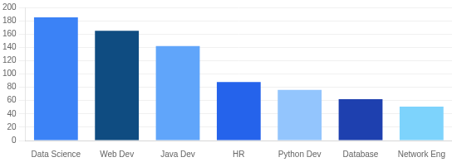
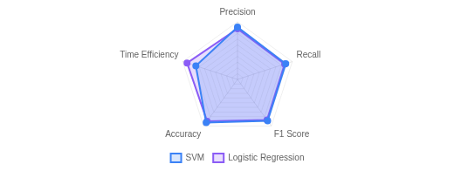

Results & Evaluation
Key Performance Metrics
Model Accuracy
Career Category Distribution
SVM Classifier
99.48%
Logistic Regression
99.48%
F1 Scores (Macro)
SVM Classifier
0.99
Logistic Regression
0.99
Model Comparison: Classification Report
Clustering Performance
Silhouette Score (k=15)
0.1175
CV Format Support
100% compatibility with PDF, DOCX, TXT and image formats
Top Career Category Prediction
Provides 3 most likely career paths with probability scores

Slide 15
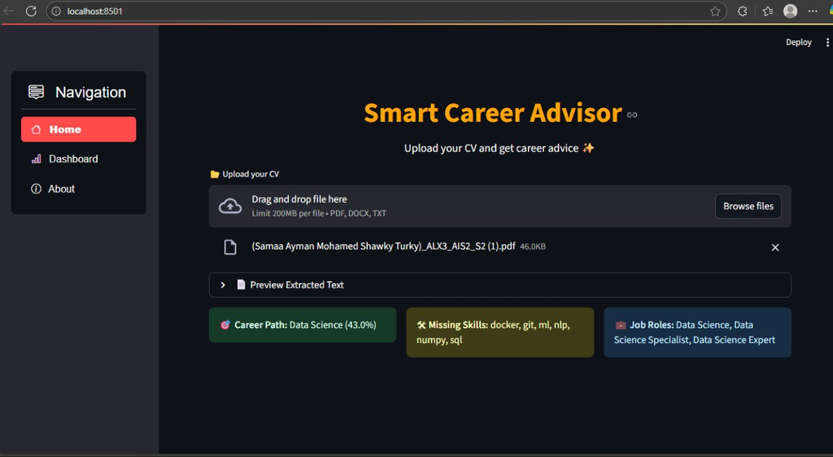


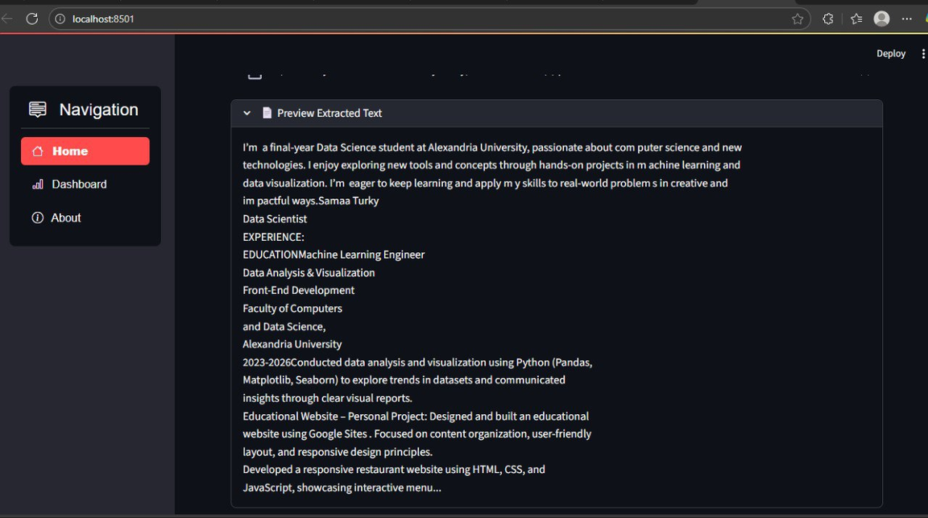

Streamlit Web Application Interface
CV Upload
Support for PDF, DOCX, and TXT formats with text extraction
Skills Gap Detection
Identifies missing skills needed for career advancement
Job Role Recommendations Suggests suitable job positions based on CV analysis

Slide 16
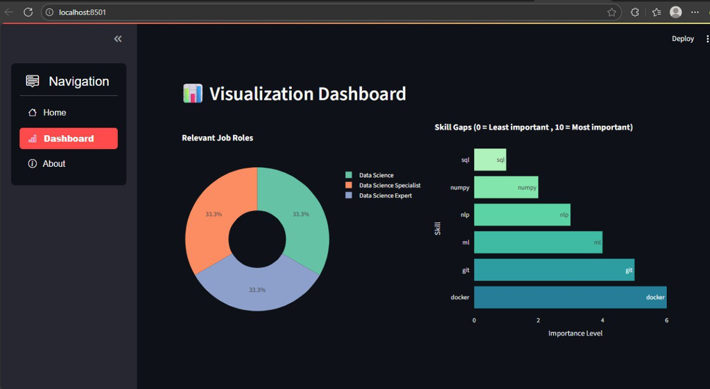
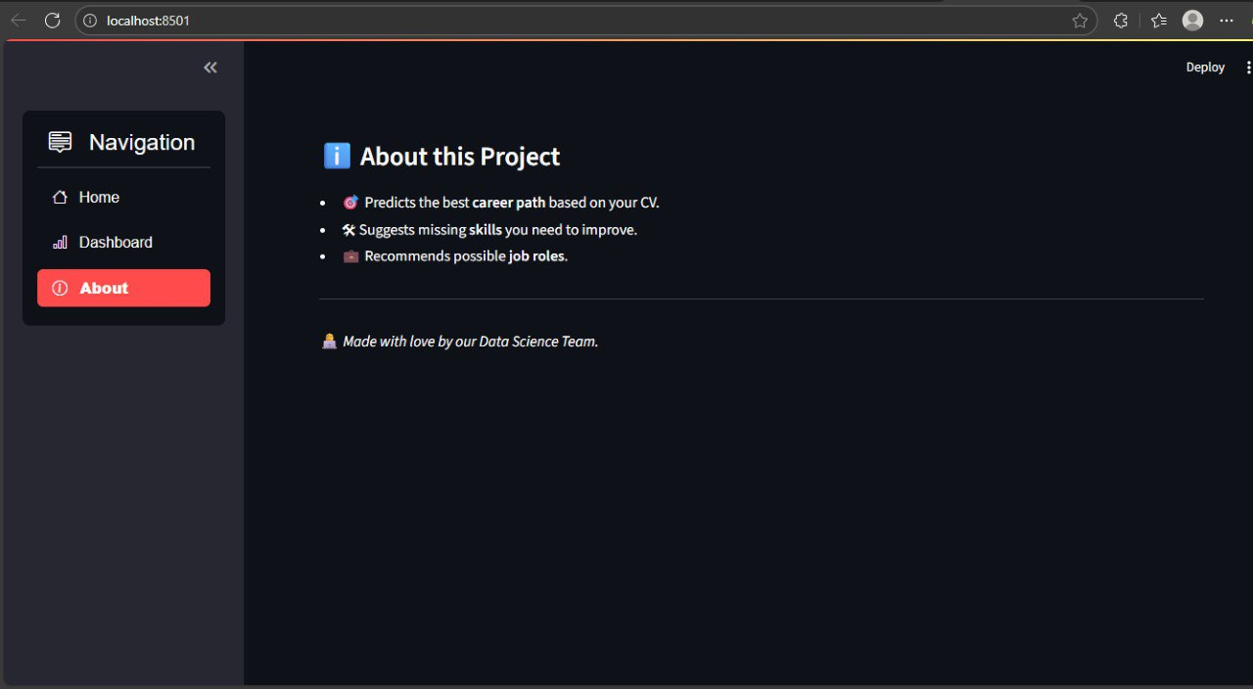
Streamlit Web Application Interface
Career Path Analysis
AI-powered career prediction with confidence score
About this App:
This tab provides an overview of the project, explaining its purpose, features, and how it helps users.

Slide 17

THANK YOU

