Slide 1
PREDICTION OF DRIFTED PERSONNEL OR ASSET
(NK825)
PROBLEM
STATEMENT
TEAM:
STAR TECHSI
ORGANIZATION
Indian National Centre for Ocean Information Services (INCOIS), Ministry of Earth Sciences
(MoES) .

Slide 2
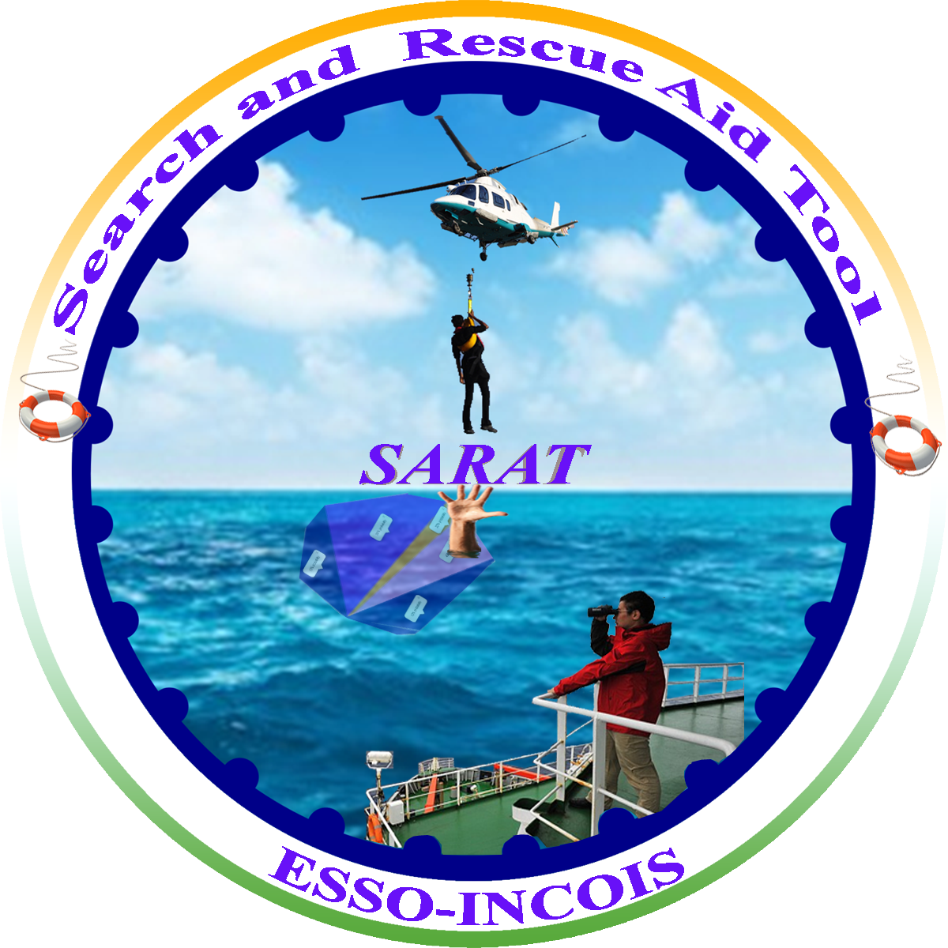
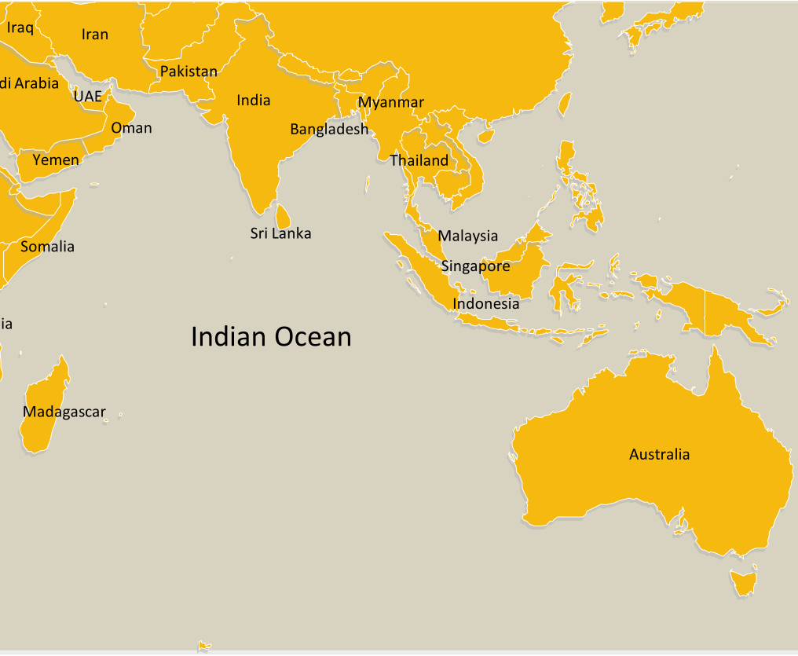
SARAT
Development of SARAT (Search And Rescue Aid Tool) to detect the object .
An effort has been made to make use of modern technology AIML to improve the prediction of drifted personnel or asset
We used Regression (LR) and time series analysis using Neural networks.
Parameters like latitude , longitude, last known time ,search time and object type are provided as input to predict the final possible location of the personnel or asset.
iNTRODUCTION

Slide 3
IDEA APPROACH
IMPLEMENTATION
FLUIDS CALCULATION
Model dependent on dataset
Lagrangian particle tracking
method
1.LINEAR REGRESSION
2.SVG
3.BAYESIAN REGRESSION
4. ROBUSTNESS REGRESSION
DEEP LEARNING

Slide 4



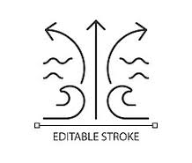


Parameters
CRUCIAL PARAMETERS
Pressure
Wave speed and direction
Wind speed and direction
Sea stress
Wave currents
Humidity

Slide 5
FLOW CHART & DEPENDENCIES
DATA FLOW
INPUTS:
1.Latitude:Latitude of the location , where the asset is lost. (Datatype – Float)
2.Longitude: Longitude of the location , where the asset is lost. (Datatype –Float)
3.Last-known time :It is the time where the asset is last seen.
4.Search time: It is the time at which we approach to search the asset
5. Object type: The type of the object which is lost in the ocean or sea
REGISTER
LAST-TIME
LAST-DESTINATION
DENSITY,WEIGHT,BUOYANCY
ALGORITHM
RESULT

Slide 6

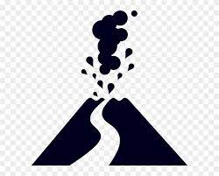




Pain Points
Rogue waves
Sudden climatic changes
During Natural disasters
Ship traffic
Fishes Migration
Heavy Ocean currents
Ocean garbage or garbage patch

Slide 7
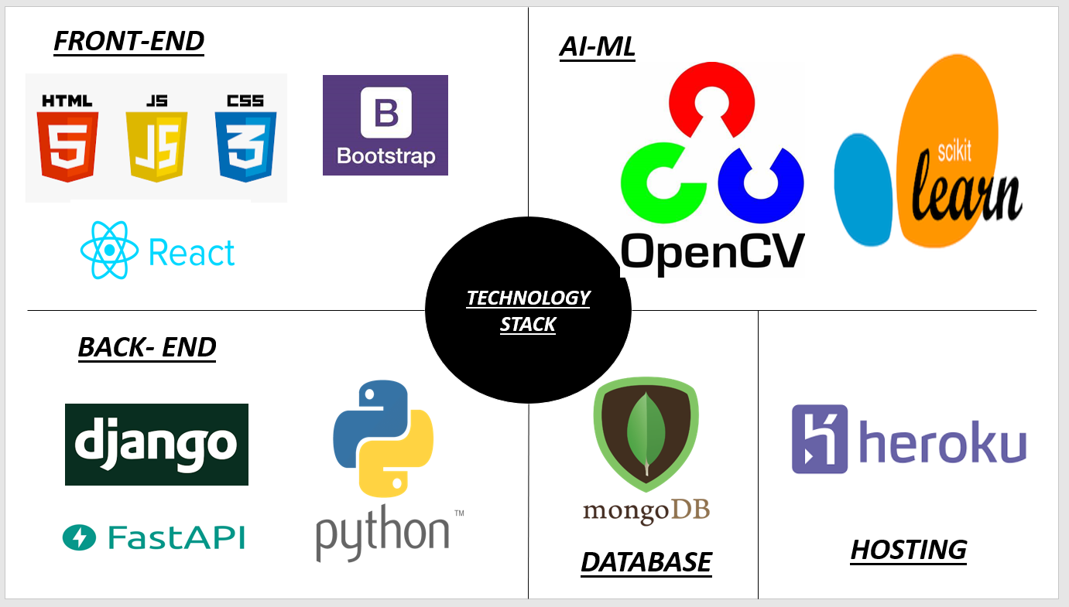
TECHNOLOGY
STACK

Slide 8

FUTURE DEVELOPMENT
Fish Migration Data Integration
Adding more weather dependencies APIs
3
2
Thermal Image Star
6
4
2
Maritime Traffic Integration
1
5
5
4
Use of commercial Satellite
Search And Rescue Operation using drones
6

Slide 9
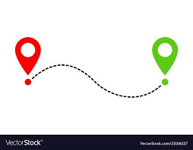
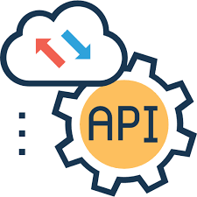

To DO’s
Phase 1
(Path Tracking)
Finding the possible trajectories to find the final destination of the lost asset/person
Phase 1
Phase 2
(Maritime Traffic)
Integration of Maritime operation.
Vessel Traffic Services (VTS)
Phase 2
(Satellite)
Phase 3
Use Satellite service using for high value assets
In collaboration with domestic and international partners.
Phase 3
Phase 4
Deploy drones to find the high value assets in possible trajectories.
Real time image processing
Phase 4

Slide 10
THANK YOU!!

