Slide 1
SSA DIGITAL TECHNOLOGY ASSETS
Mahesh
Salesforce App and Objects creation
Javascript
Salesforce IoT
Salesforce Packaging
Communities
Reports and Dashboards
Salesforce Health Cloud
Data Loader
Einstein Analytics
Data Security

Slide 2
SSADIGITAL TECHNOLOGY ASSETS
Nikhil
Heroku
Package.json
VM
HTML
CSS
Tooltip
Repository
SQL
Logic App
i18n

Slide 3
SSADIGITAL TECHNOLOGY ASSETS
Priya
MongoDB
Json
Node.js
Charts
Model Derivatives
Mongoose
Gitbash
Toolbar
Viewer V7
Creating a Local host

Slide 4
SSADIGITAL TECHNOLOGY ASSETS
Phani
Autodesk Forge
MySQL
PHP
Bootstrap
jQuery
PowerShell
Ajax
HTML Canvas
Repl.it with JavaScript
Data Management

Slide 5
SSADIGITAL TECHNOLOGY ASSETS
Samad
Azure
Creating IoT Hub
IoT Device
Creating Blob storage
Viewing the output(Telemetry messages)by running Raspberry Pi
Azure Stream Analytics job by Azure Portal
Azure Stream Analytics job by Visual Studio
Sending the alerts regarding Telemetry messages to mobile and Mail-id
Downloading the Telemetry message data file into CSS or json file and connecting to Power BI
Creating repository in GitHub
Importing Excel file into Power BI and making visualization
Connecting MySQL to Power BI
Creating real time charts and graph in Power BI using pub-nub
Create an app in Power Apps.

Slide 6
SSADIGITAL TECHNOLOGY ASSETS
Sameer
Repl.it
Python
Machine learning
IDE
Jupiter
Cloud Customization
Role and Role Hierarchies in Salesforce
Agile Methodologies
Data Models in Salesforce
Relationships in Salesforce

Slide 7
SSA-Technology Assets Road Map
Plan Agenda /Topics for Workshops
Schedule the Workshops
Wednesday 1st July 2020
2.00PM to 3.00PM Brain storm the topics (samad)
3.00PM to 3.30PM Tea/coffee break
3.30PM to 4.30PM Organize the topics
4.30PM to 5.00PM Break
5.00PM to 6.00PM Organize the topics

Slide 8
SSA-Technology Assets Road Map
Plan Agenda /Topics for Workshops
Schedule the Workshops
Thursday 2nd July 2020
10.00 AM to 11.00 AM IoT Architecture( Azure, Salesforce, AWS)(samad, Mahesh, sameer)
11.00AM to 11.30AM Tea/coffee break
11.30 AM to 12.30 PM Cyber security (All Team Members)
2.00PM to 3.00PM Core concepts and technology (Priya , Nikki & Phani)
3.00PM to 3.30PM Break
3.30PM to 4.30PM Server side concepts and technologies (Priya , Nikki & Phani)
4.30PM to 5.00PM break
5.00PM to 6.00PM Client side concepts and technologies (Priya , Mahesh & Phani)

Slide 9
SSA-Technology Assets Road Map
Plan Agenda /Topics for Workshops
Schedule the Workshops
Friday 3rd July 2020
10.00 AM to 11.00 AM Machine learning concepts and technology( Sameer & Sharma sir)
11.00AM to 11.30AM Tea/coffee break
11.30 AM to 12.30 PM Infrastructure and Operations setup (Nikki , Samad, Sameer)
12.30PM to 2.00PM lunch
2.00PM to 3.00PM Data Analytics and Data Visualization (Mahesh & samad)
3.00PM to 3.30PM Break
3.30PM to 4.30PM Platforms( Azure, Salesforce, Heroku, AWS) (All team members)
Salesforce by Aditya
4.30PM to 5.00PM break
5.00PM to 6.00PM Consolidate the workshops outcomes and next steps

Slide 10
Brain storming-(What do we have today)
Data triage
Tool tip
Model derivative
Net works
Power shell
Bootstrap,HTML,CSS
Cloud computing
Oath
Agile methodology
Schema builder
J query
Auto desk forge
Power BI
mongoose
My sql work bench
WIFI
Azure ML
AF API’s
Azure IoT
Health cloud
GitHub
Ajax
Virtual machine
Admin
Azure API”S
PHP
Data modelling
Trail head
Azure Board
customization
JavaScript
Git bash
AWS
json
Bluetooth
Data Analytics
Logic apps
SF Data loader
IDE
Artificial intelligence
Data visualization
MY SQL
Health cloud
Mongo db
Einstein Analytics
IoT central
I 18 n
Testing
Excel,word,power point
SF packaging
Python
Cyber security
CLI
Cdin libraries
VS ,VSC
Apex
Blob storage
Salesforce IoT
subscription
Unity and unreal
Machine learning
Heroku
Salesforce forum
mdm libraries
Nopde.js
Role hierarchy
Access control
Containers & dockers
Test review
AR/VR
Power Apps
Repl.it
JavaScript libraries
SDK’S
Azure
SDK’S
Heroku
SDK’S
Heroku
Sand box
Aurdino
rasbpery
SDK’S
Test automation
Postgre

Slide 11
Brain storming-(What do we have today)
Azure IoT
Power BI
Azure Board
Data triage
rasbpery
Net works
AWS
VS ,VSC
AR/VR
Auto desk forge
AF API’s
Data Analytics
Data visualization
Azure ML
subscription
Bluetooth
Cyber security
Repl.it
Aurdino
WIFI
OAuth
GitHub
Git bash
Artificial intelligence
Power Apps
Model derivative
Virtual machine
Azure API”S
Logic apps
Cdin libraries
Cloud computing
Sand box
MY SQL
Heroku
SF packaging
Einstein Analytics
Machine learning
Testing
IoT central
SDK’S
Azure
mdm libraries
Mongo db
Trail head
Containers & dockers
Role hierarchy
Salesforce IoT
Data modelling
Test automation
JavaScript libraries
Unity and unreal
Postgre
customization
CLI
Salesforce forum
Admin
community
I 18 n
Apex
Test review
mongoose
SDK’S
Blob storage
SF Data loader
Access control
Power shell
Health cloud
Schema builder
Agile methodology
J query
SDK’S
Heroku
PHP
Excel,word,power point
IDE
json
Bootstrap,HTML,CSS
JavaScript
Tool tip
Nopde.js
Python
Ajax

Slide 12
Einstein Analytics
Event
monitoring
Data modelling
Schema builder
Trail head
Salesforce IoT
Apex
Raspberry-pi
Azure IoT
Azure Board
SF Data loader
Admin
SF packaging
IoT central
community
Azure API”S
Azure ML
Data triage
Data security
subscription
Health cloud
Salesforce forum
Process builder
Logic apps
Virtual machine
Arduino
SDK’S
Azure
Sand box
Containers & dockers
Aura components
Visual force page
Lightning flow
Connected App
Salesforce connect

Slide 13
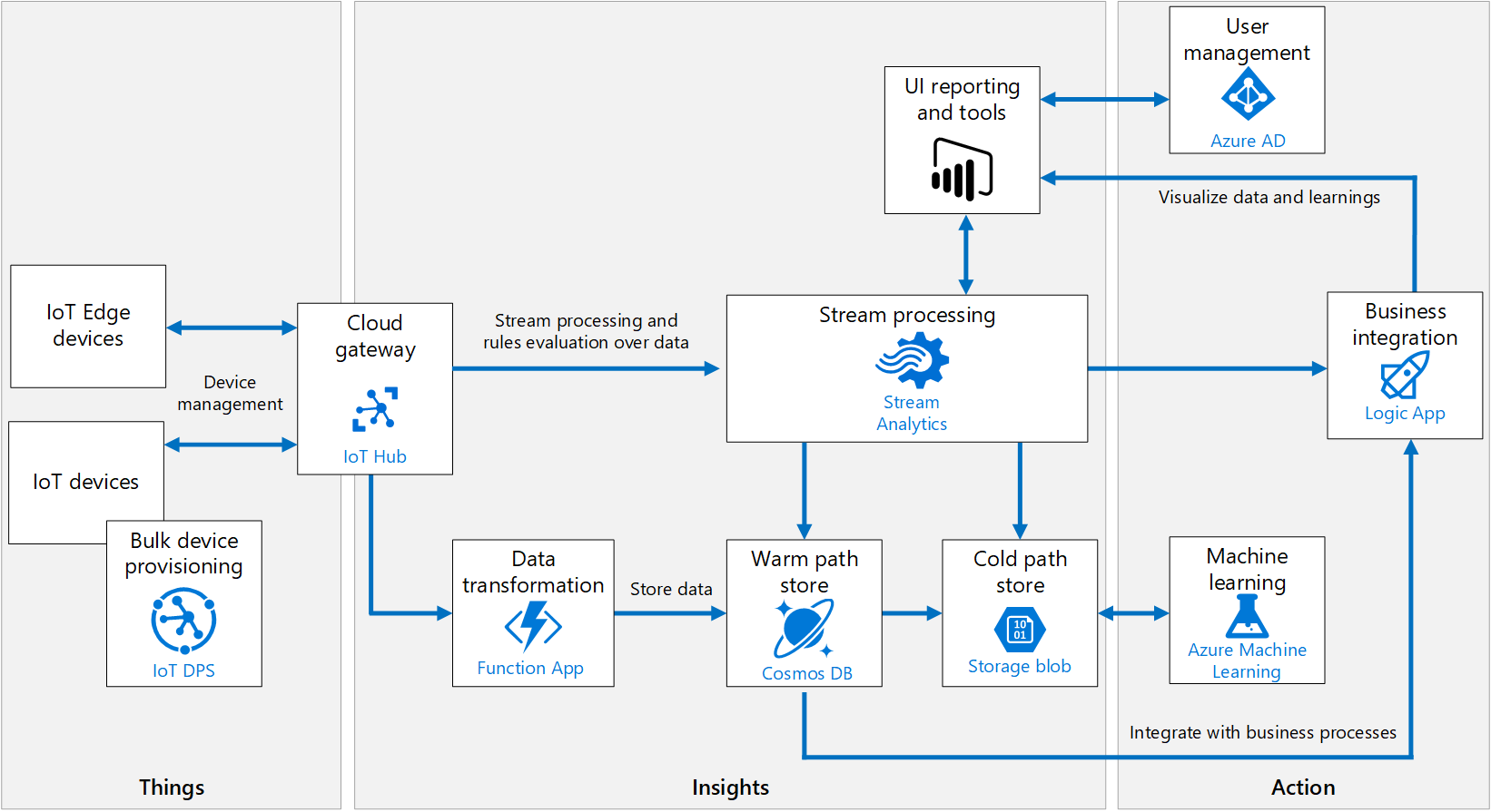

Slide 14
User Management
UI reporting and Tools
Azure AD
Power BI
Visualize data and learnings
IoT Edge Devices
Cloud Gateway
Stream processing and rules evaluation over data
Stream Processing
Business Integration
Device Management
IoT Devices
IoT Hub
Stream Analytics
Logic App
IoT Hub
Bulk Device Provisioning
Data Transformation
Warm Path Store
Cold Path Store
Machine Learning
Store Data
IoT DPS
Azure Machine Learning
Function App
Cosmos DB
Storage blob
Integrate with business process
Things
Insights
Actions

Slide 15
Technology-understanding Rubric
Rating | Criteria
1 | End–to-end understanding of the terms of the concept
2 | End–to-end understanding of the terms of the concept Present documented description of the end–to-end concept along with examples
3 | End–to-end understanding of the terms of the concept Present documented description of the end–to-end concept along with examples Present documented analysis of the end–to-end concept along with examples and tools
4 | End–to-end understanding of the terms of the concept Present documented description of the end–to-end concept along with examples Present documented analysis of the end–to-end concept along with examples and tools Implement end-to-end concept
5 | End–to-end understanding of the terms of the concept Present documented description of the end–to-end concept along with examples Present documented analysis of the end–to-end concept along with examples and tools Implement the end-to-end concept of the example Present the implemented end-to-end concept of the example

Slide 16
Time in India Daily Schedule for ….
09.00AM to 10.00AM Starting
10.00AM to11.00AM Daily catch up call
12.30PM to13.30PM Auto Desk Forge
15.30PM to16.30PM Azure
16.30PM to17.30PM Salesforce
17.30PM to18.30PM call with Aditya

Slide 17
Technology-understanding Rubric
Current Rating | Technology topics | Achieve Rating
1 | Cyber security | Rating of 2 by 15th of July 2020 Rating of 3 by 31st July 2020
1 | Client-Server Architecture | Rating of 2 by 20th July 2020 Rating of 3 by 15th Aug 2020 Rating of 4 by 1st Sept 2020
1 | Cloud Architecture
1 | Infrastructure set up
1 | Client-side technology(HTML, CSS, JavaScript, Bootstrap , Node.js) | Rating of 2 by 20th July 2020 Rating of 3 by 15th Aug 2020 Rating of 4 by 1st Sept 2020
1 | Server-side technology(Mongo DB) | Rating of 2 by 15th July 2020 Rating of 3 by 31st July 2020 Rating of 4 by 15th Aug 2020

Slide 18
Technology-understanding Rubric
Current Rating | Technology topics | Achieve Rating
1 | Salesforce IoT Architecture | Rating of 2 by 15th July 2020 Rating of 3 by 15th Aug 2020
1 | Salesforce Basics App creation Objects Fields Relationships Page Layouts | Rating of 3 by 15th of July 2020
1 | Communities Data Security | Rating of 3 by 20th of July 2020
1 | Data Import and Export Packaging | Rating of 3 by 25th of July 2020
1 | Einstein Analytics Reports And Dashboards | Rating of 3 by 30th of July 2020
1 | Health Cloud, Sales Cloud, Service Cloud | Rating of 3 by 8th of Aug 2020

Slide 19
Technology-understanding Rubric
Current Rating | Technology topics | Achieve Rating
1 | Azure IoT Architecture Things IoT Device IoT Edge Device Bulk Device provisioning Device management Cloud Gateway/IoT Hub | Rating of 3 by 25th July 2020
 | Insights Data Transformation(Function App) Warm Path(Cosmo DB) Cold Path(Storage Blob) Stream Processing(Stream Analytics) UI reporting and tools(Power BI) | Rating of 3 by 30th Aug 2020
 | Actions Machine Learning Business Integration(Logic App) User Management(Azure Ad) | Rating of 3 by 15th Sep 2020

Slide 20
July | August | September | October | November | December
Cyber Security
Client-server Architecture
Client-side technology (HTML, CSS, JavaScript, Bootstrap , Node.js) | Client-side technology (HTML, CSS, JavaScript, Bootstrap , Node.js) | Client-side technology (HTML, CSS, JavaScript, Bootstrap , Node.js)
Server side-technology Mongo DB | Server side-technology Mongo DB
Cloud architecture
Infrastructure set up
Machine Learning

Slide 21
July | August | September | October | November | December
Salesforce Salesforce IoT Architecture Salesforce Basics App creation Objects Fields Relationships Page Layouts Communities Data Security Data Import and Export Packaging Einstein Analytics Reports And Dashboards | Salesforce Health Cloud, Sales Cloud, Service Cloud

Slide 22
July | August | September | October | November | December
Azure | Azure | Azure
Things IoT Device IoT Edge Device Bulk Device provisioning Device management Cloud Gateway/IoT Hub | Insights Data Transformation (Function App) Warm Path (Cosmo DB) Cold Path (Storage Blob) Stream Processing (Stream Analytics) UI reporting and tools (Power BI) | Actions Machine Learning Business Integration (Logic App) User Management (Azure Ad)

Slide 23
Knowledge 40%
20 Q with 2 marks each
Understanding 40%
5 Q with 8 marks each
Applying 20%
1Q with 20 marks each
Nikhil,priya,
15 days for knowledge,10 days for understanding, 5 days for applying.
Mahesh,samad,phani
10 days for knowledge,15 days for understanding, 5 days for applying.
sameer
8 days for knowledge,8 days for understanding, 8 days for applying.

