Slide 1
Tamil ASR & Translation
Evaluation
Tamizh Internship - Round 2
Project 1: Translation Evaluation
Project 2: ASR + Transliteration

Slide 2
Project Overview
Project 1
Project 2
Evaluation of Indic Translation Models
ASR-Based Transcription & Transliteration
Part A: Batch Translation & sacreBLEU
Part B: Token-Based Comparative Analysis
Part C: Indic Token Behavior Analysis
Dataset: FLORES-200 devtest (1,012 sentences)
Models: 5 translation models
ASR: openai/whisper-medium
Transliteration: custom Tamil-aware ASCII romanizer
Interface: Gradio (port 7860)
Buffer: chunked (≤30 s) + queue.Queue(maxsize=10), bounded batches
Deploy: Docker + docker-compose
Tests: 20/20 passed

Slide 3
Project 1 — Dataset & Setup
Dataset — FLORES-200
5 Models Compared
Source: FLORES-200 devtest split
Total: 1,012 sentences
Used: 100 (Part A), 10 (Parts B & C)
Domains: wikinews, wikibooks, wikivoyage
Ref: Human-verified Tamil translations
Label | HuggingFace ID
IndicTrans2 | ai4bharat/indictrans2-en-indic-1B
NLLB-600M | facebook/nllb-200-distilled-600M
mT5-base | google/mt5-base
OpusMT-mul | Helsinki-NLP/opus-mt-en-mul
MADLAD-3B | google/madlad400-3b-mt
⚠ Model Substitution Notes
opus-mt-en-ta → opus-mt-en-mul
Model does not exist on HuggingFace.
en-mul uses the same MarianMT architecture and supports Tamil as target.

Slide 4
Project 1 — Methodology
Part A — Batch Translation & sacreBLEU
Part B — Token-Based Comparative Analysis
Part C — Indic Token Behavior
Model: ai4bharat/indictrans2-en-indic-1B (1B params, loaded once)
Preprocessor: AI4Bharat IndicProcessor (eng_Latn → tam_Taml)
Input: First 100 English sentences (FLORES-200 devtest)
Metric: sacreBLEU corpus score + BP + length ratio
Outputs: translation_outputs.csv, sacrebleu_results.csv
Scope: 5 tokenizers × 10 English sentences
Metrics: source_token_count, target_token_count
expansion_ratio = target / source
avg_word_length, subword_fragmentation, unknown_token_rate
EDA: histogram, boxplot, scatter, bar chart
Scope: Same 5 tokenizers on Tamil reference sentences
Metrics: chars/token, Unicode fragmentation rate
rare-token rate, Tamil vocab coverage
Memory: Illustrative footprint (hidden=768, fp32)
Outputs: 6 plots under part_c_indic_token_behavior/plots/

Slide 5
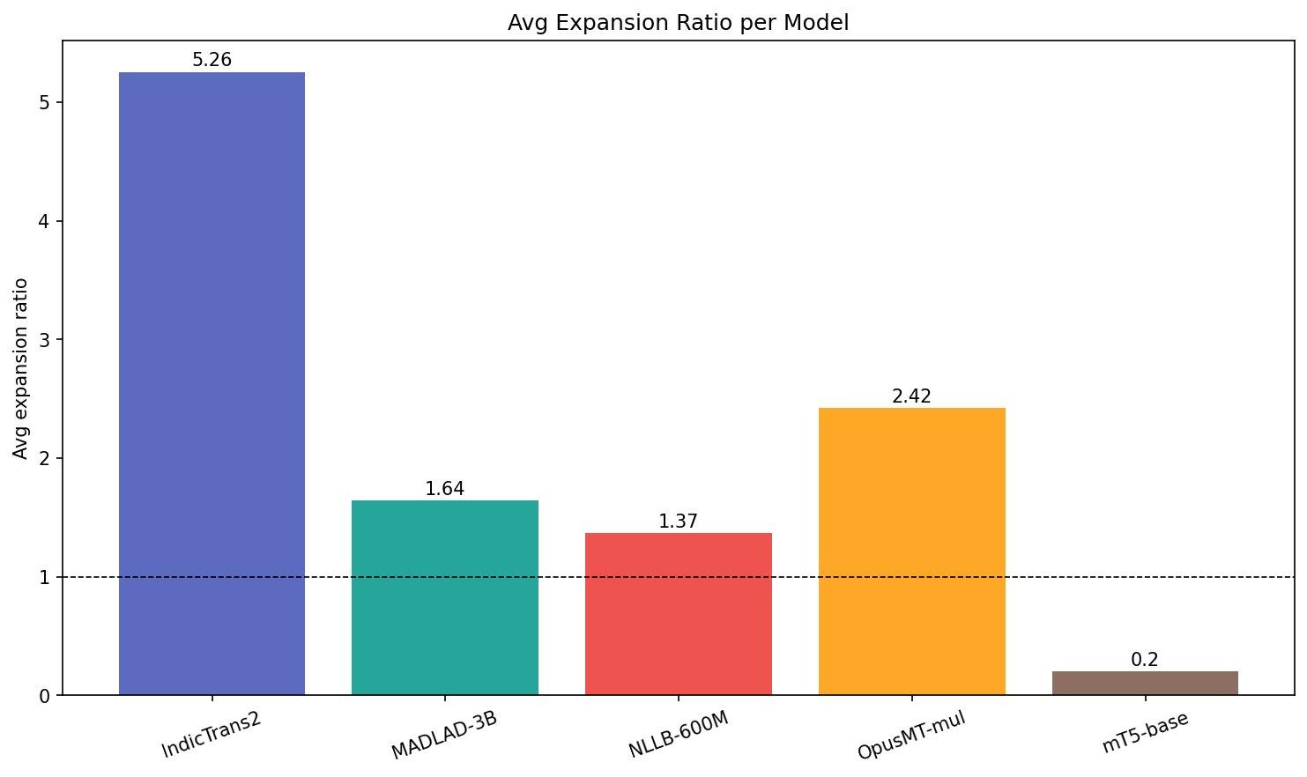
Project 1 — Results Summary
Part A
Part B — Token Expansion Ratio
sacreBLEU Score
Model | Avg Expansion | Valid Tamil
IndicTrans2 | 5.256 | ✅
NLLB-600M ★ | 1.366 (lowest valid) | ✅
MADLAD-3B | 1.641 | ✅
OpusMT-mul | 2.421 | ✅
mT5-base | 0.200 ⚠ (not MT) | ❌
22.42
GOOD range (15–25)
BP: 0.9638
Ratio: 0.9645
Part C — Indic Token Behavior
Model | Chars/Tok | Frag | Mem(MB)
IndicTrans2 | 1.004 | 0.861 | 102.3
NLLB-600M ★ | 3.035 | 0.241 | 9.1
mT5-base | 3.097 | 0.148 | 8.8
OpusMT-mul | 0.929 | 0.850 | 96.1
MADLAD-3B | 2.678 | 0.237 | 11.6
Fig: Avg expansion ratio per model (Part B)

Slide 6
Key Insights — Project 1
01
Tokenizer Efficiency ≠ Translation Quality
02
IndicTrans2 — Best Translation Quality
mT5-base ranks best on tokenizer metrics but produces invalid Tamil translations. IndicTrans2 achieves BLEU 22.42 despite high token counts due to internal romanization.
sacreBLEU 22.42 (BP 0.9638, ratio 0.9645). IndicProcessor romanization explains high token counts — not a vocabulary weakness.
03
NLLB-600M — Best Real-World Balance
04
OpusMT-mul — Avoid for Tamil NLP
Lowest expansion (1.366) among valid models. 89.1% Tamil token ratio. SentencePiece on 200+ languages gives strong Tamil subword coverage.
85% single-character Unicode fragmentation. 96 MB memory — 11× more than NLLB. English-centric BPE not suited for Tamil's agglutinative morphology.

Slide 7
Project 1 — Why These Results?
1
Tamil is Agglutinative
2
SentencePiece vs BPE
One Tamil word bundles tense, case, number, and politeness that English expresses as multiple words. European-text tokenizers don't learn long Tamil subword units — structural reason for consistently higher token counts.
NLLB / mT5 / MADLAD use SentencePiece on raw Unicode — keeps multi-char Tamil graphemes together (~3 chars/token, low fragmentation). OpusMT uses Marian BPE built on Latin-script data — falls back to character splits on Tamil (0.93 chars/token, 85% single-codepoint).
3
IndicTrans2 — High Tokens by Design
4
Vocabulary Coverage → Memory Cost
IndicProcessor romanizes Tamil input before tokenization. Externally looks worst (1.0 chars/token, 0.86 fragmentation) but still wins sacreBLEU 22.42. High token count is a preprocessing artifact, not a vocabulary weakness.
Tamil-aware SentencePiece vocab (NLLB/mT5/MADLAD): 9–12 MB. Fragmenting vocab (IndicTrans2/OpusMT): ~100 MB — ≈10× more. Token explosion also increases attention compute as sequence_length².

Slide 8
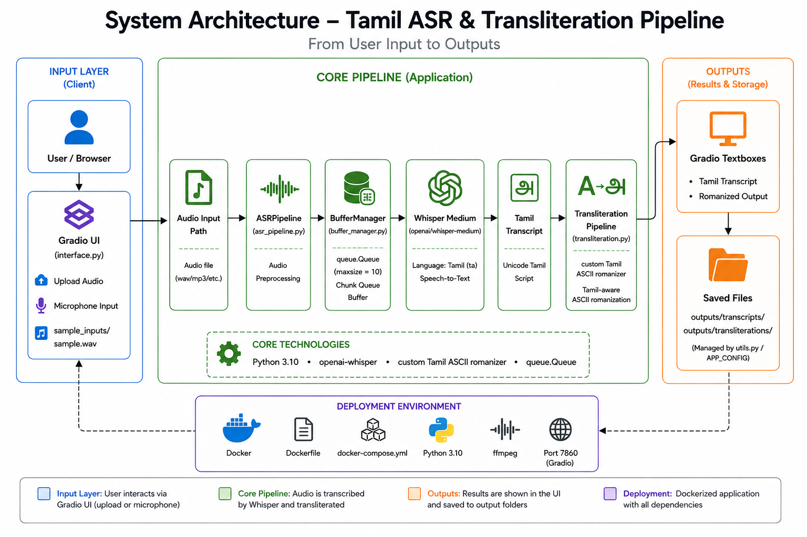
Project 2 — System Architecture

Slide 9
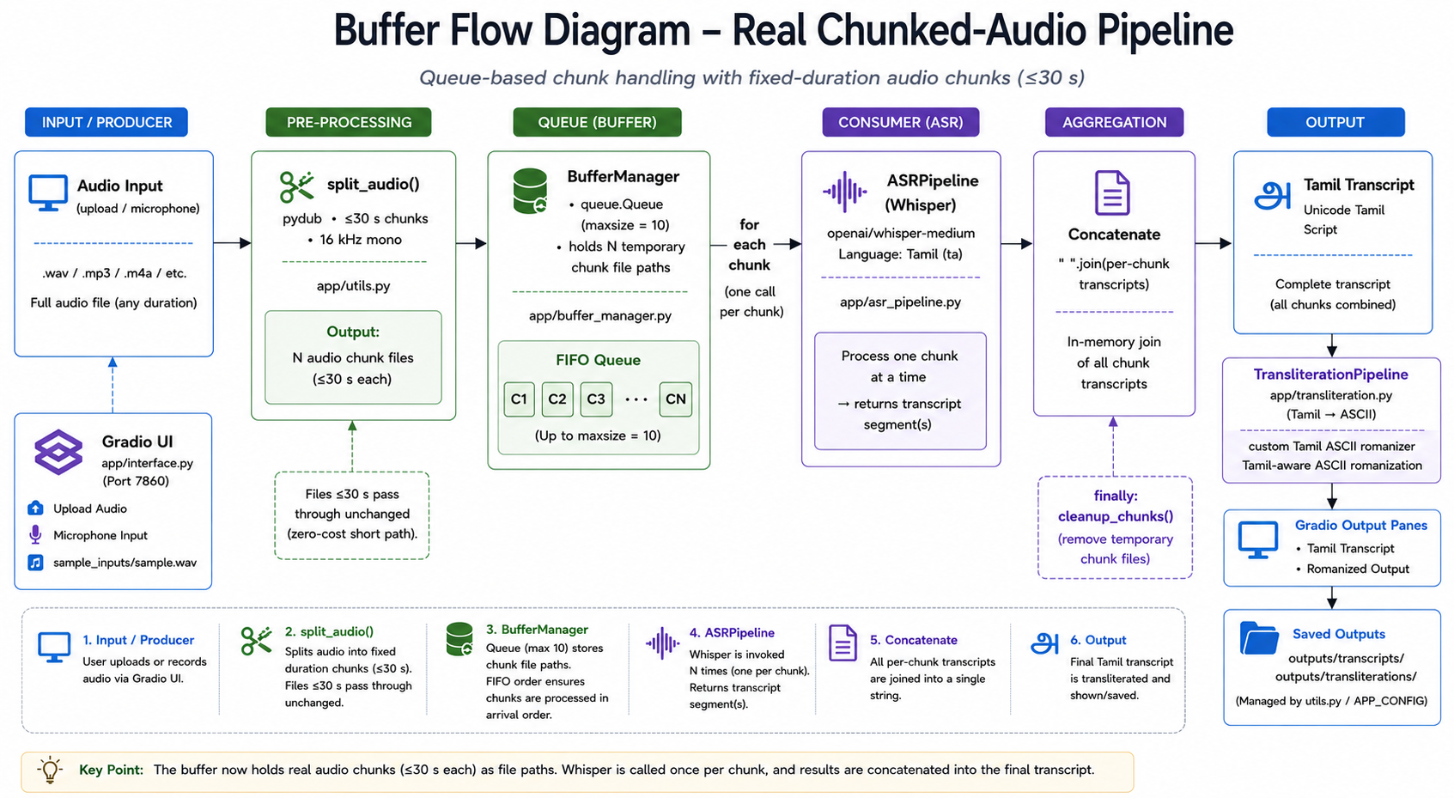
Project 2 — Buffer Flow Diagram

Slide 10
Project 2 — Demo Results & Testing
Demo — sample.wav (4 Tamil sentences via gTTS)
Test Results
Input:
நான் ஒரு மென்பொருள் பொறியாளர் | தமிழ் மொழி மிகவும் அழகானது...
20 / 20
PASSED
Transcript:
நான் ஒரு மென்பொருள் பொரியாளர் தமிழ் மொழி மிகவும் அழகானது இந்த அமைப்பு...
Buffer Manager 6 tests — add, get, full, empty, clear, process_all
Transliteration Pipeline
4 tests — basic, empty, sentence, scheme_info
Utils
5 tests — timestamp, audio validation, format
Audio Splitting
4 tests — short-file passthrough, 65s → 3 chunks, cleanup, safety belt
Chunk Batching
1 test — N > maxsize batched correctly (no truncation)
Romanized
(ASCII):
naan oru menporuL poriyaaLar tamiL moLi mikavum aLakaanatu inta amaippuu...
Custom grapheme-based romanizer produces pure ASCII output safe for any rendering environment.

Slide 11
Limitations & Future Work
Project 1 — Limitations
Project 2 — Limitations
Parts B & C use only 10 sentences — small-sample averages
Memory footprint is illustrative (hidden=768, fp32 assumed)
mT5-base is not MT fine-tuned — tokenizer only comparison
Two model substitutions made (opus-mt-en-ta → en-mul, madlad400-1b → 3b)
CPU-only experiments — measures tokenizer behaviour, not inference speed
Default device: CPU, fp16=False — GPU opt-in via model_config.py
Whisper-medium: ~1.5 GB cold-start download
Fixed-duration chunks without overlap — minor seam artifacts possible at chunk boundaries
Romanization fixed to custom Tamil-aware ASCII scheme — single scheme only
Future Work
Streaming ASR over chunked PCM audio (with overlap) • User-selectable romanization (IAST / ITRANS / Velthuis) • Latency in UI • Wider sentence sample for Parts B & C across multiple FLORES domains

Slide 12
Conclusion
✦
IndicTrans2 achieves sacreBLEU 22.42 (BP 0.9638) — strongest English→Tamil translation quality
✦
NLLB-600M provides the best token efficiency for valid Tamil output — expansion ratio 1.366
✦
Tokenizer efficiency ≠ translation quality — the key analytical finding across Parts B and C
✦
Full ASR pipeline deployed — Whisper-medium + custom Tamil ASCII romanizer + Gradio + Docker port 7860
✦
20/20 unit tests passed — BufferManager, TransliterationPipeline, Utils, AudioSplitting, ChunkBatching fully validated
Round 2 Hands-On Projects | Tamizh Internship | 2026

