Slide 1


To Measure Referrer and Keyword Performance Using AWS
By: Aditya Kannan

Slide 2
Agenda
Business Question and Requirements
Current Architecture and Data Flow
Results and Analysis
Future Scope and Improvements

Slide 3
Business Question and Requirements:
How much revenue is the client getting from external Search Engines, such as Google, Yahoo and MSN, and which keywords are performing the best based on revenue?
Input File: Hit level tab separated file.
Notes:
https://www.ibm.com/blogs/watson/2016/05/biggest-data-challenges-might-not-even-know/

Slide 4


Current Architecture and Data Flow
A data file drop to s3 bucket generates an event for aws lambda function.
Lambda function uses python to ingest, transform data and upload results back to s3.
Data Processing Platform
Notes:
http://searchcrm.techtarget.com/definition/clickstream-analysis

Slide 5
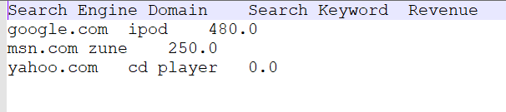
Results and Analysis
After successful execution of lambda function, below results can be inferred.
Best Referrer: google.com
Best Keyword: ipod

Slide 6
Future Scope and Improvements
Scalability improvement options for current data pipeline
Option 1:
Use AWS Step Functions and run lambda functions in loop.
Option 2:
Use Snowflake and snowpipe for data pipeline.
Inbuilt snowflake functions for data cleaning.

Slide 7

Any Questions?

Slide 8
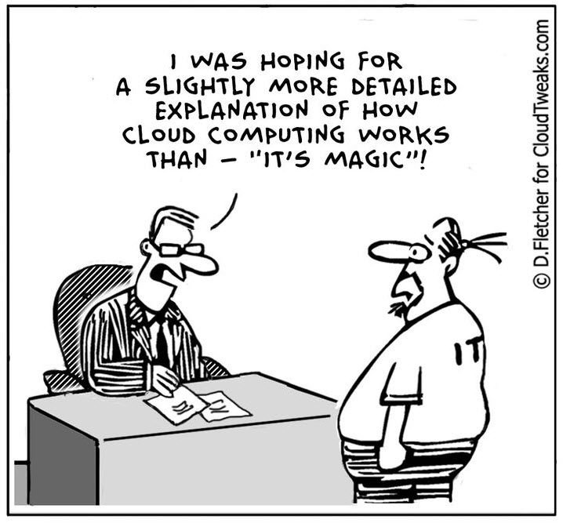
Thank you!!!

