Slide 1
Determination of optimum value
of Number of Clusters in
K-Means Algorithm
Presented By:
Samadrita Ghosh- 1505505
Sayan Bakshi- 1505508
Anjali Priya- 1505531
Arkaprabha Bhandari- 1505533
Under the guidance of:
Prof. Arup Sarkar

Slide 2
CLUSTERING

Slide 3
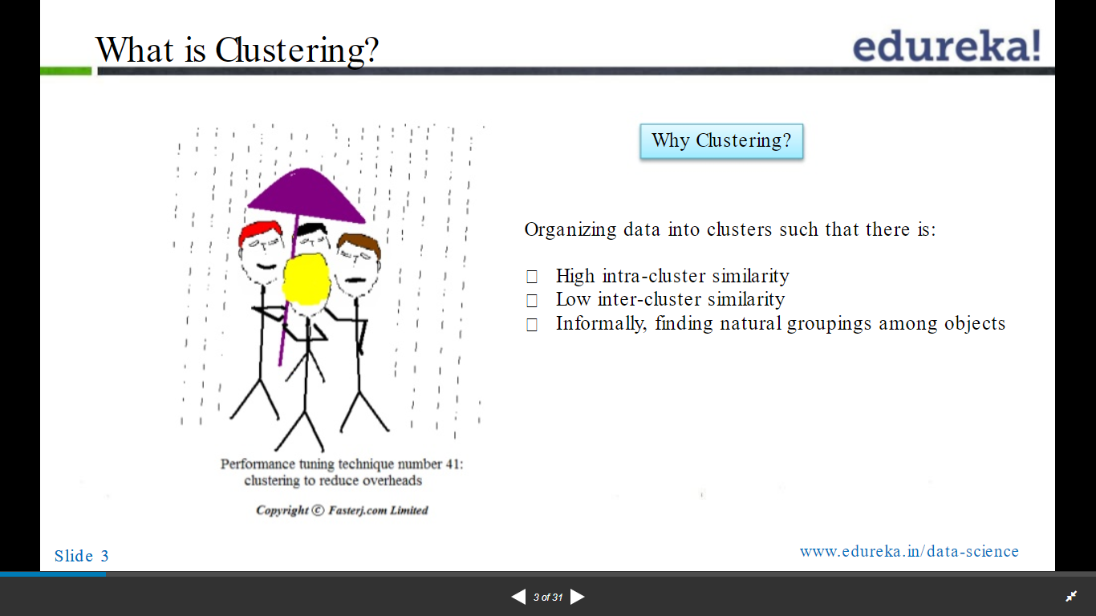

Slide 4
K-MEANS CLUSTERING

Slide 5
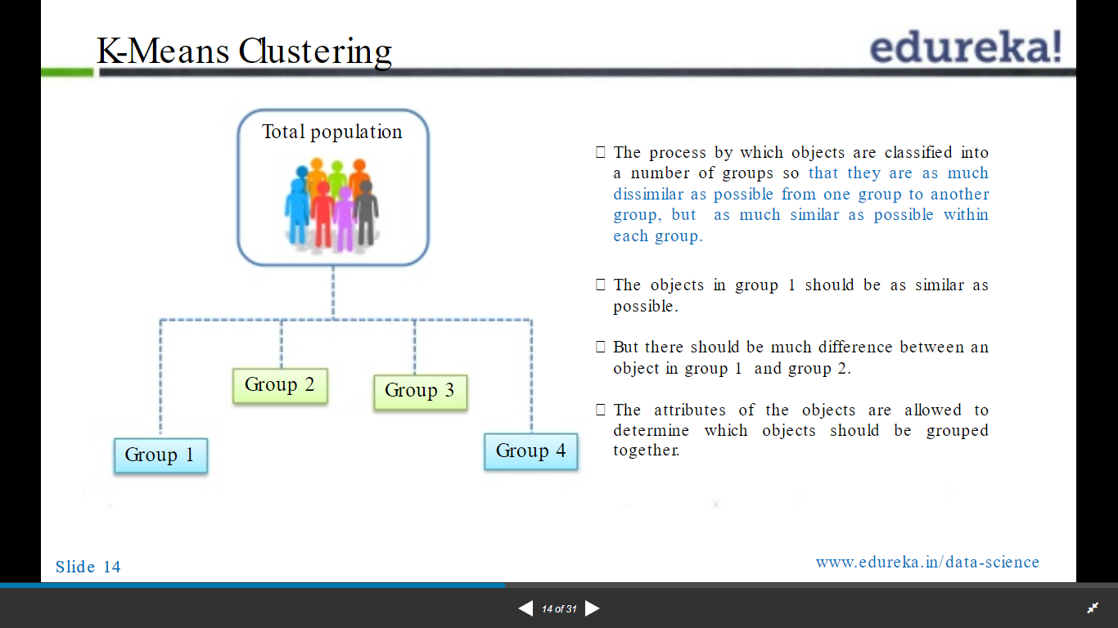

Slide 6
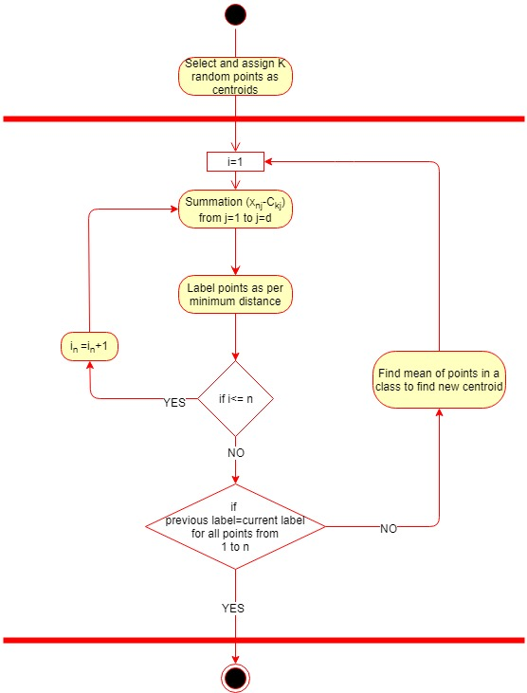
K-MEANS CLUSTERING ACTIVITY DIAGRAM

Slide 7
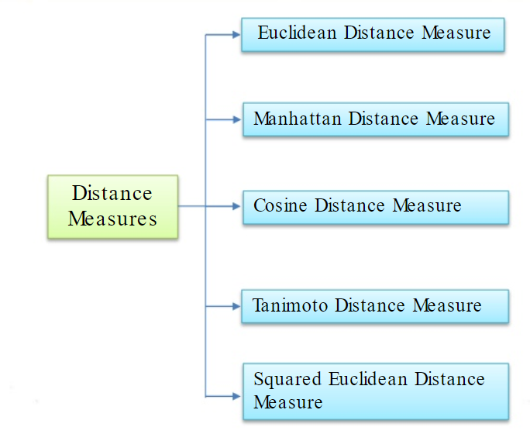
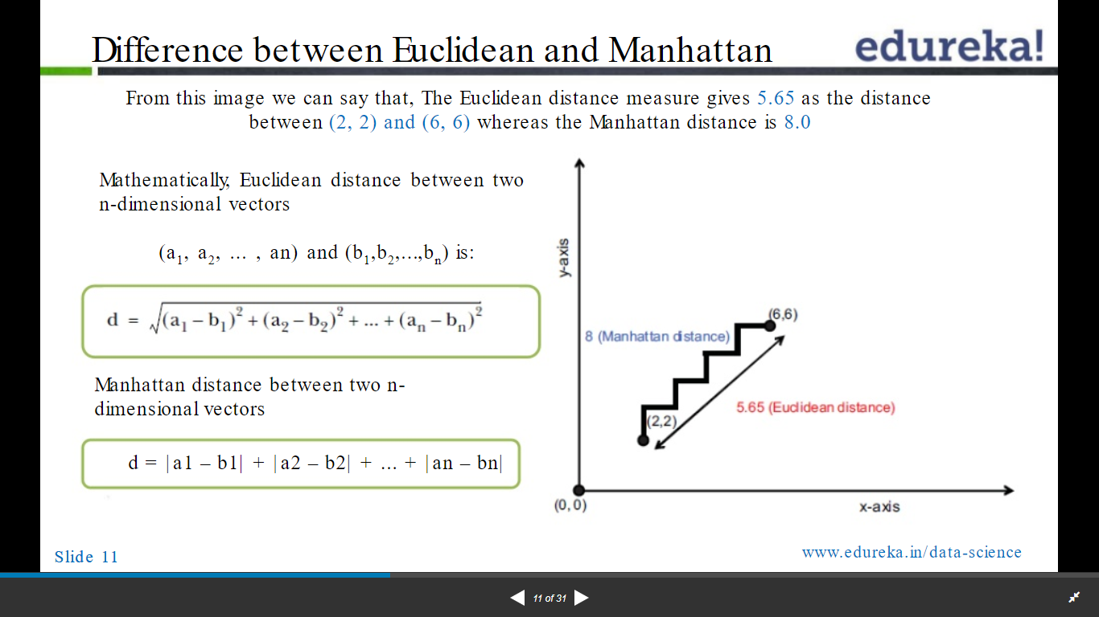
We consider the Euclidean Distance Measure

Slide 8
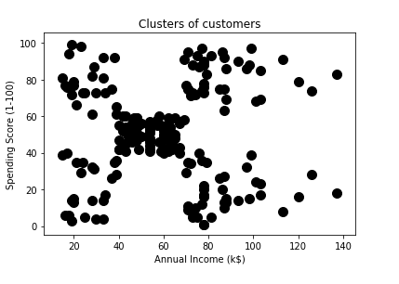
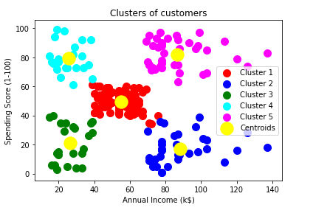
Initial set of random data points
Clustered data points

Slide 9

But, to choose a proper number of clusters ‘k’ is a domain dependent problem.

Slide 10

OUR GOAL
To compute optimum value of ‘K’
without human intervention.

Slide 11
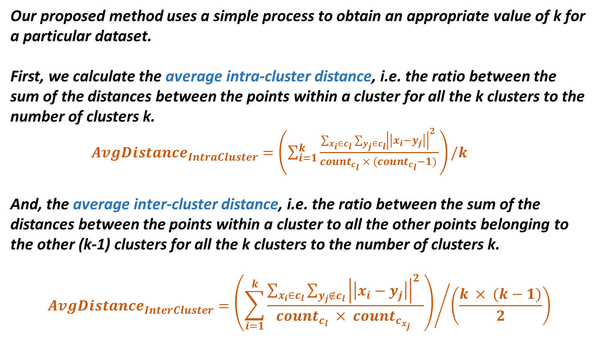
Our proposed method uses a simple process to obtain an appropriate value of k for a particular dataset.
First, we calculate the average intra-cluster distance, i.e. the ratio between the sum of the distances between the points within a cluster for all the k clusters to the number of clusters k.
$AvgDistance_{IntraCluster}=\left(\sum_{i=1}^{k}{\frac{\sum_{x_{i}∈c_{l}}{\sum_{y_{j}∈c_{l}}{{\left|\left|x_{i}−y_{j}\right|\right|}^{2} }}}{count_{c_{l}} × (count_{c_{l}}−1) }}\right)/k$
And, the average inter-cluster distance, i.e. the ratio between the sum of the distances between the points within a cluster to all the other points belonging to the other (k-1) clusters for all the k clusters to the number of clusters k.
$$AvgDistance_{InterCluster}={\left(\sum_{i=1}^{k}{\frac{\sum_{x_{i}∈c_{l}}{\sum_{y_{j}∉c_{l}}{{\left|\left|x_{i}−y_{j}\right|\right|}^{2} }}}{count_{c_{l}} × count_{c_{x_{j}}} }}\right)}/{\left(\frac{k × (k−1)}{2}\right)}$$

Slide 12
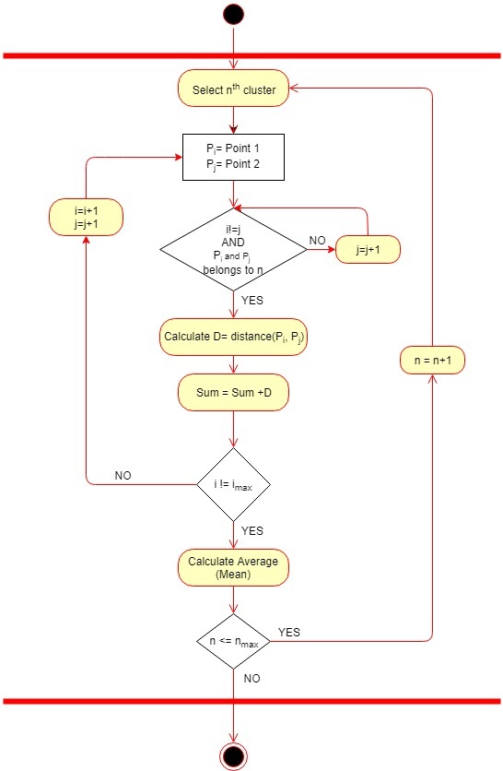
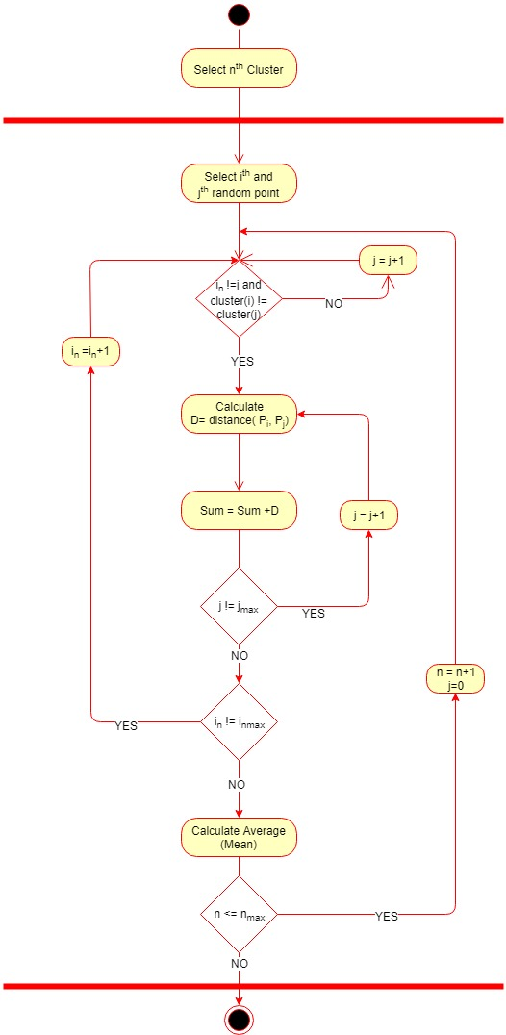
Average Intra-Cluster Activity Diagram
Average Inter-Cluster Activity Diagram

Slide 13
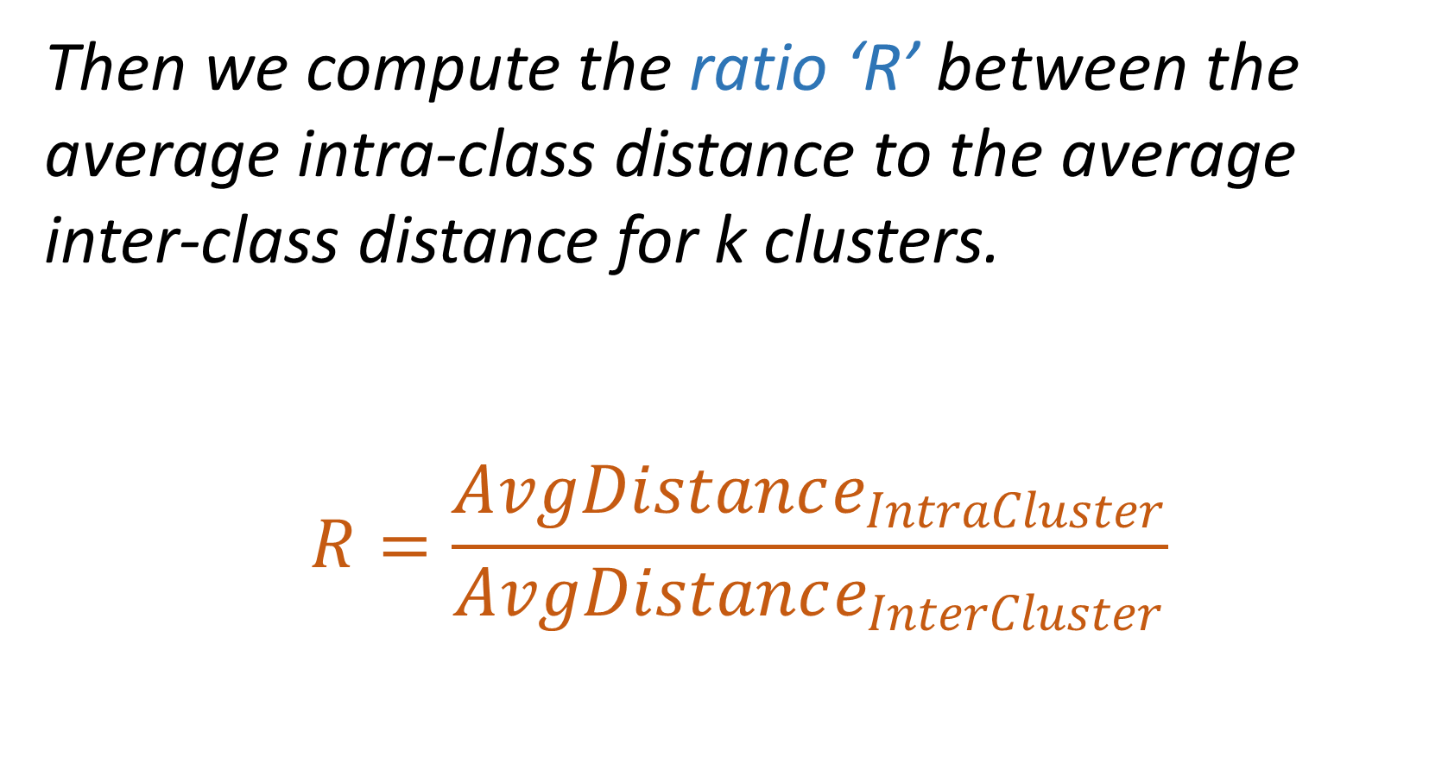
Then we compute the ratio ‘R’ between the average intra-class distance to the average inter-class distance for k clusters.
$$R=\frac{AvgDistance_{IntraCluster}}{AvgDistance_{InterCluster}}$$

Slide 14
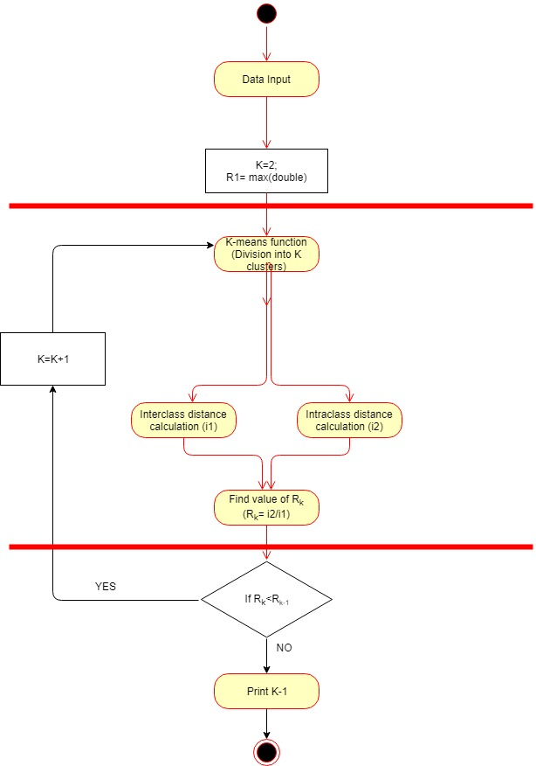
PROPOSED ALGORITHM
ACTIVITY DIAGRAM

Slide 15
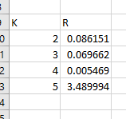
Example 1 – Optimum value: K=4

Slide 16
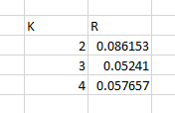
Example 2 – optimum value: K=3

Slide 17
We are able to train the machine to be able to find the optimum value for the number of clusters that is,
the best suited value for 'k' for a given set of observations.

Slide 18


