Slide 1


K-Drama For All
Kyung Hee University Global Campus
SHAN SAMA E
2022315690
ATIKUZZAMAN MD
2022315497
CHOWDHURY SHAYHAN AMEEN
2022311138
HASHEM MOHAMMAD SHADMAN
2022310113

Slide 2
INDEX
Goal
Calcite Adapters
Data Pre-processing
Application Functionalities
Transformation Rules
Role
Timeline
References
Notes:
The principal sections of this presentation will be divided on:

Slide 3


Goal
To develop a K-Drama database with a special emphasis on:
Fashion
Style
Rich Culture
Sold to 150 countries

Slide 4
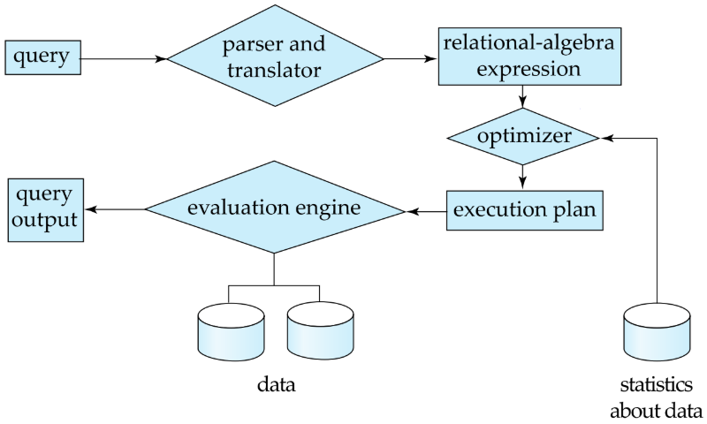
Traditional DBMS
Parse and convert to relational-algebra form
Optimize the query execution plan
Executes the query based on the plan
Notes:
The parser and translator convert the input query into relational-algebra form.
The optimizer establishes a query execution plan based on the statistical information of the data.
The evaluation engine executes a query based on the plan and returns the result.
But it is a blackbox how our query is executed

Slide 5
Apache Calcite
SQL query
Schema
API Calls
SQL Parser
SqlNode
RelBuilder
SqlNode
SQL Validator
CatalogReader
SqlToRelConverter
FILTER_INTO_JOIN
TABLE_SCAN_RULE
FILTER_RULE
JOIN_RULE
PROJECT_RULE
SORT_RULE
RelNode
RelOptRule
RelOptPlanner
RelMetadata
Provider
RelNode
RelRunner
Results
Notes:
But apache calcite gives us different components of the query processor to execute query
We can read data from heterogenous sources. Apply different transformational rules to optimize query using different java classes
We give it schema. Now when query is passed it validates the query then converts it into a logical plan. We can give it certain rules or add new rules to optimize the query. And after the rules are passed then we get the results

Slide 6
Calcite Adapters
Adapter=Schema Factory (Lists tables)+convention + rules to convert nodes to convention
Adapters allows to fetch from heterogeneous data sources
Show top 5 movies from after year 2016
My SQL
Condition:
drama_year>2016
Key: drama
Key: Desc
Scan:Genres
Key:Dra_id
Join
Filter
Group
Sort
CSV
Scan:Dramas
Notes:
Adapters allow to build tables from heterogenous data sources. First for a given query we may fetch data from 2 sources.then join them then filter ,group and then sort them

Slide 7
Calcite Adapters (Cont.)
Show top 5 movies from after year 2016
My SQL
Key: Desc
Scan:Genres
Key:Dra_id
Key: drama
Join
Group
Sort
CSV
Scan:Dramas
Filter:drama year>2016
https://www.slideshare.net/julianhyde/apache-calcite-a-foundational-framework-for-optimized-query-processing-over-heterogeneous-data-sources
Notes:
However we can also filter the movies beforehand in the filesystem layer to show the results. And this can be done using calcite adapters

Slide 8
Features of our Adapter
Allows to read data from both CSV and MySQL source at the same time
Scan rules for queries are passed down in the filesystem to improve the adapter.

Slide 9
Justification for using various data source
Data is sparse. In practical cases we might have to write query over
multiple sources such as csv and mysql
Normally CSV do not allow creating indexes. It does not allow
sql queries, data manipulation, transaction etc.
So if we want to combine data sources while maintaining integrity and
not migrate data and write queries over them we can use our adapter
CSV
queries
MySQL
queries
queries
CSV
MySQL
queries
Notes:
However we can also filter the movies beforehand in the filesystem layer to show the results. And this can be done using calcite adapters

Slide 10
Data Collection and Pre-processing
K-Drama DATA Source
Separate Name
Artist Name
Generate Link using the Name
Separated Information as CSV
Using Beautiful Soup
Web Scraping using Python
Artist Information on Wiki
Artist Information in Web format

Slide 11
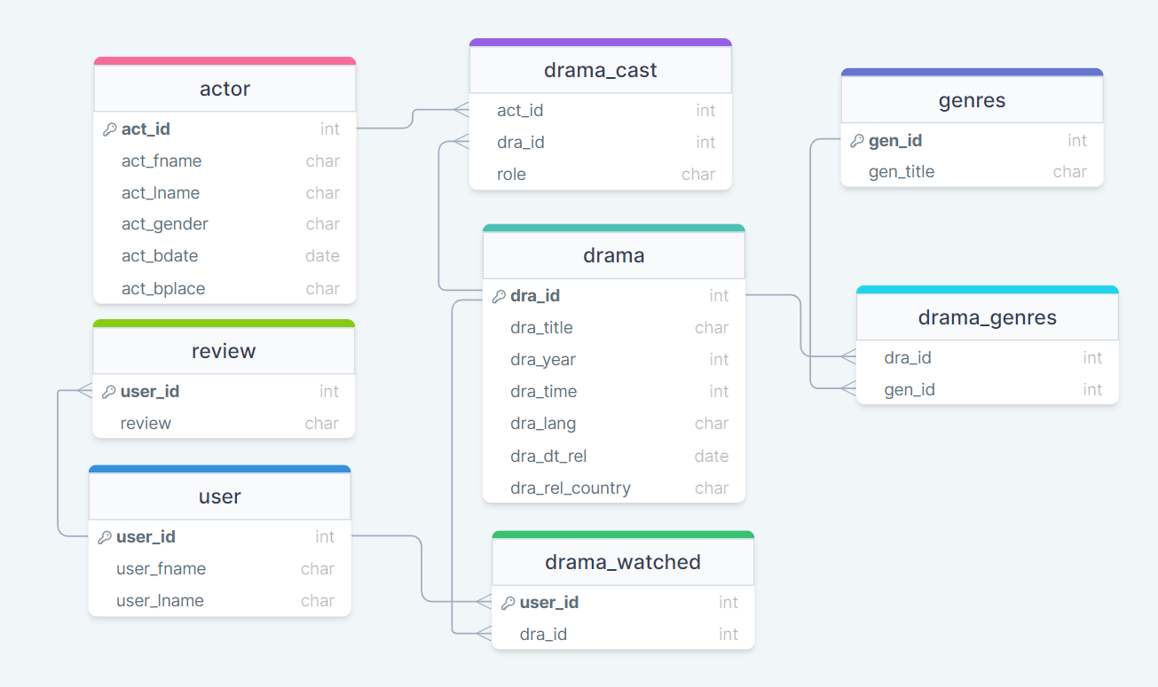
Schema Diagram

Slide 12


Application Functionalities
Develop a K-Drama database
Discarding score
Instead promote personal preference
Search reviews of a drama
Search drama acted by an actor
Search drama of a specific time period

Slide 13




Personal Preference
Please enter your previously watched dramas.
Ho
Watched

Slide 14
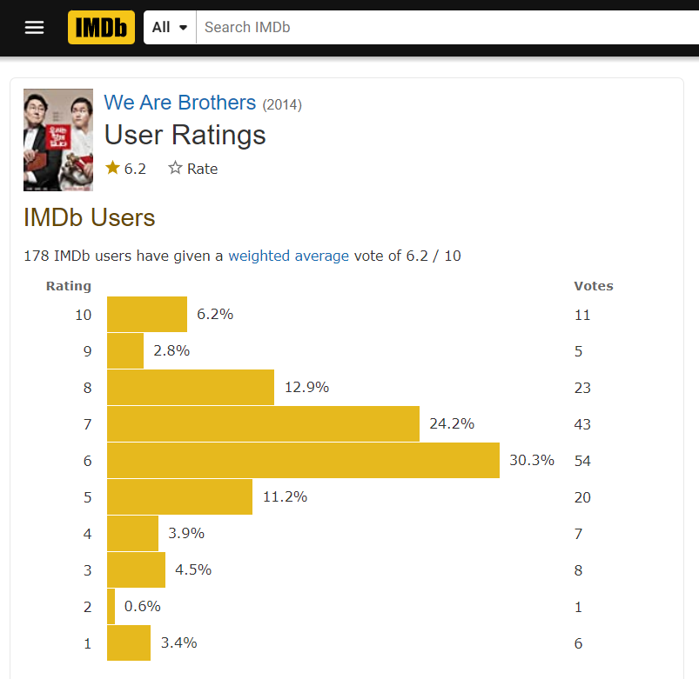
Search Reviews of a Drama
Not all reviews are “relevant!”
Only consider users with similar taste

Slide 15
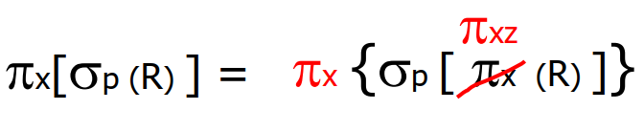
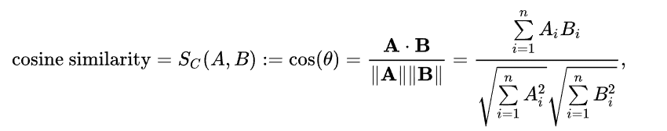
∏_{AVG(review)}
⋈_{dra_id}
∏_{dra_id, rev_id}
∏ _{dra_id}
⋈_{rev_id}
σ _{dra_title LIKE ‘%$PATTERN%’}
Cosine Similarity, ∏_{rev_id}
∏_{dra_id, review, rev_id}
∏ _{dra_id, dra_title}
∏ _{dra_id, user_id}
review
drama
⋈
∏ _{user_id, dra_id}
∏_{rev_id}
drama_watched
⋈_{dra_id}
∏_{dra_id, rev_id}
∏ _{dra_id}
review
σ _{mov_title LIKE ‘%$PATTERN%’}
drama

Slide 16
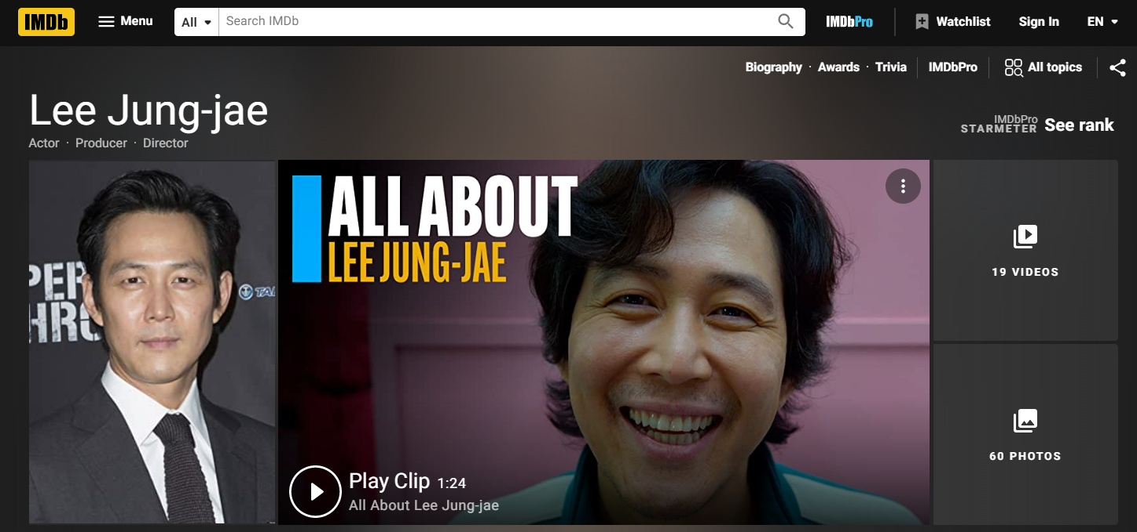
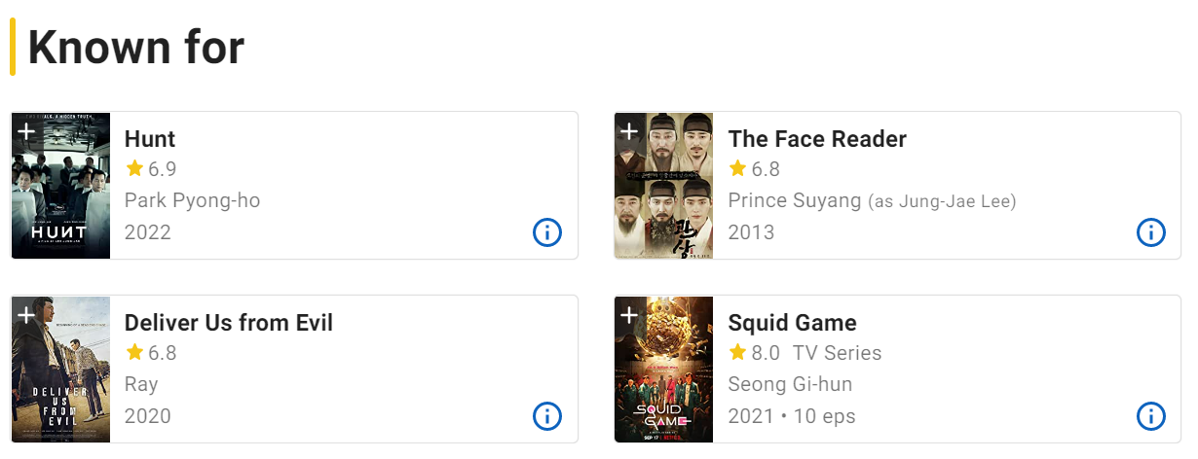
Search Drama Acted by an Actor
Drama watched
Most watched genres

Slide 17

∏_{dra_title}
⋈ _{dra_id}
∏ _{dra_id}
∏ _{dra_id, dra_title}
⋈ _{gen_id}
drama
τ _{COUNT(dra_id)}
∏ _{gen_id, dra_id}
γ _{gen_id}
⋈ _{dra_id}
⋈ _{dra_id}
∏_{act_id}
∏_{dra_id}
∏_{dra_id}
σ _{user_id = $USER_ID}
σ _{act_name LIKE ‘%$PATTERN%’}
drama_genres
drama_genres
drama_watched
drama_cast

Slide 18
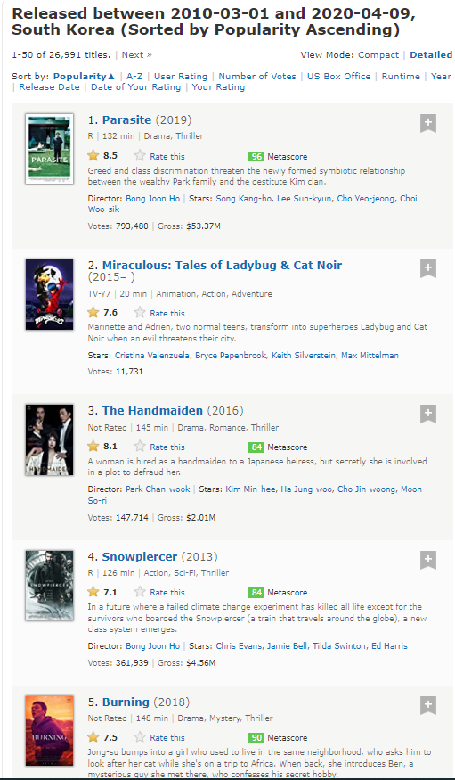
Search Drama of a Specific Time Period
Actor
Genre

Slide 19

∏_{dra_title}
⋈ _{dra_id}
∏ _{dra_id, dra_title}
∏ _{dra_id}
σ _{dra_year =$YEAR}
⋈_{dra_id}
drama
∏_{dra_id}
∏_{dra_id}
σ _{role = ‘Leading’}
σ _{user_id = $USER_ID}
drama_cast
drama_watched
Notes:
3

Slide 20
∏_{dra_title}
⋈ _{dra_id}
∏_{dra_id, dra_title}
∏ _{dra_id}
drama
⋈ _{gen_id}
τ _{COUNT(dra_id)}
∏ _{gen_id, dra_id}
γ _{gen_id}
drama_genre
⋈ _{dra_id}
drama_genres
σ _{user_id = $USER_ID}
drama_watched
Notes:
4

Slide 21
For the general query :
Create JOINs with INNER JOIN (not WHERE)
Use TOP to sample query results
Use SELECT fields instead of SELECT *
Avoid using SELECT DISTINCT
Avoid too many JOINs
Avoid using multiple OR in the FILTER predicate
Avoid using DISTINCT and GROUP BY at the same time
Notes:
4

Slide 22
Role Assignments
System Design
Data Preparation and Integration
Query Optimization Rules
Shan Sama E,
Atikuzzaman Md
Chowdhury Shayhan Ameen,
Hashem Mohammad Shadman
Shan Sama E,
Atikuzzaman Md,
Chowdhury Shayhan Ameen,
Hashem Mohammad Shadman

Slide 23




Requirements
Front End: Bootstrap, JavaScript, PHP
API & Service Layer : Spring Boot
Data Access Layer : Apache Calcite
Dataset: CSV Files

Slide 24
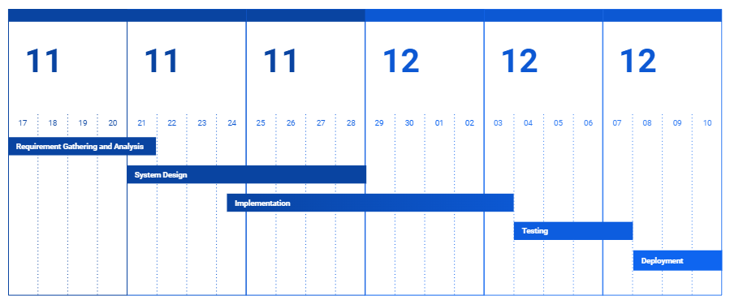
Timeline

Slide 25

Conclusion
We want to develop a K-Drama management system, which promotes the Korean culture to the audiences

Slide 26
References
IMDB
https://www.imdb.com/
Rotten Tomatoes
https://www.rottentomatoes.com/
Apache Calcite
https://calcite.apache.org/
Dataset
https://www.kaggle.com/datasets/chanoncharuchinda/top-100-korean-drama-mydramalist
Images
https://www.google.com/url?sa=i&url=https%3A%2F%2Fwww.liputan6.com%2Fon-off%2Fread%2F4691374%2Freview-drama-korea-jewel-in-the-palace-di-vidio-kisah-nyata-dari-zaman-joseon&psig=AOvVaw2mdL3FPklGIobC9XHQTKCv&ust=1668593364910000&source=images&cd=vfe&ved=0CBAQjRxqFwoTCNDtxuf4r_sCFQAAAAAdAAAAABAF
https://www.google.com/url?sa=i&url=https%3A%2F%2Fwww.rottentomatoes.com%2Ftv%2Fsquid_game&psig=AOvVaw0TATAWrMadlexVuxKmyNdu&ust=1668593440591000&source=images&cd=vfe&ved=0CBAQjRxqFwoTCNi1zYv5r_sCFQAAAAAdAAAAABAE

Slide 27
Thank’s for your Attention

