Slide 1


Tweets Opinions
Samah M. Balkhair

Slide 2
Outlines:
Phase1
Original Idea
Setup
Phase2
Collect the Data
EDA &
Plan B
Phase3
Text Pre- processing
Conclusion

Slide 3


Phase 1:
Original Idea
Goal
Check public festival status
The original idea was to analyze all tweets generated in specific geographic point using its latitude and longitude

Slide 4
Phase 1:
Setup
Obtain Twitter developer account
Obtain API security codes
api_key , api_key_secret, access_token, access_token_secret
Write a script for import the
Tweets using location
latitude and longitude

Slide 5

Phase 2:
Data Collection
Use Tweetpy package
tweepy.Stream
API.search_tweets
API.search_30_day
API.search_full_archive

Slide 6


Phase 2:
Data Collection
Latitude: 33.81365119
Longitude: 117.9197350
Latitude: 21.4240767
Longitude: 39.8258948
~ 700 Tweets
< 10 Tweets

Slide 7
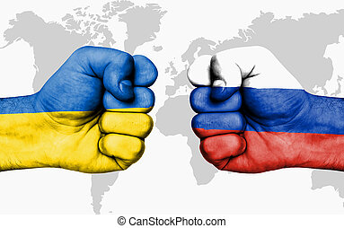

Phase 2:
Plan B
Search Using Hashtag
#ukrainarussiawar
ukraina
russia
> 25,000 tweets

Slide 8
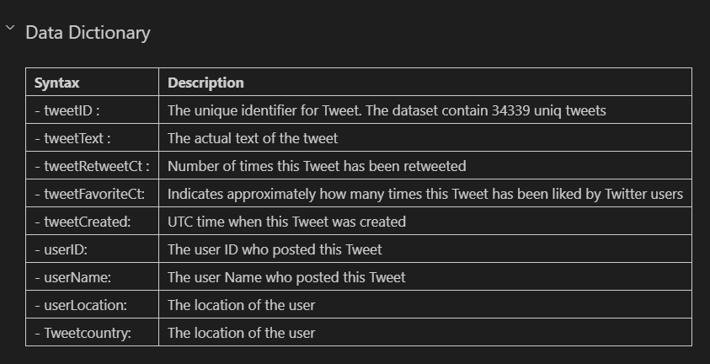
Phase 2:
Plan B

Slide 9
Phase 2:
Plan B
Identify the emotion in different countries based on tweets’ text

Slide 10
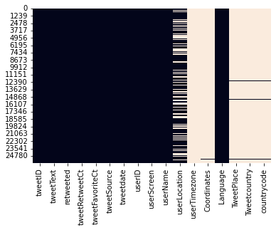
Phase 2:
Plan B
Missing Tweet Place: 25678 (98.8%)
User Permission
Premium Account
Not accurate
Virtual
Location
Native
Language

Slide 11
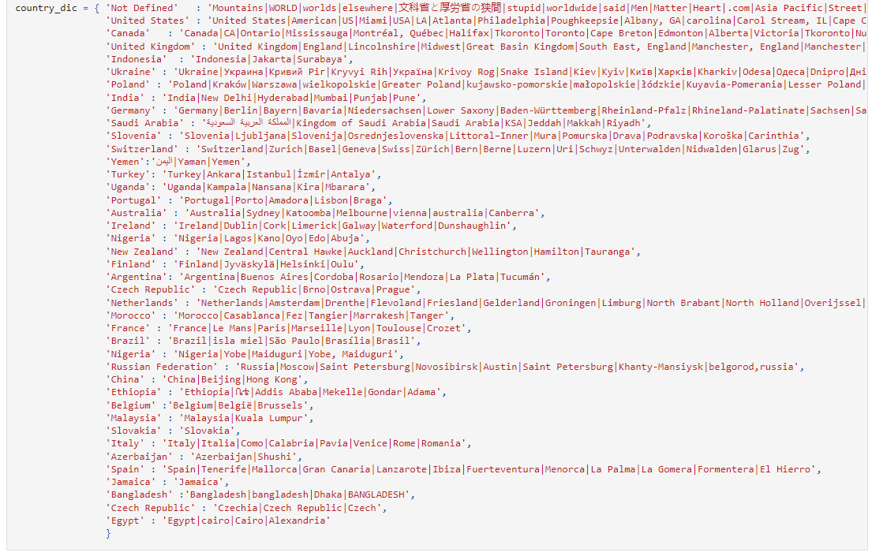

Phase 2:
Plan B

Slide 12


Phase 2:
Plan B
Challenge to Achieve the Goal
Missing Data
Premium Account
Dealing with multi languages

Slide 13
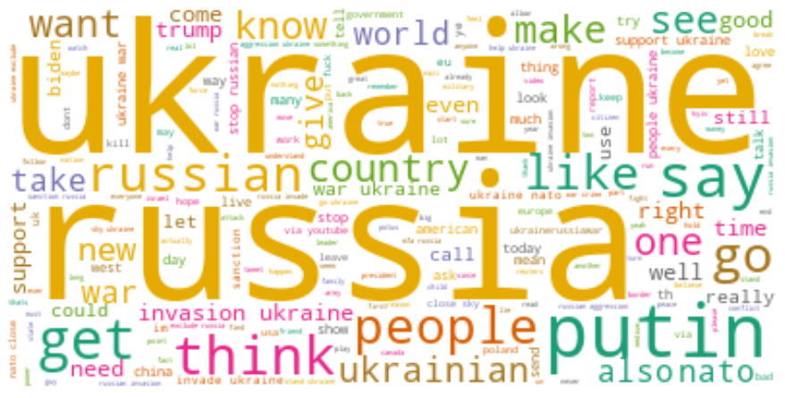
Phase 2:
EDA

Slide 14
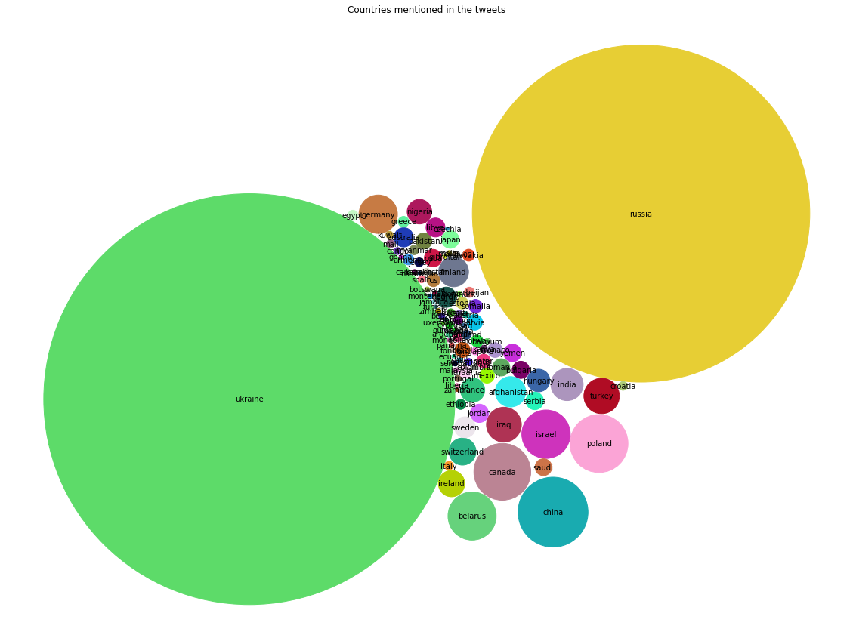
Phase 2:
EDA
What are the
Countries that
were mentioned
in the tweets?

Slide 15
Phase 2:
EDA
What is the general emotion in tweet?
How the tweets describe Russia and Ukraine?

Slide 16

Phase 3:
Text pre-processing
Select the features
[tweetText]
Clean the Tweet Text
[cleanText]
Converting to lowercase
Removing punctuations
Removing links
Removing stopwords (NLTK)
Text lemmatizer (NLTK)

Slide 17
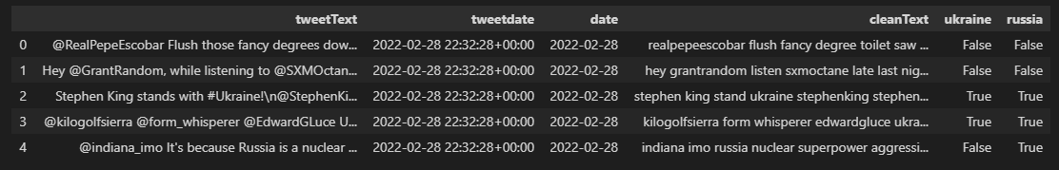
Phase 3:
Text pre-processing
Extract Target Countries
Add Ukraine & Russia flag in new columns
Create new data frame for each

Slide 18
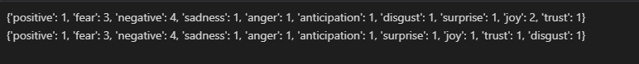
Phase 3:
Conclusion
Using NRCLex package
Predicts the sentiments and emotion of a given text

Slide 19
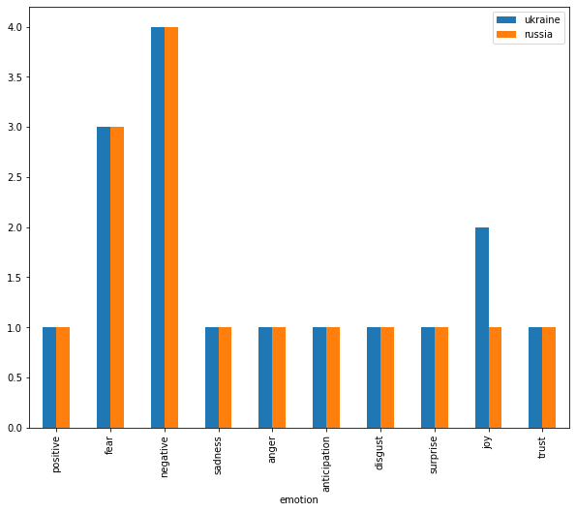
Phase 3:
Conclusion

Slide 20
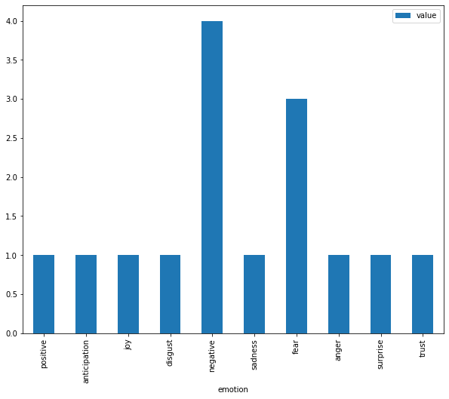
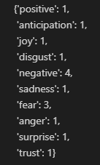
Phase 3:
Conclusion

Slide 21


Phase 3:
Conclusion
Using spaCY package
Identify the Noun / Adjective in the tweets text
Took 5 hours to execute ~ 24,000 rows
List of adjective contains some incoherent words
Clean the list using words in nltk.corpus package (manually)

Slide 22
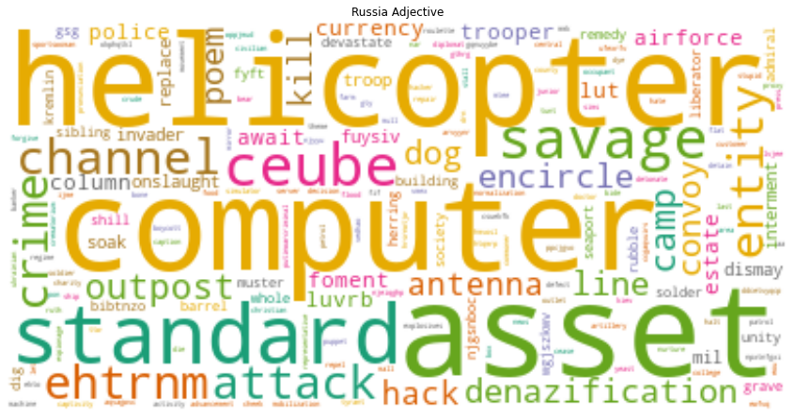
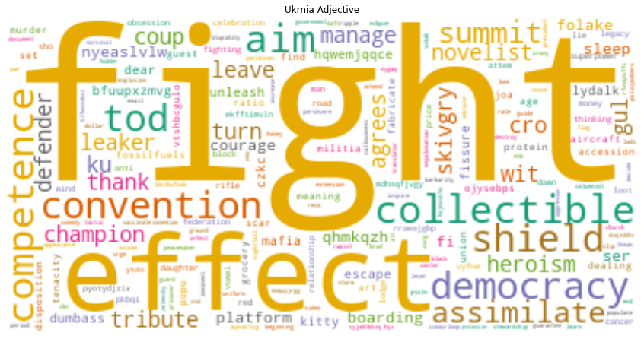
Phase 3:
Conclusion
Adj associated with Russia
Adj associated with Ukraine

Slide 23


Phase 3:
Lesson Learned
Start Early.
If you take too LONG to do it, you probably doing
the wrong thing.
Work smart not hard.
There is no one way to solve a problem.

Slide 24

Phase 3:
Lesson Learned
Finally
I learned that I am stronger than
the little voice in my head telling
me to quit.

Slide 25

Questions & Answers:

