Slide 1


Tweets Opinions
Samah M. Balkhair

Slide 2
Outlines:
Phase1
Original Idea
Setup
Phase2
Collect the Data
EDA &
Plan B
Phase3
Text Pre- processing
Find
the Result

Slide 3


Phase 1:
Original Idea
Goal
Check public festival status
The original idea was to analyze all tweets generated in specific geographic point using its latitude and longitude

Slide 4
Phase 1:
Setup
Obtain Twitter developer account
Obtain API security codes
api_key , api_key_secret, access_token, access_token_secret
Write a script for import the
Tweets using location its
latitude and longitude

Slide 5

Phase 2:
Data Collection
Use Tweetpy package
tweepy.Stream
API.search_tweets
API.search_30_day
API.search_full_archive

Slide 6


Phase 2:
Data Collection
Latitude: 33.81365119
Longitude: 117.9197350
Latitude: 21.4240767
Longitude: 39.8258948
~ 700 Tweets
< 10 Tweets

Slide 7
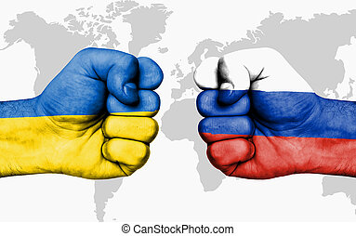

Phase 2:
Plan B
Search Using Hashtag
#ukrainarussiawar
ukraina
russia
> 25,000 tweets

Slide 8
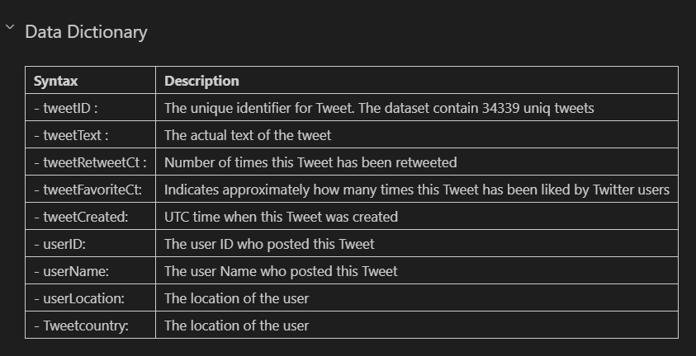
Phase 2:
Plan B

Slide 9
Phase 2:
Plan B
Identify the tweets feeling based on tweets countries

Slide 10
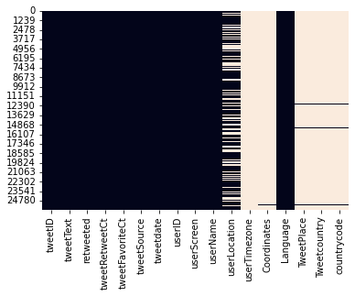
Phase 2:
Plan B
Missing Tweet Place: 25678 (98.8%)

Slide 11


Phase 2:
Plan B
Challenge to Achieve the Goal
Missing Data
Premium Account
Dealing with multi languages

Slide 12
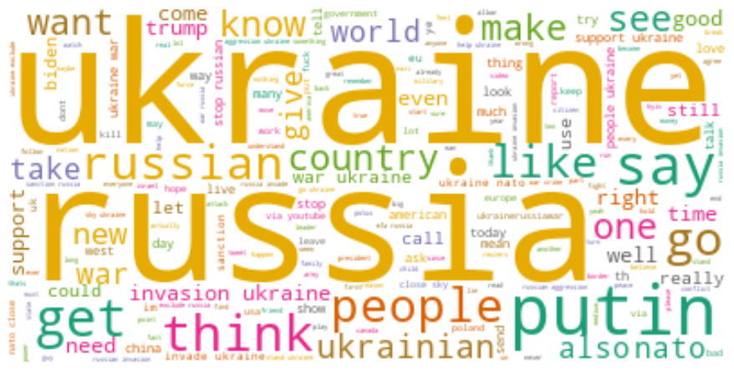
Phase 2:
EDA

Slide 13
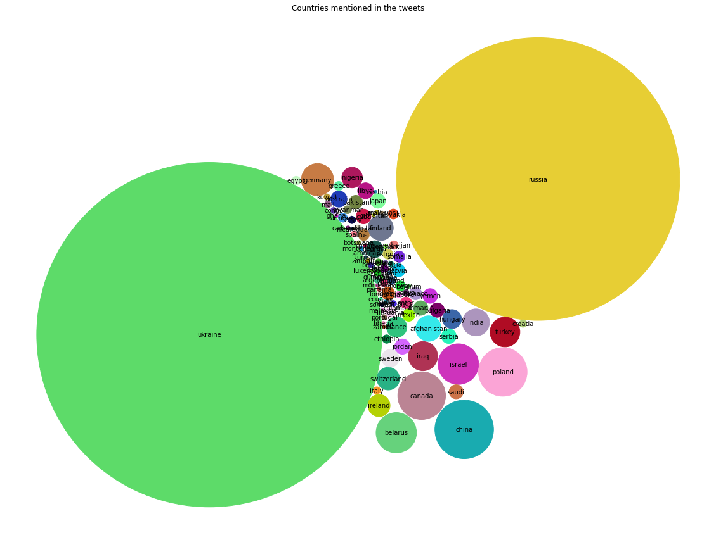
Phase 2:
EDA
What are the
Countries that
were mentioned
in the tweets?

Slide 14
Phase 2:
EDA
Identify the tweets emotion toward Ukraine and Russia

Slide 15

Phase 3:
Text pre-processing
Select the features
[tweetText]
Clean the Tweet Text
[cleanText]
Convert to lowercase
Remove punctuations
Remove links
Remove stopwords (NLTK)
Text lemmatizer (NLTK)

Slide 16
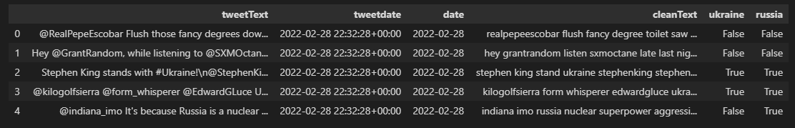
Phase 3:
Find the Result
Extract Target Countries
Add Ukraine & Russia flag in new columns
Create new data frame for each

Slide 17
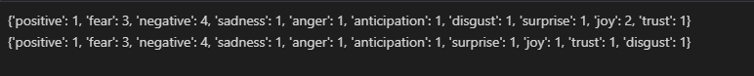
Phase 3:
Find the Result
Using NRCLex package
predicts the sentiments and emotion of a given text

Slide 18
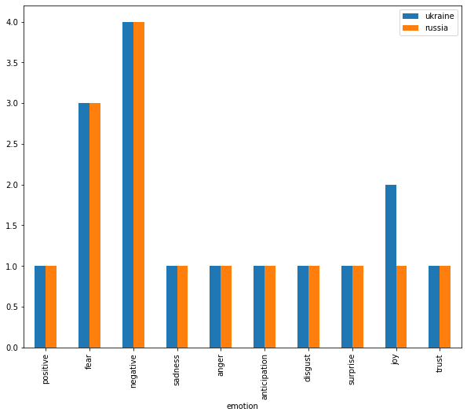
Phase 3:
Find the Result

