Slide 1

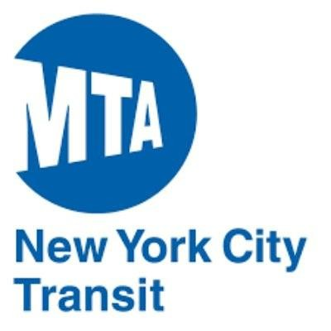

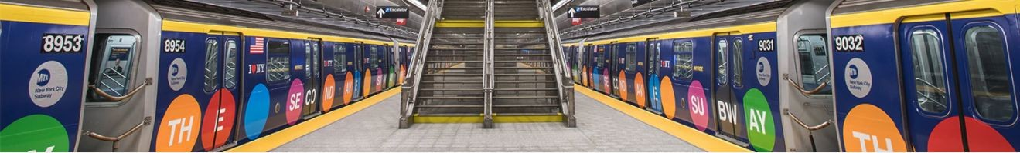
PROJECT:
MTA DATASET
Presented by: samah Alrefaei
Maximum Reach for Critical Connections

Slide 2

OBJECTIVE
-
I conducted this study :
1-Busiest subway entrances
2- Busiest days and times
3-Areas where people are more likely to crowded

Slide 3
goals
1-encourage ridership during the peak hours.
2-generate revenue .
3-satisfy our customers
-

Slide 4
Dataset:
MTA Turnstile data study this data for 3 months (May ,June, july)

Slide 5
Dataprocessing
:
1-groupby
2-Concat coulmns data
3- Add columns
4- remove for na
5-Remove duplicut

Slide 6
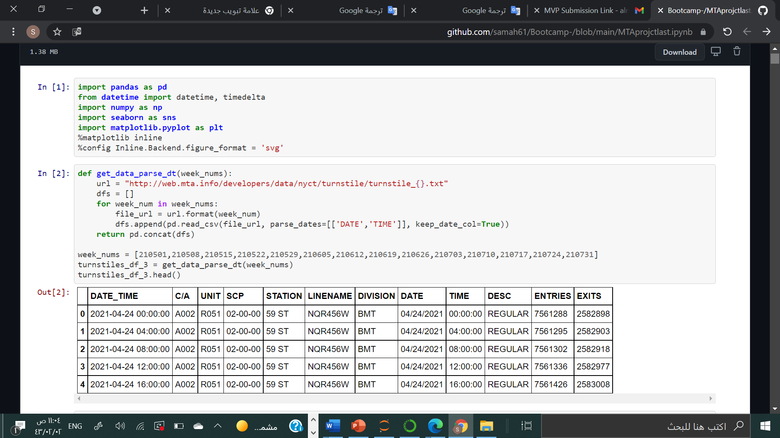

Slide 7
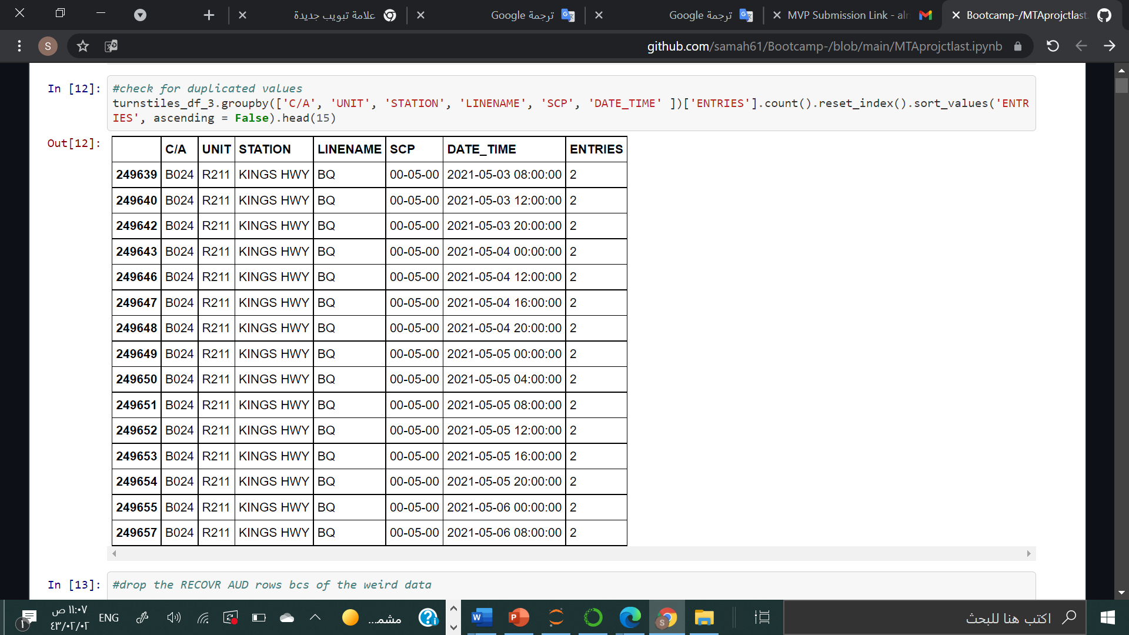

Slide 8
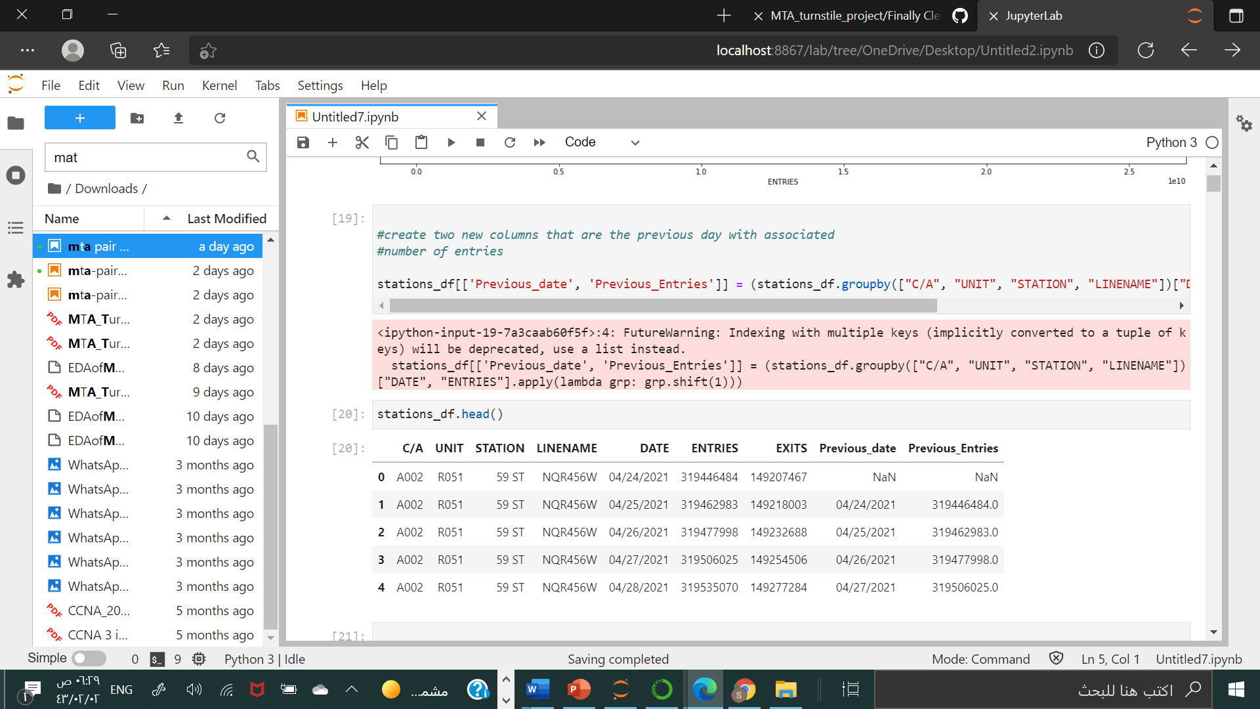

Slide 9
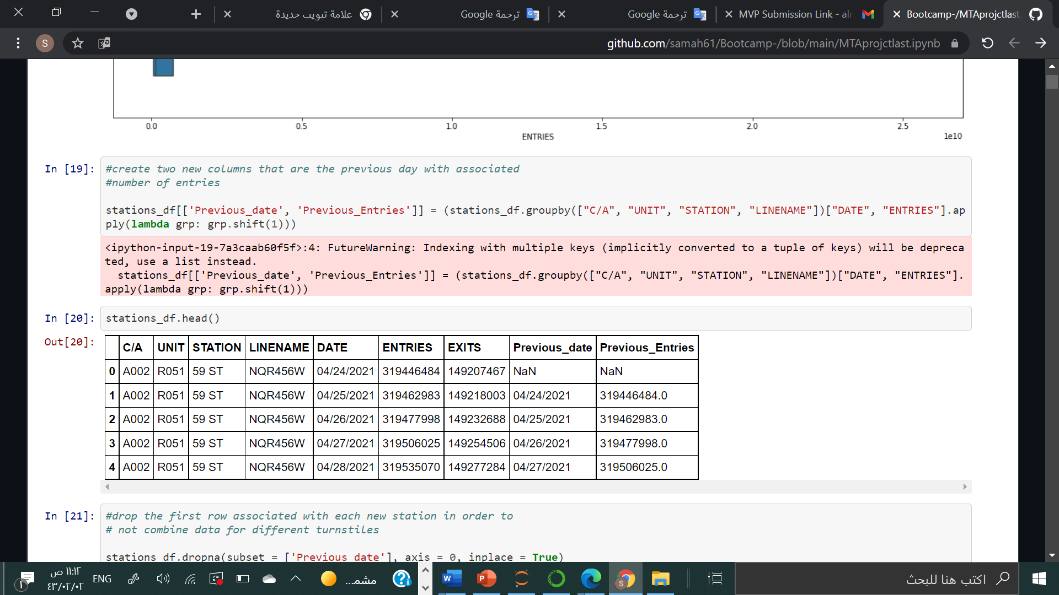

Slide 10
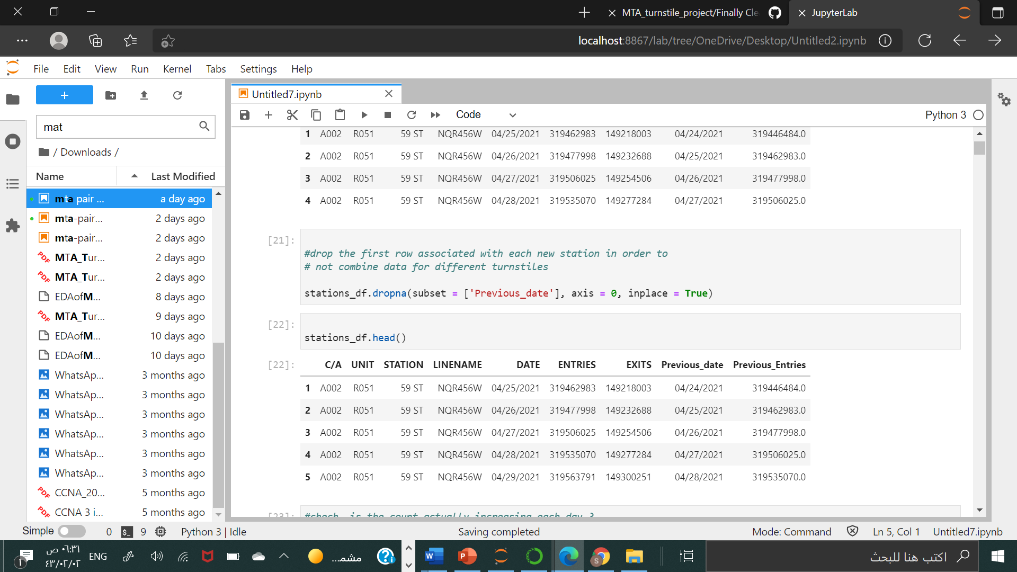

Slide 11
Tools::
Python (pandas, numpy)
matplotlib – jupyter - seaborn

Slide 12
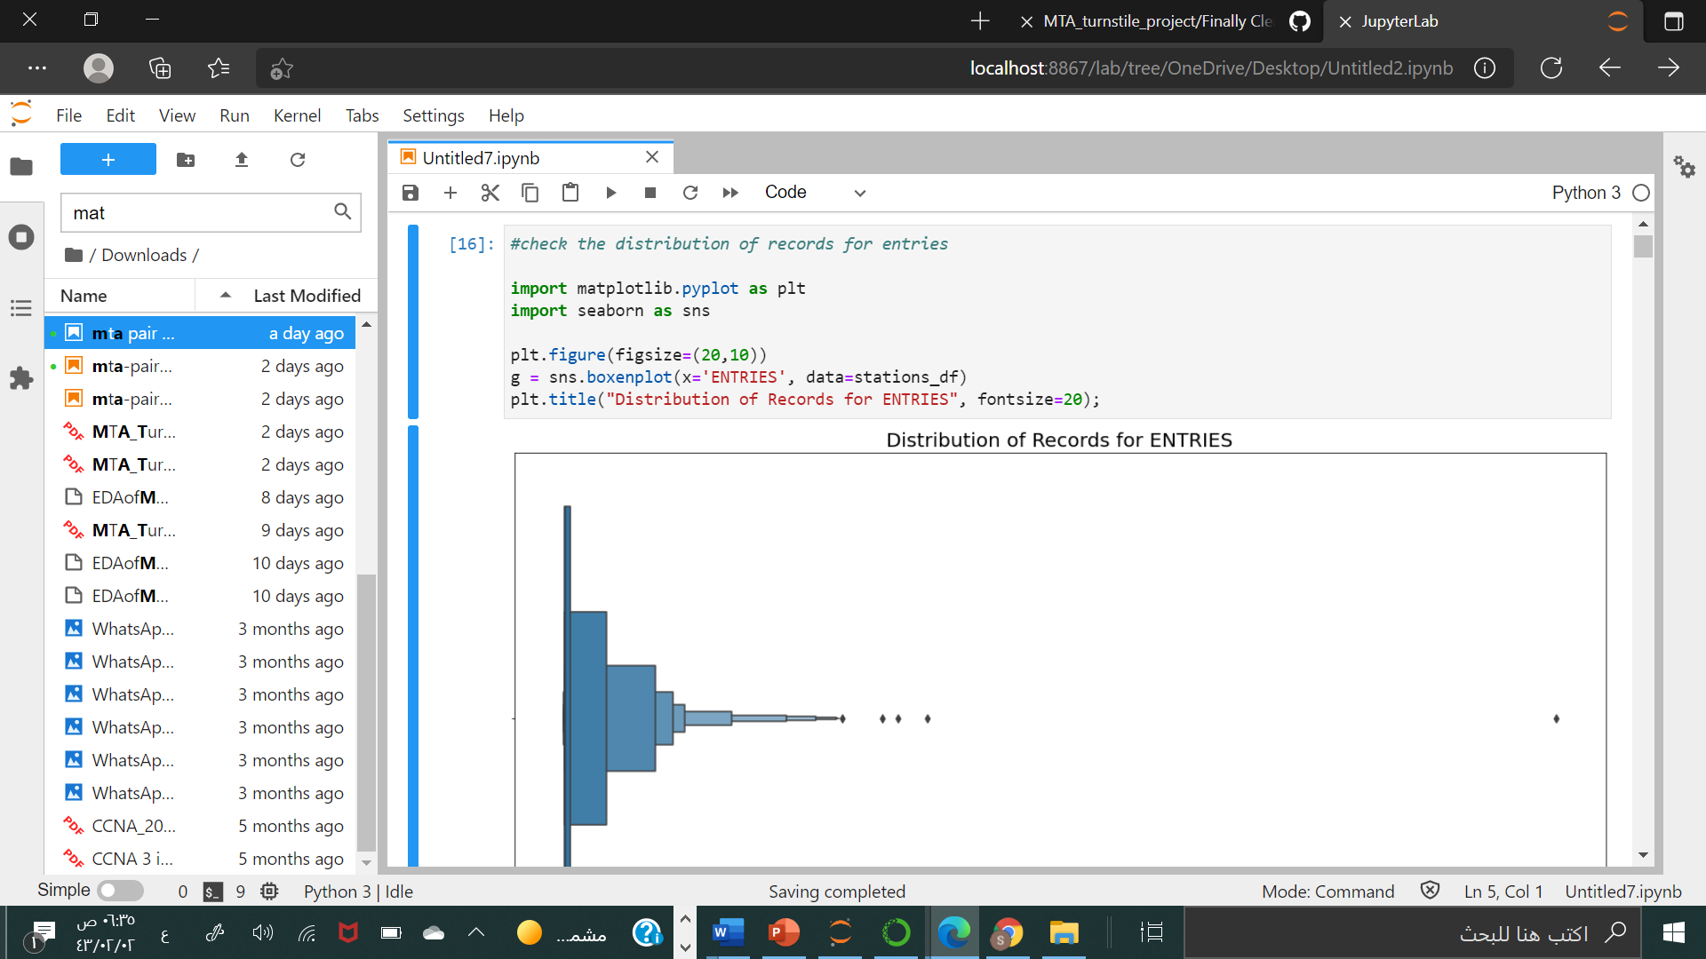

- Blue Dot == Stations
outlayer:
MTA stations designated by unique turnstiles
Represents boundaries of reach within MTA subway system
- 468 unique locations in data set
- ≈ 460 represented here

Slide 13
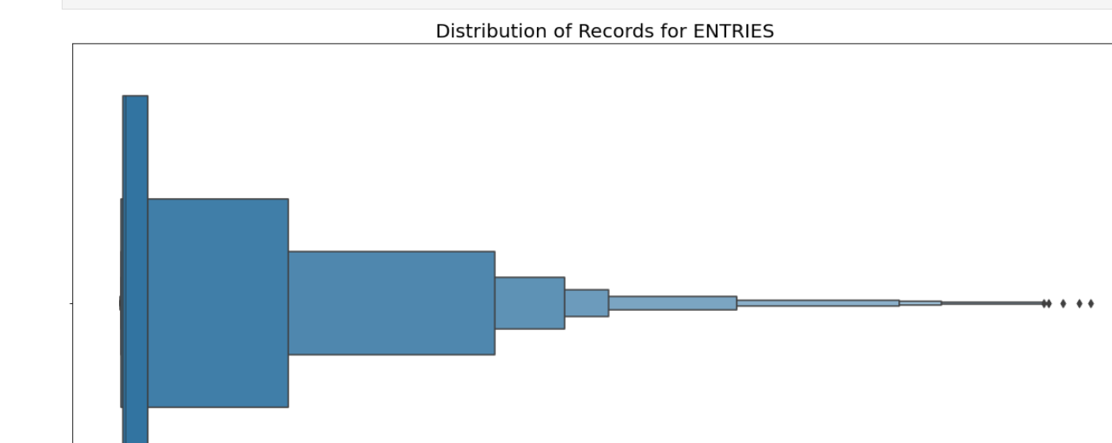
Drop outlayer:

Slide 14
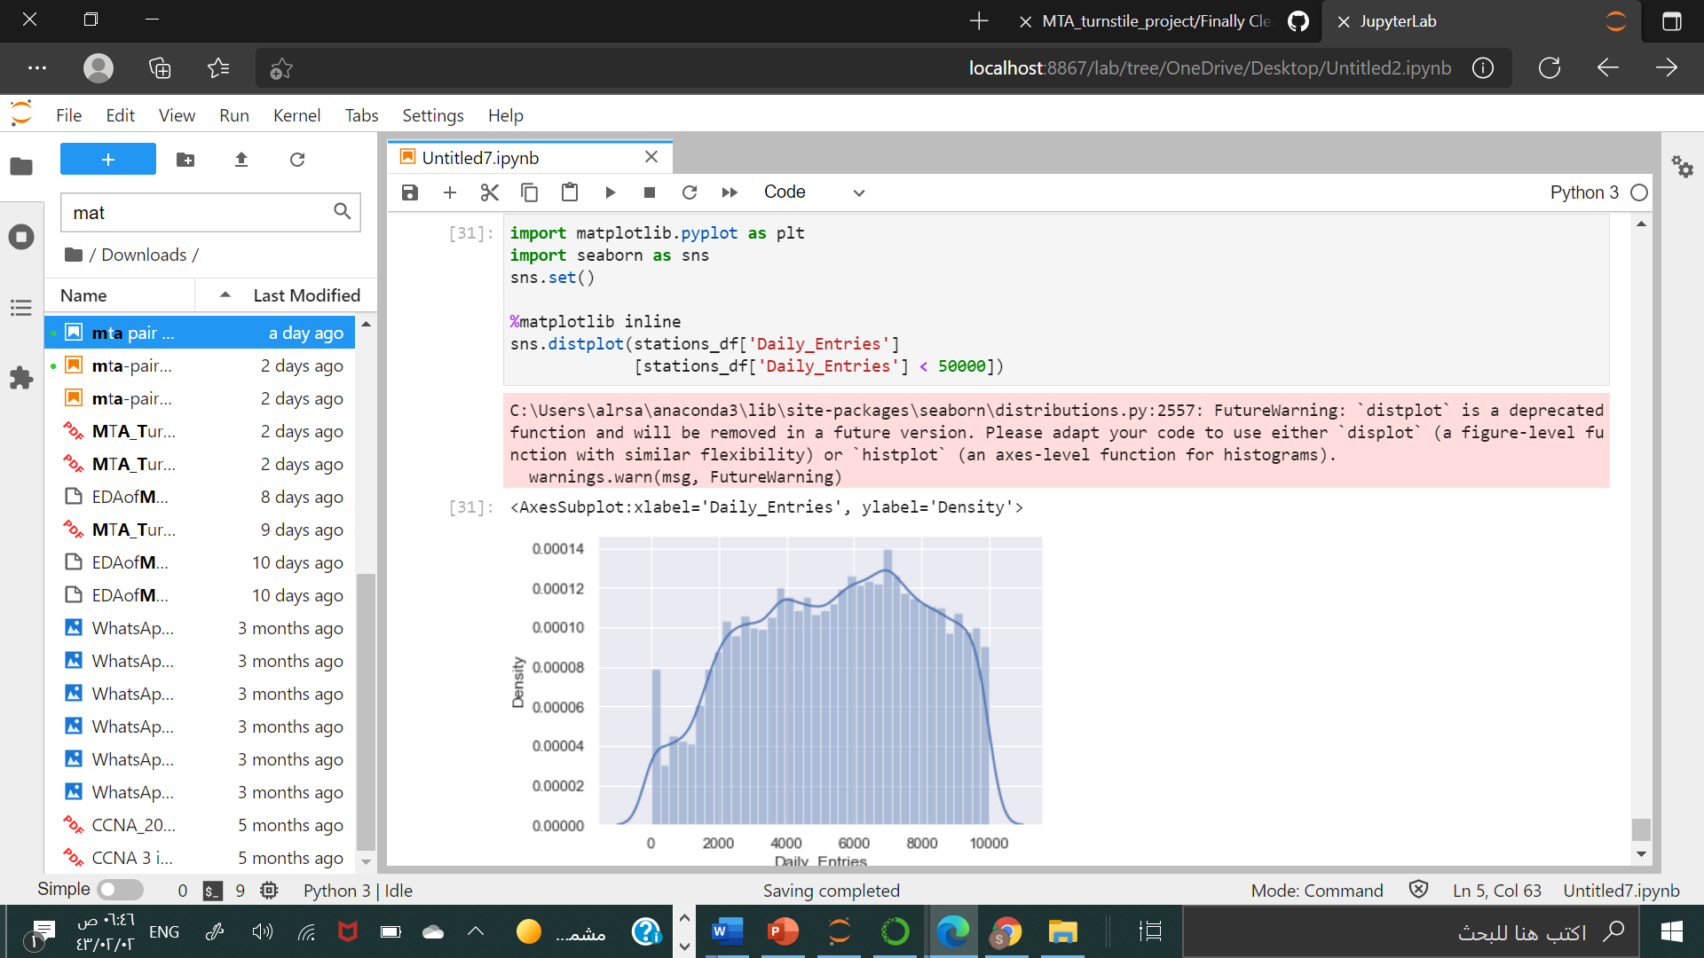

Slide 15
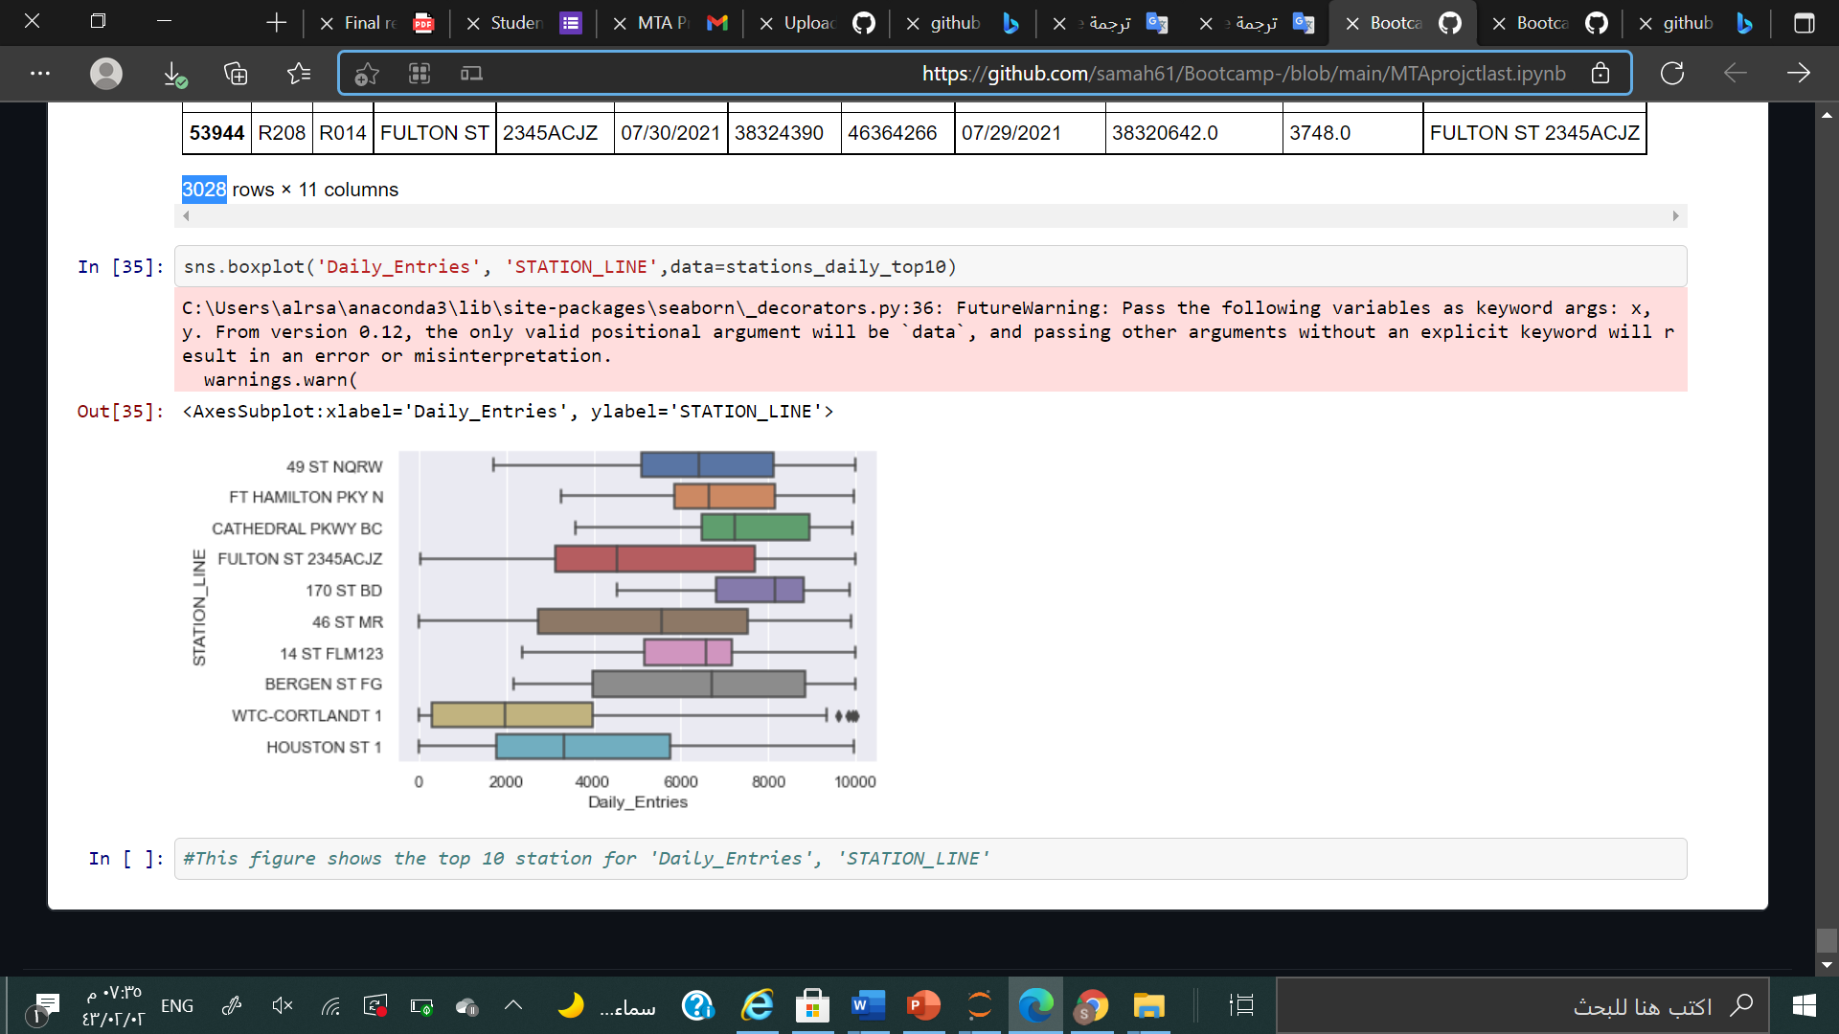

Slide 16


conclusion, the optimal advertising strategy is to target the ten stations with the highest exit rates. The poster advertisements should be placed near the exits at these locations and push notifications should be sent out between 8 AM and 12 PM. Finally, we recommend that turnstils should be distrubitis next to the coffee shops which has the highest number of coustomer .

Slide 17
Thank you!

