Slide 1

Analyzing Amazon Sales data

Slide 2
Introduction
Amazon is a Seattle, Washington–based e-commerce and cloud computing giant whose humble beginnings can be traced to founder Jeff Bezos's garage, where he began selling books on the still-emerging World Wide Web.
Amazon now places sales volume data for products within the search results and under the title on the product detail page.

Slide 3
Details of Data
Region: object
Country: object
Item Type: object
Sales Channel: object
Order Priority: object
Order Date: object
Order ID: int64
Ship Date: object
Units Sold: int64
Unit Price: float64
Unit Cost: float64
Total Revenue: float64
Total Cost: float64
Total Profit: float64

Slide 4
Main KPIs
Total Units Sold: 512,871
Total Revenue: $137,348,768.31
Total Cost: $93,180,569.91
Total Profit: $44,168,198.40
Average Unit Price: $276.76
Average Unit Cost: $191.05
Average Profit Margin: 32.16%
Additional :
Sales_month- Sales according to month
Sales_year- Sales according to year
Year_month sales- Sales according to year-month

Slide 5
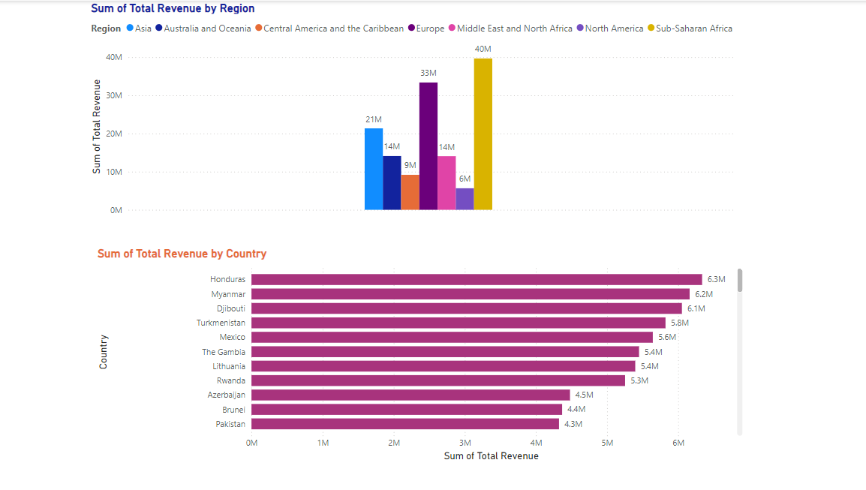
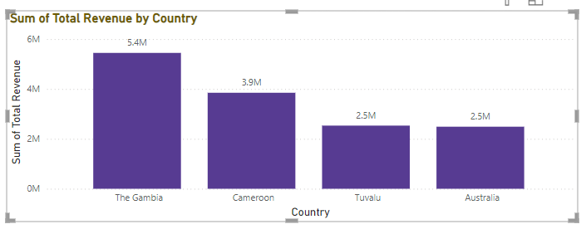

Mock-up Dashboard
Filter by country

Slide 6
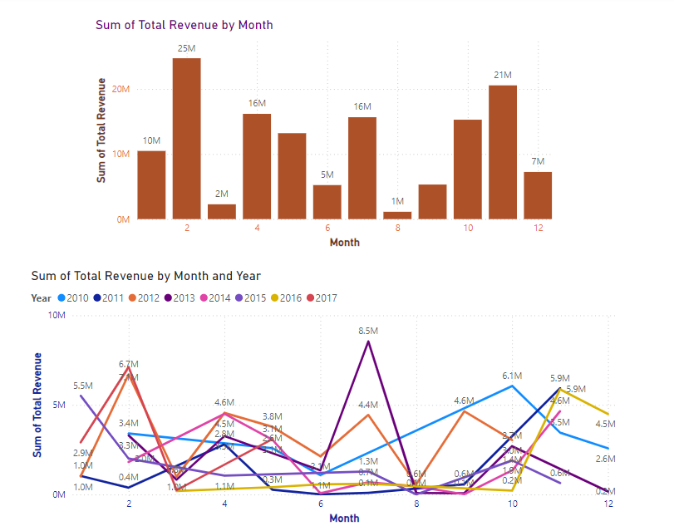
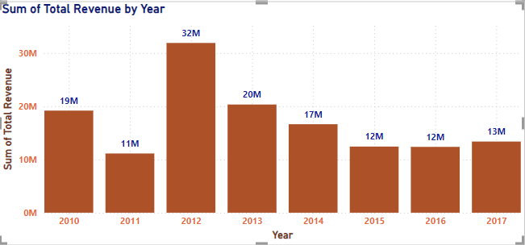
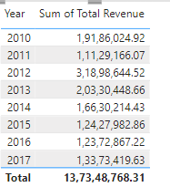
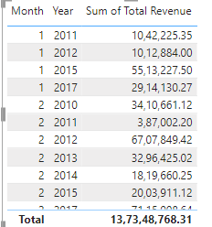
My Design
Amazon Sales Analysis by month-wise,
year-wise,yearly_month-wise

Slide 7


