Slide 1
COMPUTER ORGANIZATION & ARCHITECTURE
DESIGN AND SIMULATION OF
PROJECT TEAM
8-BIT SIGNED BINARY
YUVA NAYAN NARRA
Roll No: 2620030243
NUMBER REPRESENTATION
SANJANA
USING ONE'S COMPLEMENT METHOD
Roll No: 2620030234
SAMALA RUCHITHA
SIMULATION
LOGISIM
Roll No: 2620030235
SREEVALLI DEVARAI
Roll No: 2620030266
8 BIT
0
1
0
1
1
0
1
0
COA • DIGITAL LOGIC • LOGISIM
01

Slide 2
01 • THE PROBLEM
Why Do Computers Need Signed Numbers?
8-BIT WORD
CORE IDEA
0
1
0
0
0
1
0
1
Unsigned binary cannot represent values below zero.
MSB / SIGN
Signed representation adds a way to encode the sign while keeping the word fixed at 8 bits.
0 → positive
1 → negative
Remaining bits → value information
MSB
Presenter cue
SIGN
“The same 8 bits must tell the hardware both the value and its sign.”
COA • DIGITAL LOGIC • LOGISIM
02

Slide 3
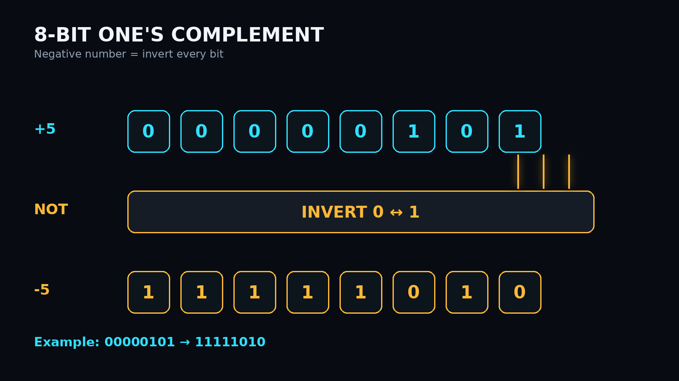
02 • THE METHOD
One's Complement = Bit Inversion
KEY RULE
Negative = NOT(Positive)
8-bit range
−127 to +127
+0 = 00000000
−0 = 11111111
COA • DIGITAL LOGIC • LOGISIM
03

Slide 4
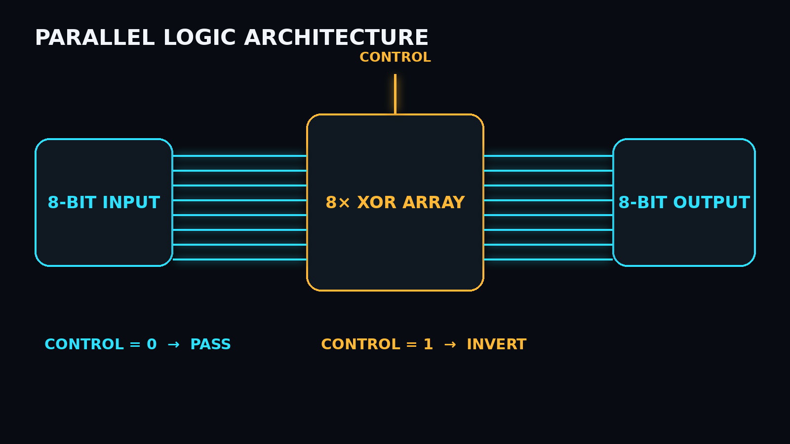
03 • ARCHITECTURE
From Mathematics to Logic Gates
DESIGN CHOICE
8-bit input
Parallel data lines
XOR array
Conditional inversion
Control
0 = pass • 1 = invert
8-bit output
Verified result
Y[i] = X[i] XOR CONTROL
COA • DIGITAL LOGIC • LOGISIM
04

Slide 5
04 • LOGISIM
Project Implementation in Logisim
Logisim-style simulation canvas
CONTROL
REAL LOGISIM VIEW
BUILD WITH
• Input Pins
8-BIT
INPUT
XOR / NOT
ARRAY
8-BIT
OUTPUT
• XOR / NOT gates
• Output Probes
• Hex Display
Interface reference:
component library + circuit canvas + simulation controls
• Control line
Example input: 00000101
Expected: 11111010
OUTPUT: PASS
Take a real Logisim screenshot and replace the schematic mockup here before submission.
Use your own circuit screenshot here after implementation.
VISUAL EVIDENCE • CIRCUIT + SIMULATION
COA • DIGITAL LOGIC • LOGISIM
05

Slide 6
05 • VERIFICATION
Simulation Test Cases
INPUT
8-BIT
1'S COMPLEMENT
RESULT
VERIFICATION LOGIC
+5
00000101
11111010
PASS
Expected output
+12
00001100
11110011
PASS
=
Logisim output
+25
00011001
11100110
PASS
+127
01111111
10000000
PASS
✓ PASS
Test multiple values before final demo.
Logisim simulation environment
COA • DIGITAL LOGIC • LOGISIM
06

Slide 7
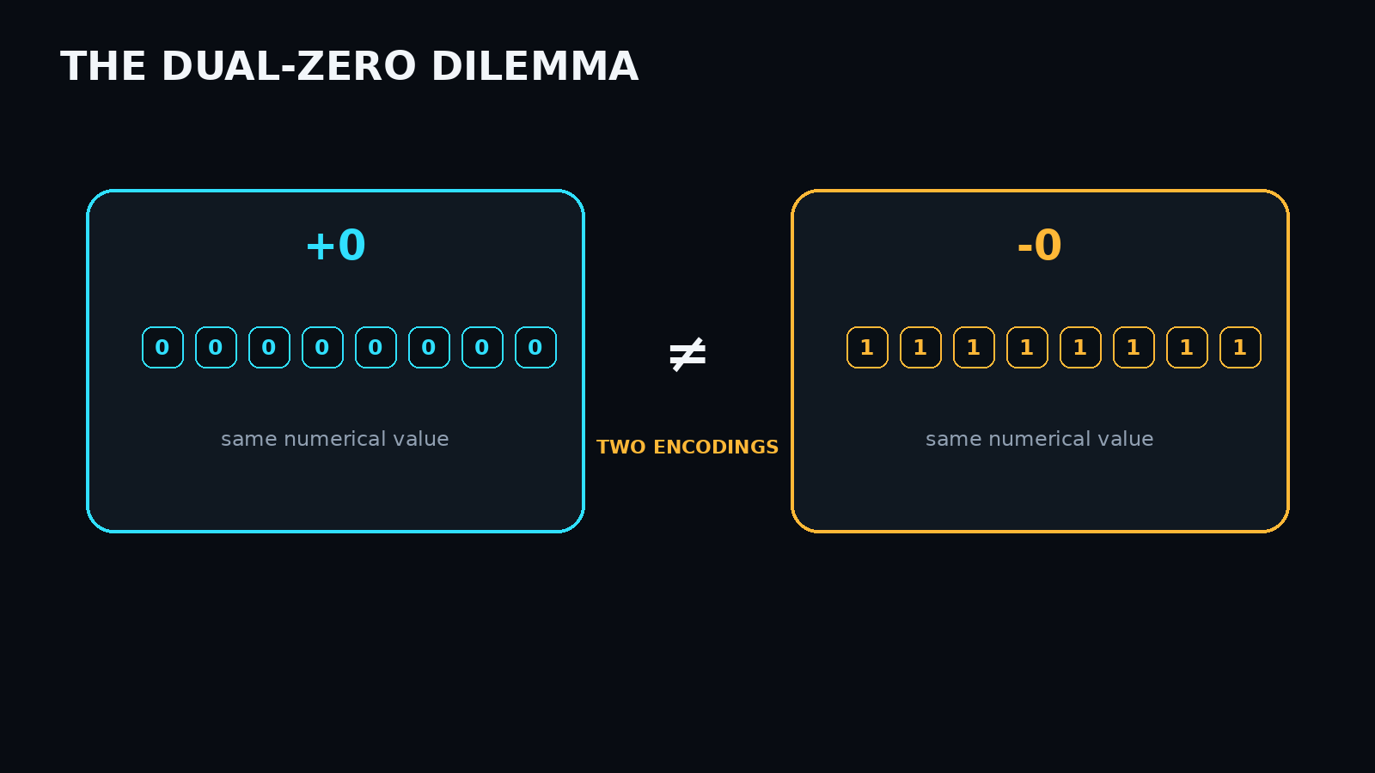
06 • CRITICAL ANALYSIS
The Dual-Zero Dilemma
WHY IT HAPPENS
Inversion maps every 0 to 1 and every 1 to 0.
Therefore:
00000000 → 11111111
Both encode zero.
Engineering impact: arithmetic needs extra handling.
COA • DIGITAL LOGIC • LOGISIM
07

Slide 8
07 • COMPARISON
One's Complement vs. Two's Complement
ONE'S COMPLEMENT
TWO'S COMPLEMENT
Negative
Invert bits
Negative
Invert + 1
Zero
Two representations
Zero
One representation
8-bit range
−127 … +127
8-bit range
−128 … +127
Addition
End-around carry
Addition
No end-around carry
Hardware
Simple inversion
Hardware
Adder + inversion
Project focus
Understand → implement → verify → analyze
Future scope
Extend the same design toward 2's complement
COA • DIGITAL LOGIC • LOGISIM
08

Slide 9
08 • WRAP-UP
Conclusion & Project Takeaways
01
UNDERSTAND
02
BUILD
03
SIMULATE
04
ANALYZE
Signed 8-bit representation
Parallel inversion logic
Logisim circuit implementation
Dual zero + trade-offs
FINAL INSIGHT
A simple bit-level rule can be translated directly into parallel digital hardware.
ONE'S COMPLEMENT → LOGIC GATES → LOGISIM → VERIFIED RESULT
THANK YOU
COA • DIGITAL LOGIC • LOGISIM
09

