Slide 1
Retire Statistical Significance (!) (?) – How Do We Know What We Know?
Professor Deborah Ashby
Director, School of Public Health,
Imperial College London
President, Royal Statistical Society
PSI Conference 2020
10th June 2020

Slide 2


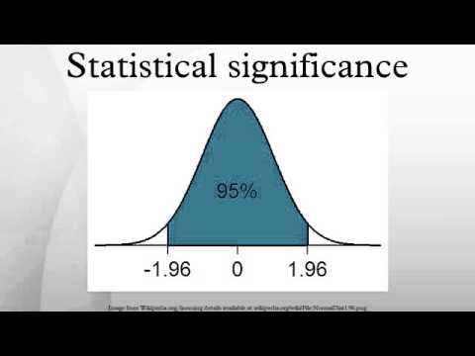


What do the following have in common?
Fire
Money
Knives
Power
Statistical significance

Slide 3
Inappropriate use of significance testing: bioequivalence
Not significantly different does NOT imply equivalence
Need to specify equivalence margins for parameter of interest
eg 90% CI for ratio of AUCs within (80%, 125%)
(Drug regulation mid-1990’s)
“To be inside the acceptance interval the lower bound should be ≥ 80.00% when rounded to two decimal places and the upper bound should be ≤ 125.00% when rounded to two decimal places.”
  (CHMP Guideline on the Investigation of Bioequivalence 2010)

Slide 4
Inappropriate use of significance testing: baseline testing
From the ‘editors concerns’ from NEJM clinical trial submission 2016:
6) The editors generally request that tables of baseline characteristics include information about the baseline variables, since strictly speaking all baseline differences have presumably occurred at random. However, we consider it useful to calculate the (nominal) P values for these comparisons, and to indicate with an asterisk and footnote which (if any) of the baseline characteristics differ at P <0.05. Please provide this information for new Table 1 and 2.
So, on the basis of choosing our fights carefully, we ended up with a similar statement to the other statistician’s as footnotes to the first two tables. We declined to use the recommended asterisk, we did give the actual P-value. Table 1 had no sig diffs, Table 2 had one at P=0.02. Quelle surprise!
(Correspondence with Doug Altman, who was facing similar battles with NEJM)

Slide 5
Appropriate use of significance testing: baseline testing
Fraud detection in clinical trials

Slide 6
Quantifying heterogeneity in a meta-analysis
I² much more informative than Q
(Julian Higgins and Simon Thompson SiM, 2002)

Slide 7
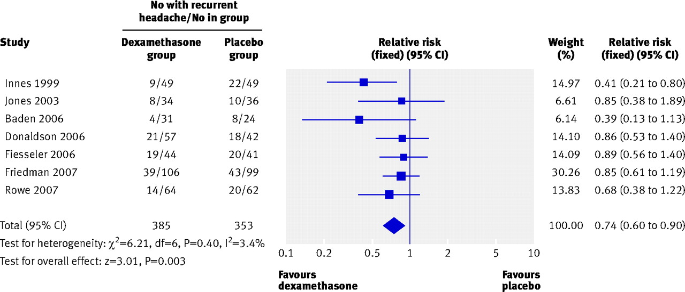

Meta-Analysis: Forest plot
Forest plot of the effectiveness of dexamethasone in preventing the recurrence of acute severe migraine headache in adults compared with placebo.
Sedgwick P BMJ 2011;341:bmj.d229
©2011 by British Medical Journal Publishing Group
Notes:
Forest plot of the effectiveness of dexamethasone in preventing the recurrence of acute severe migraine headache in adults compared with placebo

Slide 8
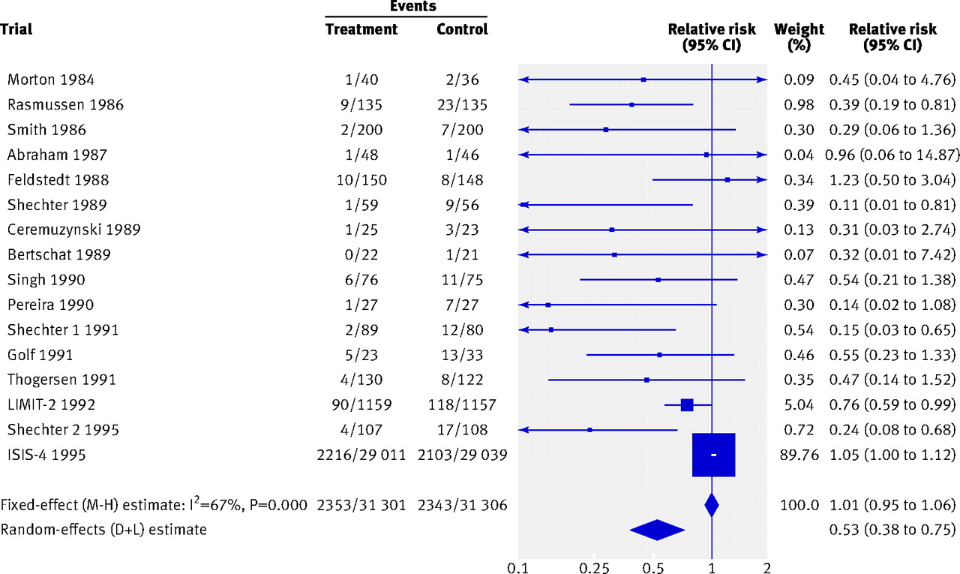
Meta-Analysis: Forest plot
Comparison of fixed and random effects meta-analytical estimates of the effect of intravenous magnesium on mortality after myocardial infarction.
Sterne J A C et al. BMJ 2011;343:bmj.d4002
©2011 by British Medical Journal Publishing Group
Notes:
Fig 5 Comparison of fixed and random effects meta-analytical estimates of the effect of intravenous magnesium on mortality after myocardial infarction

Slide 9
Why is statistical significance so abused?
Stems from a desire to make decisions
Seems nicely binary with language of “reject” and “accept”
cf dichotomisation
We can always do better by focussing on estimation with its associated uncertainty

Slide 10
Should we retire statistical significance?
Nature
Comment
20 March 2019
Scientists rise up against statistical significance
Valentic Armhein, Sander Greenland, Blakce McShance and more than 800 signatories call of an end to hyped claims and the dismissal of possibly crucial effects.

Slide 11
RSS comments
Deborah Ashby, RSS President
“I understand the desire for a ‘simple’ rule of thumb – but a naïve interpretation of p-values can lead to seriously wrong conclusions such as whether medicines are effective of not. This is well understood by many but misused by many more. I’ve signed to help draw attention to the dangers of this outdated practice and promote the wider use of better alternatives.”
David Spiegelhalter, RSS Past-President
  “I like p-values, but feel they are delicate things and should not be crudely split into “significant” and “not-significant”. I signed this article because I am fed up with researchers claiming a discovery when p<0.05, and claiming there is no effect when p>0.05.”

Slide 12
RSS comments continued
Guy Nason, RSS Vice-President for academic affairs
“I signed the article because I agree with it! I am often surprised by how the outcomes of statistical methods are used to communicate results with unwarranted definiteness, based on assumptions, sometimes hidden, for which there is also usually considerable uncertainty. I particularly liked the article’s idea to talk about results’ compatibility with the data.”
Stephen Senn, former RSS Council Member
  “Information is rarely dichotomous but decisions often are. Significance versus non-significance as a qualitative absolute distinction is ridiculous. As a threshold for action it may sometimes be justified but the appropriate standard will differ according to context.”

Slide 13
Decision making
Proper approaches to decision making exist if we need to formalise it
Decision-making under uncertainty closely allied with Bayesian statistics for decades, especially in health applications e.g. Raiffa, Schlaiffer, Cornfield, Lindley, Smith AFM, Smith J, Spiegelhalter, Berry, Parmigiani – see Ashby, SiM, 2006 for key references
Extend uncertainty analysis in a probabilistic model
Landscape for decisions through entire distributions
Growing applications but there is still resistance

Slide 14
The licensing challenge
The task of regulators (e.g. EMA, FDA) is to make a good and defensible decisions on which medicines should receive a license for which indications, based on the available evidence of risks and benefits
It is increasingly important to be able to justify and explain these decisions to patients and other stakeholders.
Can more formal approaches of decision-making, and especially more modern methods of graphical display help regulators do these better?

Slide 15
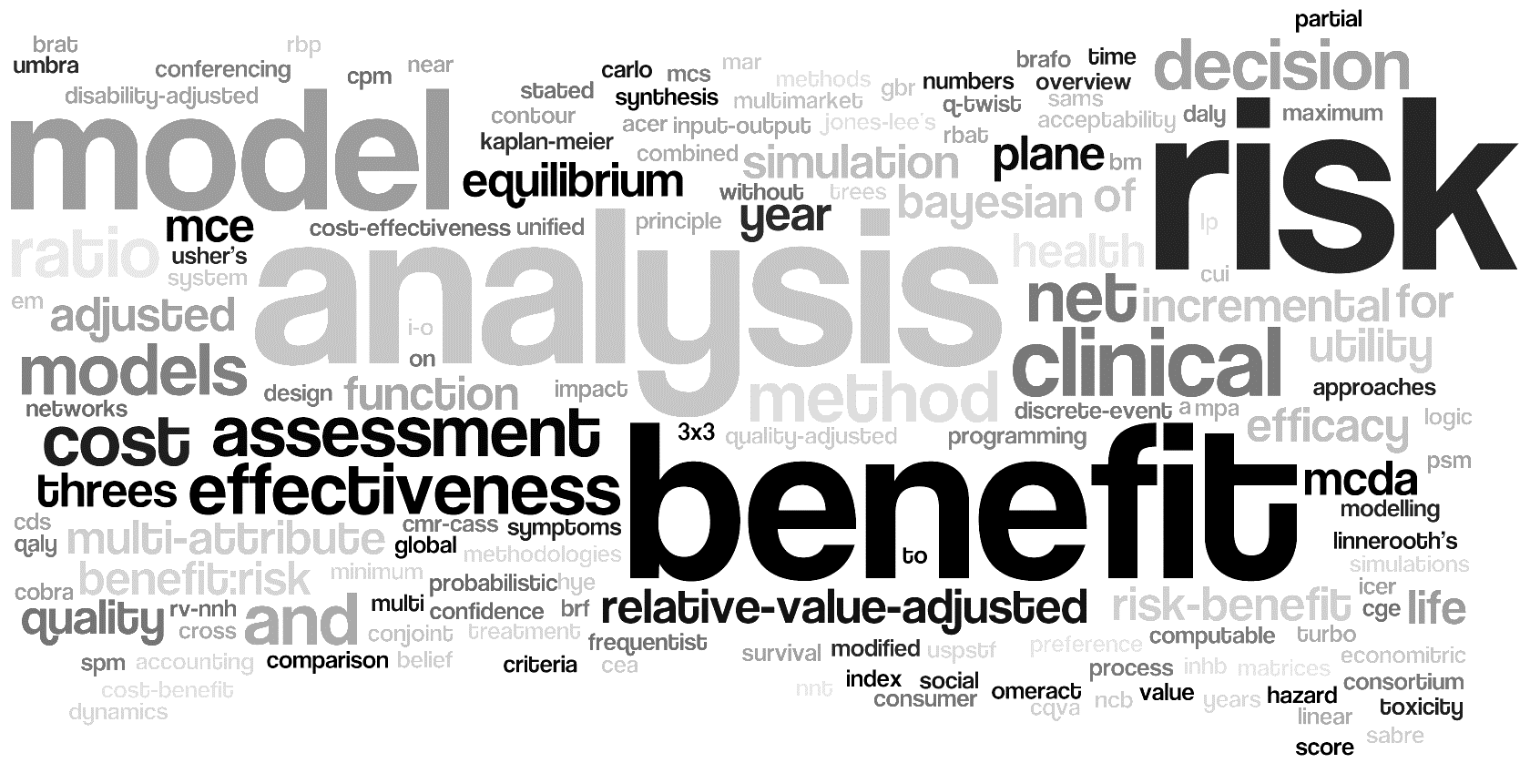

Methodologies available
Utility survey techniques
Estimation techniques
Utility survey techniques
Benefit-risk assessment framework
Estimation techniques
Benefit-risk assessment framework
Metric indices for B-R assessment
Metric indices for B-R assessment
Non –quantitative
Non –quantitative
Descriptive framework
Quantitative framework
Threshold indices
Health indices
Trade-off indices
Descriptive framework
Quantitative framework
Threshold indices
Health indices
Trade-off indices
SPM
CV
CA
DCE
-----o-----
AHP
Swing-weighting
MACBETH
PROACT-URL
ASF
BRAT
FDA BRF
CMR-CASS
COBRA
SABRE
UMBRA
OMERACT 3x3
BLRA
NCB
Decision tree
MDP
MCDA
SMAA
SBRAM
CUI
DI
QALY
DALY
HALE
Q-TWiST
UT-NNT
INHB
BRR
GBR
Principle of 3
TURBO
Beckmann
DAGs
PSM
CPM
ITC
MTC
CDS
SPM
CV
CA
DCE
-----o-----
AHP
Swing-weighting
MACBETH
PROACT-URL
ASF
BRAT
FDA BRF
CMR-CASS
COBRA
SABRE
UMBRA
OMERACT 3x3
BLRA
NCB
Decision tree
MDP
MCDA
SMAA
SBRAM
CUI
DI
NNT
NNH
AE-NNT
RV-NNH
Impact numbers
MCE
RV-MCE
MAR
NEAR
QALY
DALY
HALE
Q-TWiST
UT-NNT
INHB
BRR
GBR
Principle of 3
TURBO
Beckmann
DAGs
PSM
CPM
ITC
MTC
CDS
NNT
NNH
AE-NNT
RV-NNH
Impact numbers
MCE
RV-MCE
MAR
NEAR
Mt-Isa et al. Balancing benefit and risk of medicines: a systematic review and classification of available methodologies. Pharmacoepidemiology and Drug Safety 2014. DOI: 10.1002/pds.3636.

Slide 16
Value tree: Natalizumab case study
Reduction in relapse rate
Benefits
Slowdown in disability progression
Administration
PML
Benefit-risk balance
Reactivation of serious herpes viral infections
Serious side effects
Seizures
Abortion or congenital abnormalities
Risks
Transaminase elevation
Infusion or injection site reactions
Mild side effects
Hypersensitivity reactions
Flu-like reactions

Slide 17
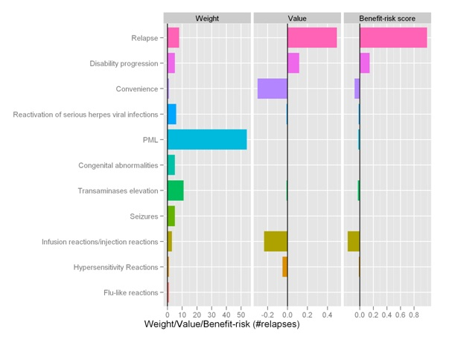
Natalizumab: MCDA weighted utilities analysis
Contribution of each outcome for Natalizumab vs. placebo
The Benefit-risk is the product of the weight and the value.
Most of the Benefit-risk contribution is coming from prevention of relapses.
Infusion site reactions are the worst risk

Slide 18
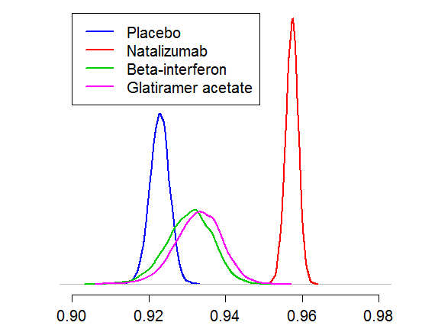
Natalizumab: Bayesian sensitivity analysis
Distribution of overall benefit-risk score
P(natalizumab ranked 1st) = 1

Slide 19

Dissemination and recommendations arising from PROTECT
http://PROTECTBenefitRisk.eu/

Slide 20
Alternatives to statistical significance
Estimate quantities of interest
Show uncertainty from statistical modelling
Acknowledge other sources of uncertainty e.g. uncertainty about model, biases
Consider more formal approaches to decision making

Slide 21










Significance from the RSS and ASA not to be retired!

