Slide 1
UML Class Diagrams
Notes:
‹#›
‹#›

Slide 2
Class
Template for object creation:
  Instantiated into objects
  An abstract data type (ADT)‏
Examples: Employees, Books, etc.
Sometimes not intended to produce instances:
  Abstract classes
Notes:
‹#›

Slide 3
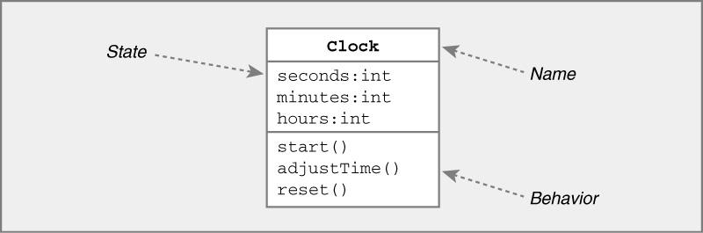
UML Class Diagrams
Represent the (static) structure of the system
General In Java In C++
  Name Name Name
  State Variables Members
  Behavior Methods Functions
Notes:
‹#›

Slide 4
Class Attribute Examples
Java Syntax | UML Syntax
Date birthday | Birthday:Date
Public int duration = 100 | +duration:int = 100
Private Student students[0..MAX_Size] | -Students[0..MAX_Size]:Student
Notes:
‹#›

Slide 5
UML Class Representation
A class represents a set of objects having similar attributes, operations, relationships and behavior.
Class Name
Window
A class can implicitly have a few association attributes
size: Size
visibility: boolean
Inline Attributes
display()
hide()
Operations
Notes:
‹#›

Slide 6
Example UML Classes
LibraryMember
LibraryMember
LibraryMember
Member Name
Membership Number
Address
Phone Number
E-Mail Address
Membership Admission Date
Membership Expiry Date
Books Issued
issueBook( );
findPendingBooks( );
findOverdueBooks( );
returnBook( );
findMembershipDetails( );
issueBook( );
findPendingBooks( );
findOverdueBooks( );
returnBook( );
findMembershipDetails( );
Different representations of the LibraryMember class
Notes:
‹#›

Slide 7
Visibility Syntax in UML
Visibilty | Java Syntax | UML Syntax
public | public | +
protected | protected | #
package |  | ~
private | private | -
Notes:
‹#›

Slide 8
Relationships Between Classes
Association
  Permanent, structural, “has a”
  Solid line (arrowhead optional)
Aggregation
  Permanent, structural, a whole created from parts
  Solid line with diamond from whole
Dependency
  Temporary, “uses a”
  Dotted line with arrowhead
Generalization
  Inheritance, “is a”
  Solid line with open (triangular) arrowhead
Implementation
  Dotted line with open (triangular) arrowhead
OR
Notes:
‹#›

Slide 9
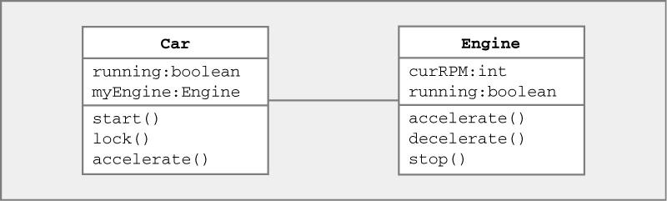
Association
Denotes permanent, structural relationship
State of class A contains class B
Represented by solid line (arrowhead optional)
Car and Engine classes know about each other
Notes:
‹#›

Slide 10
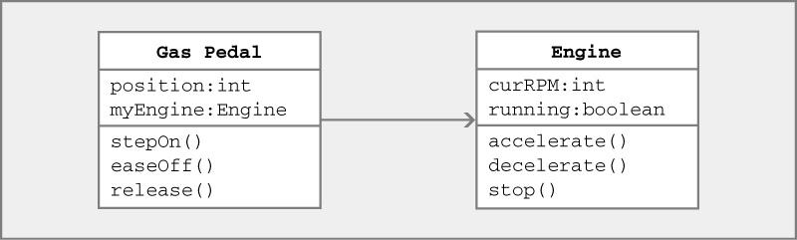
Associations w/ Navigation Information
Can indicate direction of relationship
Represented by solid line with arrowhead
Gas Pedal class knows about Engine class Engine class doesn’t know about Gas Pedal class
Notes:
‹#›

Slide 11
Associations w/ Navigation Information
Denotes “has-a” relationship between classes
“Gas Pedal” has an “Engine”
State of Gas Pedal class contains instance of Engine class ⇒ can invoke its methods
Notes:
‹#›

Slide 12

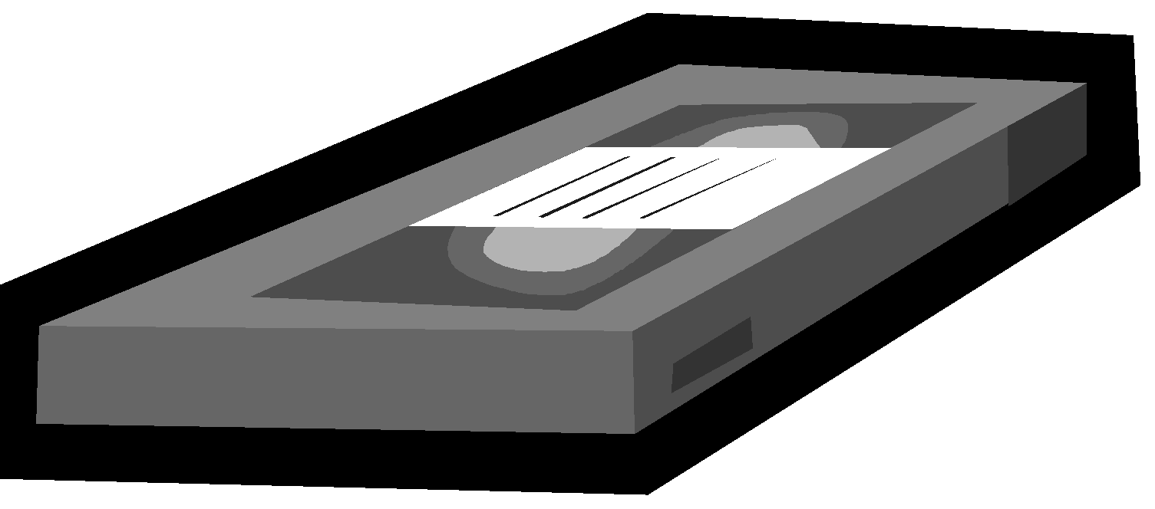
Association – example
In a home theatre system,
  A TV object has an association with a VCR object
    It may receive a signal from the VCR
  VCR may be associated with remote
    It may receive a signal (command) to record
1
1
1
Remote
VCR
1
TV
commands
Connected to
Notes:
‹#›

Slide 13
1-1 Association – example
tax_file
Rakesh Shukla
760901-1234
V. Ramesh
691205-5678
People
Tax_files
People
1
1
Tax_files
Associated with
Notes:
‹#›

Slide 14
Multiple Association – example
motherOf
Bhim
motherOf
Kunti
Yudhistir
motherOf
Arjun
Women
People
Women
1
*
People
Mother of
Notes:
‹#›

Slide 15
Association UML Syntax
role B
Class A
Class B
role A
A Person works for a Company.
Role
Person
Company
employee
employer
works for
Association Name
Notes:
‹#›

Slide 16
Association - More Examples
Library Member
0..5
Book
1
borrowed by
Lion
*
eats
Human
*
Notes:
‹#›

Slide 17
Navigability
Door
Key
opens
*
0..5
Notes:
‹#›

Slide 18
Association – Multiplicity
A teacher teaches 1 to 3 courses (subjects)
Each course is taught by only one teacher.
A student can take between 1 to 5 courses.
A course can have 10 to 300 students.
Teacher
1
teaches
1..3
Course
1..5
Students
takes
10..300
Notes:
‹#›
1.

Slide 19
Quiz: Draw Class Diagram
A Student can take up to five Courses.
A student has to enroll in at least one course.
Up to 300 students can enroll in a course.
A class should have at least 10 students.
Notes:
‹#›
1.

Slide 20
Student
credits
hasEnrolmentOf
Course
10..300
1..5
Enrols in
Notes:
‹#›

Slide 21
Student
credits
hasEnrolmentOf
Course
Enrols in
10..300
1..5
Student
credits
hasEnrolmentOf
Course
Enrols in
10..300
1..5
Student
credits
hasEnrolmentOf
Course
Enrols in
10..300
1..5
Notes:
‹#›

Slide 22
Quiz: Read the Diagram?
Teacher
1..2
teaches
0..3
Course
*
opens
0..5
Door
Key
Notes:
‹#›

Slide 23
Association and Link
A link:
  An instance of an association
  Exists between two or more objects
  Dynamically created and destroyed as the run of a system proceeds
For example:
  An employee joins an organization.
  Leaves that organization and joins a new organization etc.
Notes:
‹#›

Slide 24
Association Relationship
A class can be associated with itself (recursive association).
  Give an example?
An arrowhead used along with name:
  Indicates direction of association.
Multiplicity indicates # of instances taking part in the association.
Notes:
‹#›

Slide 25
Self Association: Example 0
Person
Friend of
Notes:
‹#›

Slide 26
Self Association: Example 0
Computer Network
Connects to
*
Computer
*
Notes:
‹#›

Slide 27
Computer Network: Object Diagram
Node1
Node2
Node3
Node4
Node5
Node6
Node7
Node8
Notes:
‹#›

Slide 28

Self Association: Example 1
next
LinkedListNode
previous
Notes:
‹#›

Slide 29
Reflexive Association: Example 2
Course
*
is pre-requisite for
*
has pre-requisite of
Notes:
‹#›

Slide 30
Multiplicity of Associations
Some relationships may be quantified
Multiplicity denotes how many objects the source object can legitimately reference
Notation
  * ⇒ 0, 1, or more
  5 ⇒ 5 exactly
  5..8 ⇒ between 5 and 8, inclusive
  5..* ⇒ 5 or more
Notes:
‹#›

Slide 31
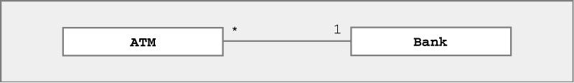
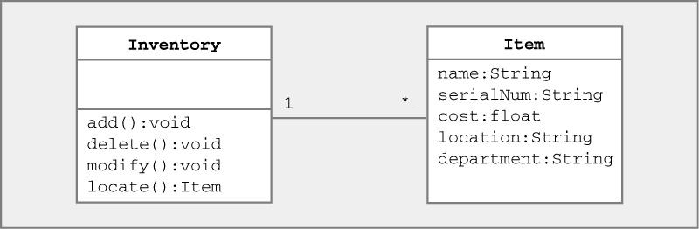
Multiplicity of Associations
Many-to-one
  Bank has many ATMs, ATM knows only 1 bank
One-to-many
  Inventory has many items, items know 1 inventory
Notes:
‹#›

Slide 32
Aggregation and Composition
A special kind of association
Models whole-part relationship between things
Whole is usually referred to as composite
Notes:
‹#›

Slide 33
Composite aggregation
Also referred to as composition
Composite solely owns the part and they are in a tree structure parts hierarchy
Most common form of aggregation
In UML, represented by filled diamond
Hand
Finger
1
0..7
Notes:
‹#›

Slide 34
Shared Aggregation
Part may be in many composite instances
In UML, represented as hollow diamond
Network
Node
Arc
Notes:
‹#›

Slide 35
How to identify aggregation
Lifetime of part is bound within lifetime of composite
  There is a create-delete dependency
There is an obvious whole-part physical or logical assembly
Some properties of composite propagate to parts (e.g., location)
Operations applied to composite propagate to parts (e.g., destruction, movement, recording)
Notes:
‹#›

Slide 36
Why show aggregation
Clarifies domain constraints regarding part- whole relationship
Assists in identification of a creator
Operations applied to whole should usually propagate to parts
Identifying whole wrt a part supports encapsulation
Notes:
‹#›

Slide 37
Dependency
Denotes dependence between classes
Always directed (Class A depends on B)
Represented by dotted line with arrowhead
A
B
A depends on B
Notes:
‹#›

Slide 38
Dependency
Caused by class methods
Method in Class A temporarily “uses a” object of type Class B
Change in Class B may affect class A
A
B
A uses object of class B
Notes:
‹#›

Slide 39
Dependency
Dependence may be caused by
  Local variable
  Parameter
  Return value
Example
  Class A { Class B {
  B Foo(B x) { …
  B y = new B(); …
    return y; …
  } } }
Notes:
‹#›

Slide 40
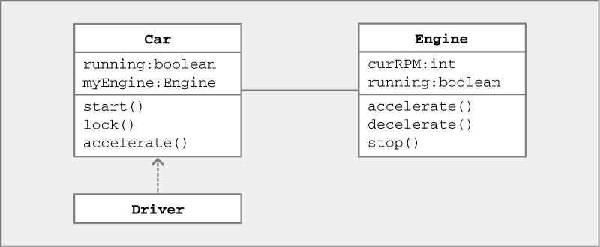
Dependency Example
Class Driver depends on Class Car
Notes:
‹#›

Slide 41
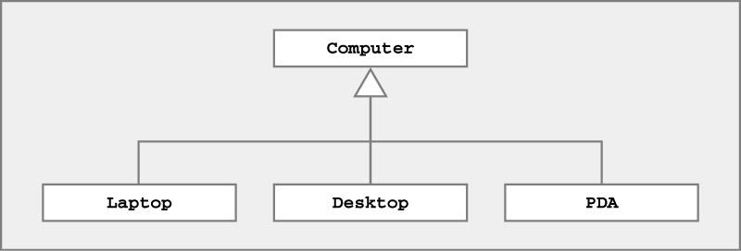
Generalization
Denotes inheritance between classes
Can view as “is-a” relationship
Represented by line ending in (open) triangle
Laptop, Desktop, PDA inherit state & behavior from Computers
Notes:
‹#›

Slide 42
Implementation
Denotes class implements Java interface
Represented by dotted line ending in (open) triangle
A
«B»
A implements interface B
Notes:
‹#›

Slide 43
UML Examples
Read UML class diagram
Try to understand relationships
Examples
  Pets & owners
  Computer disk organization
  Banking system
  Home heating system
  Printing system
Notes:
‹#›

Slide 44
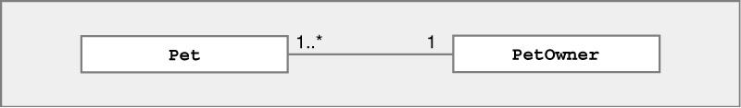
UML Example – Veterinary System
Try to read & understand UML diagram
Notes:
‹#›

Slide 45
UML Example – Veterinary System
Try to read & understand UML diagram
1 or more Pets associated with 1 PetOwner
Notes:
‹#›

Slide 46
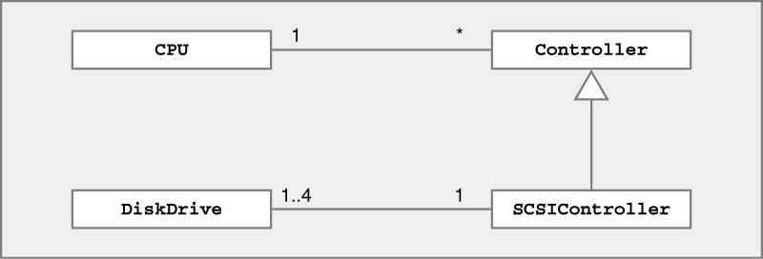
UML Example – Computer System
Try to read & understand UML diagram
Notes:
‹#›

Slide 47
UML Example – Computer System
Try to read & understand UML diagram
1 CPU associated with 0 or more Controllers
1-4 DiskDrives associated with 1 SCSIController
SCSIController is a (specialized) Controller
Notes:
‹#›

Slide 48
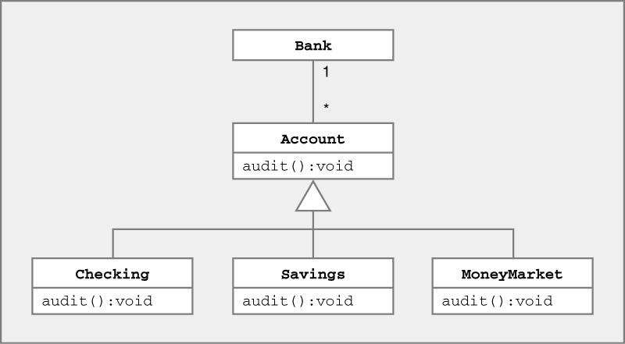
UML Example – Banking System
Try to read & understand UML diagram
Notes:
‹#›

Slide 49
UML Example – Banking System
1 Bank associated with 0 or more Accounts
Checking, Savings, MoneyMarket are Accounts
Notes:
‹#›

Slide 50
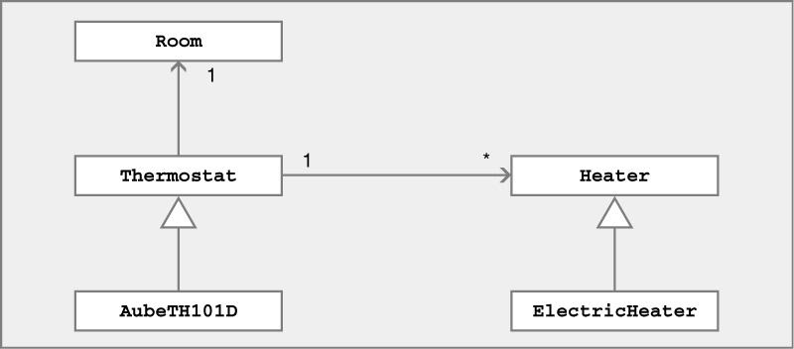
UML Example – Home Heating System
Try to read & understand UML diagram
Notes:
‹#›

Slide 51
UML Example – Home Heating System
Each Thermostat has 1 Room
Each Thermostat associated with 0 or more Heaters
ElectricHeater is a specialized Heater
AubeTH101D is a specialized Thermostat
Notes:
‹#›

Slide 52
UML Class Diagrams ↔ Java
Different representation of same information
  Name, state, behavior of class
  Relationship(s) between classes
Practice deriving one from the other
  Accurately depicting relationship between classes
Notes:
‹#›

Slide 53
UML → Java : Veterinary System
UML
Java
Notes:
‹#›

Slide 54
UML → Java : Veterinary System
UML
Java
  class Pet {
  PetOwner myOwner; // 1 owner for each pet
  }
  class PetOwner {
  Pet [ ] myPets; // multiple pets for each owner
  }
Notes:
‹#›

Slide 55
Java → UML : Veterinary System
Java
  class Pet {
  PetOwner myOwner; // 1 owner for each pet
  }
  class PetOwner {
  Pet [ ] myPets; // multiple pets for each owner
  }
UML
Notes:
‹#›

Slide 56
Java → UML : Veterinary System
Java
  class Pet {
  PetOwner myOwner; // 1 owner for each pet
  }
  class PetOwner {
  Pet [ ] myPets; // multiple pets for each owner
  }
UML
Notes:
‹#›

Slide 57
UML Class Diagrams ↔ Java
UML
Java
  class Pet {
  PetOwner myOwner; // 1 owner for each pet
  }
  class PetOwner {
  Pet [ ] myPets; // multiple pets for each owner
  }
Notes:
‹#›

Slide 58
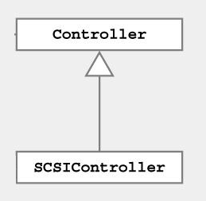
UML → Java : Computer System
UML
Java
Notes:
‹#›

Slide 59
UML → Java : Computer System
UML
Java
  class Controller {
  }
  class SCSIController extends Controller {
  }
Notes:
‹#›

Slide 60
UML → Java : Computer System
UML
Java
  Design code using all available information in UML…
Notes:
‹#›

Slide 61
UML → Java : Computer System
Java
  class CPU {
  Controller [ ] myCtlrs;
  }
  class Controller {
  CPU myCPU;
  }
  class SCSIController extends Controller {
  DiskDrive [ ] myDrives = new DiskDrive[4];
  }
  Class DiskDrive {
  SCSIController mySCSI;
  }
Notes:
‹#›

Slide 62
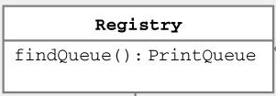
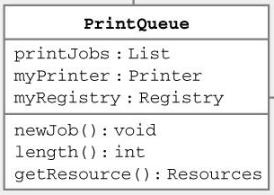
Java → UML : Printing System
Java
  class Registry {
  PrintQueue findQueue();
  }
  class PrintQueue {
  List printJobs;
  Printer myPrinter;
  Registry myRegistry;
  void newJob();
  int length();
  Resources getResource();
  }
Notes:
‹#›

Slide 63

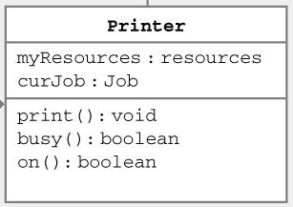
Java → UML : Printing System
Java
  Class Printer {
  Resources myResources;
  Job curJob;
  void print();
  boolean busy();
  boolean on();
  }
  class Job {
  Job(Registry r) {
  …
  }
  }
Notes:
‹#›

Slide 64
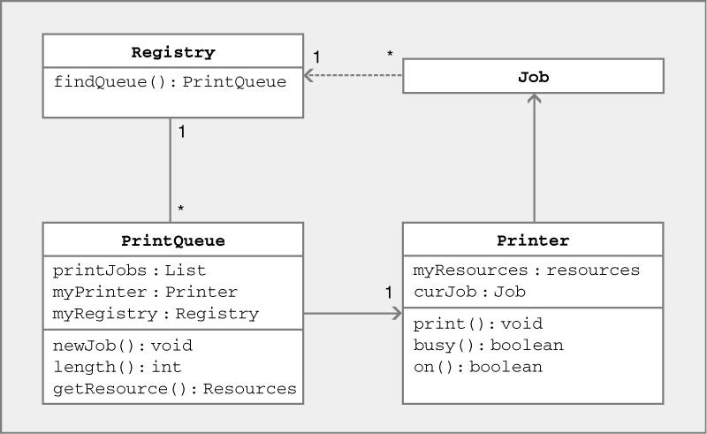
Java → UML : Printing System
Notes:
‹#›

Slide 65
Implementing Association Relationship: Example 1
To implement in Java:
  Use a reference variable of one class as an attribute of another class
Bookname: OOSD
Author: Gamaa
ISBN: 12234434
abook
Book Reference
Book instance
Member
Book
Bookname:
memberName: AKK
Member Number: 412323
1
1
Borrowed
by
abook
Notes:
‹#›

Slide 66
public class Member{
private Book book;
public issueBook(Book abook){
setBook(abook);
abook.setLender(this);
}
setBook(Book abook){
book=abook;
}
…
}
Book
Member
1
1
Borrowed
by
Notes:
‹#›

Slide 67
public class Book{
private Member member;
setLender(Member aLender){
member=aLender;
}
…
}
Book
Member
1
1
Borrowed
by
Notes:
‹#›

Slide 68
Association Implementation: Example 2
Student
hasEnrolmentOf
credits
Course
1..300
enrols
1..5
Class Student { Observe the
Course credits[5]; Navigation
…
}
Class Course {
Student hasEnrolmentOf[300];
…
}
Notes:
‹#›

Slide 69
Association Example 2
A Person works for a Company.
Role
Implicit attribute of Company
Implicit attribute of Person
Person
Company
employee
employer
works for
Association Name
Observe: Implicit bidirectional navigation
Implementation?
Notes:
‹#›

Slide 70
Example 2 Implementation
public class Company {
private Person employee;
public void setCompany(Person p){ employee=p;}
}
public class Person {
private Company employer;
public Company getWorksFor() {
return employer;
}
public void setWorksFor(Company c) {
employer=c;
}
}
Notes:
‹#›

Slide 71
Code for Association Multiplicity
class Customer{
private ArrayList <Account> accounts = new ArrayList<Account>();
public Customer() {
Account defaultAccount = new Account();
accounts.add(defaultAccount);
}
}
Customer
has
Account
1
1..*
Notes:
‹#›

Slide 72
1-1 Association Example 3
has
1
1
Advertiser
Account
public class Advertiser {
private Account account;
public Advertiser() {
account = new Account(this);
}
public Account getAccount() {
return account;
}
}
Now, Write code for Account
Notes:
‹#›
If Advertiser accesses only Account, but not vice versa, the class Account can be made a local attribute in the Advertiser class

Slide 73
1-1 Association
Advertiser
1
1
Account
public class Advertiser {
private Account account;
public Advertiser() {
account = new Account(this);
}
public Account getAccount() {
return account;
}
}
public class Account {
private Advertiser owner;
publicAccount(Advertiser owner) {
this.owner = owner;
}
public Advertiser getOwner() {
return owner;
}
}
Notes:
‹#›

Slide 74
Quiz: Read and understand UML class diagram
has
CPU
Controller
1
0..2
1..4
1
DiskDrive
SCSIController
controls
1 CPU has 0 to two Controllers
1-4 DiskDrives controlled by 1 SCSIController
SCSIController is a (specialized) Controller
Notes:
‹#›

Slide 75
Java Code?
has
  class CPU {
  Controller [ ] myCtlrs;
  }
  class Controller {
  CPU myCPU;
  }
  class SCSIController extends Controller {
  DiskDrive [ ] myDrives = new DiskDrive[4];
  }
  Class DiskDrive {
  SCSIController mySCSI;
  }
CPU
1
Controller
*
1..4
1
DiskDrive
SCSIController
controls
Notes:
‹#›

Slide 76
Quiz 1: Write Java Code
1
issues
1
Member
Book
?
?
Source code?
Notes:
‹#›

Slide 77
Quiz 2: Draw UML Class Diagram
    public class TreeMap {
    TreeMapNode topNode = null;
    public void add(Comparable key, Object value) {…}
    public Object get(Comparable key) {…}
    }
    class TreeMapNode {
    private Comparable itsKey;
    private Object itsValue;
    private TreeMapNode nodes[] = new TreeMapNode[2];
    public TreeMapNode(Comparable key, Object value) {…}
    public Object find(Comparable key) {…}
    public void add(Comparable key, Object value) {…}
    }
Notes:
‹#›

Slide 78
Ternary Association
Man
Woman
1
1
marry
1..3
Priest
and we can add more classes to the diamond…
Notes:
‹#›

Slide 79
Implementation of Ternary Association
There are several ways in which ternary association can be implemented.
  One is to decompose it to a set of binary associations
Man
Marriage
Woman
1
1
1
1
Participates in
Participates in
*
Performed by
1..3
Priest
Notes:
‹#›

Slide 80
Record
Goals against
Goals for
Player
Team
1..11
1
*
Season
Notes:
‹#›

Slide 81
Association Quiz
Book
Editor
title: String
*
1
name: String
Edited by
editor: String
myBooks: Book
What is the problem?
Association denoted by symbol not attributes.
Implementation (pointers, arrays, vectors, ids etc) is left to the detailed design phase.
Wrong arrow type
Notes:
‹#›

Slide 82
Types of Class Relationships
Relation
Generalization
Association
Dependency
Binary Association
N-ary Association
Aggregation
Composition
Notes:
‹#›
‹#›

Slide 83
Overdoing Associations
Avoid unnecessary Associations
PersonInfo
Address
E-Mail
Birthday
PersonInfo
Name
Address
E-Mail
Birthday
Person
Name
1
1
Avoid This
Do This
Notes:
‹#›

Slide 84
Aggregation Relationship
1
*
*
1
Document
Paragraph
Line
1
*
*
1
Company
Person
Club
employs
memberOf
Notes:
‹#›

Slide 85
Aggregation
cont…
An aggregate object contains other objects.
Aggregation limited to tree hierarchy:
  No circular inclusion relation.
Notes:
‹#›

Slide 86
Composition
A stronger form of aggregation
  The whole is the sole owner of its part.
    A component can belong to only one whole
  The life time of the part is dependent upon the whole.
    The composite must manage the creation and destruction of its parts.
Circle
1
Point
Circle
3..*
Point
Polygon
Notes:
‹#›

Slide 87
Composition Relationship
Life of item is same as the order
Order
1
*
Item
Notes:
‹#›

Slide 88
Composition
An object may be a part of ONLY one composite at a time.
  Whole is responsible for the disposition of its parts.
whole
Window
1
*
Frame
part
Notes:
‹#›

Slide 89
Aggregation vs. Composition
Composition:
  Composite and components have the same life.
Aggregation:
  Lifelines are different.
Consider an order object:
  Aggregation: If order items can be changed or deleted after placing the order.
  Composition: Otherwise.
Notes:
‹#›

Slide 90
Implementing Composition
public class Car{
private Wheel wheels[4];
public Car (){
wheels[0] = new Wheel();
wheels[1] = new Wheel();;
wheels[2] = new Wheel();;
wheels[3] = new Wheel();;
}
}
1
4
Car
Wheel
Notes:
‹#›

Slide 91
Summary
Focus: Class diagrams
  Contents of a class
  Relationship between classes
You should be able to
  Draw UML class diagram given code
  Write code given UML class diagram
Notes:
‹#›

