Slide 1
Object-Oriented Software Engineering
Practical Software Development using UML and Java
Focusing on Users and Their Tasks

Slide 2
7.1 User Centred Design
Software development should focus on the needs of users
  Understand your users
  Design software based on an understanding of the users’ tasks
  Ensure users are involved in decision making processes
  Design the user interface following guidelines for good usability
  Have users work with and give their feedback about prototypes, on-line help and draft user manuals

Slide 3
The importance of focusing on users
  Reduced training and support costs
  Reduced time to learn the system
  Greater efficiency of use
  Reduced costs by only developing features that are needed
  Reduced costs associated with changing the system later
  Better prioritizing of work for iterative development
  Greater attractiveness of the system, so users will be more willing to buy and use it

Slide 4
7.2 Characteristics of Users
Software engineers must develop an understanding of the users
  Goals for using the system
  Potential patterns of use
  Demographics
  Knowledge of the domain and of computers
  Physical ability
  Psychological traits and emotional feelings

Slide 5
What is a Use Case
Use Cases are the main tasks performed by the users of the system.
Use Cases describe the behavioral aspects of the system.
Use Cases are used to identify how the system will be used.
Use Cases are a convenient way to document the functions that the system must support.
Use Cases are used to identify the components (classes) of the system.

Slide 6
Development of a Use Case Diagram
Identify all of the actors who will use the system.
2. Interview these actors to identify the functions that they need to perform. (use cases)
3. Identify scenarios (sequence of steps to accomplish a use case).
4. Identify common steps within the different scenarios. Separate them into different use cases so that they can easily be included in other scenarios.
5. Identify relationships between use cases.

Slide 7
Use cases [1]
Excellent technique for improving the understanding of requirements
Narrative in nature
Use cases are dependent on having some understanding of the requirements (expressed in functional specifications document).

Slide 8
Use Cases [2]
Use case - narration of the sequence of events of an actor using a system
UML icon for use case

Slide 9
Actors [1]
Actor - an entity external to the system that in some way participates in the use case. Actor represents a role that a user can play.
An actor typically stimulates the system with input events or receives outputs from the system or does both.
Actors are treated like classes and can be generalized.
Primary actor: Use the system to achieve a goal. (found in left side of the use case diagram)
Secondary actor: plays a supporting role to facilitate the primary actor to achieve their goal. (right side)

Slide 10
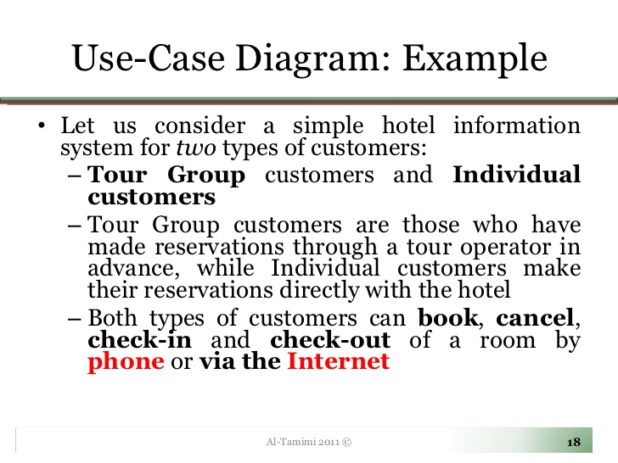

Slide 11
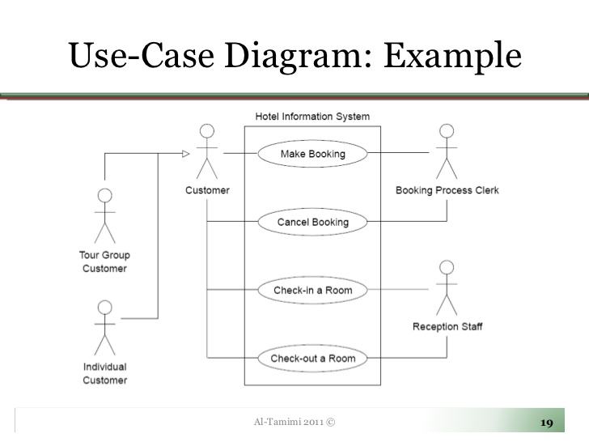

Slide 12
Identification of Use Cases
Method 1 - Actor based
  Identify the actors related to the system
  Identify the processes these actors initiate or participate in
Method 2 - Event based
  Identify the external events that a system must respond to
  Relate the events to actors and use cases
Method 3 – Goal based
  [Actors have goals.]
  Find user goals. [Prepare actor-goal list.]
  Define a use case for each goal.
  (try to use several approaches for identifying use cases, and then cross-check to be sure no use cases have been overlooked)

Slide 13
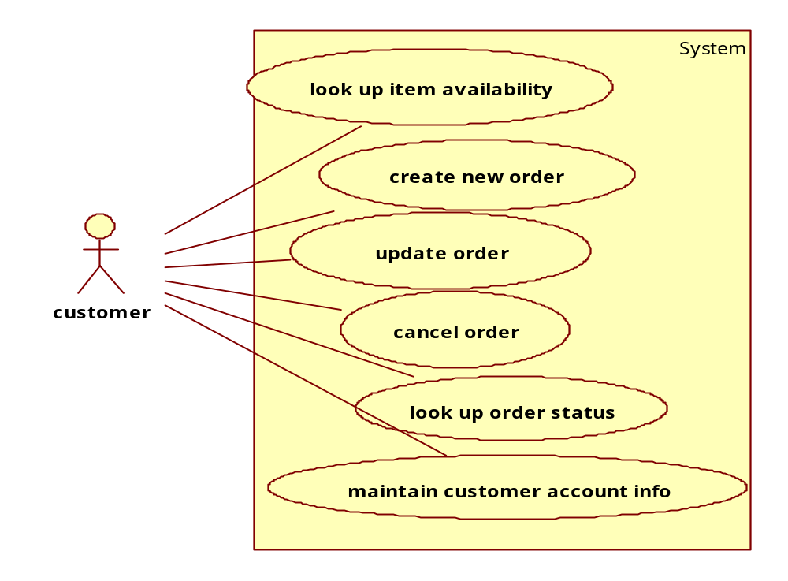
Actor based use cases

Slide 14
Event based use cases
External event: Occurs outside the system, initiated by an external agent.
Example: “customer pays bill”, “customer changes address”, “management wants some information”.
Temporal event: occurs as a result of reaching a point in time. It occurs inside the system. System produces some output automatically without being told to do so.
No external agent is making demands, but the system is supposed to generate needed information.
Example: “time to send late notice”, “time to send monthly statements”, “time to produce weekly summary report”.
State event: occurs when something happens inside the system that triggers the need for processing.
Example: if the sales of a product results in an adjustment to an inventory record and the inventory in stock drops below a Reorder point reached.
© Lethbridge/Laganière 2005
Chapter 7: Focusing on Users and Their Tasks

Slide 15
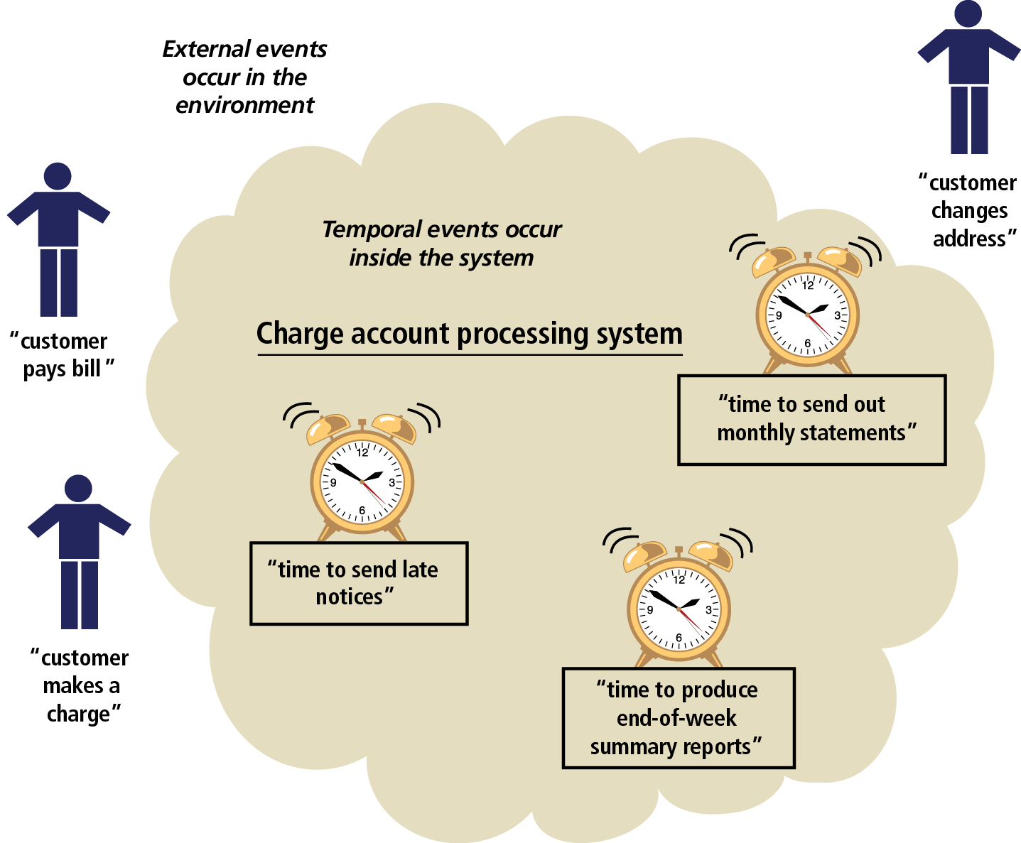
Events Affecting a Charge Account Processing System that Lead to Use Cases
Object-Oriented Analysis and Design with the Unified Process

Slide 16
Goal-based
Identifying use cases by focusing on users and their goals
USER\ACTOR | USER GOAL
customer | Look up item availability Create new order Update order
Shipping clerk | Record order fulfillment Record back order

Slide 17
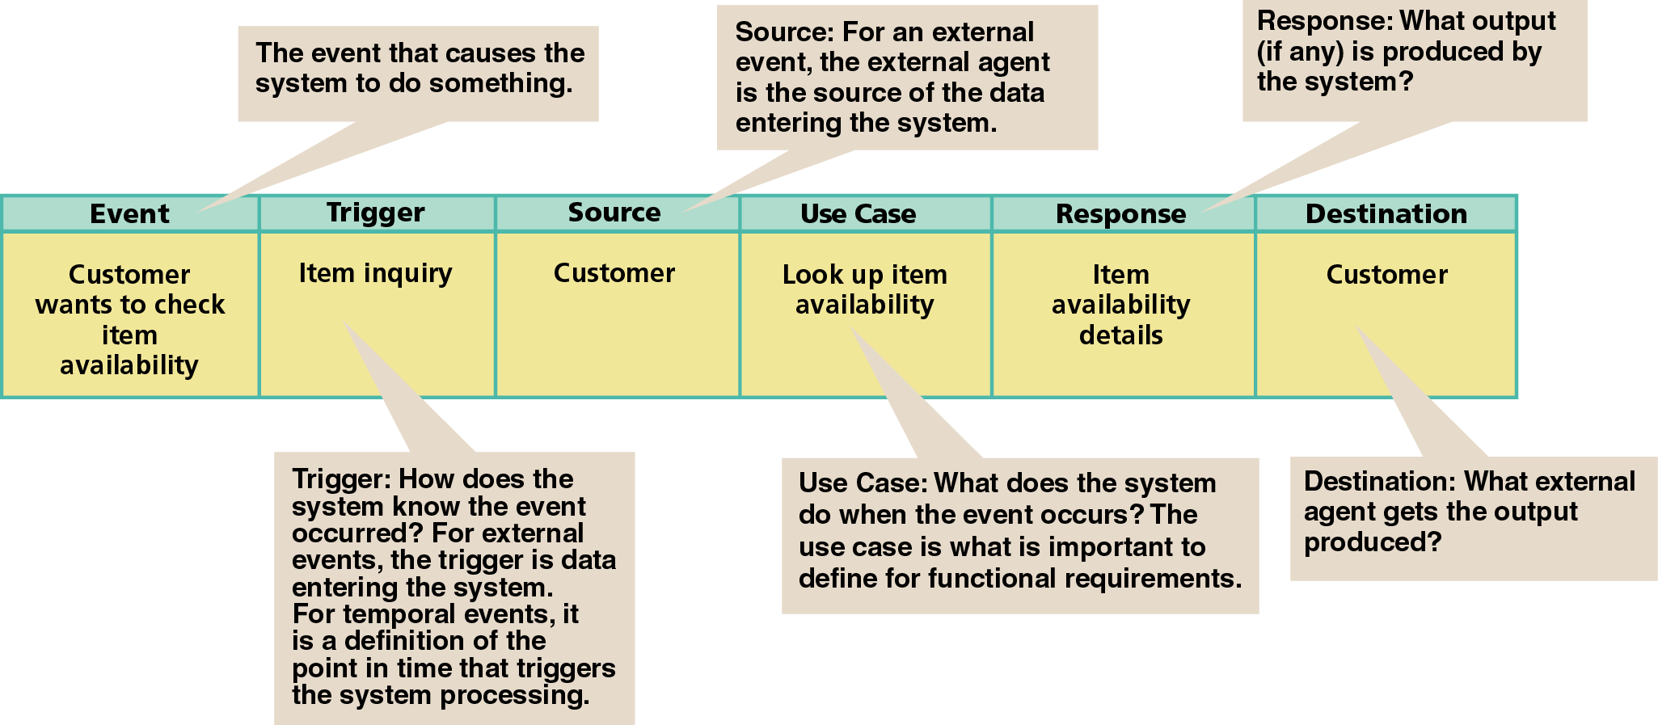
Information about each Event and the Resulting Use Case in an Event Table

Slide 18
Identification of Use Cases[2]
To identify use cases, focus on elementary business processes (EBP).
An EBP is a task performed by one person in one place at one time, in response to a business event. This task adds measurable business value and leaves data in a consistent state.
9/3/01

Slide 19
Point of Sale - Actors
Actors:
  Cashier
  Customer
  Supervisor
Choosing actors:
  Identify system boundary
  Identify entities, human or otherwise, that will interact with the system, from outside the boundary.
  Example: A temperature sensing device is an actor for a temperature monitoring application.
9/3/01

Slide 20
High level vs. Low Level Use cases[1]
Consider the following use cases:
  Log out
  Handle payment
  Negotiate contract with a supplier
These use cases are at different levels. Are they all valid? To check, use the EBP definition.
Log out: a secondary goal; it is necessary to do something but not useful in itself.
Handle payment: A necessary EBP. Hence a primary goal.
9/3/01

Slide 21
High level vs. Low Level Use cases [2]
Log out: a secondary goal; it is necessary to do something but not useful in itself.
Handle payment: A necessary EBP. Hence a primary goal.
Negotiate contract: Most likely this is too high a level. It is composed of several EBPs and hence must be broken down.
9/3/01

Slide 22
Use Case Diagram - Example
Process sale
Payment
Authorization
service
Cashier
Handle returns
<<actor>>
Tax calculator
Process rental
Manage security
<<actor>>
Accounting system
System administrator
Manage users
Use Case Diagram: illustrates a set of use cases for a system.
9/3/01

Slide 23
More on Use Cases
Try to describe use cases independent of implementation
Be as narrative as possible
State success scenarios (how do you measure the success of an use case)
A use case can have many scenarios (threads of execution)
Agree on a “format style” for use case description
Name a use case starting with a verb in order to emphasize that it is a process (Buy Items, Enter an order, Reduce inventory)
9/3/01

Slide 24
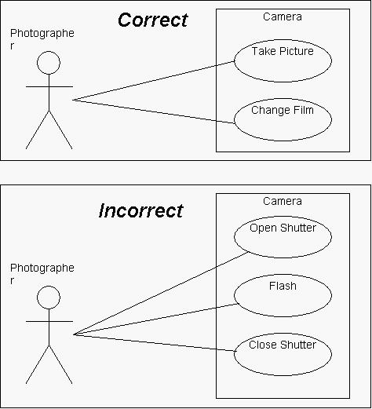
Identify high level functions

Slide 25
Use-Case Diagrams (POST)
POST: Point of Sale Terminal
Use Case
POST
System Boundary
Buy Item
Log In
Cashier
Customer
Refund a Purchased Item
Adapted from Larman “Applying UML and Patterns”

Slide 26
Question answer
Suppose we want to develop software for an alarm clock. The clock shows the time of day. Using buttons, the user can set the hours and minutes ﬁelds individually, and choose between 12 and 24-hour display. It is possible to set one or two alarms. When an alarm ﬁres, it will sound some noise. The user can turn it off, or choose to ’snooze’. If the user does not respond at all, the alarm will turn off itself after 2 minutes. ’Snoozing’ means to turn off the sound, but the alarm will ﬁre again after some minutes of delay. This ’snoozing time’ is pre-adjustable.
Identify the top-level functional requirement for the clock, and model it with a use
case diagram.

Slide 27
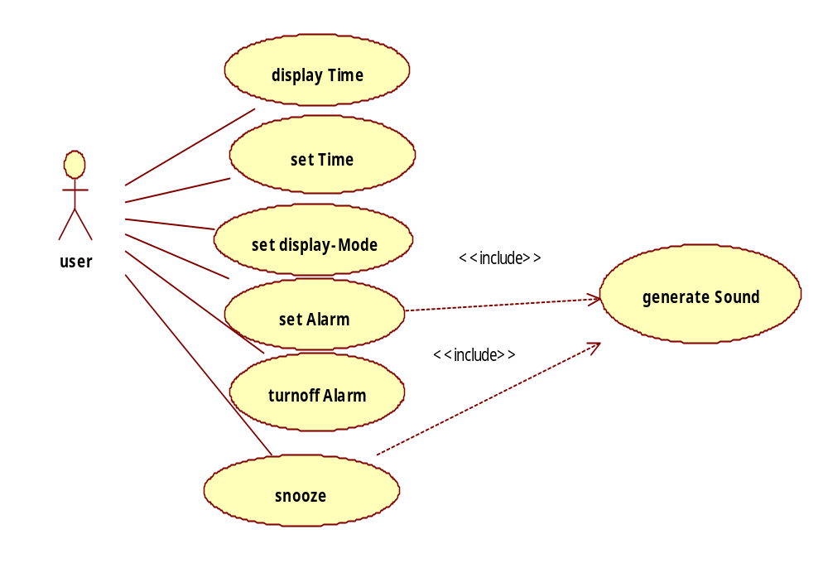
Answer

Slide 28
Assume that ’snooze’ would be one of your use cases. Work it out to the fully dressed level.
.
Use case: Snooze
Primary actor: User
Secondary actors: -
Pre-condition: An alarm is ﬁring.
Post-condition: -
Main ﬂow:
1. The use-case is activated when the user hits the snooze button.
2. The alarm is turned off.
3. Wait for snooze time.
4. Include use case ’Make sound’
Use case: Make sound
Primary actor: System
Secondary actors: -
Pre-condition: -
Post-condition: -
Main ﬂow:
The use case starts when it is called. What it does is to just make some noisy sound.

Slide 29
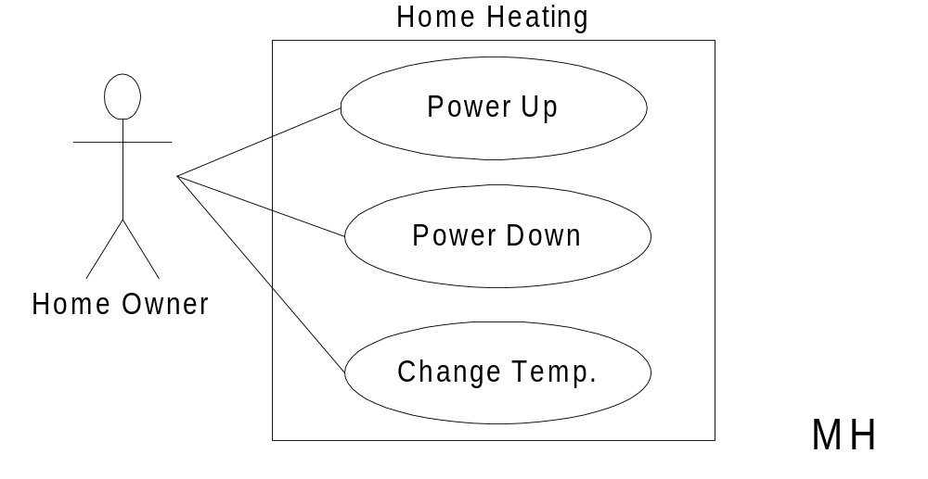
Home Heating Use-Case Diagram

Slide 30
Modified Home Heating
Home Heating
Power Up
Temp. High
«includes»
«includes»
Power Down
Adjust Temp
Home Owner
«includes»
«includes»
Change Temp.
Temp. Low
MH
05-Use-Cases

Slide 31
Modified:
Home Heating Use-Cases
*
Use case: Power Up
Actors: Home Owner (initiator)
Type: Primary and essential
Description: The Home Owner turns the power on.
Perform Adjust Temp. If the temperature
in all rooms is
above the desired temperature, no actions are taken.
Cross Ref.: Requirements XX, YY, and ZZ
Use-Cases: Perform Adjust Temp
05-Use-Cases

Slide 32
Modified:
Home Heating Use-Cases
*
Use case: Adjust Temp
Actors: System (initiator)
Type: Secondary and essential
Description: Check the temperature in each room. For each room:
Below target: Perform Temp Low
Above target: Perform Temp High
Cross Ref.: Requirements XX, YY, and ZZ
Use-Cases: Temp Low, Temp High
05-Use-Cases

Slide 33
Emphasize Goals
Investigating goals rather than tasks and procedures improves information gathering by focusing on the essence of requirements—the intent behind them.
Seeing requirements as identifying tasks to be done has a strong bias toward reproducing the existing system, even when it is being replaced because it is seriously defective.

Slide 34
Why Use Cases?
Simple and familiar storytelling makes it easier, especially for customers, to contribute and review goals.
Use cases keep it simple (KISS)
They emphasize goals and the user perspective.
New use case writers tend to take them too seriously.

Slide 35
Actors or Use Case First?
Because you have to understand each part of Use Cases, the parts are presented separately. But those who create use cases switch back and forth. The text describes use cases substantially before paying attention to actors. Typically, both actors and use cases are identified early and then examined to see if more use cases can be found from the actors, or more actors found by examining the use cases.

Slide 36
Identify Use Cases
Capture the specific ways of using the system as dialogues between an actor and the system.
Use cases are used to
  Capture system requirements
  Communicate with end users and Subject Matter Experts
  Test the system

Slide 37
Use Cases are not Diagrams
A use case is an activity the system carries out, in response to a request by a user.
Techniques for identifying use cases:
  List all users and think through what they need the system to do for their jobs.
  Start with the existing system and list all system functions that are currently included, adding any new functionality required by the user.
Use Cases may have a diagram associated with them, and a use case diagram is an easy way for an analyst to discuss a process with a subject matter expert.
But use cases are primarily text. The text is important. The diagram is optional.

Slide 38
Specifying Use Cases
Create a written document for each Use Case
  Clearly define intent of the Use Case
  Define Main Success Scenario (Happy Path)
  Define any alternate action paths
  Use format of Stimulus: Response
  Each specification must be testable
  Write from actor’s perspective, in actor’s vocabulary

Slide 39
www.usecases.org Template
This is the basic format used in the text and in Alistair Cockburn’s Writing Effective Use Cases (Addison Wesley, 2000, ISBN 0201702258).
I prefer to modify it slightly to use the actor actions and system response in tabular form. Larman calls this the Two-Column Variation.
Name
Primary Actor
Scope
Level
Stakeholders and Interests
Minimal Guarantee
Success Guarantee
Main Success Scenario
Extensions

Slide 40
Identify Actors
We cannot understand a system until we know who will use it
  Direct users
  Users responsible to operate and maintain it
  External systems used by the system
  External systems that interact with the system

Slide 41
Specifying Actors
Actors are external to the system
Actors are non-deterministic
What interacts with the system?
Actors may be different roles that one individual user interacts with the system
Actors may be other systems
Don’t assume that Actor = Individual

Slide 42
Types of Actors
Primary Actor
  Has goals to be fulfilled by system
Supporting Actor
  Provides service to the system
Offstage Actor
  Interested in the behavior, but no contribution
In diagrams, Primary actors go on the left and others on the right.

Slide 43
Define Actors
Actors should not be analyzed or described in detail unless the application domain demands it.
Template for definition:
  Name
  Definition
Example for an ATM application:
Customer: Owner of an account who manages account by depositing and withdrawing funds

Slide 44
Identifying Actors
Primary Actor
  Emphasis is on the primary actor for the use case.
Stakeholders and Interests
  Other actors are listed as stakeholders.
  The interests of each key actor should be described.

Slide 45
Working with Use Cases
Determine the actors that will interact with the system
Examine the actors and document their needs
For each separate need, create a use case
During Analysis, extend use cases with interaction diagrams

Slide 46
Preconditions
Anything that must always be true before beginning a scenario is a precondition.
Preconditions are assumed to be true, not tested within the Use Case itself.
Ignore obvious preconditions such as the power being turned on. Only document items necessary to understand the Use Case.

Slide 47
Success Guarantees
Success Guarantees (or Postconditions) state what must be true if the Use Case is completed successfully. This may include the main success scenario and some alternative paths. For example, if the happy path is a cash sale, a credit sale might also be regarded a success.
Stakeholders should agree on the guarantee.

Slide 48
Scenarios
The Main Success Scenario, or “happy path” is the expected primary use of the system, without problems or exceptions.
Alternative Scenarios or Extensions are used to document other common paths through the system and error handling or exceptions.

Slide 49
Documenting the Happy Path
The Success Scenario (or basic course) gives the best understanding of the use case
Each step contains the activities and inputs of the actor and the system response
If there are three or more items, create a list
Label steps for configuration management and requirements traceability
Use present tense and active voice
Remember that User Interface designers will use this specification
Note: Do not use the term “happy path” in formal documents.

Slide 50
Extensions (Alternative Flows)
Extensions or Alternative Flow Use Cases allow the specification of
  Different ways of handling transactions
  Error processes
Sections are convenient way to handle alternative courses of action
  Sections are a segment of a use case executed out of sequence

Slide 51
Two Parts for Extensions
Condition
  Describe the reason for the alternative flow as a condition that the user can detect
Handling
  Describe the flow of processing in the same manner as the happy path, using a numbering system consistent with the original section.

Slide 52
Expanded Essential
Use Cases
How to make one:
  Step 1: Name the Use Case (system function, e.g. “enter timesheet information”).
  Step 2: Identify the Actor(s) involved.
  Step 3: Describe the Intent of the Use Case in language the client will understand.
  Step 4: Identify the Assumptions and Limitations relevant to this Use Case and other Use Cases which the current one might extend or build upon.
  Step 5: Specify the ideal flow of actions using two columns labeled “Actor Actions” and “System Responses.” Number each step. This constitutes the Happy Path for this Use Case.
  Step 6: Identify opportunities for user error and create an Alternative Path to handle each.
Notes:
The Expanded Essential Use Case is a transition document between the Analysis phase and the Design phase of software development. During this transition, documents are created less and less in langage of the client, and more and more in the language of the computer programmer. For Expanded Essential Use Cases there are two main goals: 1) to give the client an idea of what it will be like for the user to actually use the system and 2) to give the developer a start on developing system objects and pseudocode.
With the Expanded Essential Use Case, the developer will be able to identify major events during system use and translate them into event contracts and function specifications.
Each specification must describe something tangible and testable so that once the system has been completed it can be demonstrated that the Use Case was satisfied.

Slide 53
More on Use Cases
Document exception handling or branching
  when a “Buy Item” fails, what is expected of the system
  when a “credit card” approval fails, what is expected of the system
9/3/01
CS 406 Fall 2001 Requirements Analysis

Slide 54
Use Case ID:
Use Case Name:
Created By: |  |  | Last Updated By:
Date Created: |  |  | Last Revision Date:
Actors:
Description:
Trigger:
Preconditions:
Postconditions:
Normal Flow:
Alternative Flows:
Exceptions:
Includes:
Frequency of Use:
Special Requirements:
Assumptions:
Notes and Issues:

Slide 55
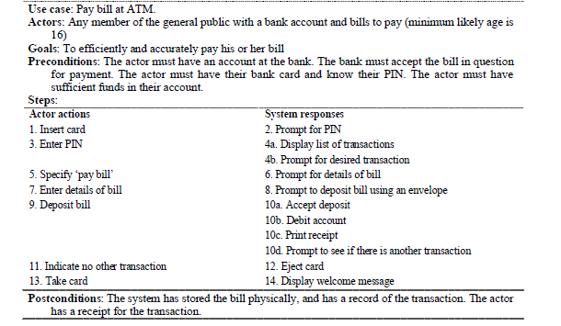

Slide 56
The «include» and «extend» Relationships in Use Case Models
UML defines three stereotypes of association between Use Cases
«include»
«extend»
generalisation

Slide 57
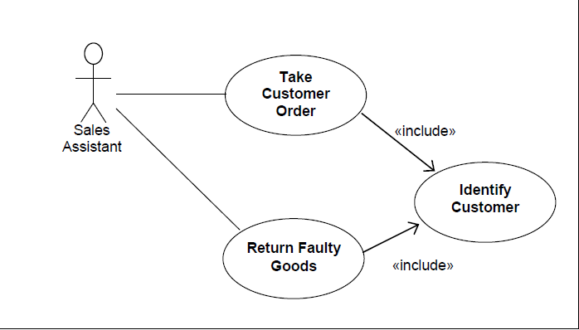
<<include>>
The «include» relationship allows us to include the steps from one Use Case into another.

Slide 58
«extend»
The «extend» relationship allows us to modify the behavior of the base Use Case.
Suppose we want to sell products that are made to order and require a degree of customer specification. For these products we will need to record the customer’s additional requirements, such as size and colour. In this case we are adding something extra to the flow of the base Use Case.

Slide 59
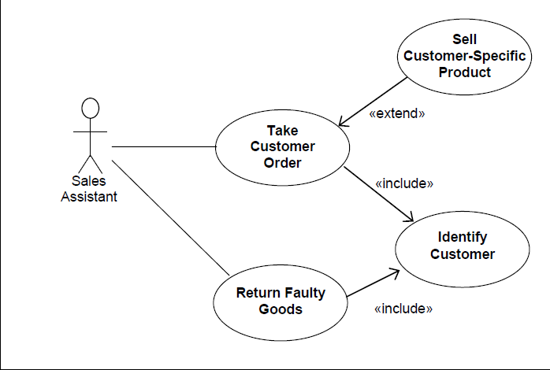

Slide 60
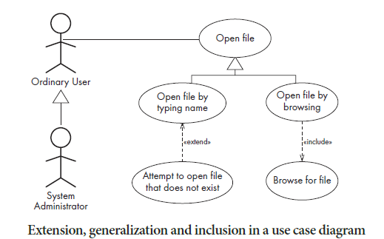

Slide 61
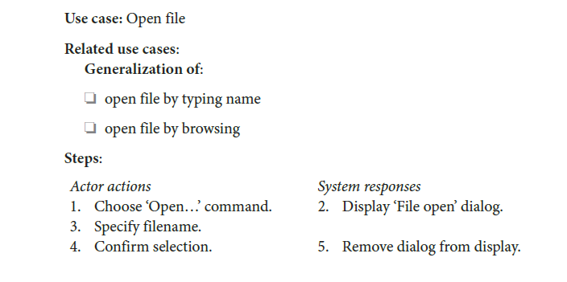

Slide 62
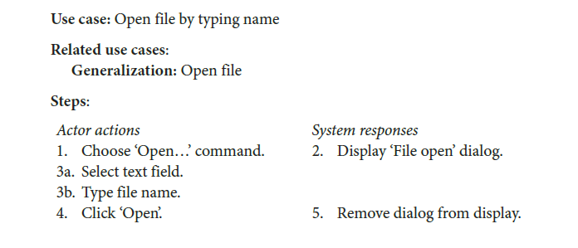

Slide 63
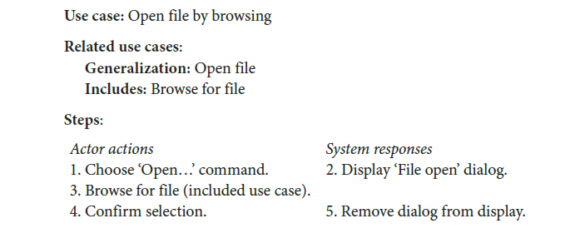

Slide 64
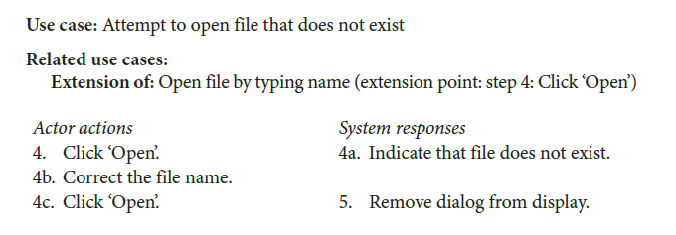

Slide 65
