Slide 1
Evolution of the MSV Soil-Moisture Platform
From 555-Timer Sensing to a Connected FDC2214 Probe
Sam Amezcua — UC Davis, Department of Electrical and Computer Engineering
MSV1 proof of concept → MSV2 connected field platform → MSV3 solar-assisted probe
August 2026 project status
Notes:
The talk is an engineering retrospective: what changed, which tests drove those changes, and what remains uncertain.

Slide 2
Why Soil-Moisture Sensing?
Motivation
• Plants get under- or over-watered because moisture isn't visible.
• Low-cost resistive probes corrode and polarize from continuous soil current.
• Capacitive electrodes reduce direct DC conduction through the soil.
• A practical product also needs low power, communication, calibration, and history.
Notes:
Frame the project as a complete measurement system. Later failures occurred in every block, not only at the electrode. ("Why not just buy a $5 resistive sensor" is the question to pre-empt here.)

Slide 3
Design Objectives
Objectives
• Repeatable moisture response across wet/dry cycles
• Minimal long-term electrode polarization
• Battery or harvested-energy operation
• Wireless raw-data delivery and per-probe calibration
• Recoverable local/cloud history
Notes:
Avoid claiming absolute volumetric water content -- the current goal is a stable, plant-specific moisture indicator.

Slide 4
Current End-to-End System
System
• Probe: nRF52840-class MCU, capacitive front end, advertise-only BLE
• Receiver: ESP32-S3, local TFT interface, calibration, filtering
• Backend: Supabase history storage
• Client: progressive web application
• MSV2 and MSV3 probes feed the same receiver/cloud family
Notes:
MSV3 is a probe redesign, not a replacement for the complete receiver/application system.

Slide 5
Three Generations at a Glance
Roadmap
Generation | Measurement principle | Output path | Main reason to advance
MSV1 | 555 frequency → analog voltage | LED threshold | Analog range compression
MSV2 | GPIO relaxation timing | BLE → receiver/cloud | Timing, supply, and polarization sensitivity
MSV3 | FDC2214 resonant conversion | Same receiver/cloud path | WIP: validate stability and harvested power
Notes:
This table is the story of the presentation. Each transition was driven by measured behavior, not feature expansion for its own sake.

Slide 6
MSV1 Architecture
MSV1
• Interdigitated PCB comb as the sensing capacitor
• Astable 555: moisture-dependent frequency
• Monostable 555: fixed-width pulse
• RC low-pass filter: duty cycle to voltage
• Comparator + potentiometer + transistor: LED threshold [1]
Notes:
One comb is the timing/sense node and the other is grounded. MSV1 was self-contained and did not need a digital receiver. Don't relitigate the whole 555 paper -- 1 slide.

Slide 7
MSV1 Signal Chain
MSV1
MSV1
Comb
electrode
Astable
555
Monostable
555
RC
LPF
Comparator
+ LED
Notes:
Visual pairing for the previous slide's architecture list.

Slide 8
MSV1 Experimental Results
MSV1 results
• Estimated design range: approximately 80–220 pF
• Measured range: 274 pF dry air to approximately 1.25–1.28 nF saturated
• Potting soil: about 27 kHz dry → 7.5 kHz wettest
• Cactus soil: about 25 kHz dry → 7.7 kHz saturated [1]
Notes:
The frequency response was strong. The failure appeared in the later frequency-to-voltage stage, not in the sensing electrode itself.

Slide 9
Why MSV1 Was Not Enough
MSV1 failure
• Actual capacitance greatly exceeded the design estimate.
• Filter output compressed to roughly 1.07–1.10 V over much of the range.
• 100 kΩ hysteresis feedback resistor caused comparator latching.
• Removing the feedback resistor stopped latching but produced near-threshold LED flicker (~10 min).
Notes:
This motivated measuring timing/frequency digitally and postponing the moisture-percentage decision until real calibration data existed -- the seed of every MSV2 design decision that follows.

Slide 10
Requirements Inherited by MSV2
Transition
• Preserve the useful frequency/capacitance relationship.
• Eliminate the saturated analog voltage conversion.
• Send raw measurements for adjustable, downstream calibration.
• Operate from a small rechargeable battery.
• Support long-term unattended observation.
Notes:
MSV2 was not only a digital rewrite; it extended a benchtop circuit into an end-to-end monitoring system.

Slide 11
MSV2 System Architecture
MSV2
• XIAO nRF52840 Sense probe
• Capacitive relaxation oscillator measured in firmware
• Non-connectable BLE advertisements
• ESP32-S3 wall receiver / display
• Per-probe calibration, local history queue, cloud upload, web UI
Notes:
The probe reports raw values. The receiver owns moisture mapping so calibration can change without reflashing probes.

Slide 12
MSV2 Signal / Data Flow
MSV2
MSV2
Electrodes
nRF52840
GPIO timing
BLE
advertise
ESP32-S3
receiver
Supabase
+ PWA
Notes:
Detailed MSV2 signal/data flow, paired with the architecture slide.

Slide 13
Historical Single-Ended MSV2 Sensing
MSV2 history
• One electrode driven; return/sense relationship remained fixed.
• Firmware charged, floated, and timed discharge behavior.
• Simple hardware, but sustained direction raised DC-bias/polarization concerns.
• In-soil behavior exposed conductivity and residual-charge effects.
Notes:
Present this as an EARLIER MSV2 architecture. It also happens to describe Alocasia's current firmware -- see the correction on the next-but-one slide.

Slide 14
Dual-Plate Alternating MSV2
MSV2 rework
• Alternate which physical electrode is driven and which is sensed.
• Measure both directions and combine the results.
• Reduces one-direction DC bias and exposes electrode asymmetry.
• This switching requirement directly motivated the hardware TMUX in MSV3.
Notes:
Still a software-timed relaxation oscillator -- "dual plate" describes electrode use, not two independent sensors.

Slide 15
Current MSV2 Units: Different Architectures, Not Just Different R
Correction
Field unit | Topology | Pulldown | Consequence
Thaumatophyllum | Dual-plate (alternating) | 10 kΩ | Faster discharge; migrated to the anti-polarization rework
Alocasia | Single-plate (fixed direction) | 100 kΩ | Slower discharge; NOT yet migrated off the original firmware
Source: arduino/MSV2_Moisture_BLE_Sleep_Alocasia/MSV2_Moisture_BLE_Sleep_Alocasia.ino (lines 11-12, 98, 339) and arduino/MSV2_Moisture_BLE_Sleep/MSV2_Moisture_BLE_Sleep.ino (lines 89-90).
Notes:
CORRECTED 2026-08-29: earlier project docs (including a dedicated fact-check pass) stated Alocasia as dual-plate/56 kΩ, matching Thaumatophyllum's architecture. That is backwards. Verified directly against arduino/MSV2_Moisture_BLE_Sleep_Alocasia/MSV2_Moisture_BLE_Sleep_Alocasia.ino, whose own header comments state single-plate/100k three separate times. "56k" does not appear in any firmware or hardware file in the repository -- only in the generated paper/slide docs. Do not compare the two units' raw numbers, and do not cite Alocasia as evidence for the dual-plate anti-polarization benefit -- it isn't running that firmware.

Slide 16
MSV2 Measurement Firmware
MSV2 firmware
• Charge / float / discharge transitions create a relaxation oscillator.
• Count activity over a short gate and repeat in bursts.
• Median filtering rejects transient outliers.
• Advertise raw values; calibrate at the receiver, not on-probe.
Notes:
An earlier one-shot RC approach failed: 10 kΩ was too fast for software timing, while much larger resistance saturated or was dominated by soil/residual-voltage effects.

Slide 17
MSV2 Power and BLE Strategy
Power/BLE
• Approximately 10 s wake/check cadence
• Approximately 60 s BLE advertisement cadence
• Advertise-only packet; no persistent probe connection
• Timed low-power System-ON sleep between work periods (not System-OFF)
• Small rechargeable battery and onboard QSPI flash
Notes:
Use "timed low-power / System-ON sleep," not "deepest sleep" or System-OFF -- the distinction matters when discussing power limits.

Slide 18
Receiver Responsibilities
Receiver
• Scan continuously for probe advertisements.
• Decode probe identity and raw measurement.
• Apply per-probe calibration and filtering.
• Update TFT / local controls.
• Queue history and upload when network/TLS work is safe.
Notes:
BLE collection and HTTPS/TLS compete for time and memory on the same ESP32-S3 -- sequencing became a major reliability concern.

Slide 19
Phone and Cloud Path
Cloud
• Supabase stores measurements, status, and history.
• Progressive web app displays current state and trends.
• Calibration can adapt per plant/probe.
• Lossless queuing and recovery protect readings during outages.
• Pagination and caching must be validated at multi-week scale.
Notes:
The phone is not directly connected to the probe -- this is why receiver firmware is central to both MSV2 and MSV3.

Slide 20
July 24: First System-Level Evidence
Milestone
• BLE loss test: 198/200 packets received in 10 min
• Observed loss: 1.00%
• In-soil RC tests exposed timing-range problems.
• History/recovery work began as real data accumulated.
Notes:
Quote this as ONE observed test result, not a universal BLE packet-loss specification.

Slide 21
One-Shot RC Approach Failed
Bug story
• 10 kΩ discharge was too fast for reliable software polling.
• Very large resistance extended timing but introduced saturation/residual-charge issues.
• Soil conductivity made the simple RC model incomplete.
• Decision: count a free-running relaxation oscillation instead.
Notes:
MSV2's equivalent of MSV1's range mismatch -- the physical time constant didn't fit the measurement mechanism. Good "field testing beats simulation" story.

Slide 22
July 25–31: Oscillator and RTC Quantization
Bug story
• Jul. 25: free-running oscillator method became active.
• Six-day data set contained 10,917 readings.
• A 1 ms sampling gate aligned with the RTC tick and created comb-like plateaus.
• A 5 ms window reduced, but did not fundamentally remove, software-timing sensitivity.
Notes:
This finding helped justify a dedicated frequency/capacitance converter in MSV3.

Slide 23
August 9: Hidden QSPI Battery Drain
Bug story
• Two 150 mAh probes reached 0% in about 4–6 days.
• Puya P25Q16H QSPI flash remained active after initialization.
• Excess current was approximately 1.3–1.5 mA.
• Explicit deep-power-down/uninitialization corrected both probes.
• JEDEC check: awake 0x856015, asleep 0x000000.
Notes:
Strong lesson: a peripheral unused by the application can still dominate the power budget if the board support package initializes it silently.

Slide 24
Receiver and Interface Bugs (Aug 12–25)
Bug story
• Blocking TLS uploads interfered with BLE collection.
• Touch-controller traffic could corrupt shared SPI/display state.
• Stale service-worker assets obscured whether fixes were actually active.
• History required lossless batching, recovery, and unbiased filtering.
• Pagination failures appeared only at longer (>14-day) time ranges.
Notes:
Keep the Aug 25 30-second overlap/in-flight infinite-reload bug SEPARATE from the later server-side Supabase 1000-row-cap pagination fix -- distinct defects, don't conflate.

Slide 25
Why Build MSV3 at All?
Why MSV3
• Move sensing off MCU-timed GPIO polling entirely.
• Use a real capacitance-to-digital chip instead of a timing approximation.
• Formalize electrode alternation in hardware, not firmware.
• Add self-powering via solar energy harvesting.
Notes:
MSV3 is not yet proven better in soil -- it's designed to remove known MSV2 mechanisms. The remaining slides distinguish verified bring-up from pending field validation.

Slide 26
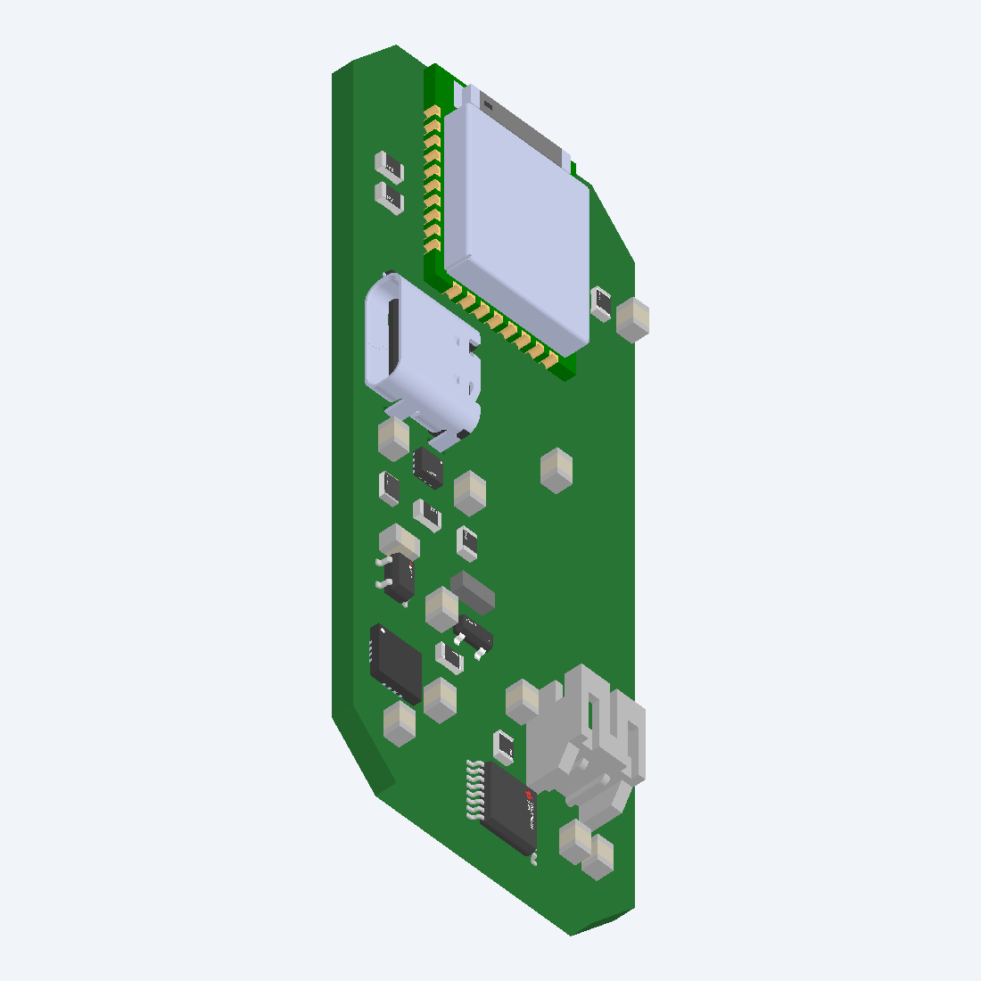
MSV3 Hardware Architecture
MSV3
• E73-2G4M08S1C / nRF52840 MCU module (no crystal)
• FDC2214 capacitance-to-digital converter
• TMUX1109 dual 4:1 analog multiplexer
• BQ25504 solar harvester + BQ25170 USB charger
• TPS7A0233 3.3 V LDO and USB/battery source selection
Notes:
The same BLE receiver/cloud family remains downstream, reducing system-level migration risk.

Slide 27
FDC2214 Resonant Measurement
MSV3
• CH0 LC tank: 6.8 µH + 270 pF fixed components
• Electrode capacitance shifts the tank's resonant frequency
• FDC2214 reports a 28-bit digital count [2]
• Legacy-compatible mapping: (24,000,000 − count) / 100, clamped to 16 bits
• Example: 20,243,803 counts → 37,561 transmitted raw value
Notes:
The 16-bit compatible value lets the existing calibration path continue while the packet also carries higher-resolution information.

Slide 28
TMUX1109: Two Electrodes, Four States
MSV3
• Phase 1: capacitance measurement, electrode roles in one direction
• Phase 2: capacitance measurement, electrode roles swapped
• Phase 3: auxiliary EC-check routing state
• Phase 4: bare-tank / reference routing state
• Two designed electrodes, four defined states — not an arbitrary N-channel array
Notes:
Do not label this an arbitrary N-channel array. Graded EC is NOT operational -- DIV_NODE was routed to non-ADC-capable P0.00.

Slide 29
MSV3 Bring-Up Results
MSV3
Date (2026) | Result
Aug. 20 | I2C, FDC2214, mux, and battery-ADC bring-up confirmed
Aug. 21 | LFCLK/RTC1 freeze root-caused and repaired — 900/900 clean samples (was freezing at 115–122)
Aug. 21 | Sleep current: 65–71 µA → 10–15 µA after GPIO disconnects on VBAT/CHG pins
Aug. 22 | First production probe/receiver observed live end-to-end; 17-byte packet
Aug. 22 (daylight) | Direct sun: 6 V open circuit, 30 mA short circuit (measured)
Notes:
The board has no 32.768 kHz crystal -- selecting LFRC before FreeRTOS/SoftDevice init fixed freezes seen after 115–122 samples. Solar charging of roughly 10 mA was INFERRED, not directly measured. (Sleep-current figure corrected to 65–71 µA -- matches the firmware source's own comment; an earlier fact-check doc had 60–71.)

Slide 30
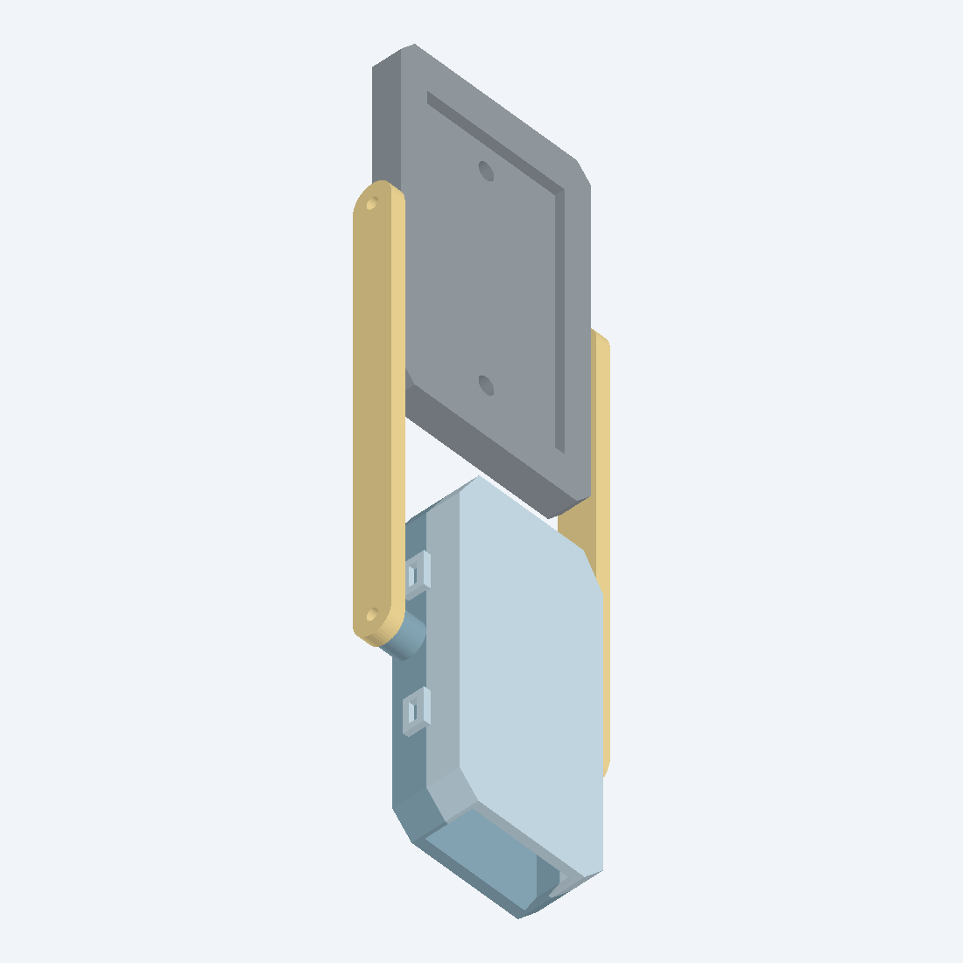
MSV3 Solar Harvester Test
Solar test
• Dim indoor light: 2.7 V open circuit, 50 µA short circuit
• Direct sun: 6 V open circuit, 30 mA short circuit — both directly measured
• Battery charge current ≥ 10 mA INFERRED (no-solder implied-current method), not ammeter-measured
• Aug. 29: a fully-discharged unit was flashed with production sleep-cycling firmware and released to test solar recovery from empty
• Result not yet known as of this deck
Notes:
Keep the inferred vs. measured distinction explicit when presenting this slide -- it's one of the most likely questions from the room.

Slide 31
Current Status and Open Work
Status
Verified / implemented
Still open
• FDC/mux basic operation, BLE compatibility
• LFRC startup, 10–15 µA timed sleep
• 17-byte high-resolution packet, observed live in production path
• Wet-soil calibration and multi-day drift
• IDRIVE / ring-down tuning
• Overcast duty-cycle and low-battery solar-recovery test
• EC ADC bodge / next PCB revision
• 23-byte temp/bare-tank diagnostics: compile-tested, not confirmed deployed
Notes:
Die temperature is electronics temperature, not soil temperature. Verify the receiver /device build string immediately before presenting.

Slide 32
Takeaways and Discussion
Wrap-up
• MSV1 proved the capacitive frequency response but compressed it in analog conversion.
• MSV2 delivered the connected platform and revealed clock, power, electrode, and cloud-system interactions.
• MSV3 replaces software timing with a dedicated converter and adds hardware routing plus harvested power.
• Next success criterion: stable multi-day soil data per unit — not a single bench reading.
Notes:
Invite discussion on calibration protocol, reference channels, soil-test design, and energy-neutral acceptance criteria.

Slide 33
Build / Deployment Timeline (Selected)
Backup A
Date (2026) | Event | Evidence level
Jul. 24 | BLE loss test: 198/200 in 10 min | Measured test
Jul. 31 | RTC quantization root cause documented | Data analysis (10,917 readings)
Aug. 9 | QSPI power fix applied to both probes | Documented live hardware fix
Aug. 21 | MSV3 LFCLK/RTC1 repair; sleep-leak repair | Bench verified
Aug. 22 | Full adaptive-calibration rollout; MSV3 production observed live | Documented live
Aug. 25 | History infinite-reload correction | Documented flashed
Aug. 26–28 | Supabase 1000-row-cap pagination work | Source/documented; live status unproven
Aug. 29 | MSV3 empty-battery solar-recovery test flashed and released | Directly confirmed this session; result pending
Notes:
Keep 'source,' 'compiled,' 'flashed,' and 'observed live' as different statuses -- see docs/MSV_BUILD_MILESTONE_FACT_CHECK.md for the full reconciled timeline.

Slide 34
Acceptance Test Matrix
Backup B
Test | Independent variable | Measure | Minimum useful result
Wet/dry cycle | Water content/time | FDC raw, reference channel, temperature | Repeatable direction, bounded hysteresis
Supply sensitivity | Battery voltage/charging state | Raw FDC value | No material mapping shift after compensation
Drift | Constant soil condition over days | Raw and calibrated values | Drift characterized with confidence interval
Energy | Indoor/overcast/direct sun | Harvested current, VBAT, duty cycle | No net loss under the stated lighting profile
Recovery | Battery below reconnect threshold | Startup sequence and time | Defined, repeatable reprime behavior

Slide 35
Version Comparison
Backup C
Attribute | MSV1 | MSV2 (2 field units) | MSV3
Front end | 555 / LPF / comparator | GPIO relaxation timing | FDC2214 LC tank
Electrodes | Single comb pair, fixed roles | Thaumatophyllum: dual-plate (10k). Alocasia: single-plate (100k) — not yet migrated | Two electrodes, TMUX four-state routing
MCU | None required for measurement | XIAO nRF52840 Sense | E73 nRF52840 module
Output | LED threshold | BLE + receiver/cloud | Same receiver/cloud, 17-byte packet
Power | AAA battery | Rechargeable battery, timed System-ON sleep | Solar harvester + charger + timed sleep
Main limitation | Analog saturation/flicker | Timing/supply sensitivity, integration defects | Field stability/energy not yet characterized
Notes:
CORRECTED electrodes row: earlier version of this table said both MSV2 units were 'later alternating dual plate.' Alocasia has not been migrated -- see the correction slide earlier in the deck.

