Slide 1
MEMS Microphone
Recorder System
FPC
0
1
2
3
4
5
6
7
PCB development, firmware bring-up, troubleshooting, and next deployment
USB-C
ESP32-S3
WROOM
LiPo / power
FPC
SD
PDM audio
local WAV
BLE control
Sam Amezcua | UC Davis | EDIT PRESENTATION DATE

Slide 2
What I was building
A compact audio platform that works without a PC in the recording loop
Capture PDM MEMS microphone data as standard WAV files
Store recordings locally for untethered experiments
Trigger without touching the setup: pushbutton or Bluetooth
Make failures visible through LEDs, telemetry, and recoverable files
Support both a quick devkit prototype and custom microphone hardware
PLANNED USE — EDIT THIS LINE
[Replace with the exact final experiment/application.]
Current evidence supports describing it as a portable, remotely triggered acoustic-data platform for controlled or field measurements.
Design principle
Record first, verify continuously, and preserve usable audio when hardware or storage misbehaves.

Slide 3
Three ordered PCB designs form the hardware path
Prototype quickly, scale the sensor geometry, then integrate the recorder
1 ESP32 devkit carrier
2 Eight-mic flex array
3 Integrated controller
Rapid bring-up board
• ESP32-S3 DevKitC
• Two PDM microphones
• microSD + buttons + LEDs
• Platform used for firmware validation
Spatial sensor board
• Eight IMP34DT05TR PDM mics
• Four left/right microphone pairs
• Local decoupling
• 10-pin FPC tail
Portable system direction
• ESP32-S3-WROOM-N8R8
• USB-C + LiPo charging
• 3.3 V and 1.8 V rails
• FPC, SD, buttons, and status LEDs
USB-C
LiPo / power
ESP32-S3
WROOM
ESP32-S3
DevKitC
MIC L
MIC R
microSD
FPC
0
1
2
3
4
5
6
7
FPC
SD
REC

Slide 4
Board 1 — ESP32 devkit recorder
The fast-learning platform: prove the microphone, storage, controls, and enclosure before full integration
What is on this board
• ESP32-S3 DevKitC module
• Two ST IMP34DT05TR PDM microphones
• 1.8 V microphone regulator
• microSD socket over SPI
• Record button and three status LEDs
• Exported STEP plus printable enclosure files
ESP32-S3
DevKitC
microSD
MIC L
MIC R
REC
48 kHz
stereo
16-bit PCM
microSD
Validated pin map
PDM 4/5 • SD SPI 12/13/11/14 • button 35 • LEDs 40/41/42

Slide 5
Board 2 — eight-microphone flex array
A narrow sensor strip for known microphone spacing and multi-point acoustic capture
FPC
0
1
2
3
4
5
6
7
MIC7
≈ 350 mm overall
MIC0 + FPC
Sensor layout
Electrical strategy
System role
Eight ST IMP34DT05TR omnidirectional digital PDM microphones arranged along a narrow flex PCB.
Four left/right PDM pairs, shared clocking, paired data behavior, and local 100 nF / 10 µF decoupling.
Moves the microphones away from the controller and enables repeatable spatial placement through one 10-pin FPC interface.
Design status: ordered PCB design; validate each pair, cable integrity, clock loading, and channel mapping during bring-up.

Slide 6
Board 3 — integrated microphone controller
Turns the bench prototype into a battery-capable, connectorized recorder
Integration decisions
USB-C
ESP32-S3
WROOM
• ESP32-S3-WROOM-1-N8R8 replaces the plug-in dev board
• MCP73871 battery charging and load sharing
• Dedicated 3.3 V and 1.8 V regulation
• 10-position FPC connector for external mic hardware
• SD interface, USB access, controls, and visible status
• Mechanical mounting holes and compact enclosure path
LiPo / power
FPC
SD
USB-C + ESD
LiPo charge / load share
FPC sensor interface
Engineering shift
From “can this record?” to “can this be deployed, powered, connected, and recovered reliably?”

Slide 7
Firmware evolved in five deliberate steps
Each intermediate build isolated one subsystem before combining them
1
PDM → serial
Captured raw PCM to a PC with a Python script.
2
USB microphone
Exposed the board as a USB Audio Class device.
3
SD diagnostic
Probed SPI behavior and swept mount speeds.
4
Standalone WAV
Recorded locally with button control and status LEDs.
5
BLE + reliability
Added remote control, telemetry, recovery, and storage guards.
Current recorder: bench validated and working

Slide 8
The key reliability fix was separating capture from storage
SD writes are bursty; microphone sampling cannot wait
PDM microphones
I²S + DMA
Core 0 reader
128 KB pool
Core 1 writer
48 kHz stereo
16-bit PCM
Hardware intake
deepened queue
Never touches
the SD card
32 × 4 KB
≈680 ms headroom
WAV + periodic
flush/header update
Failure observed
Result after redesign
A slow SD transaction could exceed the I²S DMA buffering. Samples were silently lost, so playback sounded sped up with clicks and pops.
The reader runs continuously while storage latency consumes buffer headroom. Average SD throughput comfortably exceeds the 192 kB/s audio stream.
Control plane: button + BLE commands → start/stop | status path: LEDs + 500 ms BLE heartbeat

Slide 9
Troubleshooting that materially changed the design
The project became robust by reproducing failures and adding explicit recovery paths
Observed problem
Root cause
Fix / lesson
Sped-up audio / clicks
SD writes blocked capture
Dedicated core-0 reader + 128 KB queue
SD failed after reset
Card left in partial SPI transaction
Send ≥74 clocks before every mount
Level LED froze with no card
Full mount retry ran every 50 ms
Separate 50 ms probe from 1 s remount
Pulled card ruined whole WAV
Header size updated only at stop
Refresh WAV header every 1 s
Old take overwritten
Flaky remount restarted filename scan
Monotonic in-RAM recording index
No serial / build too large
Board options were wrong
CDCOnBoot=cdc + huge_app partition
Upload port busy
IDE daemon held COM port
Stop the background Arduino CLI process

Slide 10
What the recorder can do now
Bench-tested on the custom ESP32-S3 PCB
AUDIO
48 kHz • stereo • 16-bit PCM
CONTROL
Button or Bluetooth LE
Standard incrementing WAV files
Self-contained Web Bluetooth remote
PROOF
Live byte counter
STORAGE
20 MHz SPI on a 32 GB card
Confirms data is actually reaching the card
200 MB warning / 50 MB hard stop
RECOVERY
Hot-plug inference + periodic headers
STATUS
Three LEDs + 500 ms heartbeat
At most ~1 s tail loss on card removal
Recording, SD, free space, and error state
Known-good boot: SD mounted at 20 MHz → BLE advertising → ready to record

Slide 11
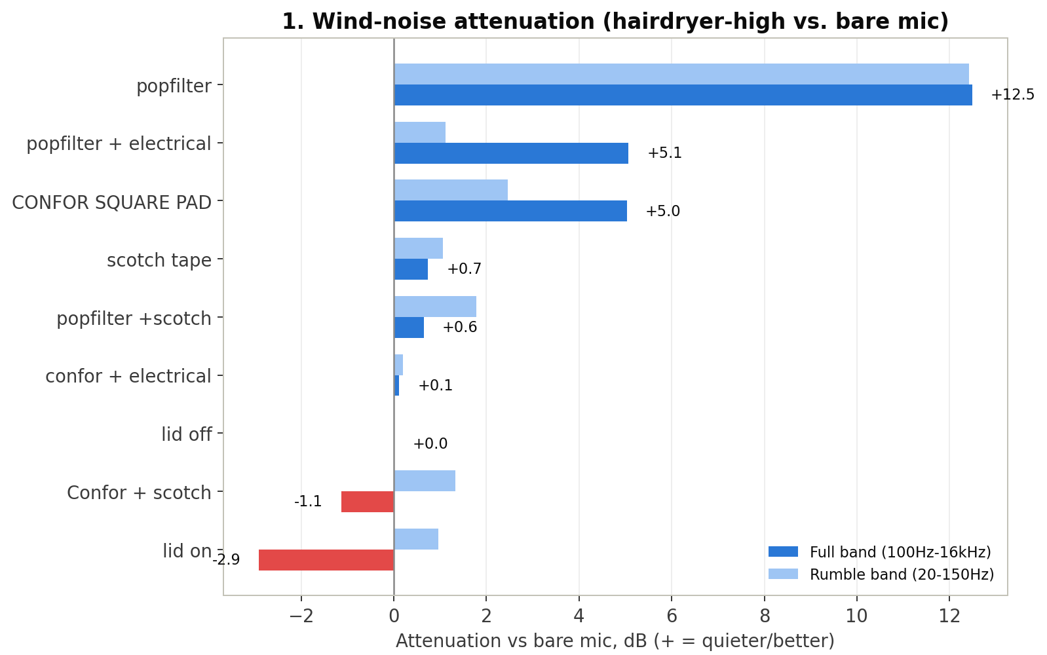
Material damping check — feasibility only
A quick screen to learn what was possible and verify that the recorder produced analyzable data
What was done
Nine coverings × ambient / low / high hairdryer conditions. One short recording per combination; the source was hand-positioned.
Only takeaway
Bare pop-filter fabric looked promising (~12.5 dB lower recorded level than lid-off under high airflow). This is not calibrated attenuation or a scientific treatment comparison.
Presentation framing: engineering proof-of-concept and material down-selection—not a validated acoustic experiment.

Slide 12
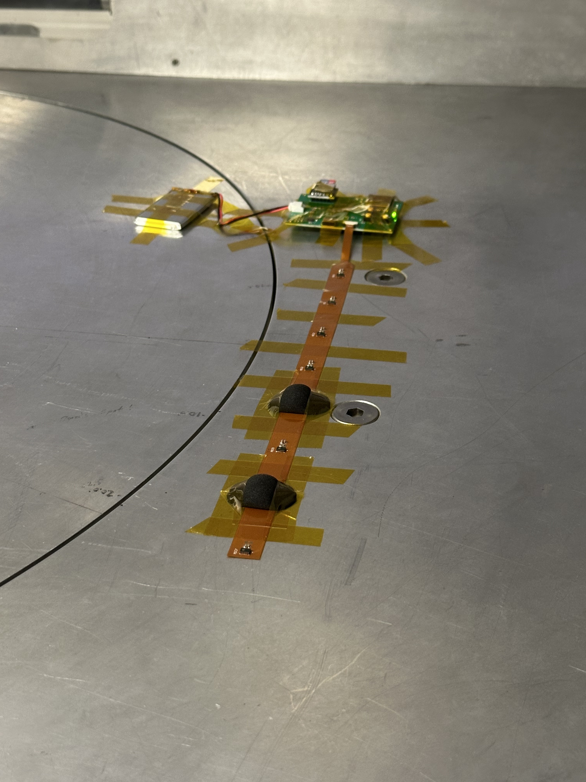
Eight-microphone array with both pop filters taped down
12

Slide 13
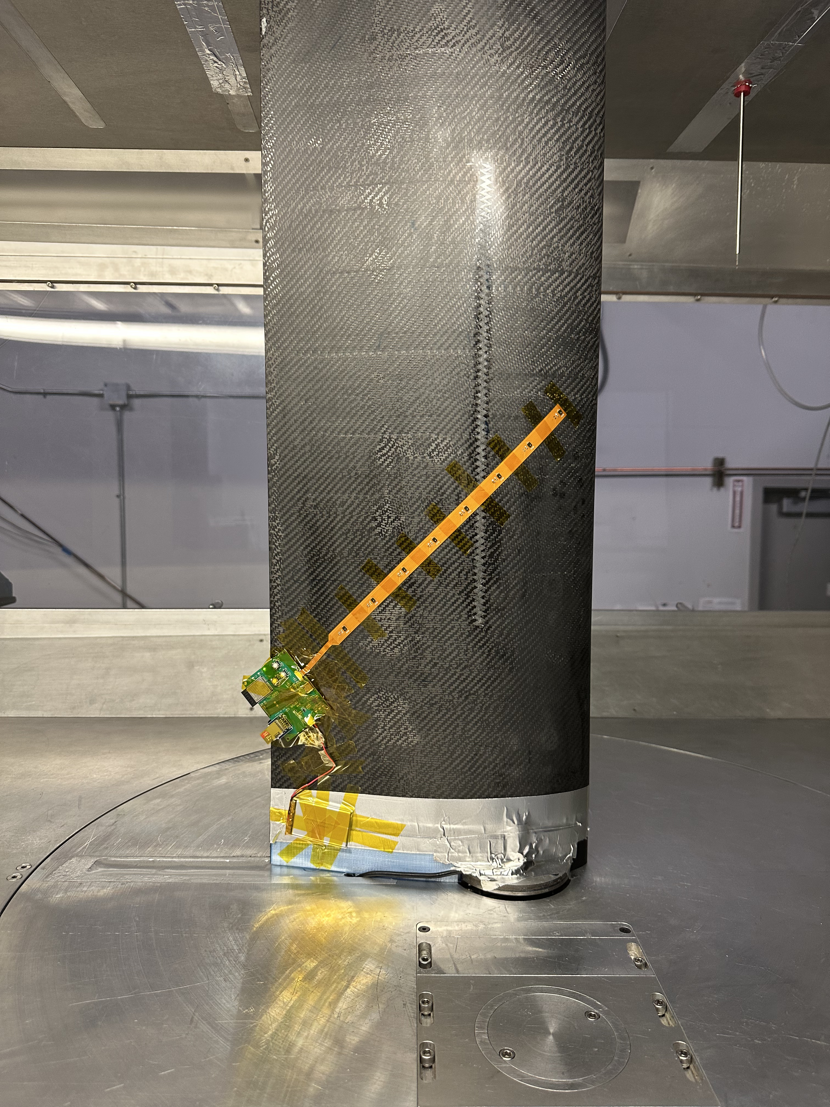
Array installed on the wing
13

Slide 14
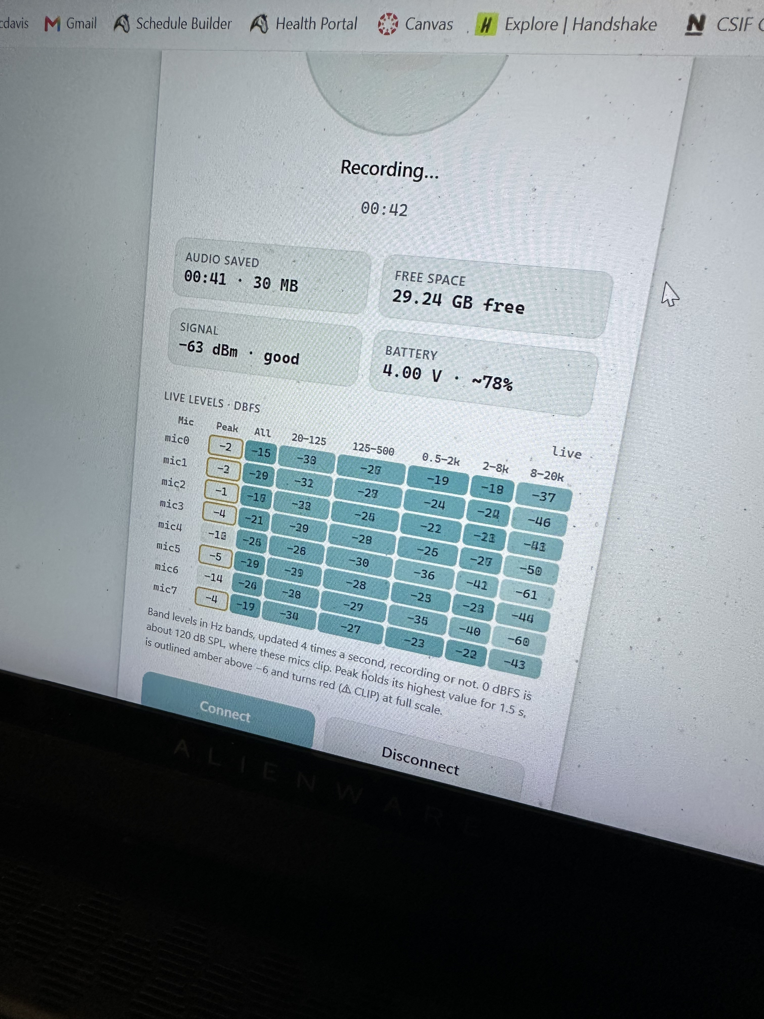
Live eight-channel band-level display during recording
14

Slide 15
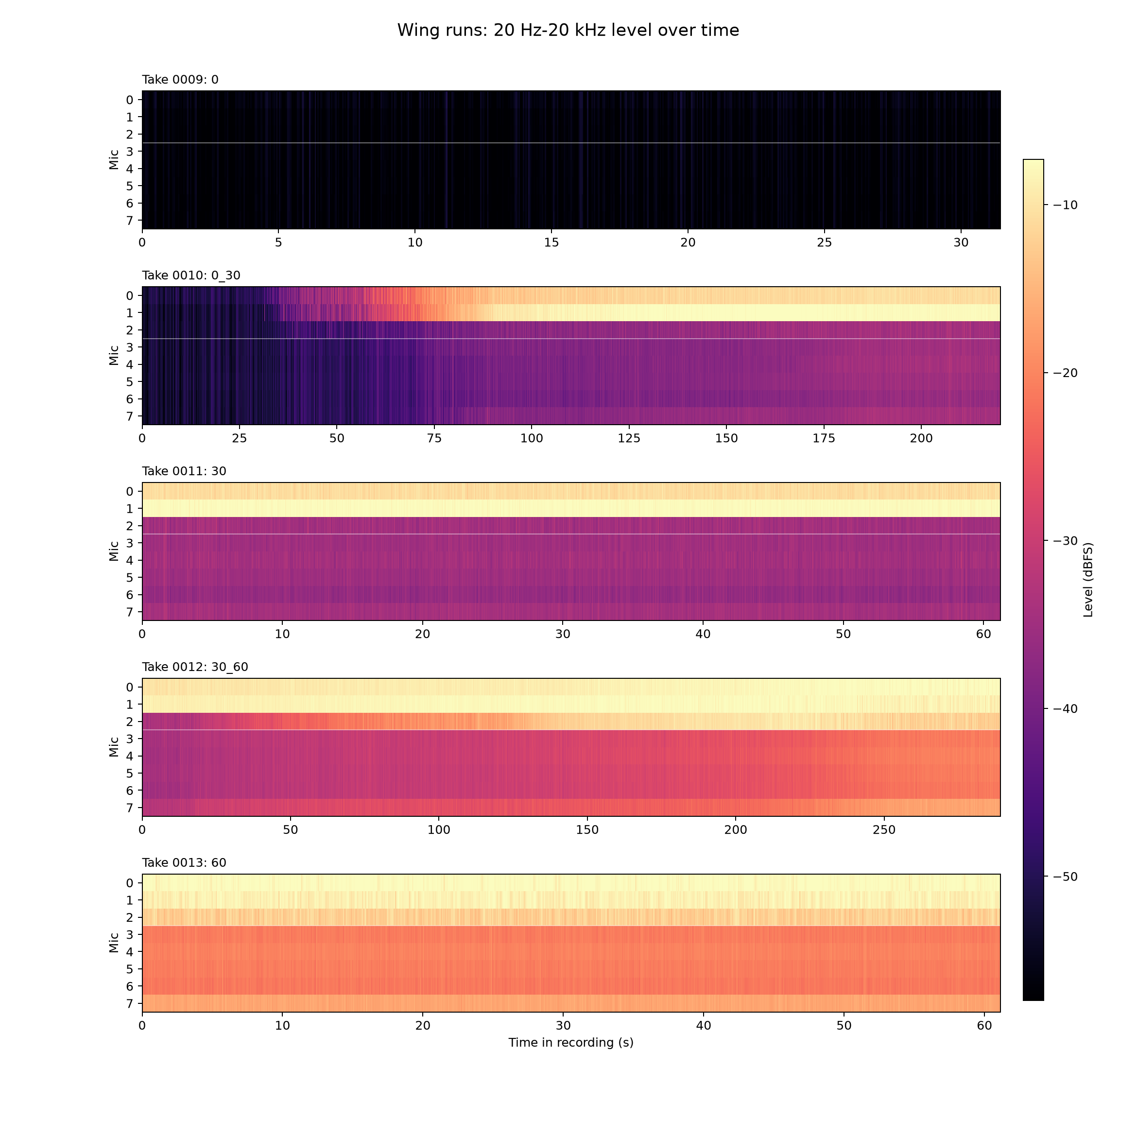
15

Slide 16
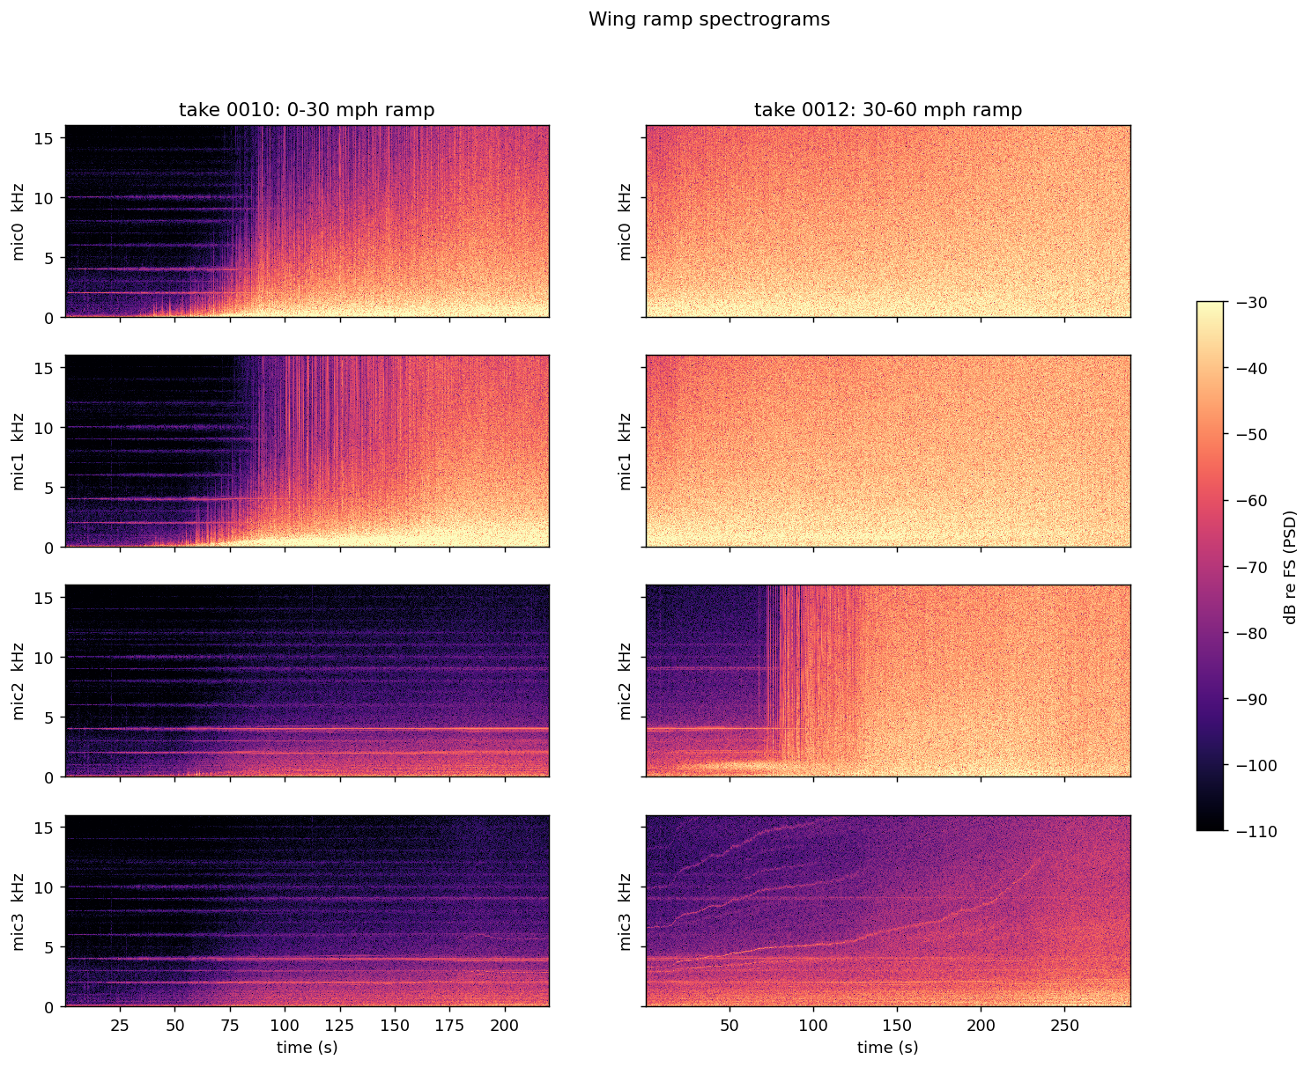
16

Slide 17
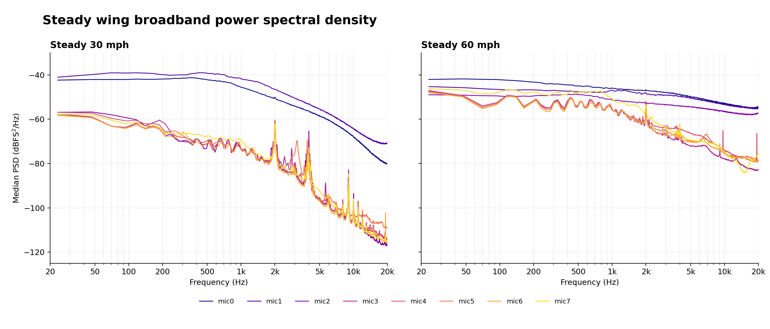
17

Slide 18
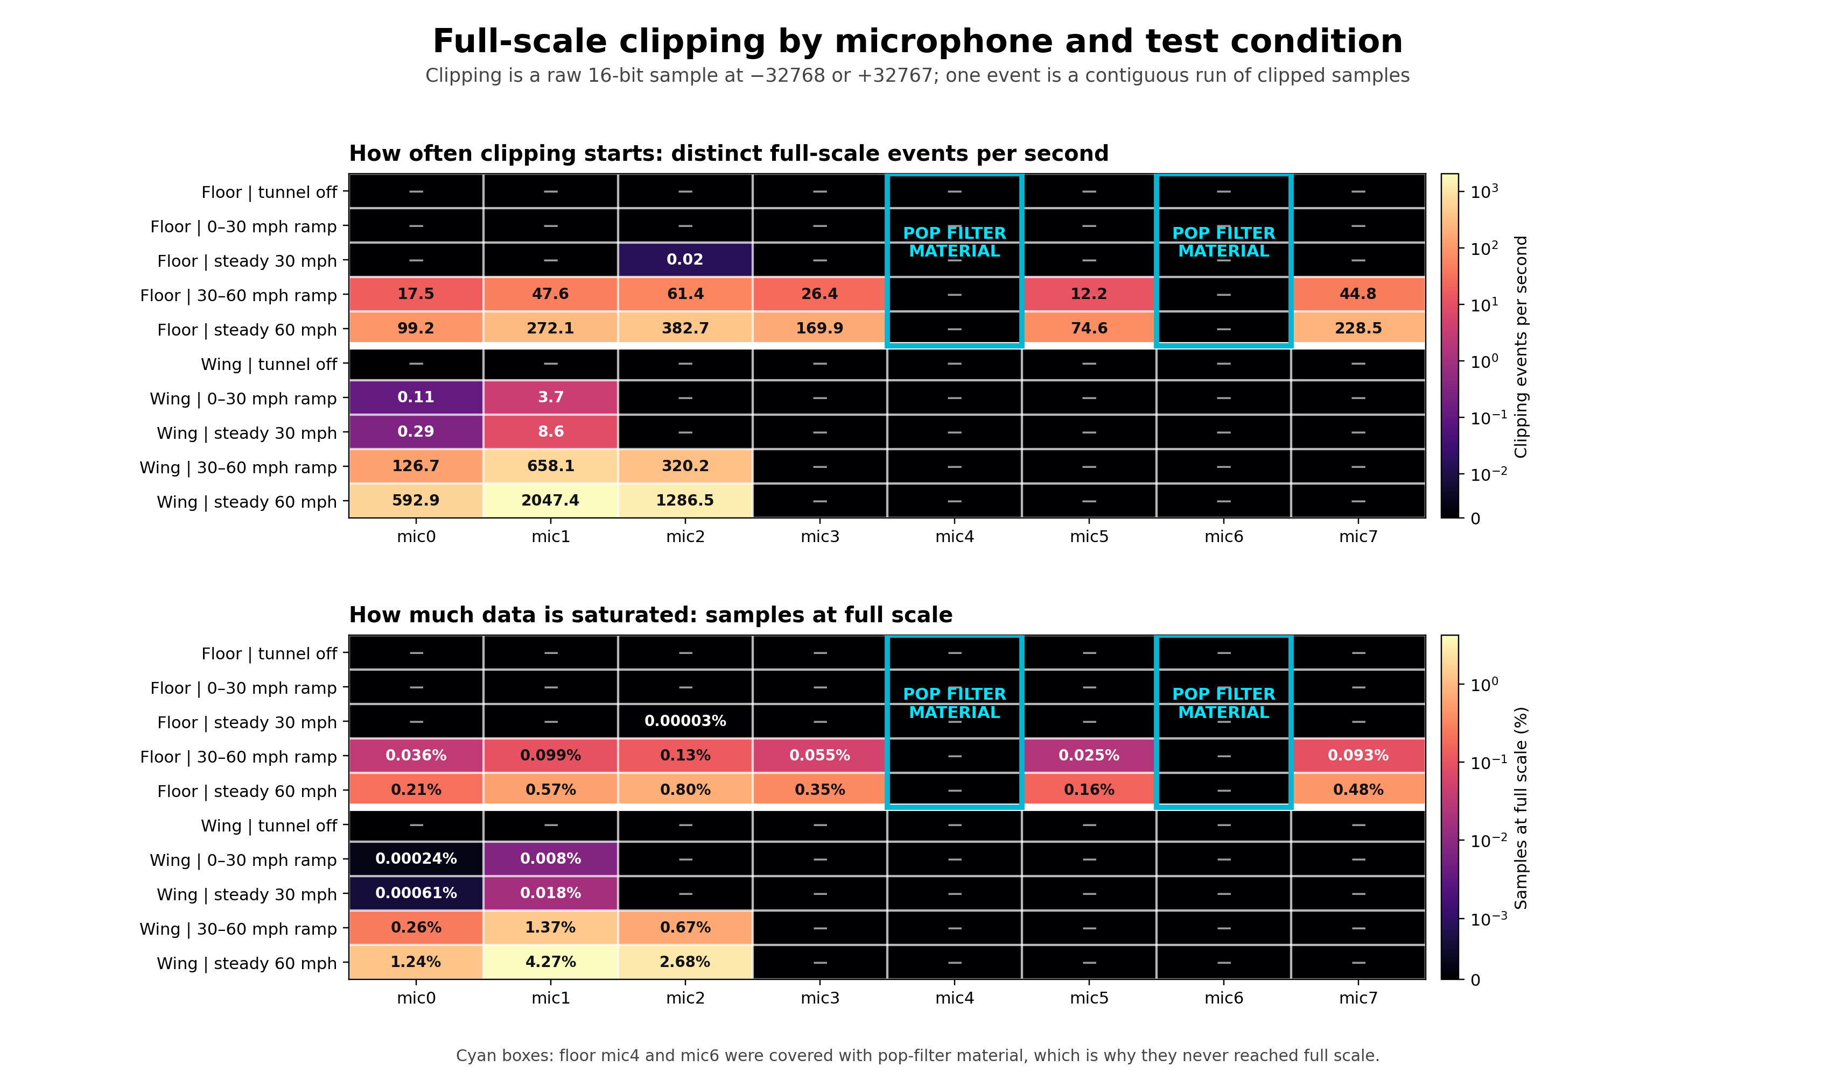
18

Slide 19
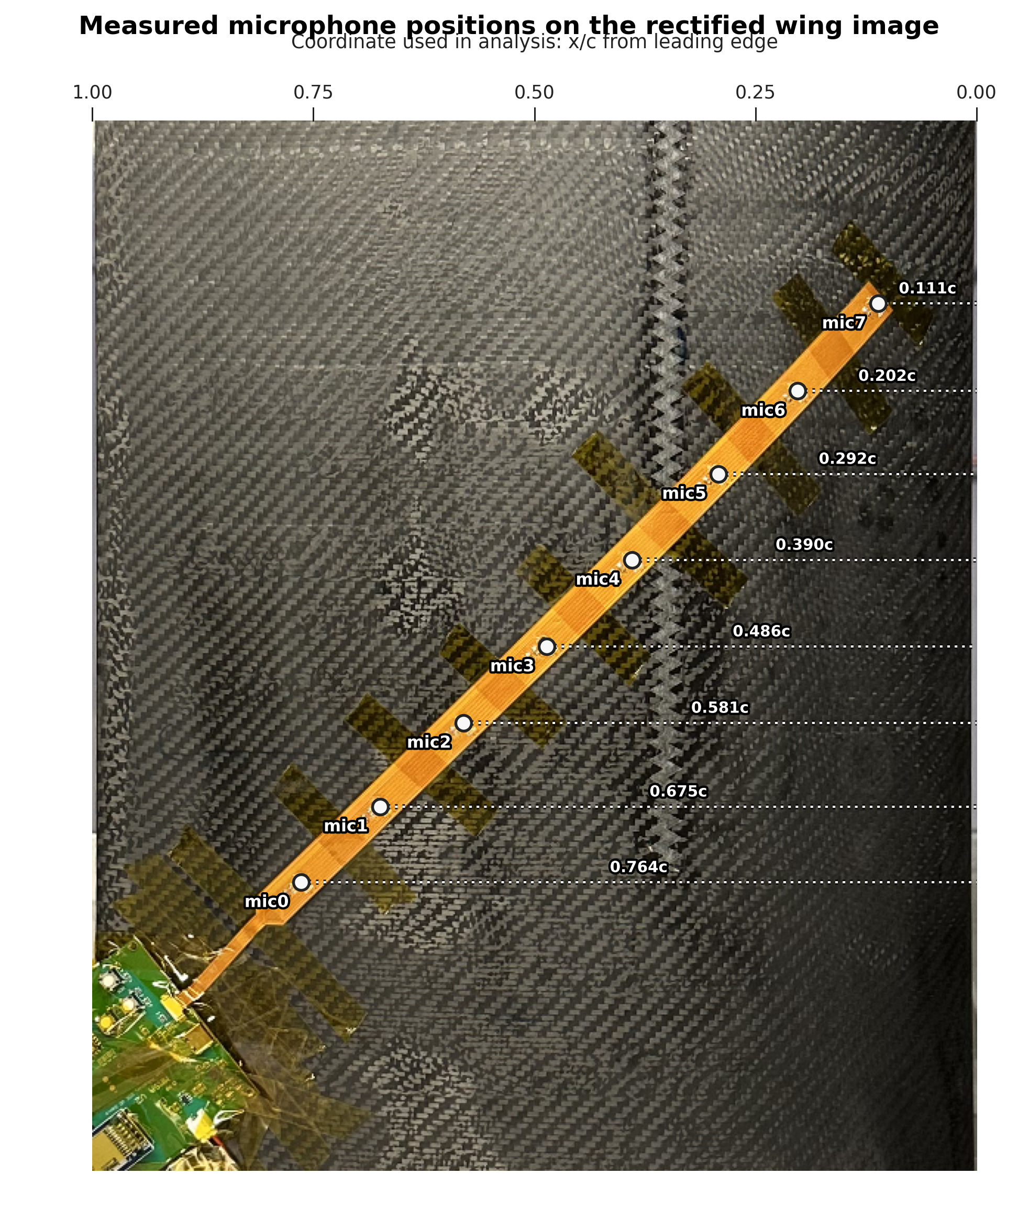
19

Slide 20
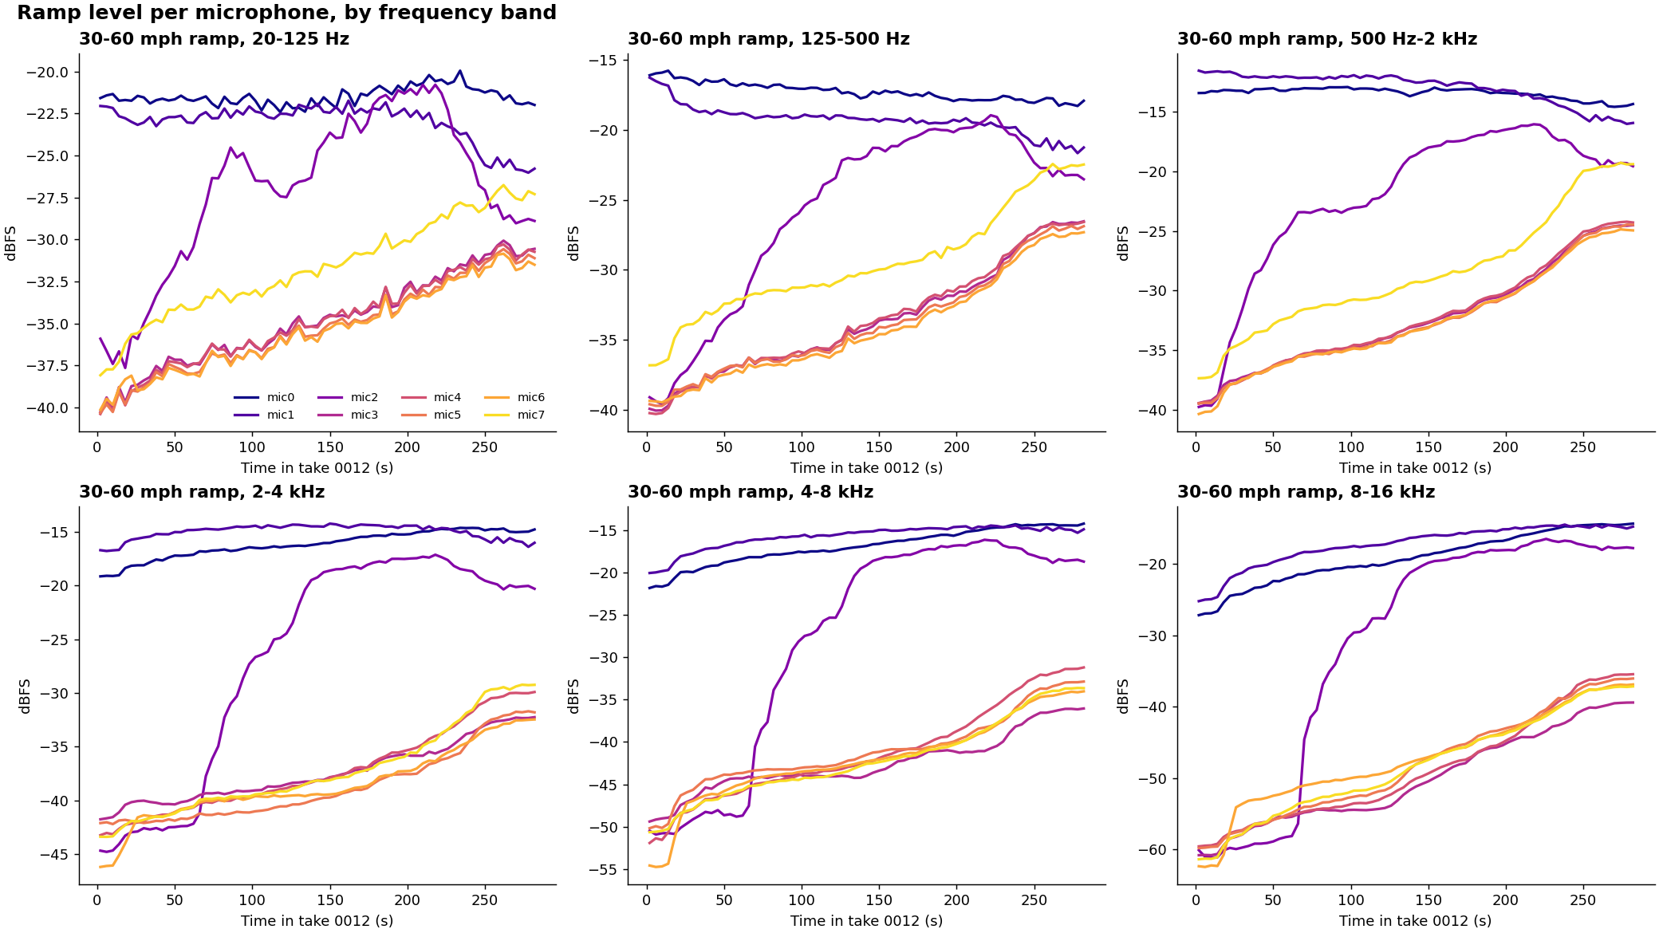
20

Slide 21
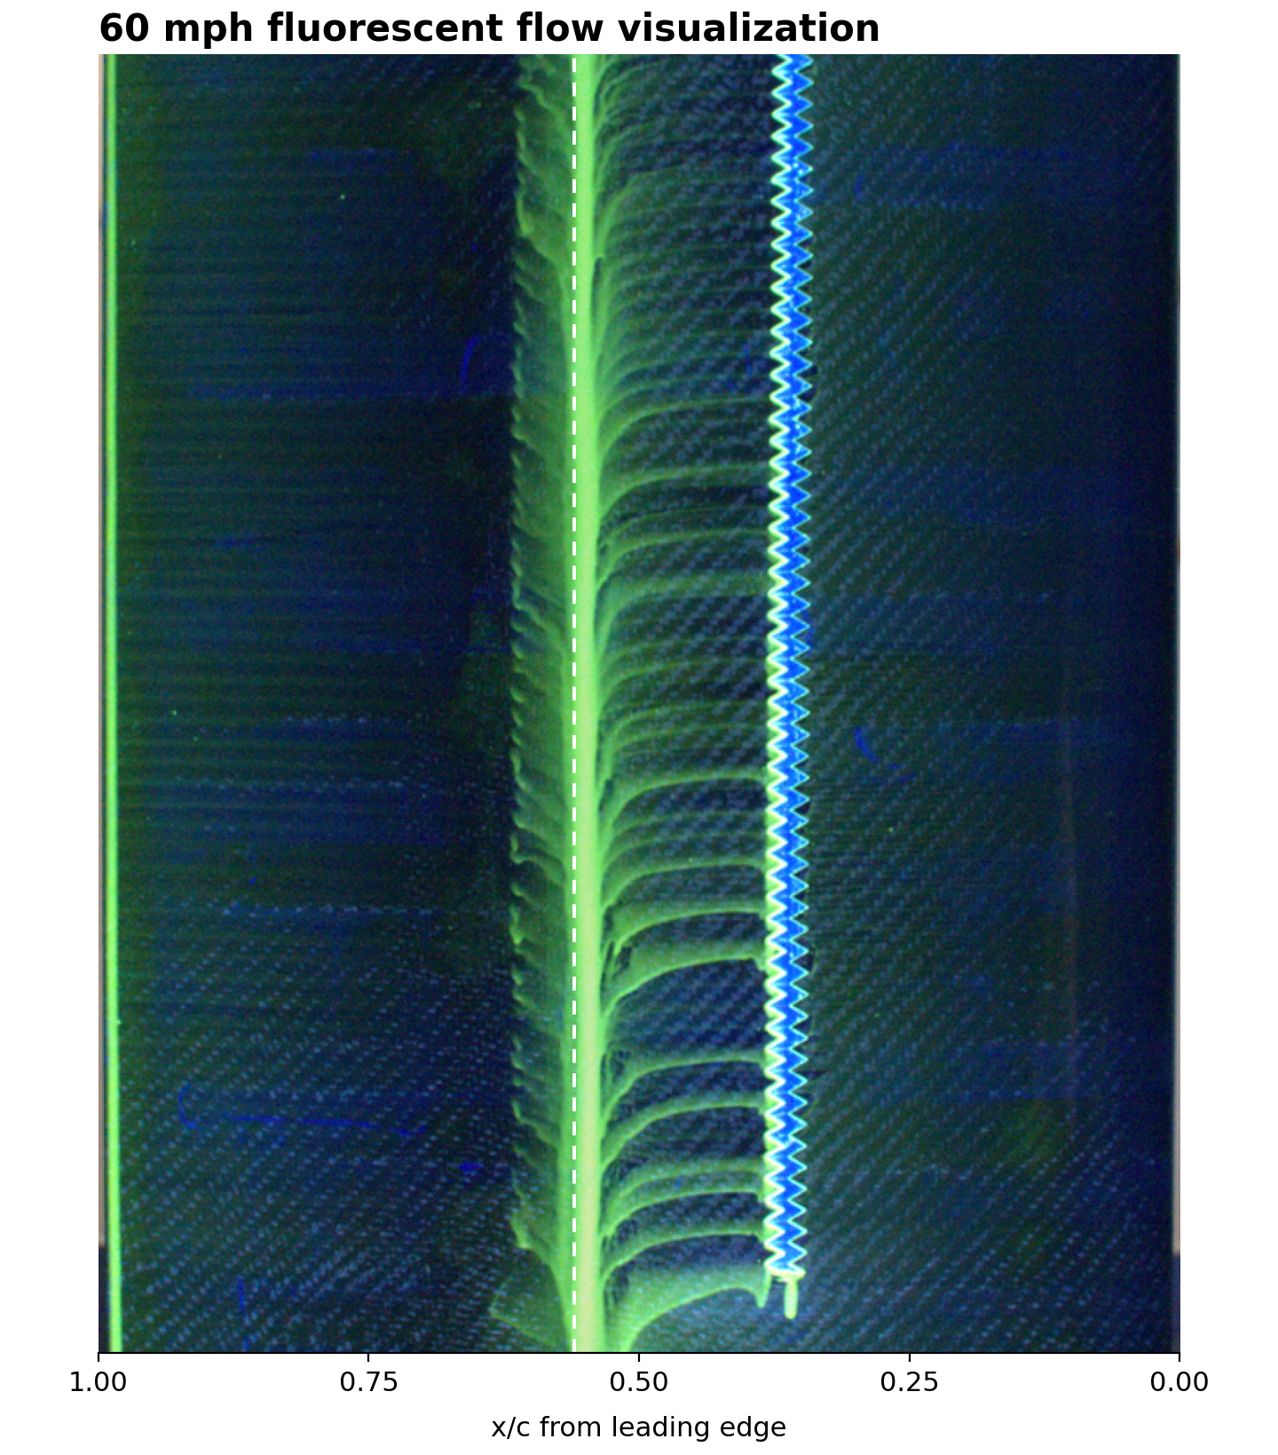
21

Slide 22
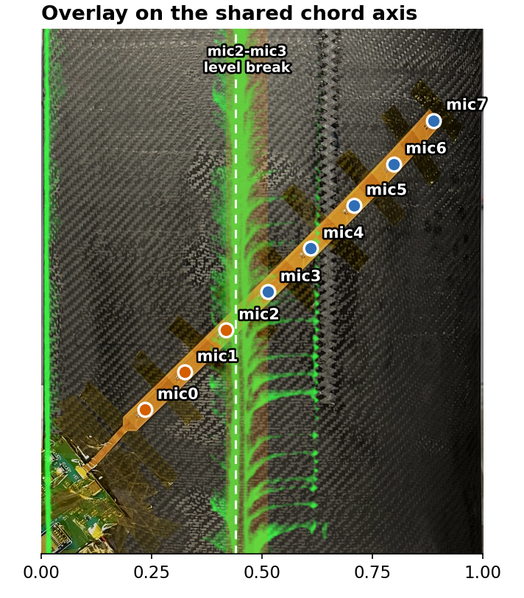
22

Slide 23
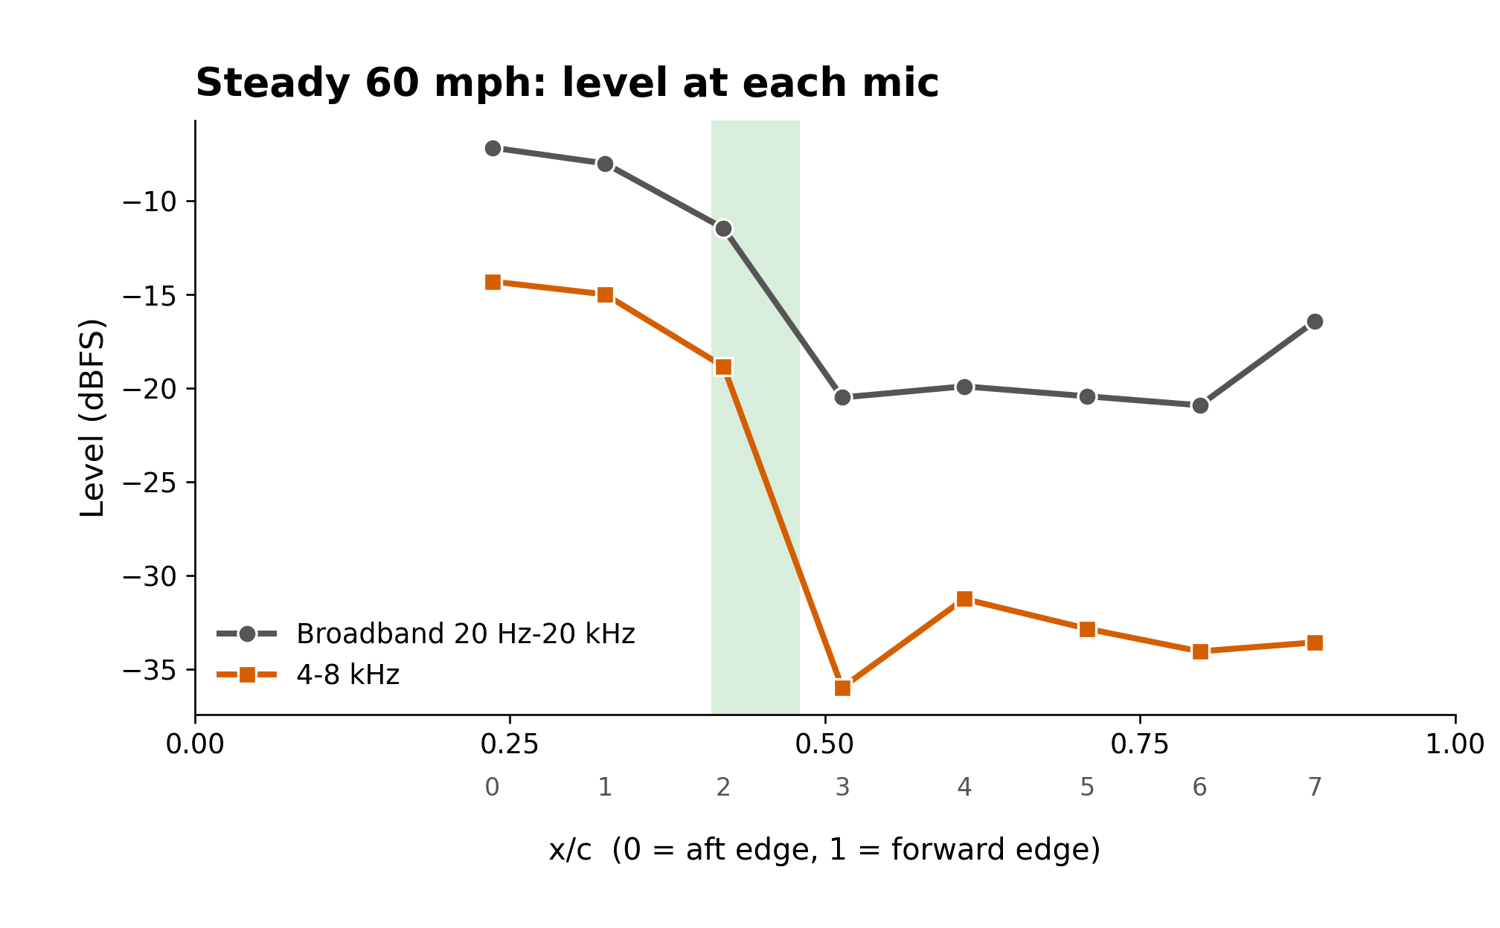
23

Slide 24
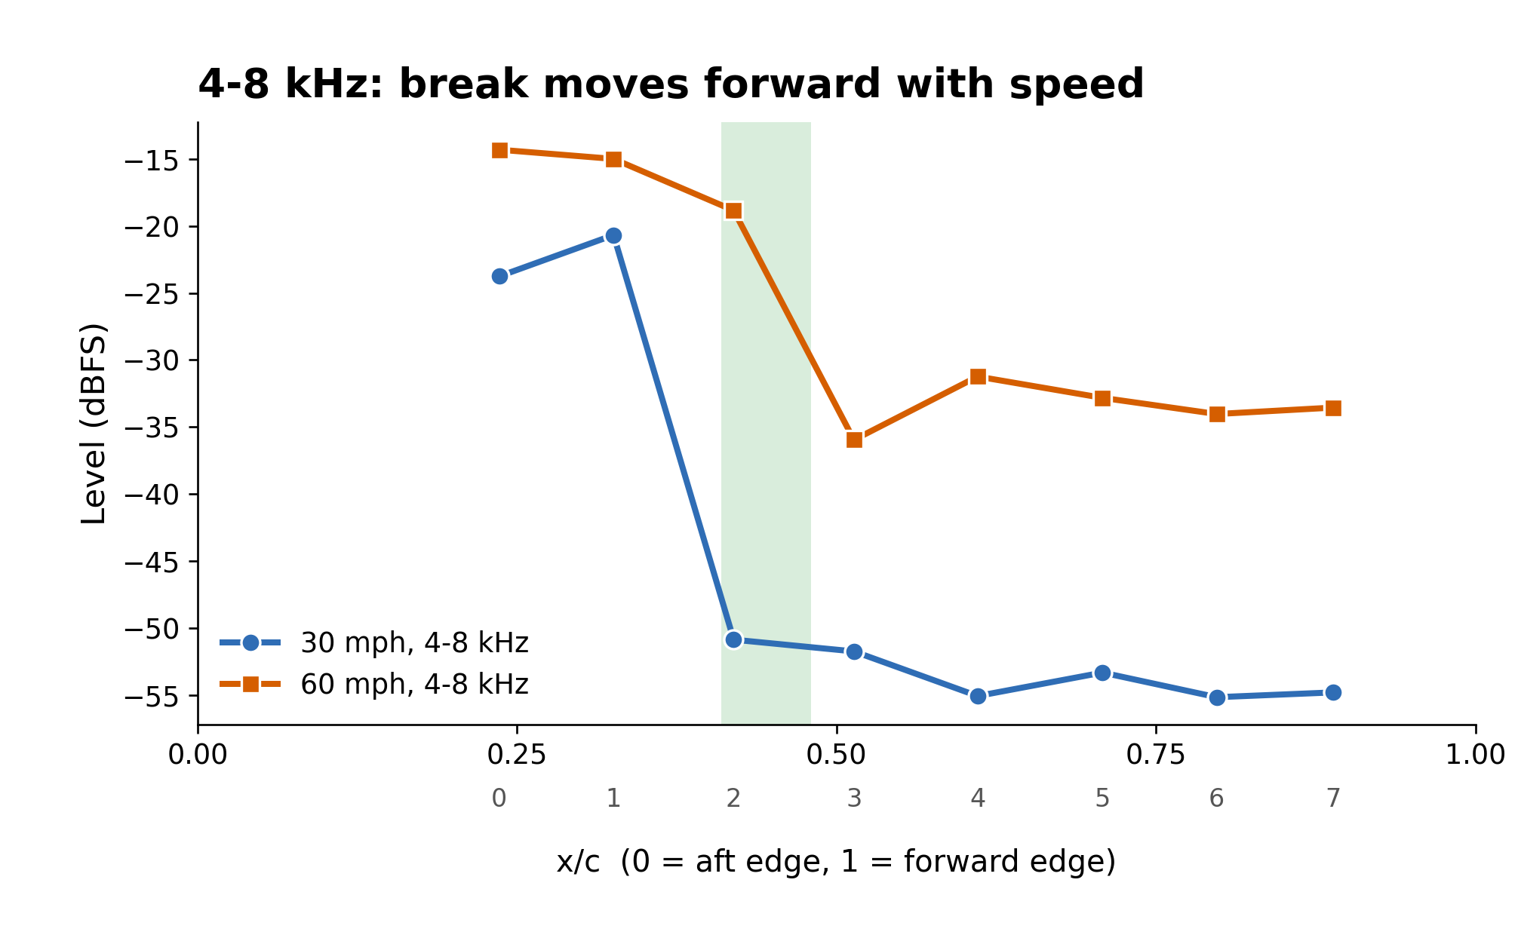
24

Slide 25
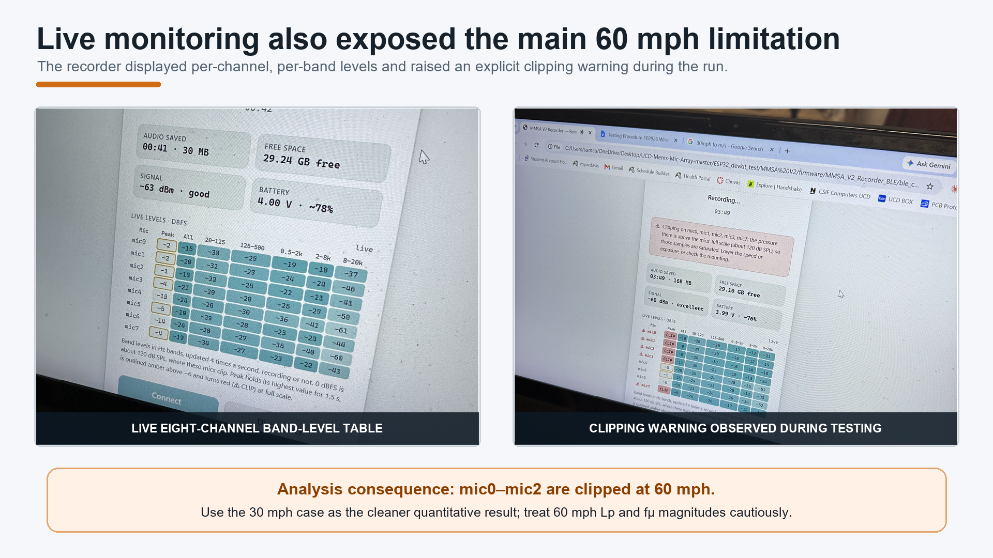
25

Slide 26
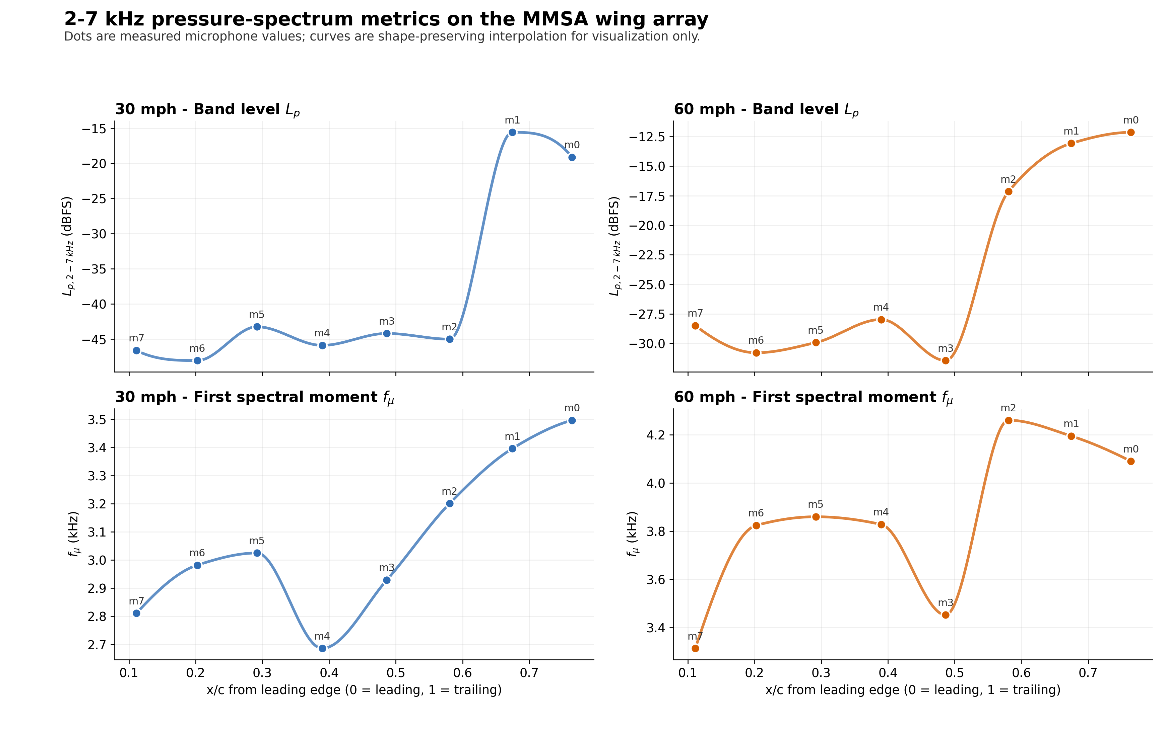
26

Slide 27
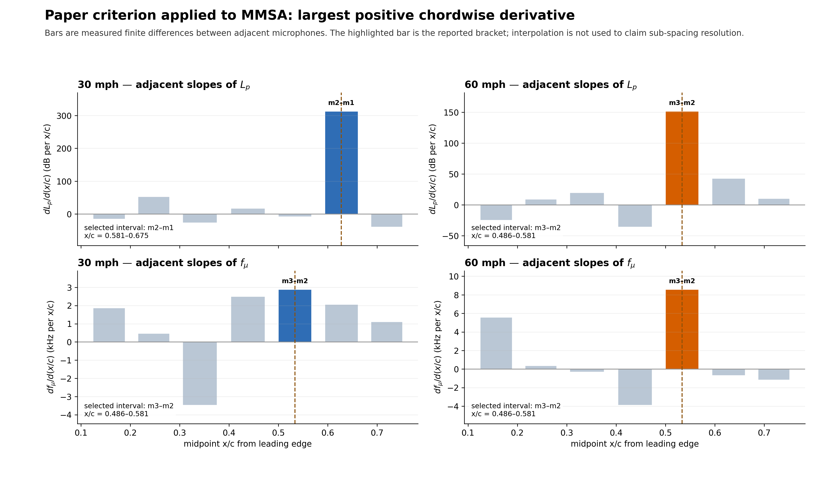
27

Slide 28
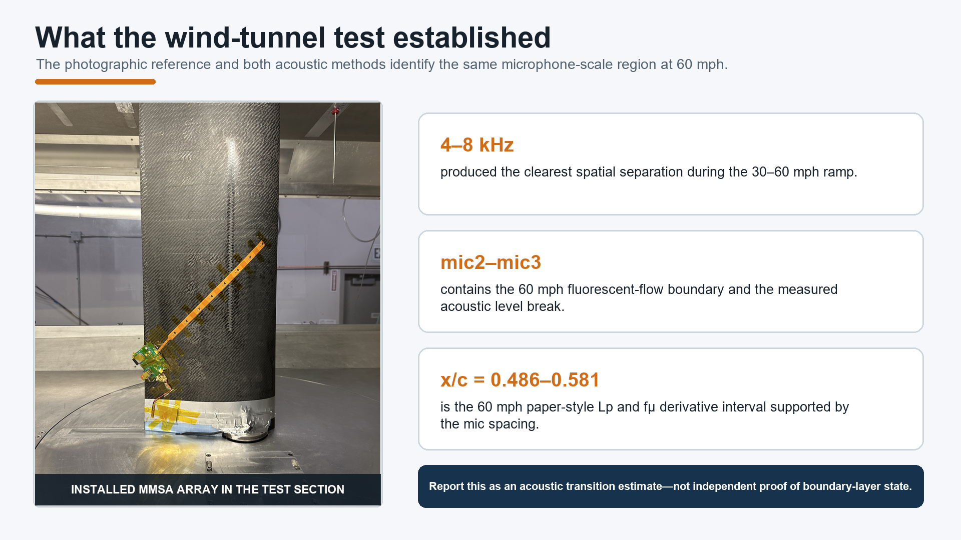
28

Slide 29
Next steps toward deployment
The core recorder works; the remaining work is board bring-up and application-specific validation
1
Define deployment
Replace the use-case placeholder with the exact study, placement, duration, and channel requirements.
2
Bring up ordered boards
Verify power rails → USB/flash → PDM clock/data → SD → BLE → multi-mic channel map.
3
Connect the flex array
Measure clock integrity, cable behavior, channel pairing, and simultaneous capture limits.
4
Package the system
Finalize mounting, enclosure, strain relief, acoustic opening, and environmental protection.
5
Run a controlled pilot
Use repeatable geometry, metadata, timing, and a validation recording before field deployment.
Main message
The project is now a working recording platform—not just a microphone breakout—and its reliability problems have defined the final hardware and firmware architecture.

