Slide 1
WEEKLY PROGRESS REPORT • WEEK 3
Overconfidence in GenAI Answers
First experiments: how often is an LLM confidently wrong?
PRESENTER
GROUP & SUPERVISOR
CURRENT MILESTONE
Saman Rai • ID 2317130
Group 7 • Prof. Simeon
Week 2 • Baselines + first results
Team: Ramauli Madan Bahadur • Tamang Sajan • Jaiswal Anand Bihari • Sunar Binod • Kaliraj Bikram • Rai Saman • Dahal Sushil • Subedi Chetana • Saad
16 October 2026
Overconfidence in GenAI Answers • Seminar on AI
16 Oct 2026
Notes:
Good morning. I'm Saman Rai, presenting Group 7's Week-2 progress on overconfidence in GenAI answers. Last week we defined the problem, reviewed the literature and proposed a tiered confidence-triage pipeline. This week we moved from planning to evidence: we built the evaluation harness, implemented the baselines we promised, and ran our first experiment on a real benchmark.

Slide 2
1. Where We Left Off
2
Week-1 commitment → what we delivered in Week 2
LAST WEEK WE COMMITTED TO
Dataset selected & sampled
DONE • 400 Qs
“Implement the baseline calibration methods — temperature scaling and verbalized confidence — and establish the first evaluation results.”
Evaluation harness (grading + metrics)
DONE
Verbalized confidence baseline
DONE
RESEARCH QUESTION
Can a tiered confidence-triage pipeline reduce overconfident wrong answers while keeping computation practical?
Temperature scaling baseline
DONE
Self-consistency (Stage 1 of triage)
DONE • bonus
First evaluation results
DONE
Overconfidence in GenAI Answers • Seminar on AI
16 Oct 2026
Notes:
Quick recap. Our research question is whether a tiered confidence-triage pipeline can reduce overconfident wrong answers at a practical cost. At the end of Week 1 we committed to implementing temperature scaling and verbalized confidence and getting first results. All of that is done. We also added self-consistency, because it is Stage 1 of our own pipeline, so we can already get an early signal on whether triage is promising. The experiment covered 400 questions.

Slide 3
2. What We Built This Week
3
An end-to-end, reproducible evaluation harness
1
2
3
4
5
Sample
Query LLM
Auto-grade
Calibrate
Measure
400 questions, fixed random seed
Greedy answer,
5 samples,
verbalized conf.
Normalized match against all gold answer aliases
Temperature scaling,
5-fold cross-fitted
Accuracy, ECE, Brier, AUROC, risk–coverage
WHY THIS MATTERS
REPRODUCIBILITY
Same questions, grader and metrics for every method → fair comparison.
Week 3: our triage pipeline plugs in as just one more method.
Every raw model output is logged (one JSON line per question).
Runs are resumable and rate-limit safe; one command re-creates every number and chart.
Overconfidence in GenAI Answers • Seminar on AI
16 Oct 2026
Notes:
This is the harness we built. Step one samples questions from the benchmark with a fixed random seed so results are reproducible. Step two queries the model three ways for every question. Step three grades answers automatically against all accepted gold answers. Step four fits temperature scaling with 5-fold cross-validation, so we never evaluate on the data we calibrated on. Step five computes all the metrics from our Week-1 plan. The key point: every method sees the same questions, grader and metrics, so in Week 3 our triage pipeline just plugs in as one more method.

Slide 4
3. Experimental Setup
4
What exactly we ran
DATASET
MODEL
PROBES PER QUESTION
TriviaQA (rc.nocontext, validation)
gpt-4.1-mini
1 greedy + 5 samples + 1 verbalized
400 questions • random sample (seed 7)
via OpenAI API • token log-probs: not available
Greedy & verbalized at temperature 0; samples at temperature 1.0
GRADING
CALIBRATION
RUN COST
Automatic, lenient alias match
Temperature scaling (1 parameter)
987 API calls
Lower-case, strip punctuation/articles; correct if a gold alias appears in the answer
Fitted on 4/5 of questions, applied to the held-out 1/5 (×5 folds)
≈ 89,559 tokens • 2 min wall-clock
Overconfidence in GenAI Answers • Seminar on AI
16 Oct 2026
Notes:
Setup details. We used TriviaQA (rc.nocontext, validation) — factual questions with ground-truth answers and several accepted aliases, which makes automatic grading reliable. We sampled 400 questions with a fixed seed. The model is gpt-4.1-mini, accessed through the openai API. For each question we made a greedy answer at temperature 0, 5 sampled answers at temperature 1, and a separate prompt asking for an answer plus a confidence percentage. In total 987 API calls and about 89,559 tokens — cheap enough to scale up next week.

Slide 5
4. Confidence Signals Compared
5
Every method attaches a confidence score in [0, 1] to an answer
METHOD
HOW THE CONFIDENCE IS OBTAINED
GENERATIONS / Q
Verbalized confidence
Model states 'Confidence: NN%' with its answer
1
Verbalized + TS
Verbalized confidence rescaled by temperature scaling (median T = 4.28, 5-fold CV)
1
Self-consistency (k=5)
Share of 5 samples (temperature 1.0) that agree with the greedy answer
6
Temperature scaling: calibrated = σ( logit(p) / T ). T > 1 softens over-confident scores; T is learned from held-out data.
Overconfidence in GenAI Answers • Seminar on AI
16 Oct 2026
Notes:
These are the confidence signals we compared. Verbalized confidence simply asks the model how sure it is. Temperature scaling learns a single number T from held-out data and rescales the confidence; when T is above one it pulls overconfident scores down. Self-consistency asks the same question 5 times with randomness and checks how often the answers agree. Note the cost column: self-consistency is the most expensive, which is exactly why our pipeline uses it only as a cheap first filter and saves heavy verification for the uncertain cases.

Slide 6
5. Headline Results
6
400 questions • gpt-4.1-mini • TriviaQA
Method
Accuracy
Avg. conf.
ECE ↓
Brier ↓
AUROC ↑
Wrong but ≥90% conf. ↓
Verbalized confidence
82.0%
95.8%
0.138
0.152
0.77
81.9%
Verbalized + TS
82.0%
78.5%
0.081
0.137
0.76
16.7%
Self-consistency (k=5)
81.0%
89.8%
0.098
0.116
0.80
32.9%
82%
0.138 → 0.081
0.80
of wrong answers came with ≥90% verbalized confidence
verbalized ECE before → after temperature scaling
AUROC of self-consistency (5 samples) at flagging wrong answers
Overconfidence in GenAI Answers • Seminar on AI
16 Oct 2026
Notes:
Here are the headline numbers. Accuracy is how often the answer is right; average confidence is what the model claims. ECE — expected calibration error — is the gap between claimed confidence and actual accuracy; lower is better. Brier score also measures probability quality; lower is better. AUROC measures whether confidence separates right from wrong answers; 0.5 is random, 1.0 is perfect. The last column is our headline overconfidence measure: of the answers that were WRONG, what share were stated with at least 90% confidence. For verbalized confidence that is 82%. Green marks the best value in each column.

Slide 7
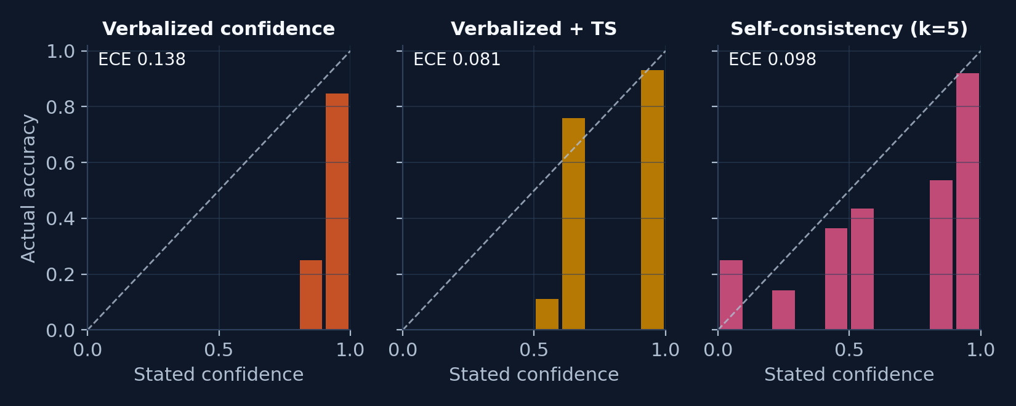
6. Calibration: Stated Confidence vs. Reality
7
Reliability diagrams — a perfectly calibrated model sits on the dashed diagonal
Reading it: bars below the diagonal = over-confident. Largest average gap: Verbalized confidence (+14 pts confidence above accuracy).
Overconfidence in GenAI Answers • Seminar on AI
16 Oct 2026
Notes:
How to read these: we group answers by stated confidence, then plot how often each group was actually correct. On the dashed diagonal, 80% confidence means 80% accuracy. Bars BELOW the diagonal mean the model was less accurate than it claimed — that is overconfidence. Look at where most answers sit and how far they are from the line, and compare the raw verbalized panel with the temperature-scaled panel. In our run the largest average overconfidence gap was Verbalized confidence, at +14 percentage points.

Slide 8
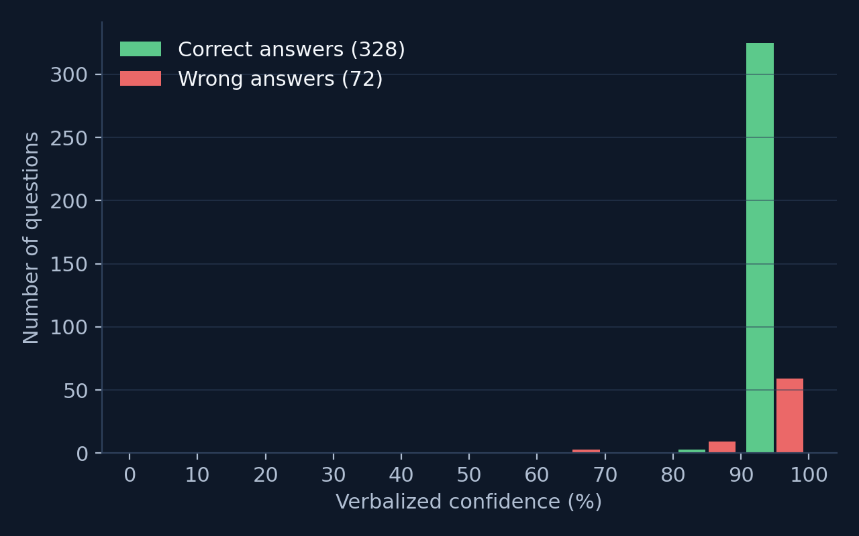
7. Evidence: Confidently Wrong Answers
8
Distribution of verbalized confidence for right vs. wrong answers
How was President Kennedy assassinated?
Model: By gunshot (100% sure)
Correct: Shot
Of the ten most populated cities of the USA which is furthest north?
Model: Chicago (100% sure)
Correct: Detroit
Who was the cartoon adversary of Pixie and Dixie, who would often say I hate those meeces to pieces?
59 of 400 answers were wrong while the model claimed ≥90% confidence.
Model: Jinks the Cat (100% sure)
Correct: Mr Jinx
Overconfidence in GenAI Answers • Seminar on AI
16 Oct 2026
Notes:
This chart is the core of our topic. Green bars are correct answers, red bars are wrong answers, by the confidence the model stated. If the model knew what it didn't know, the red bars would sit on the left. Instead, 82% of the wrong answers were stated with at least 90% confidence. On the right are real examples from our run — the model is wrong and still very sure. Overall we found 59 confidently-wrong answers out of 400 questions.

Slide 9
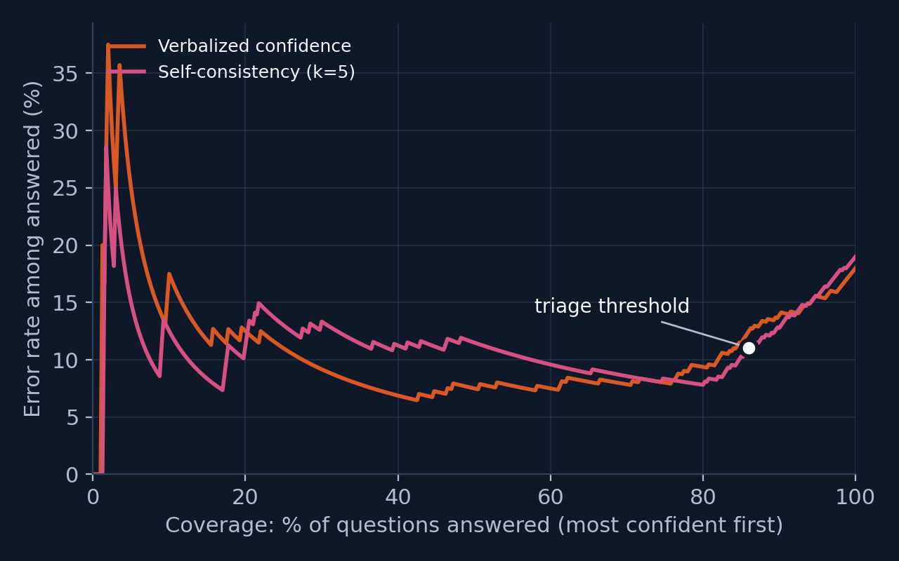
8. Early Look: Does Triage Make Sense?
9
Stage 1 of our pipeline = self-consistency filter (5 samples)
86%
answered directly (≥4/5 samples agree)
accuracy on these: 89%
14%
escalated to Stage 2 (low agreement)
error rate on these: 68%
50%
of ALL wrong answers land in the escalated group
Lower curve = fewer errors among the answers we choose to give. White dot = our triage threshold.
→ verification effort goes where the errors are
Overconfidence in GenAI Answers • Seminar on AI
16 Oct 2026
Notes:
This is an early test of our own idea, using data we already have. Stage 1 of the pipeline accepts an answer if at least 4 of the 5 samples agree; otherwise it escalates to an expensive check. The curve shows error rate against coverage — if we answer only the most confident questions, how many mistakes remain. A lower curve is better. At our threshold we would answer 86% of questions directly with 89% accuracy, and escalate only 14%, which contain 50% of all errors. So expensive verification would only be needed for a minority of queries. Building and costing that Stage-2 check is our Week 3–4 work.

Slide 10
9. Key Findings & Lessons Learned
10
What the first results tell us
FINDINGS (FROM OUR DATA)
LESSONS & CHALLENGES
• The model answered 82% correctly but claimed 96% confidence on average (gap +14 pts).
• 82% of the WRONG answers were stated with ≥90% confidence (avg. 91% when wrong vs 97% when right).
• Temperature scaling reduced verbalized ECE from 0.138 to 0.081 (42% lower) — calibration can be repaired cheaply.
• Best at telling right from wrong answers: Self-consistency (k=5) (AUROC 0.80). Temperature scaling barely moves AUROC — it rescales scores, it does not re-rank answers.
• Grading free-text answers is noisy → lenient alias matching + manual spot-checks.
• Calibration ≠ discrimination: TS fixes the confidence scale, but barely changes which answers get trusted.
• Token log-probs are not offered by every API (e.g. reasoning models) → black-box signals matter.
• Rate limits shaped the design: resumable runs, parallel requests, caching.
Overconfidence in GenAI Answers • Seminar on AI
16 Oct 2026
Notes:
To summarise the findings: The model answered 82% correctly but claimed 96% confidence on average (gap +14 pts). 82% of the WRONG answers were stated with ≥90% confidence (avg. 91% when wrong vs 97% when right). Temperature scaling reduced verbalized ECE from 0.138 to 0.081 (42% lower) — calibration can be repaired cheaply. Best at telling right from wrong answers: Self-consistency (k=5) (AUROC 0.80). Temperature scaling barely moves AUROC — it rescales scores, it does not re-rank answers. Lessons learned: automatic grading of free-text answers is the biggest source of measurement error, so we spot-check it manually; and temperature scaling fixes the scale of confidence but not which answers get high confidence — that is why we need a stronger signal such as self-consistency plus verification, which is exactly our triage design.

Slide 11
10. Next Steps & Timeline
11
We are on schedule — Week 3 milestone complete
W1-2
W3
W3–4
W5
W6
Literature • scope
Baselines + first results
Build & test triage pipeline
Evaluate vs. baselines
Write-up & final talk
DONE
DONE
NEXT
PLANNED
PLANNED
NEXT 1
NEXT 2
NEXT 3
Build Stage 2 (escalation)
Measure cost honestly
Test generality
Retrieval fact-check or multi-agent / stronger-model re-check, applied only to low-agreement questions.
Log tokens & latency: always-answer vs. always-escalate vs. triage; tune the agreement threshold.
Add a harder benchmark (e.g. SimpleQA) and a second model; larger sample for tighter estimates.
Overconfidence in GenAI Answers • Seminar on AI
16 Oct 2026
Notes:
We are on schedule. Weeks 1 and 2 are done. In Weeks 3 and 4 we build Stage 2 of the pipeline: for low-agreement questions we will try a retrieval-based fact check or a multi-agent / stronger-model re-check, and we will log tokens and latency so we can compare cost against always running the expensive check. We also plan to add a harder dataset and a second model to see whether the findings generalise. Week 5 is the full evaluation against the baselines, and Week 6 is the write-up.

Slide 12
THANK YOU
REFERENCES USED THIS WEEK
Questions?
Guo et al. (ICML 2017)
On Calibration of Modern Neural Networks — temperature scaling.
Tian et al. (EMNLP 2023)
Just Ask for Calibration — verbalized confidence from RLHF-tuned LLMs.
Wang et al. (ICLR 2023)
Self-Consistency Improves Chain of Thought Reasoning in Language Models.
Geifman & El-Yaniv (NeurIPS 2017)
Selective Classification for Deep Neural Networks — risk–coverage.
Joshi et al. (ACL 2017)
TriviaQA: a large-scale distantly supervised challenge dataset for reading comprehension.
Saman Rai • ID 2317130
Group 7 • Seminar on AI
TAKE-AWAY
50% of the model's errors sit in the 14% of questions where its own samples disagree — that is where verification should go.
Overconfidence in GenAI Answers • Seminar on AI
16 Oct 2026
Notes:
Thank you — happy to take questions.

