Slide 1
Braille Keyboard
Complex Embedded Lab
Supervised by:
M.Sc. Thomas Dietrich
M. Sc. Alexander Wichmann
Presented by:
Md Shakhout Hossain
Samaneh Nazari Dastjerdi

Slide 2

Agenda
Braille Keyboard
Components
Circuit
Pseudo code

Slide 3
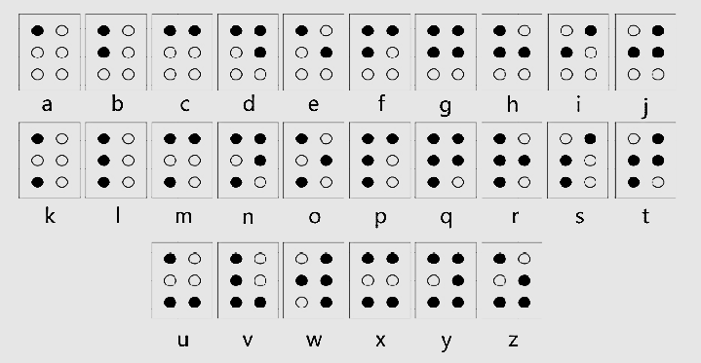
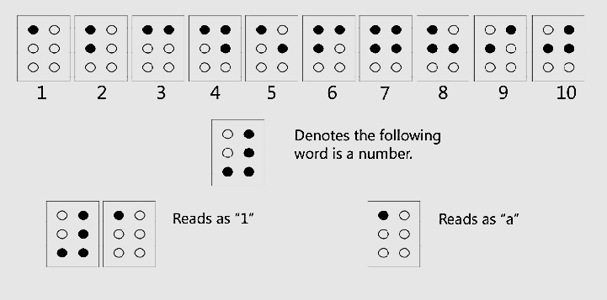
Braille Keyboard
A Braille keyboard is a specialist input device that allows the user to type and enter text or instructions for the computer in Braille.
English and braille letter
English and Braille numbers

Slide 4
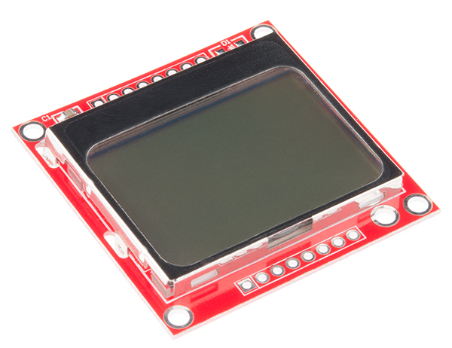
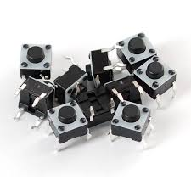
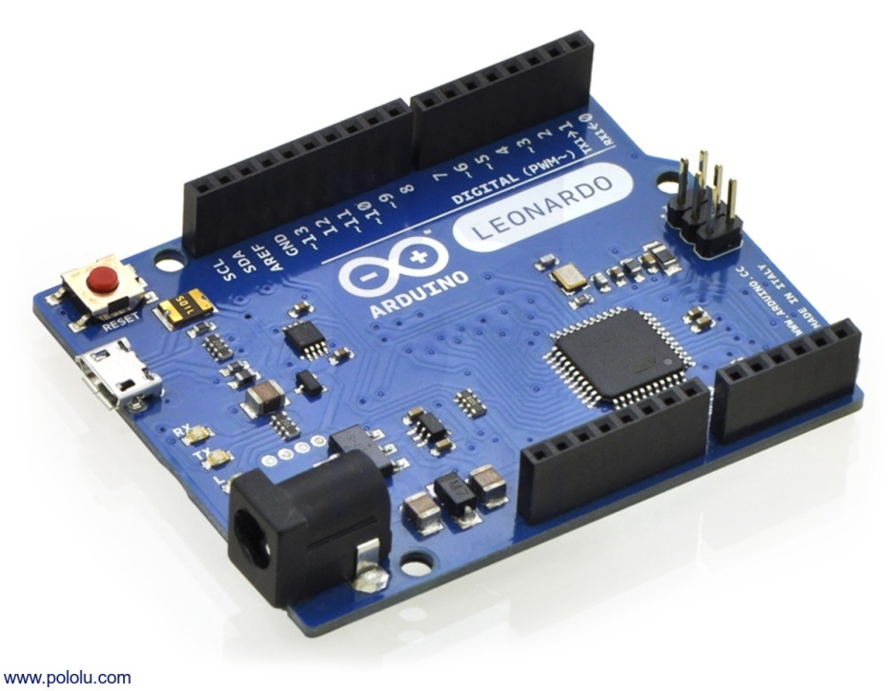
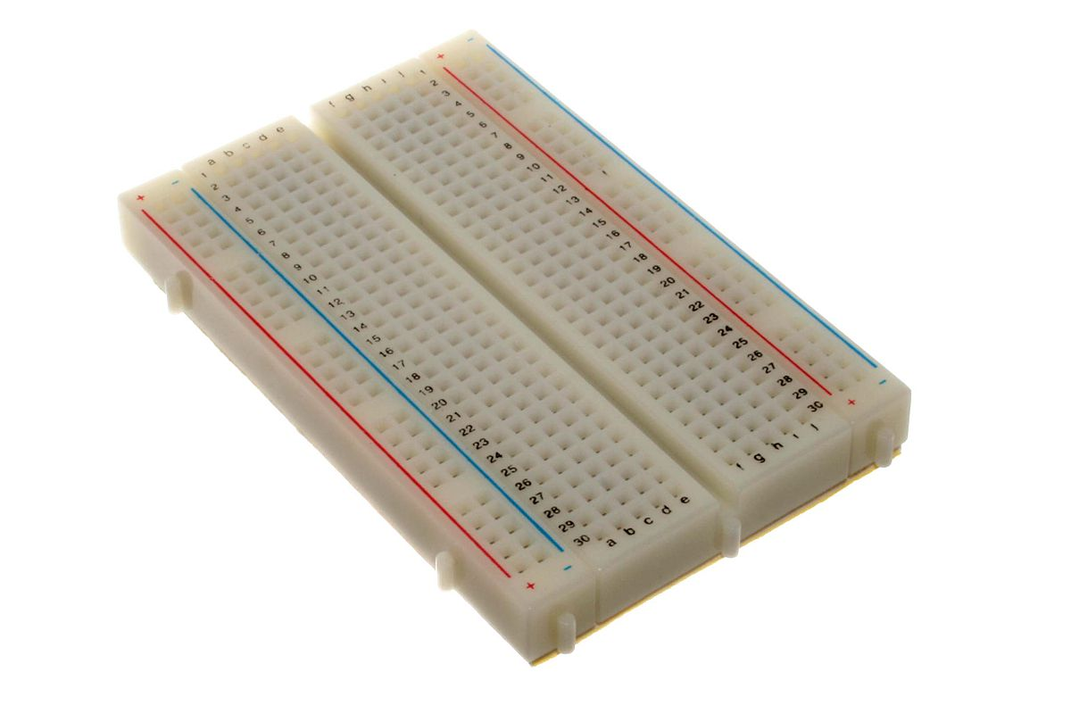
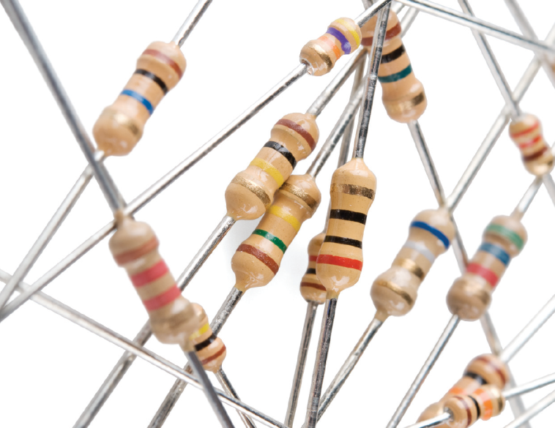
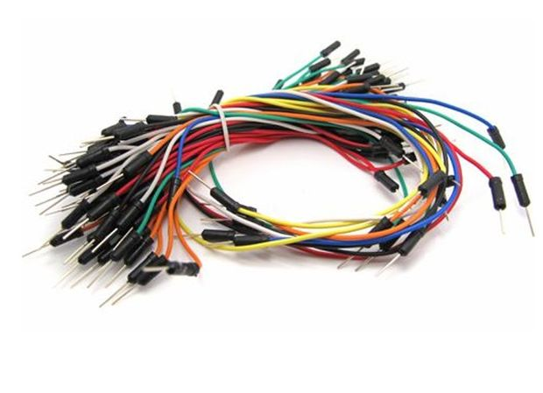
Components
Arduino board
LCD5110 (Nokia 5110)
7 Push buttons
Breadboard
Resistor
Cable

Slide 5
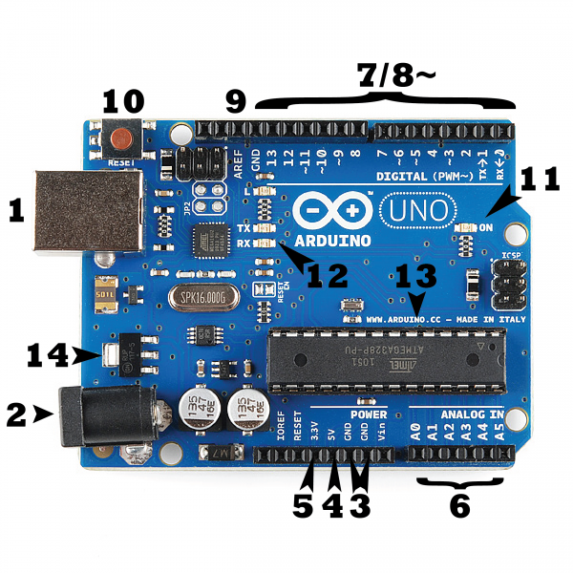
Arduino
The USB connection
The barrel jack
Ground
5V
3.3V
Analog
Digital
Pulse-Width Modulation (PWM)
Analog Reference
Reset button
Power LED Indicator
Transmit and Receive indicator LEDs
Integrated Circuit
The voltage regulator

Slide 6
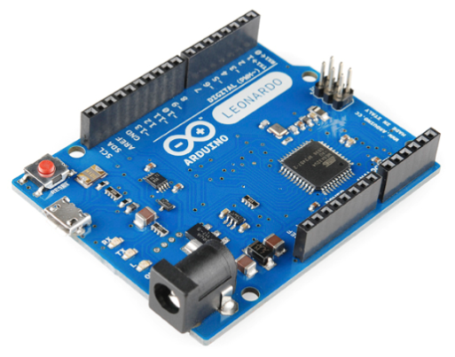
Arduino Leonardo
The Leonardo is Arduino’s first development board to use one microcontroller with built-in USB.

Slide 7
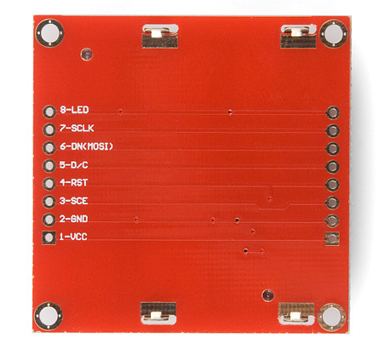
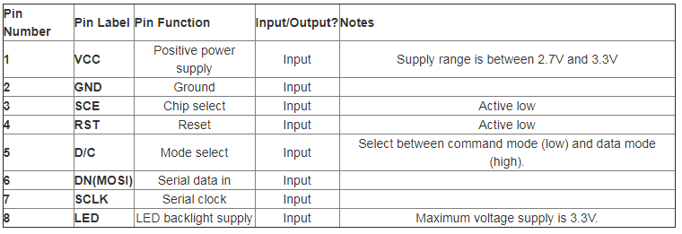
LCD 5110

Slide 8
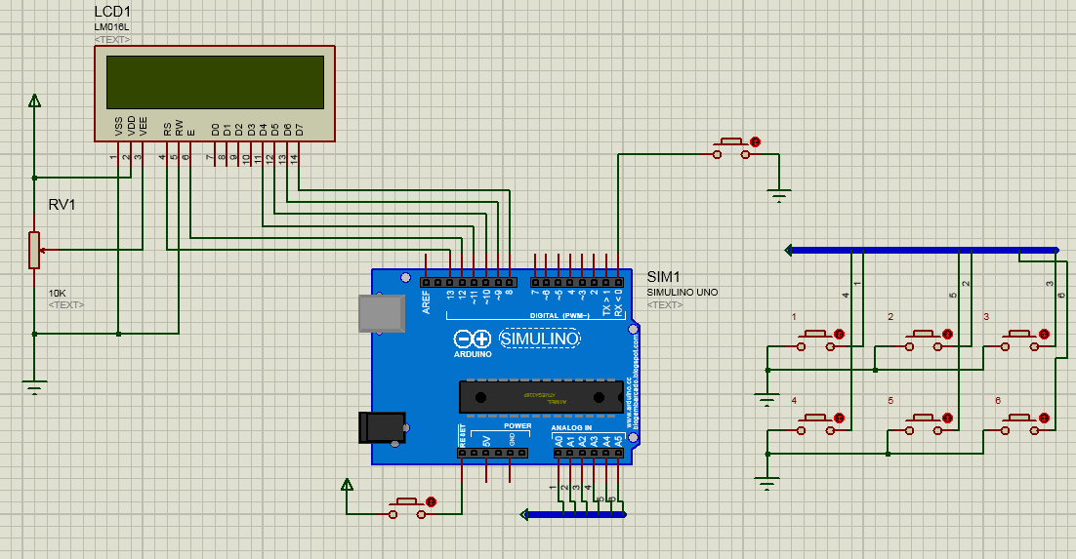
Circuit

Slide 9
Pseudo code
Declaring all the entire buttons as constant
Setting initial values for pins
Complete button press flag
Sum up all values container
Check Number Format
lastDebounceTime = 0;
debounceDelay = 200;
Initialize pinMode for the entire button
Read All The Button Pressed
complete =1 & is Number = 0
NO
complete =1 & is Number = 1
NO
Invalid Values
Yes
Yes
Switch( sum value)
Case1: serial point(“A”)
…
Switch( sum value)
Case1: serial point(“0”)
…
Print Letter
Print Numbers
Complete=0
Sum value=0
…
Complete=0
Sum value=0
Is Number=0
…

Slide 10
Thank You
md-shakhout.hossain@tu-ilmenau.de
Samaneh.nazari-dastjerdi@tu-ilmenau.de

