Slide 1

Stackoverflow Developer Survey Data Analysis
Olcum, Firat
June 12, 2022

Slide 2




OUTLINE
Executive Summary
Introduction
Methodology
Results
Visualization – Charts
Dashboard
Discussion
Findings & Implications
Conclusion
Appendix

Slide 3

EXECUTIVE SUMMARY
Relevant skills required in the field of IT and business consulting are ever-changing and evolving
It is important to identify future skill requirements and trends to keep peace with changing technologies and remain competitive.
This presentation will show current and future trends in Programming Languages, Databases, Platforms and Webframes.
Consequently, the aim in identifying future skill requirements and trends is to help the firm make more informed data-driven hiring and budgetary decisions.

Slide 4

INTRODUCTION
This presentation has been crated for stakeholders and business decision makers within the global IT and business consulting services firm.
The presentation will help identify future skill requirements in the global IT sector necessarry for the firm to keep pace with changing technologies and remain competitive.
Recommendations will be stated based on the analysis.

Slide 5

METHODOLOGY
Using a modified subset of the Stackoverflow dataset, the data was wrangled in order to remove duplicates, impute missing values and normalize data.
Next, the data underwent exploratory analysis in order to find the distribution of data, presence of outliers and determine the correlation between different columns in the dataset.
The data was then used to visualize the distribution, the relationship between two features and the composition and comparison of data.
Finally after downloading two files, which are also a modified subset of the Stackowerflpw dataset, Cognos Dashboard Embedded(CDE) was used to create three slides:
Current Technology Usage
Future Technology Trends
Demographics

Slide 6
RESULTS

Slide 7
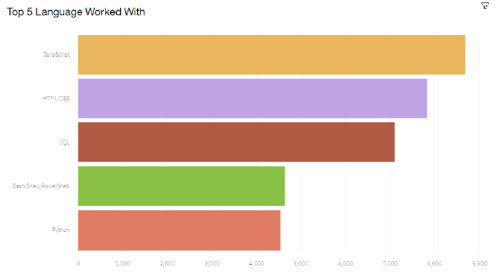
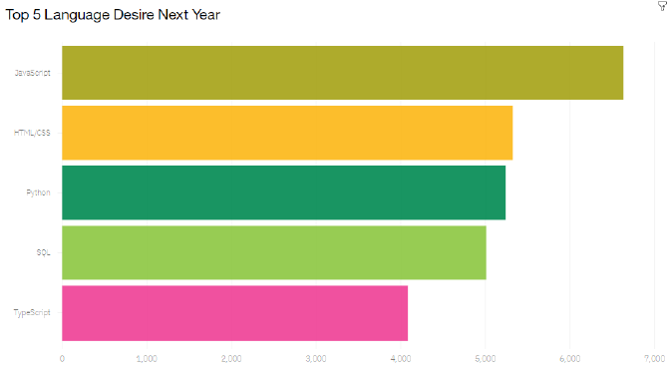
PROGRAMMING LANGUAGE TRENDS
Current Year
Next Year

Slide 8
PROGRAMMING LANGUAGE TRENDS - FINDINGS & IMPLICATIONS
Findings
JavaScript and HTML/CSS continue to be the top two most popular programming languages for this year and next.
Python and TypeScript have gained more intereset for next year.
Whereas interest in SQL and Bash/Shell/Powershell has decreased.
Implications
You can continue to employ a similar number of people skilled in JavaScript and HTML/CSS.
You can employ more people skilled in Python and Typescript
You can employ less people skilled in SQL and Bash/Shell/PowerShell.

Slide 9
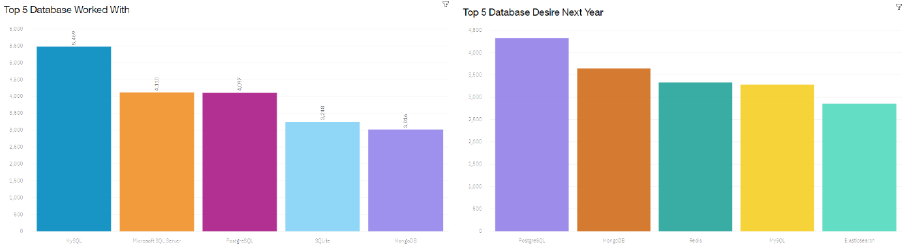
DATABASE TRENDS
Current Year
Next Year

Slide 10
DATABASE TRENDS - FINDINGS & IMPLICATIONS
Findings
Interest in MySQL, Microsoft SQL Server and SQLite has decreased for next year.
Interest in PostgreSQL and MongoDB have increased compared to the current year.
There is gained interest in Redis and Elasticsearch for next year.
Implications
You can employ less people skilled in MySQL, Microsoft SQL Server and SQLite.
You can employ more people skilled in PostgreSQL and MongoDB.
You can employ more people skilled in Redis and Elasticsearch.

Slide 11

DASHBOARD
Click here to view the Cognos Dashboard

Slide 12
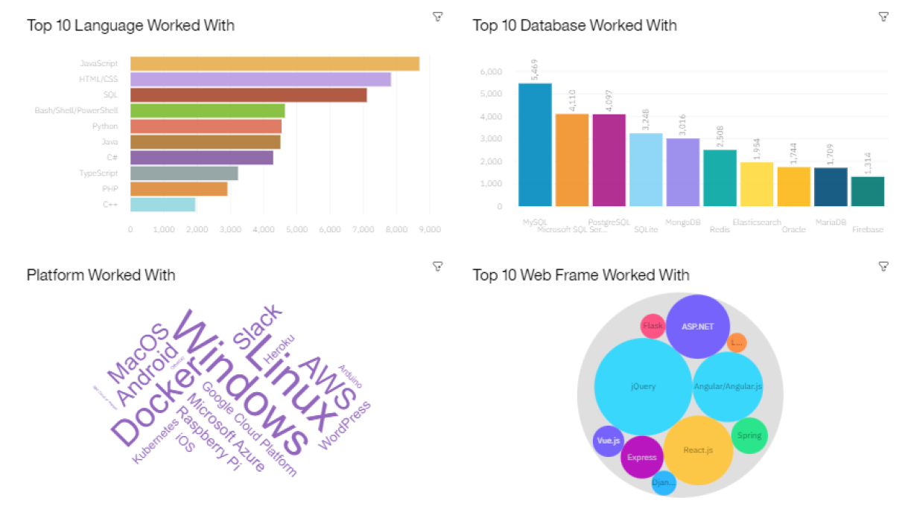
DASHBOARD TAB 1

Slide 13
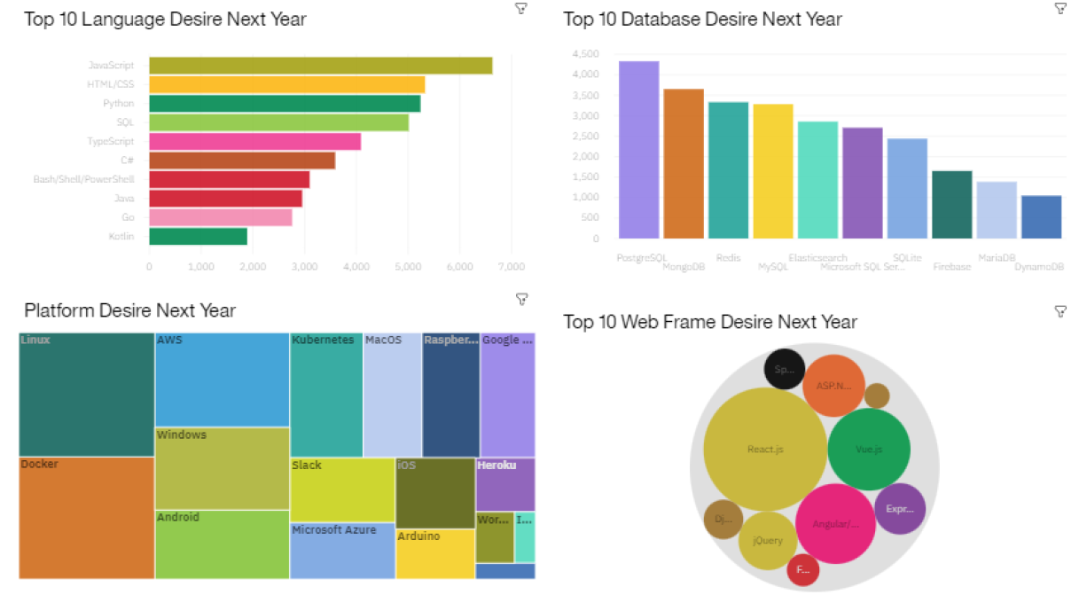
DASHBOARD TAB 2

Slide 14
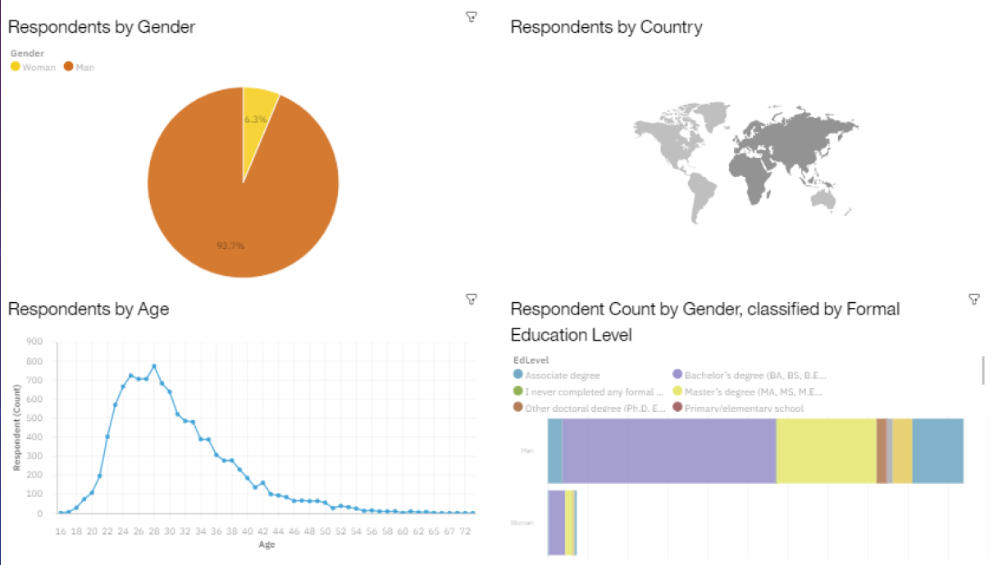
DASHBOARD TAB 3

Slide 15
DISCUSSION

Slide 16
OVERALL FINDINGS & IMPLICATIONS
Findings
More than 90 percent of those surveyed are men.
The average age of the respondents is 30.
Typescript is gaining significant interest and Python continues to grow as well.
Redis, Elasticsearch, PostgreSQL and MongoDB are gaining more interest.
Interest Slack and Windows is dropping significantly.
Vue.js is gaining substantial interest and React.js continues to grow as well.
Implications
The software space continues to be male-dominated.
It still seems difficult to find highly experienced personnel in the field of development.
You can continue to staff enough Javascript and HTML/CSS but employ more people skilled in Python and Typescript.
You can employ more people skilled in PostgreSQL, MongoDB, Elasticsearch, and Redis.
You can continue to staff enough ASP.NET but employ more people skilled in Vue.js and React.js.
You can continue to staff enough Linux, employ more people skilled in Docker, AWS and Android, but make reductions to Slack and Windows.

Slide 17

CONCLUSION
You can make adjustmenst in staff for those skills no longer in demand.
You can carve out budget in order to hire additional staff with skills needed to fill any gaps.
You can set aside budget or put a program in place to upskill those already employed.

Slide 18

APPENDIX

Slide 19
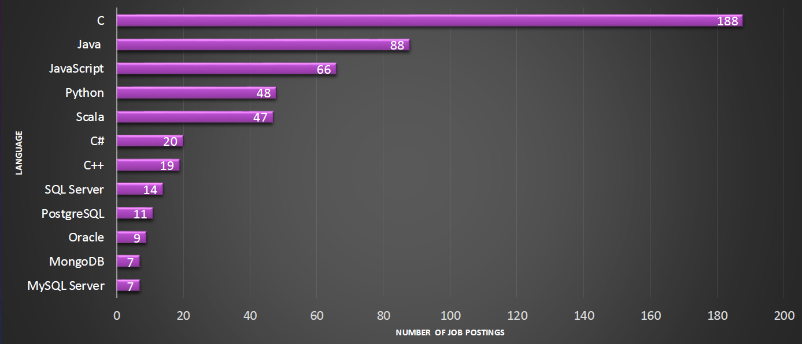
JOB POSTINGS

Slide 20
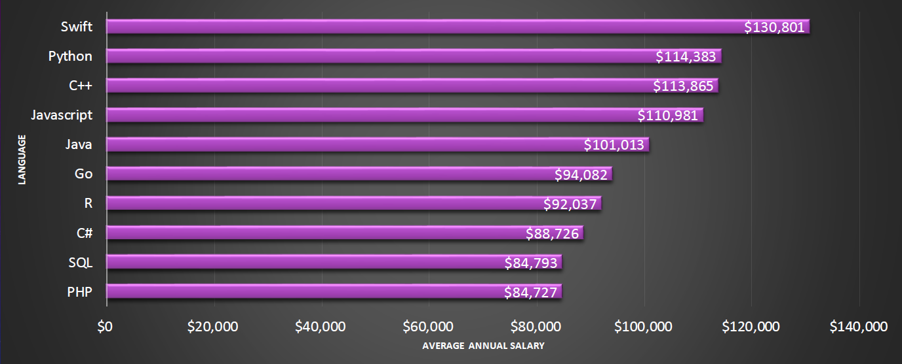
POPULAR LANGUAGES

