Slide 1
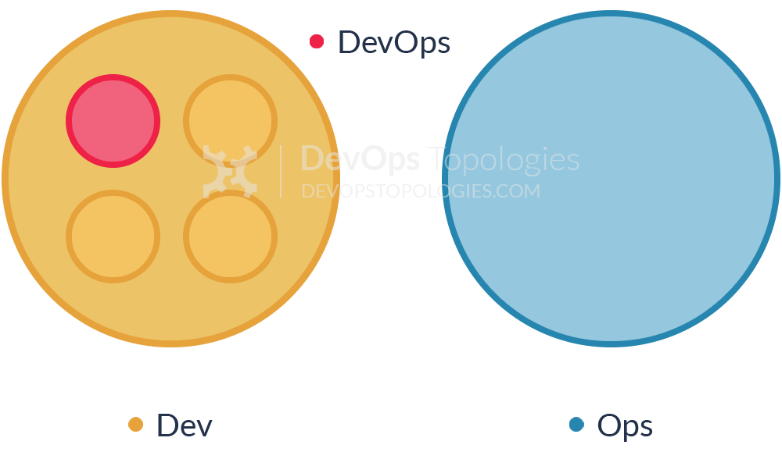
7 DevOps Team Antipatterns

Slide 2
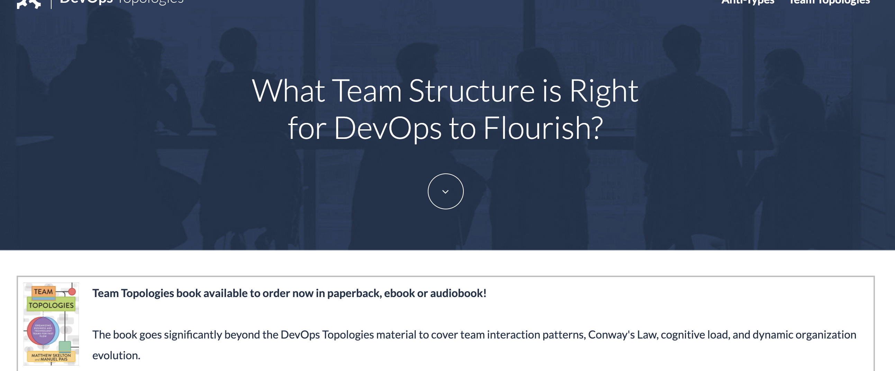
https://web.devopstopologies.com/

Slide 3
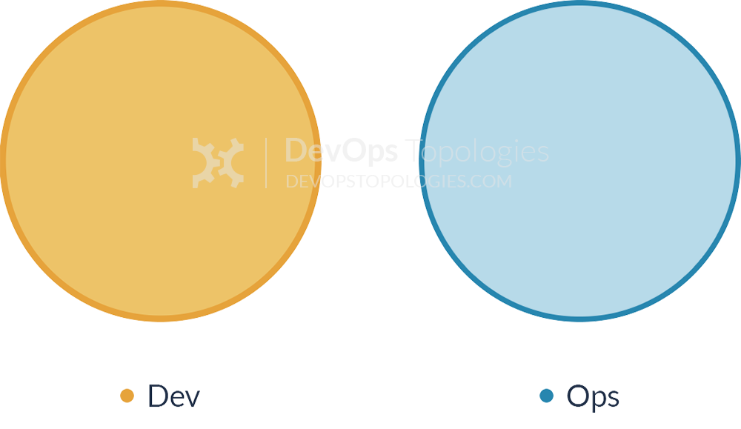
Anti-Type A: Dev and Ops Silos
Throw it over the wall
DONE means ‘feature-complete’, but not working in Production
Notes:
While Ansible acts as a configuration management solution, Terraform is a service orchestration tool.

Slide 4
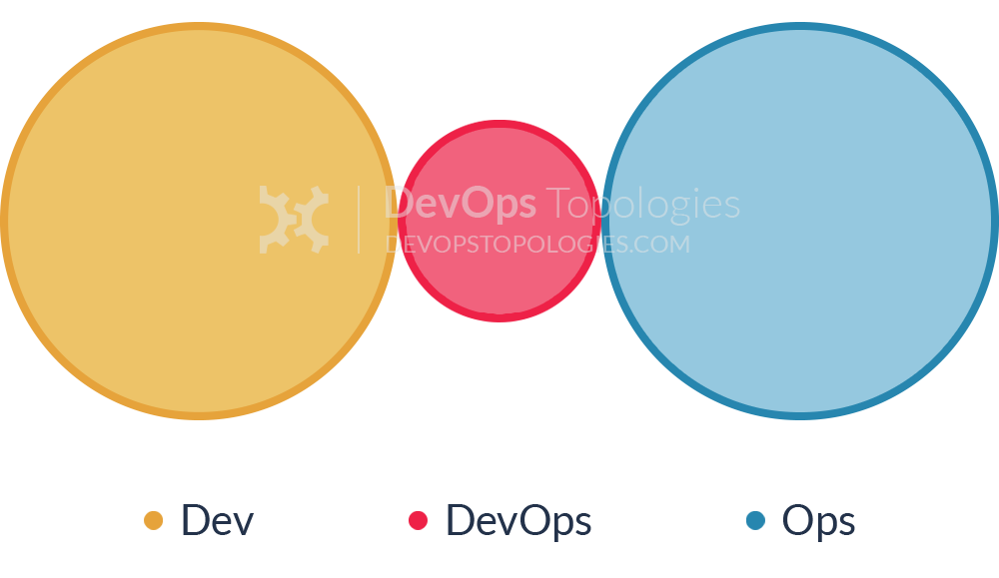
Anti-Type B: DevOps Team Silo
manager or exec deciding that they “need a bit of this DevOps thing”
DONE means ‘feature-complete’, but not working in Production
Notes:
While Ansible acts as a configuration management solution, Terraform is a service orchestration tool.

Slide 5
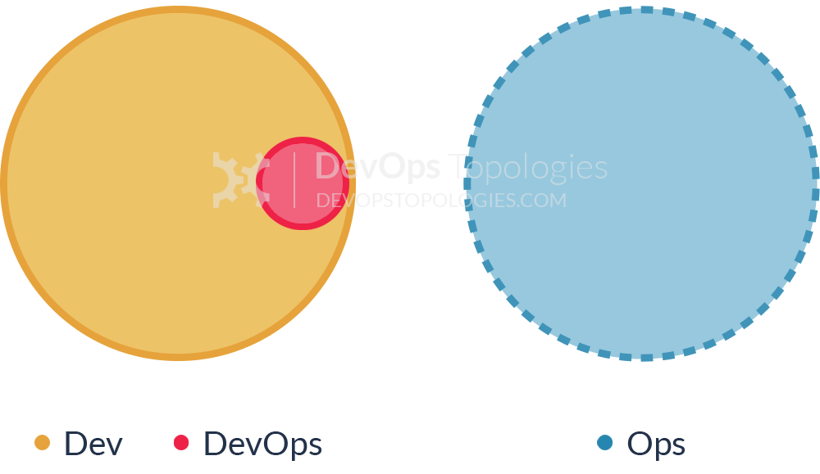
Anti-Type C: Dev Don't Need Ops
Combination of naivety and arrogance from developers and development managers
wildly underestimate the complexity and importance of operational skills and activities
Operational activities will start to swamp ‘development’ (aka coding) time
Notes:
While Ansible acts as a configuration management solution, Terraform is a service orchestration tool.

Slide 6
Anti-Type D: DevOps as Tools Team
To facilitate delivery of functional stories by Dev Teams
Good step forward, but still Ops working in isolation
Notes:
While Ansible acts as a configuration management solution, Terraform is a service orchestration tool.

Slide 7
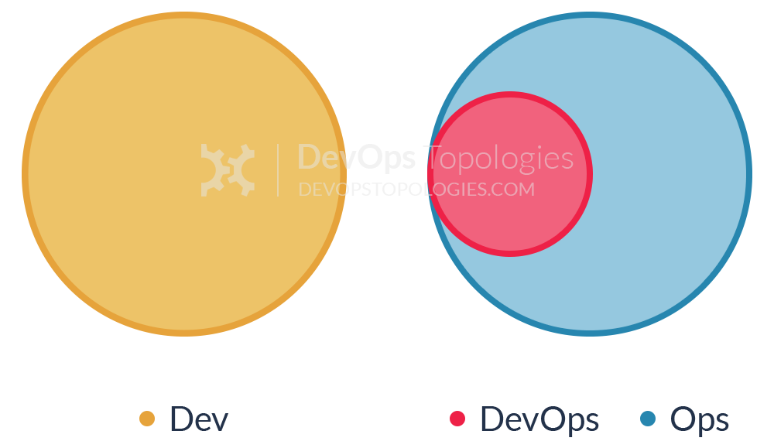
Anti-Type E: Rebranded SysAdmin
typical in organizations with low engineering maturity
no real cultural/organizational change taking place
Red flag when recruiters are looking for candidates with automation and tooling skills
Notes:
While Ansible acts as a configuration management solution, Terraform is a service orchestration tool.

Slide 8
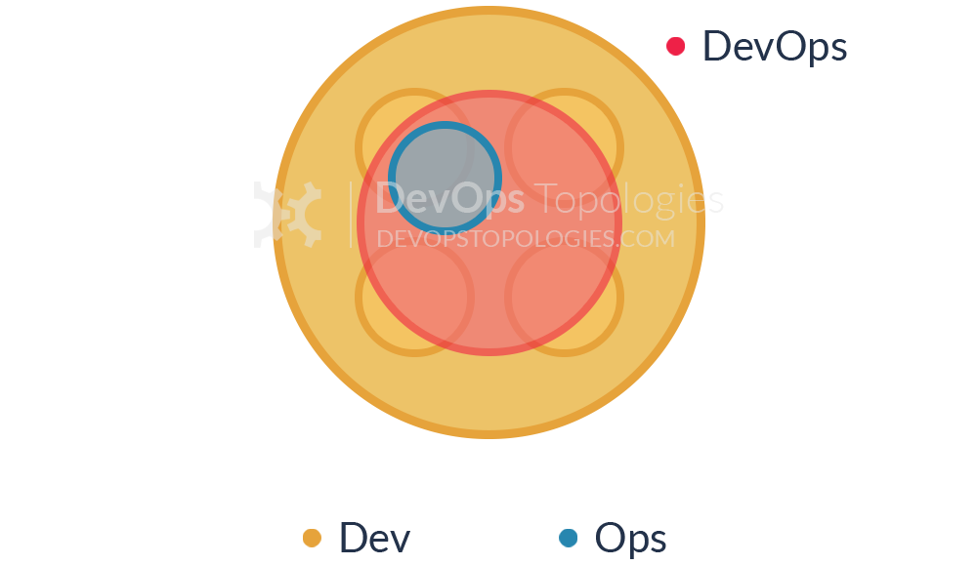
Anti-Type F: Ops Embedded in Dev Team
The organization does not want to keep a separate Ops team
development teams take responsibility for infrastructure, managing environments, monitoring, etc
Ops items will face resource contraints
Notes:
While Ansible acts as a configuration management solution, Terraform is a service orchestration tool.

Slide 9
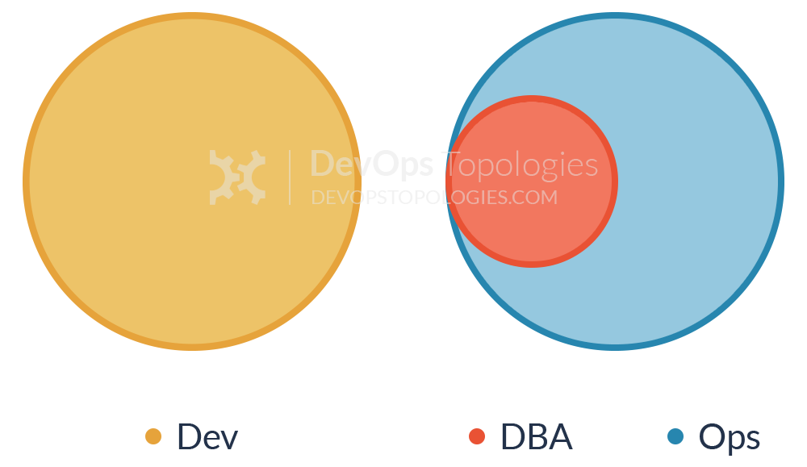
Anti-Type G: Dev and DBA Silos
A variant of anti-pattern A (Dev and Ops silo)
When company needs a dedicated DBA to keep systems up
DBA will become a road block to continuous delivery
Like anti-pattern A, the DBA is not involved early in dev lifecycle
Notes:
While Ansible acts as a configuration management solution, Terraform is a service orchestration tool.

Slide 10
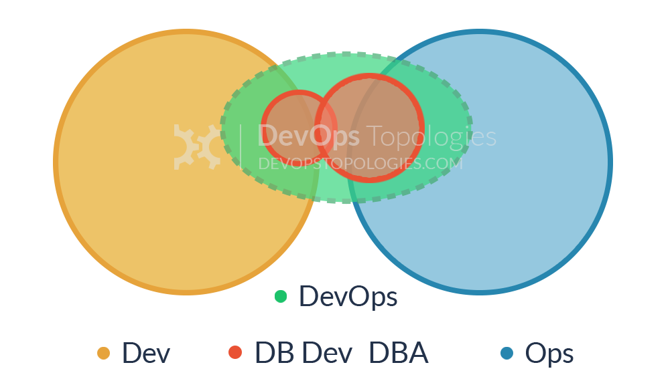
9 DevOps Team Patterns

Slide 11

Start the change
Notes:
While Ansible acts as a configuration management solution, Terraform is a service orchestration tool.

