Slide 1
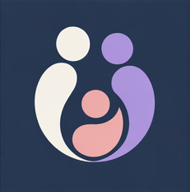
OVIFY
AI-Powered IVF Patient Adherence & Clinic Support Ecosystem
Keeping IVF patients on track, on time, and supported through every cycle.
A UAE-Born Innovation in Reproductive Health | Hub71 Initiate Application
Founder: Samaneh Khaleghi · Abu Dhabi, UAE · June 2026

Slide 2

1. Executive Summary
Ovify solves an expensive, everyday IVF problem using targeted, compliant AI.
During an IVF cycle, patients administer confusing injections at home for weeks. Between visits, clinics have zero visibility. A single missed or mis-timed dose can cancel a cycle worth up to 55,000 AED. Globally, 54% to 65% of patients drop out.
Ovify bridges this gap with an AI-prioritised ecosystem.
1
2
3
The Patient Web App
The Support Sync App
The Clinic Dashboard
Step-by-step injection visual timers, automated alarms, and an AI companion answering common questions in English/Arabic instantly. Saves hospital support lines from basic calls.
Keeps support companions informed with daily cues on how and when to support, synchronizing tasks to decrease the patient's emotional workload.
Uses an AI model to analyse patient logging latency and sentiment check-ins, ranking patients dynamically by cycle-dropout risk so nurses can intervene 48 hours before an injection window is missed.
Source/Verification: WHO Infertility statistics
OVIFY

Slide 3

2. The Problem
IVF treatment is overwhelming, manual, and disconnected.
Patients: High Emotional & Cognitive Burden
54% - 65%
Confusing medication regimens, self-injection anxiety, and a total lack of structured real-time support between weekly clinic check-ins.
IVF patient dropout rate before completing cycles.
Support: Willing but Left Out of the Loop
30,000 - 55,000 AED
Support companions feel invisible and disconnected, with no guidance on how to offer physical or emotional support during critical injection windows.
Cost to the patient when a single cycle is cancelled due to a missed injection.
15 Hours / Week
Nurses: Burned Out & Overloaded with Admin
Clinical coordinators spend up to 15 hours every week manually chasing patient compliance logs via phone calls and disorganized WhatsApp chats.
Spent by each nurse manager on manual patient tracking.
Source/Verification: ESHRE / Human Reproduction Journal; UAE Clinical Pricing Benchmarks (2026)
OVIFY

Slide 4
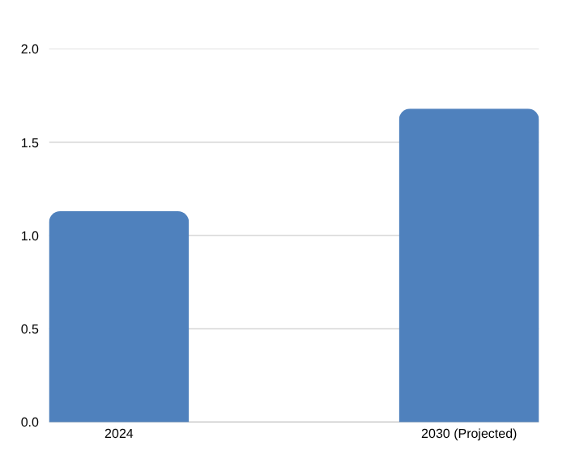
3. Market Opportunity & Growth
Unprecedented regional demand coupled with supportive regulatory changes.
1 in 6 Adults Affected Globally
GCC IVF Market Size (USD Billion)
WHO estimates that infertility affects 17.5% of the adult population, driving a massive increase in clinical demand.
UAE: Regional IVF Hub
18,000 to 20,000 IVF cycles are performed annually in the UAE alone, valued at $294M to $310M. High out-of-pocket spending.
GCC Growth Trajectory
The GCC IVF market size is valued at USD 1.13B in 2024, projected to grow to USD 1.68B by 2030 (6.7% CAGR).
beachhead expansion: Abu Dhabi (Y1) -> Dubai (Y2) -> Saudi Arabia (Y3)
Source/Verification: WHO Research; Grand View Research; IMARC (2025/2026)
OVIFY

Slide 5
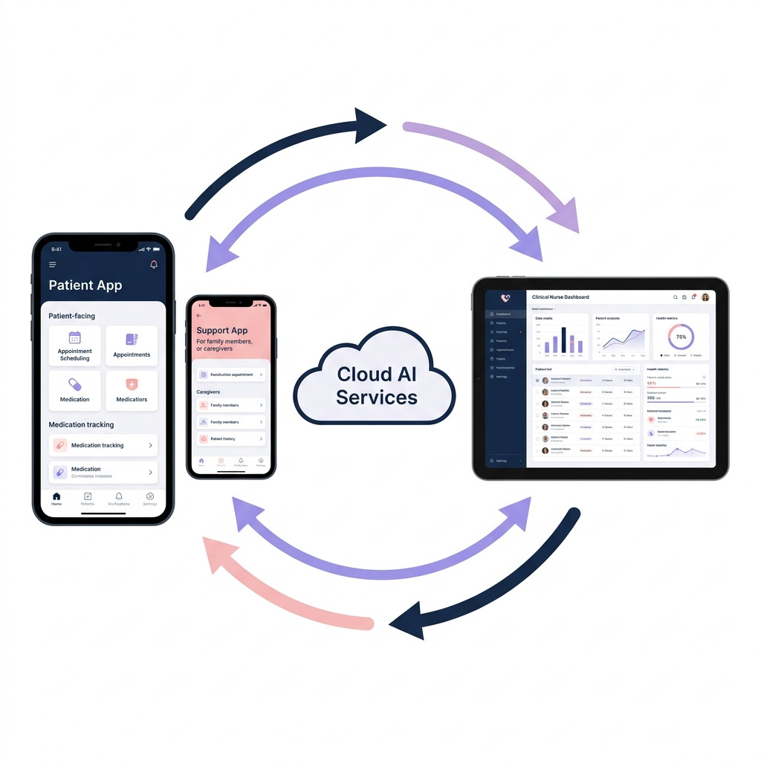
Step 3: Change "AI Alerts Clinic" to 3.
4. The Solution & Process Flow
A real-time clinical loop running on friction-free, app-store-independent PWAs.
AI Voice & Text Onboarding:
Nurses dictate or paste medication protocols; AI parses and builds the patient timeline in 90 seconds.
1
Instant Patient Onboarding:
Patient receives a secure WhatsApp/SMS link; installs app to homescreen instantly.
Support Companion Sync:
Companion is invited; calendars sync and coordination prompts align automatically.
Interactive Guidance:
Daily timers alert patient; step-by-step visual guides verify syringe preparation.
CalmSeed Companion (RAG):
Patient chats with a medical Explainer; daily check-ins monitor psychological distress.
Predictive Triage Engine:
Logging latencies and sentiment anomalies trigger risk ranking on the dashboard.
Nurse Priority Intervention:
Coordinator triages high-risk patients proactively to prevent dropouts before failures.
Friction-Free Onboarding (PWA)
• No App Store Dependency
• 100% Onboarding Success: Eliminates clinic IT delays, compatibility issues, etc...
Source/Verification: PWA & AI Architecture Specification
OVIFY

Slide 6
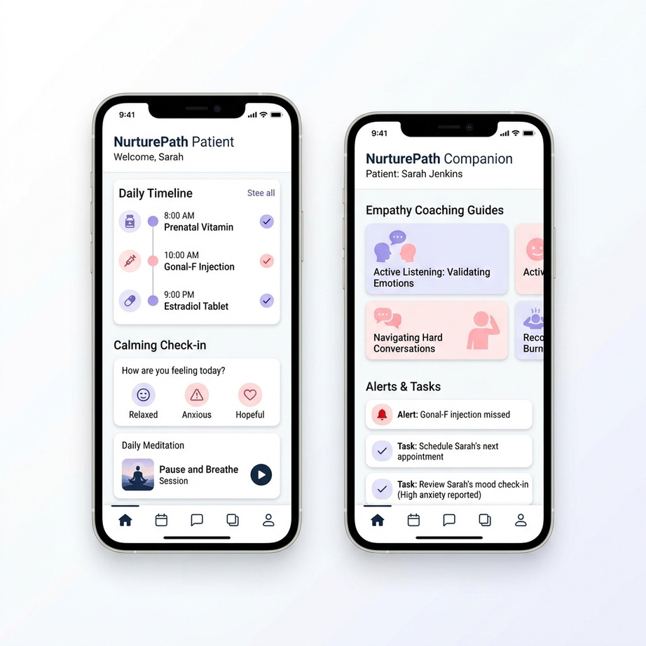
5. Patient & Support Companion Apps
Integrated, AI-powered mobile tools that turn confusing protocols into clear, guided tasks.
AI Patient & Support Features
LLM-Driven & Tracker
Allows nurses to dictate or paste medication protocols; AI parses audio and text to automatically build the patient daily timeline
Interactive Guidance Engine
Step-by-step visual timers and mixing guides that patients follow during the critical self-injection window.
Ask-Me-Anything Explainer
Conversational agent leveraging RAG grounded in verified clinical guidelines (ASRM/ESHRE) to answer medication and clinical questions instantly in English/Arabic.
Support Companion Sync
Delivers timely nudges, empathy coaching cues, and aligned calendars, reducing patient anxiety and relationship friction.
OVIFY

Slide 7
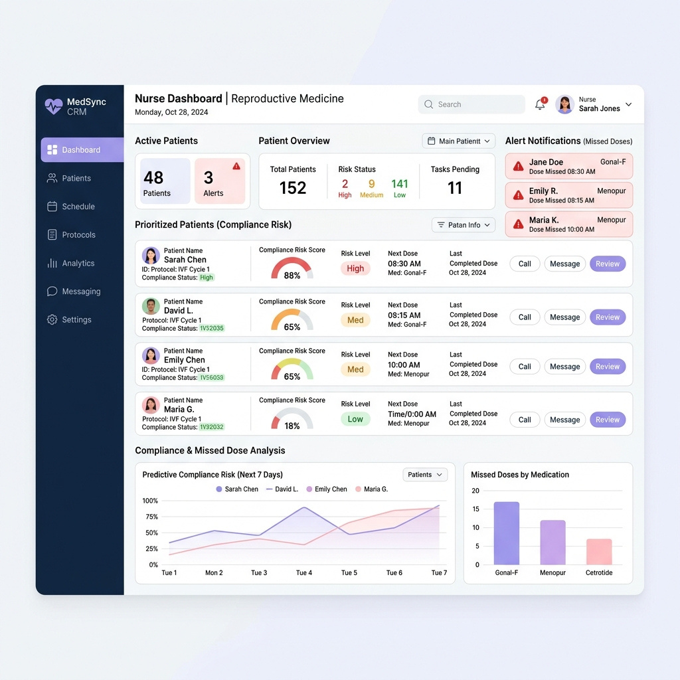
7. AI Engine & Clinic Dashboard
Machine learning that anticipates dropouts and optimizes nurse workloads.
CalmSeed Emotional AI (NLP)
Analyzes daily check-in logs and user text trends for semantic markers to identify warning signs of severe anxiety, highlighting patients for nurse follow-up.
Predictive Adherence Classifier
A supervised model trained on logging cadence trends (e.g., a patient logging Menopur 15 minutes later each day) to predict dropout risks 48 hours before compliance failure.
Dynamic Patient Risk Vector
Synthesizes compliance behavior, NLP sentiment logs, and cycle phase complexity (dosage, patient age) into a unified priority score.
Nurse Priority Triage Console
Dynamically ranks active patients based on the Risk Vector, streamlining clinic workflows and saving nurses up to 40% of administrative phone chasing.
OVIFY

Slide 8
8. Competitive Landscape
No existing competitor delivers both deep EMR integration and patient support.
Our real
competitor
Paper & WhatsApp
Ovify Moat & Defensibility
No visibility, no compliance alerts. Heavy manual workload that burns out clinical staff.
GCC-Specific Localisation
Arabic-first localized content, WhatsApp notifications, PDPL-compliance, and direct integration with Abu Dhabi's Malaffi exchange.
Consumer Apps (e.g., Embie, Naula, Bonzun)
Patient only
Purely patient-facing tracking calendars, zero clinic dashboard or nurse compliance alerts.
First-Mover Clinic Lock-in
Free clinical pilots secure early clinic partnerships, integration with EMR systems, and a reference system that is hard to replace.
Fertility EMRs (e.g., eIVF, MedITEX, BabySentry)
Records only
Records and scheduling platforms with very basic, rarely-used patient portals.
AI Adherence Data Flywheel
Unlike legacy EMR databases, Ovify's closed-loop system actively feeds real-time patient adherence and sentiment data back into our ML model, compounding accuracy over time and creating a defensible medical data moat."
Hospital / HIS Portals (e.g., Epic, Cerner, Malaffi)
Generic portals
Generic, non-specialized health portals that lack IVF-specific workflows.
"Traditional systems are passive record repositories. Ovify is a predictive adherence engine that dynamically prevents dropout failures."
OVIFY

Slide 9
9. Monetization Strategy
A simple annual software licence, billed upfront, generating over 90% gross margin.
Starter Platform
Growth Platform
Scale / Enterprise
55,000 AED
99,000 AED
249,000 AED
per year
per year
per site / year
Up to 150 cycles (~370 AED / cycle)
9,000 AED setup fee
Best for boutique, single-site fertility clinics.
Up to 500 cycles (~198 AED / cycle)
18,000 AED setup fee
Optimized for active regional mid-size centres.
500+ cycles (~166 - 249 AED / cycle)
35,000 AED setup fee
For large multi-site clinical hospital chains.
“Immediate Clinic ROI: Preventing just two canceled cycles per year pays for the entire annual software subscription.”
Future Expansion Revenue Models (from Year 2)
Engine 2: Co-Branded Cycle Bundle
Engine 3: Wellness & Partner Network
Fold Ovify into standard clinic IVF cycles. Clinic charges patients 350 AED, pays Ovify 150 AED, and keeps 200 AED margin (turns software into a profit center for clinics).
Earn referral commission fees on opt-in fertility-friendly wellness sessions (yoga, nutritionists) and payment/financing referrals (e.g. Bank Loans).
OVIFY

Slide 10
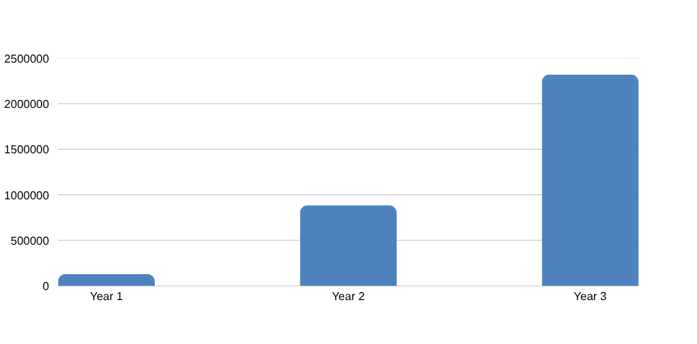
10. Execution Roadmap & Financials
A phased rollout plan designed to prove clinical value, then scale.
1
Months 0 - 4
2
Months 4 - 6
3
Months 7 - 9
4
Months 10 - 12
Phase 1: Build MVP
Phase 2: Live Pilots
Phase 3: Prove Value
Phase 4: Convert & Paid
Complete Patient app & AI nurse dashboard build.
Free pilots with 3 Abu Dhabi clinics; onboard 150 patients.
Measure nurse hours saved and dropout rates prevented.
Convert 2 out of 3 pilots into paid annual contracts.
Three-Year Projections (Bottom-Up Model)
Projected Revenue Growth (AED)
Metric
Year 1
Year 2
Year 3
Paying Clinics
2
6
13
Cycles Processed
400
2,200
5,500
Total Revenue
131.5K AED
885K AED
2.32M AED
Operating Costs
511.5K AED
809.6K AED
1.20M AED
Net Profit / (Loss)
(380K AED)
+75.4K AED
+1.12M AED
OVIFY

Slide 11
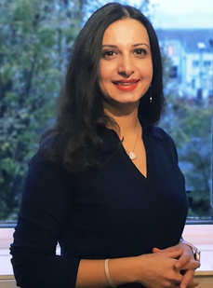
11. The Team
Lived IVF patient experience combined with enterprise cloud architecture.
2x Senior Developers (Full-Stack & Mobile) - To be hired
Samaneh Khaleghi
Offshore resources. Build AI platform backend, database APIs, AI engine, and PWA companion apps.
Founder & CEO | Ovify
UI / UX Experience Designer - To be hired
Offshore resource. Focuses on the patient app and clinical coordinator dashboard: clean, calm, and simple layout.
• Lived Experience:
Went through four personal IVF treatment cycles, providing a deep, personal understanding of patient challenges.
• Technical Expertise:
15+ years in Enterprise Cloud Architecture, Banking Infrastructure Transformation, and Cloud Systems Delivery.
Medical & Clinical Advisor - To be hired
Informal advising regional IVF doctor. Validates clinical credibility, protocol structures, and coordinates pilot introductions.
Sales & Commercial - To be hired
Planned Year 2 hire. Key commercial resource responsible for pilot-to-paid conversions and GCC clinical expansions.
OVIFY

Slide 12
12. Why Hub71 & Abu Dhabi?
The fastest path to build a regional, regulated health-technology company.
1
Strategic Introductions
2
Regulatory Alignment
3
Cost Optimization
Direct Clinical Pilot Access
Aligned with Department of Health
Runway Capital Efficiency
Hub71's network and healthcare partnerships (like Daman, SEHA, Cleveland Clinic) help us open the hardest door: direct, credible access to clinical pilot sites.
Abu Dhabi's DoH vision, the Malaffi unified health information exchange, and ADGM data regulations align perfectly with Ovify. Compliance is built in from day one.
Subsidized office space, housing support, and licensing incentives stretch our capital runway, accelerating our path to profitability.
"Abu Dhabi provides the network, the clinical integration, and the regulation to transform an unsolved medical problem into a global benchmark."
OVIFY

Slide 13
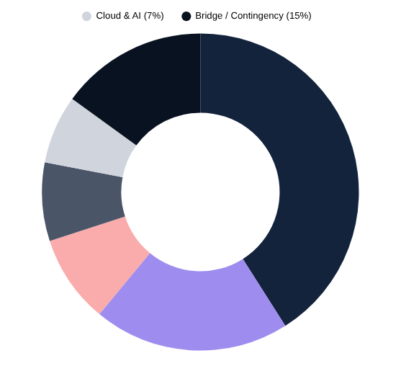
13. Funding Ask
Seed capital request to achieve a revenue-ready MVP and paid conversions.
Use of Funds Allocation (%)
Use of Funds Table
The Seed Round
500,000 AED
Product Build
205k AED
Equivalent to $136,000 USD
Founder Runway
100k AED
Runway Timeline
Legal & Setup
45k AED
12 Months (to operational profitability)
Pilots & GTM
40k AED
✓ Revenue-ready MVP build
✓ First 3 Abu Dhabi pilots live
✓ Initial paid conversions
Cloud & AI APIs
35k AED
Bridge Buffer
75k AED
Source/Verification: Hub71 Business Plan Section 10 (Use of Funds Table)
OVIFY

Slide 14
OVIFY
"Our vision is to build the regional standard for digital IVF patient adherence, making the UAE the global benchmark for how patients are supported through their fertility journey."
Let's build it from Abu Dhabi.
Samaneh Khaleghi · Founder & CEO
Email: sama.khaleghi@gmail.com | Web: www.ovify.com
Abu Dhabi Global Market (ADGM) · Hub71 Initiate
OVIFY

