Slide 1
Introduction to IETF CoAP, CORE, and CORECONF with YANG Tooling
Exploring protocols and tools for IoT network management
Notes:
---

Slide 2
Context and Scope of the Presentation
Notes:
Presentation Goals and Technical Scope

Slide 3
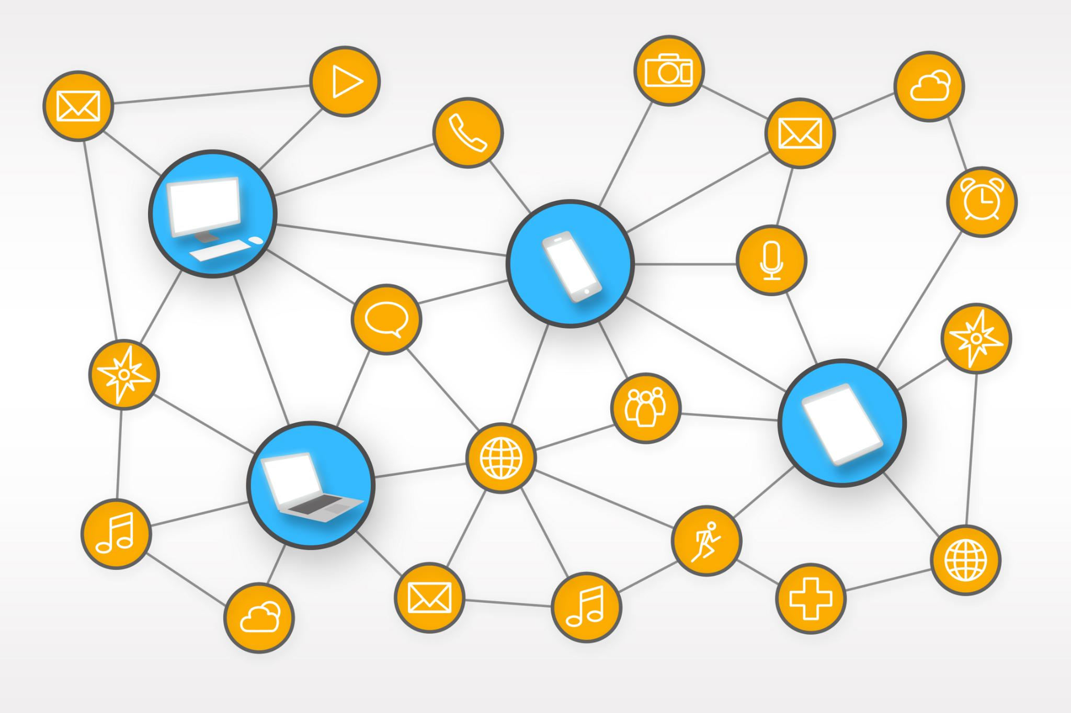
Presentation Goals and Technical Scope
Introduction to IETF CORE Technologies
  Overview of IETF CORE working group and CoAP protocol as foundations for constrained device management.
CORE Architecture and CORECONF
  Explanation of CORE architecture components and introduction of CORECONF using YANG over CoAP with compact encoding.
Interoperability and YANG Reuse
  CORECONF reuses YANG data models across NETCONF, RESTCONF, and constrained devices for seamless integration.
Tools and Workflows
  Highlights necessary tools for YANG model validation, encoding, and CoAP client libraries to enable deployment.
Notes:
This presentation provides a structured introduction to the IETF technologies that enable management and configuration of constrained devices, with a specific focus on the Constrained Application Protocol (CoAP), the IETF CORE working group, and the CORECONF management approach. The primary goal is to explain how REST-based concepts familiar from HTTP, RESTCONF, and NETCONF are adapted to operate efficiently in constrained environments such as IoT endpoints, embedded controllers, and industrial devices. These environments are characterized by limited memory, low processing power, intermittent connectivity, and energy constraints, which make traditional management protocols unsuitable.
The scope begins with an overview of the IETF CORE working group and its mission, followed by a detailed explanation of CoAP as the foundational transfer protocol. The presentation then expands into the broader CORE architecture, showing how components such as security mechanisms and resource discovery fit together. Building on this foundation, CORECONF is introduced as a YANG-based configuration and management solution that mirrors RESTCONF semantics while operating over CoAP and using compact encodings such as CBOR.
A key emphasis is placed on interoperability and reuse. Rather than inventing new data models or management paradigms, CORECONF reuses YANG, allowing the same models to be applied across NETCONF, RESTCONF, and constrained-device environments. This significantly lowers the barrier for operators and vendors who already rely on YANG-based workflows. The presentation also highlights the practical tooling required to work with YANG in this context, including model validation, encoding, and client-side CoAP libraries.
By the end of this presentation, the audience should understand where CoAP and CORE fit within the IETF ecosystem, how CORECONF enables standardized device management for constrained nodes, and what tools and workflows are required to design, validate, and deploy YANG-based management solutions in low-power and lossy networks. The content is intended for engineers, architects, and standards practitioners who are familiar with networking concepts and are looking to extend structured management into IoT-scale deployments.

Slide 4
IETF CORE and CoAP Fundamentals
Notes:
IETF CORE Working Group and Its Mission, Constrained Application Protocol (CoAP) Overview, Key CoAP Concepts and REST Mapping

Slide 5

IETF CORE Working Group and Its Mission
Purpose of CORE WG
  CORE standardizes protocols for constrained devices that cannot support full web technologies due to resource limits.
Core Mission and Principles
  CORE adapts web principles like REST and stateless interactions to unreliable, constrained network environments.
Technology Integration
  CORE aligns with IETF standards like IPv6, UDP, and DTLS to ensure interoperability and network integration.
IoT Management Foundation
  CORE enables standardized monitoring, configuration, and control of constrained devices for large-scale IoT deployments.
Notes:
The IETF CORE working group, short for Constrained RESTful Environments, is responsible for standardizing protocols and mechanisms that bring REST-style interactions to constrained nodes and networks. Its work targets devices that cannot reasonably support traditional web technologies such as HTTP over TCP and TLS due to memory, CPU, bandwidth, or power limitations. Typical examples include battery-powered sensors, actuators, smart building components, and industrial field devices.
CORE’s mission is to adapt the architectural principles of the web—resources, URIs, representations, and stateless interactions—to environments with unreliable links and small MTUs. Rather than creating proprietary or siloed solutions, CORE focuses on open standards that promote interoperability across vendors and application domains. This is achieved by defining a small set of reusable building blocks, most notably CoAP, along with supporting specifications such as resource discovery, observation, and security profiles.
A defining characteristic of CORE is its close alignment with existing IETF technologies. IPv6, UDP, DTLS, OSCORE, CBOR, and YANG are all leveraged rather than replaced. This alignment ensures that constrained devices remain first-class citizens of IP networks and can be integrated into broader management and orchestration systems. CORE also collaborates closely with other working groups, such as OPSAWG and NETCONF, to ensure consistency in management semantics.
In practice, the CORE working group provides the foundation that allows constrained devices to be monitored, configured, and controlled using standardized interfaces. This foundation is critical for large-scale IoT deployments, where operational consistency, security, and lifecycle management are as important as raw device functionality. CORECONF, discussed later in this presentation, is a direct result of this mission, extending CORE’s scope from application data exchange to full device configuration and management.

Slide 6

Constrained Application Protocol (CoAP) Overview
CoAP Protocol Basics
  CoAP is a lightweight UDP-based protocol providing RESTful operations over constrained networks.
Message Format and REST Methods
  CoAP uses a compact binary message format supporting GET, PUT, POST, and DELETE REST methods.
Reliability and Asynchronous Support
  Reliability is ensured by confirmable messages and retransmissions; asynchronous updates via Observe extension.
Security Features
  CoAP can be secured using DTLS for channel security or OSCORE for end-to-end message protection.
Notes:
The Constrained Application Protocol, standardized as RFC 7252, is the core transfer protocol defined by the IETF CORE working group. CoAP is designed to provide RESTful semantics similar to HTTP while operating efficiently over constrained networks. Instead of TCP, CoAP runs over UDP, significantly reducing connection overhead and state requirements on both clients and servers.
CoAP defines a compact binary message format with a small fixed header, optional tokens, and extensible options. This design allows CoAP messages to fit within the limited payload sizes typical of low-power wireless technologies such as IEEE 802.15.4. Despite its compactness, CoAP supports familiar REST methods including GET, PUT, POST, and DELETE, enabling CRUD-style interactions with resources hosted on constrained devices.
Reliability in CoAP is achieved through a lightweight message layer that supports confirmable and non-confirmable messages, retransmissions, and duplicate detection. This approach avoids the complexity of TCP while still providing reliability where needed. CoAP also supports asynchronous interactions through the Observe extension, allowing clients to subscribe to resource updates instead of polling.
From a security perspective, CoAP can be protected using DTLS or OSCORE, depending on deployment requirements. DTLS provides channel security similar to TLS, while OSCORE secures individual messages end-to-end, even across intermediaries. These features make CoAP suitable not only for simple sensor data exchange but also for secure device management and configuration use cases.

Slide 7

Key CoAP Concepts and REST Mapping
Resource Identification
  CoAP resources are identified by URIs representing data or device functions like sensor readings.
CoAP Methods and Responses
  CoAP uses GET, PUT, POST, DELETE with response codes aligned to HTTP for resource management.
Observe and Content Negotiation
  Observe enables clients to receive updates on resource changes; content negotiation supports compact formats like CBOR.
Proxying and Caching
  CoAP supports proxies bridging CoAP and HTTP and caching to reduce transmissions over lossy networks.
Notes:
CoAP closely follows the REST architectural style, mapping web concepts into a form that constrained devices can handle. At the core of this mapping is the concept of resources, which are identified by URIs and represent data or functionality exposed by a device. Examples include sensor readings, configuration parameters, or control endpoints.
The standard CoAP methods—GET, PUT, POST, and DELETE—are used to retrieve, update, create, and remove resource representations. These methods have semantics intentionally aligned with HTTP, allowing developers and operators to reuse existing REST knowledge. CoAP responses include response codes similar in spirit to HTTP status codes, indicating success, client errors, or server errors.
CoAP also introduces features that are particularly important for constrained environments. The Observe extension allows a client to register interest in a resource and receive notifications when its state changes, reducing network traffic and energy consumption compared to periodic polling. Content negotiation is supported through content-format identifiers, enabling the use of compact encodings such as CBOR in addition to more verbose formats like JSON.
Another important concept is proxying and caching. CoAP supports forward and reverse proxies, which can bridge between CoAP and HTTP or aggregate traffic from constrained nodes. Caching of responses helps minimize repeated transmissions over lossy links. Together, these concepts make CoAP a practical and scalable foundation for both application data exchange and management operations in IoT systems.

Slide 8
CORE Architecture and Management Motivation
Notes:
CORE Architectural Building Blocks, Why Device Management over CoAP Is Needed

Slide 9

CORE Architectural Building Blocks
CoAP Protocol Core
  CoAP is the central RESTful transfer protocol enabling interoperable communication in constrained networks.
Resource Discovery Mechanisms
  Resource discovery uses CoRE Link Format and Resource Directory to dynamically find available device functions.
Security Components
  Security relies on DTLS for transport and OSCORE for end-to-end object security in constrained environments.
Efficient Data Encoding
  CBOR and YANG-CBOR provide compact data representation for low-bandwidth constrained networks.
Notes:
The CORE architecture is composed of several complementary building blocks that together enable interoperable communication and management of constrained devices. At the center is CoAP, which provides the RESTful transfer protocol. Around CoAP, the architecture includes mechanisms for resource discovery, security, group communication, and data encoding.
Resource discovery is commonly handled through the CoRE Link Format and Resource Directory specifications. These allow devices to advertise the resources they host and enable clients to discover available functionality dynamically. This is particularly important in large-scale deployments where devices may join and leave the network frequently.
Security is another fundamental component. Depending on the deployment, CORE architectures may use DTLS to secure the transport channel or OSCORE to provide object-level security. OSCORE is especially valuable in constrained networks with intermediaries, as it preserves end-to-end security even when proxies are involved.
Efficient data representation is achieved through the use of CBOR and related specifications such as YANG-CBOR. These encodings significantly reduce message sizes compared to XML or JSON, making them suitable for low-bandwidth links. Together, these building blocks create a flexible architecture that supports both simple data exchange and more advanced management use cases, including those addressed by CORECONF.

Slide 10
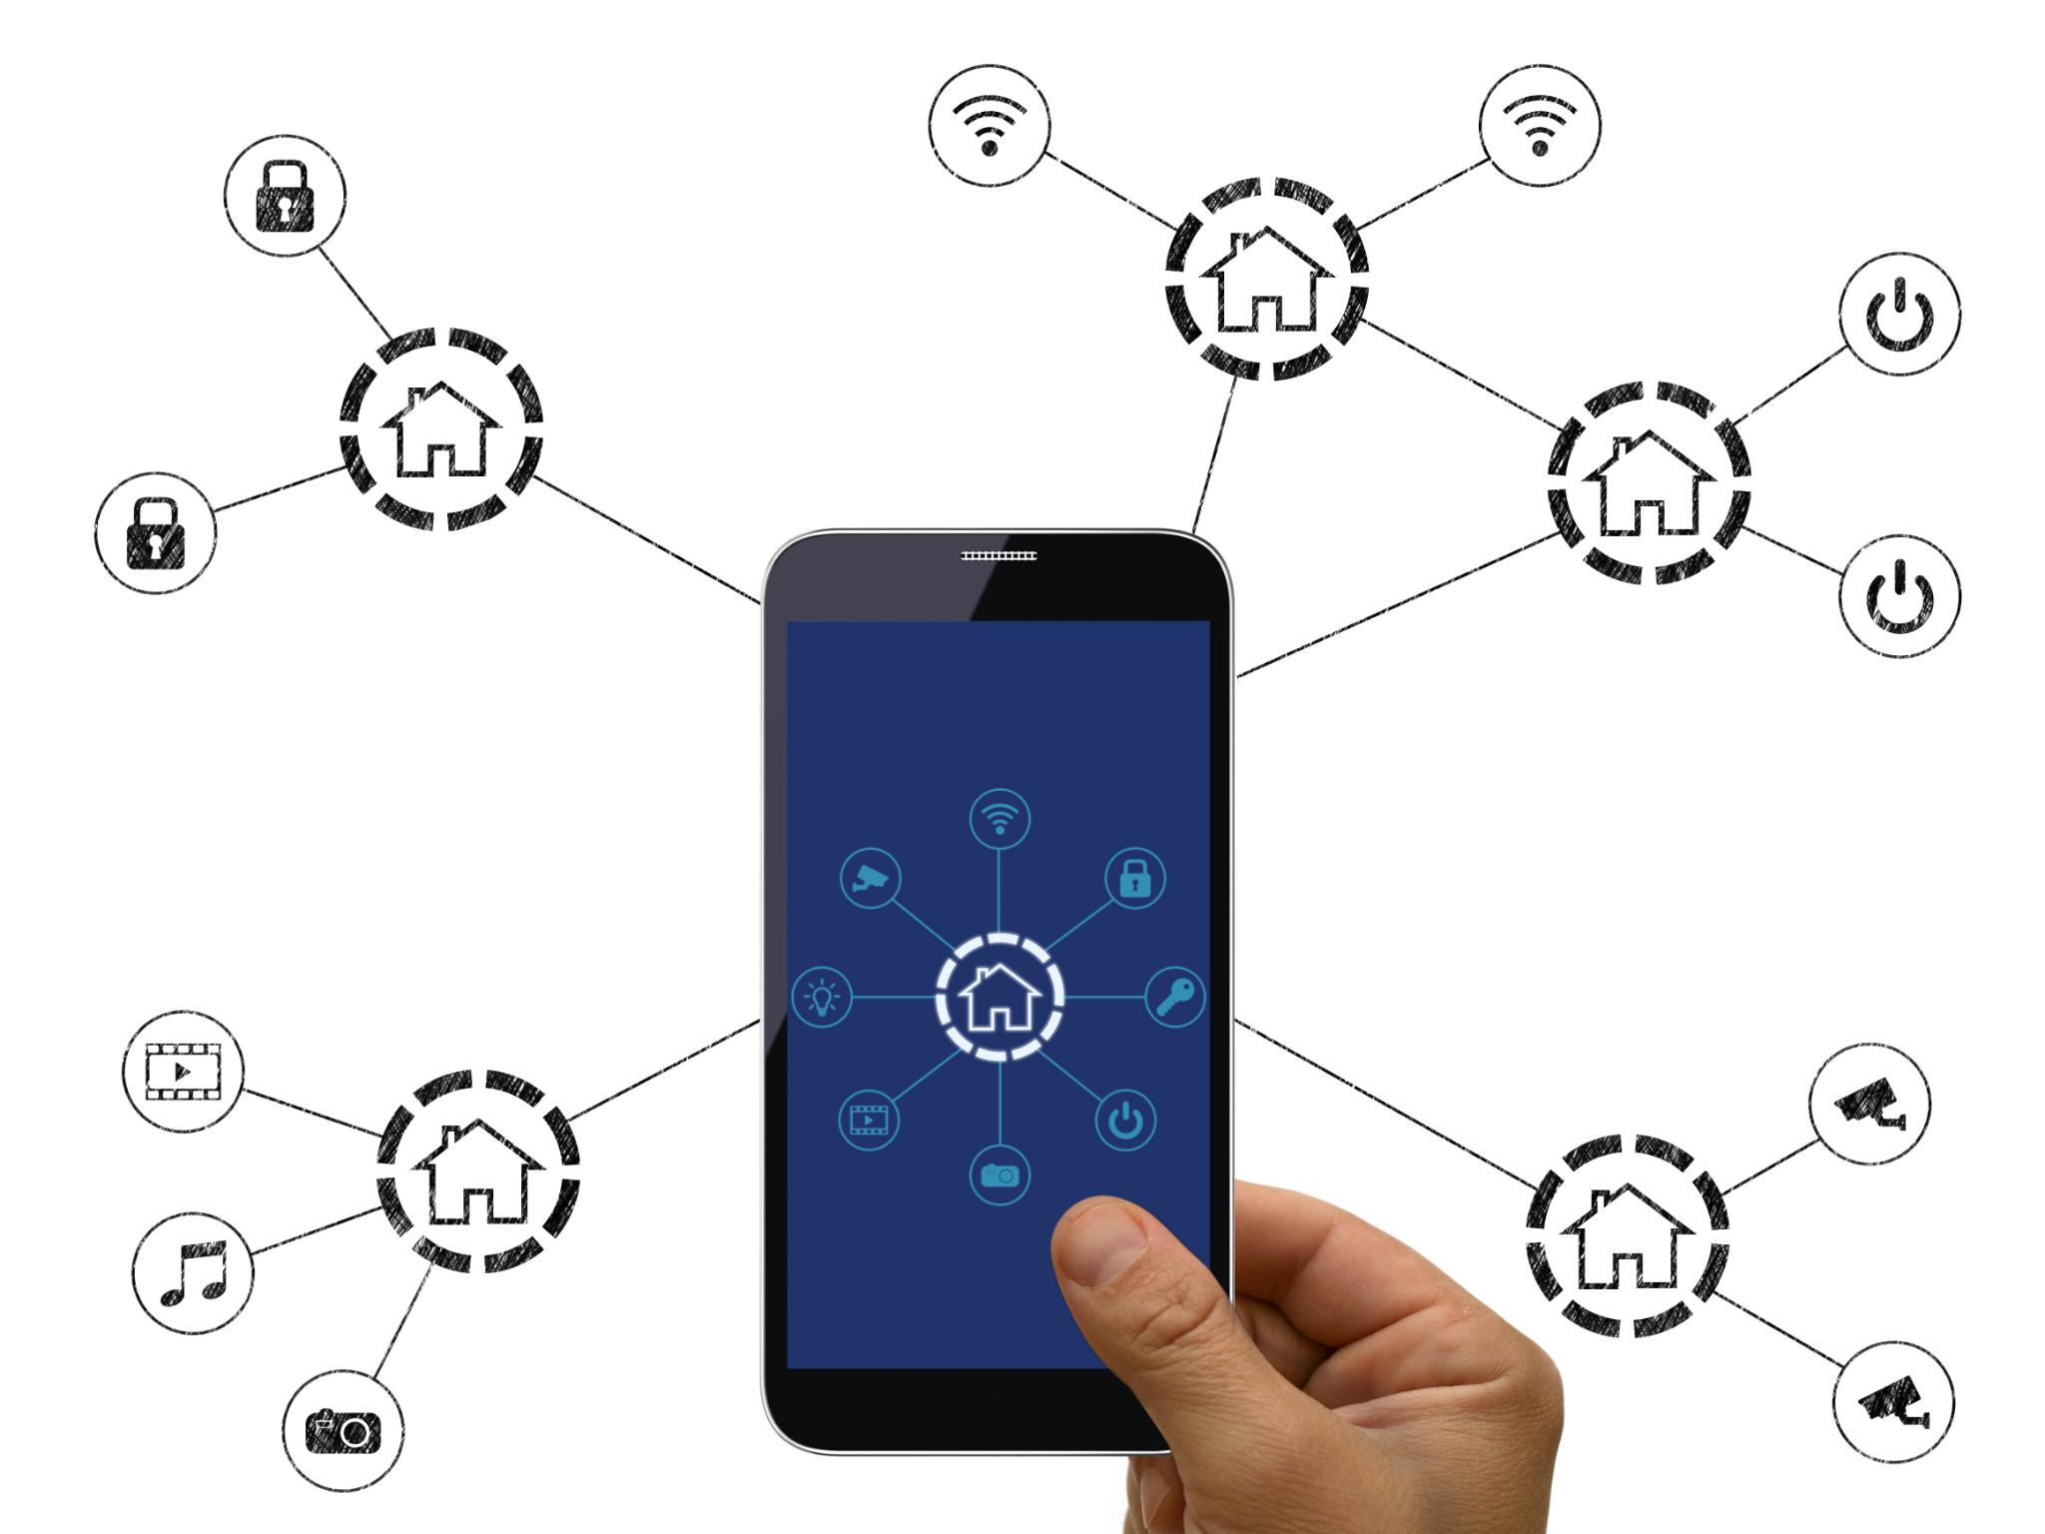
Why Device Management over CoAP Is Needed
Constraints of Traditional Protocols
  Traditional management protocols require capable devices and reliable networks, unsuitable for constrained IoT environments.
Need for Standardized IoT Management
  IoT operators require standardized, scalable methods for configuration, firmware management, and security compliance.
Advantages of CoAP Management
  CoAP reduces protocol overhead using UDP and compact encoding, optimizing resource use on constrained devices.
CORECONF and YANG Integration
  CORECONF applies YANG models for consistent, model-driven device management in constrained environments.
Notes:
Traditional device management protocols such as SNMP, NETCONF, or RESTCONF are typically built on top of TCP and assume relatively capable devices and reliable networks. In constrained environments, these assumptions often do not hold. Limited RAM and flash, strict energy budgets, and lossy wireless links make it impractical to deploy heavyweight management stacks on many IoT devices.
At the same time, operational requirements for IoT systems are increasing. Operators need standardized ways to configure devices, manage firmware and parameters, monitor operational state, and ensure security compliance. Ad-hoc or proprietary management interfaces do not scale and create long-term maintenance challenges.
Management over CoAP addresses this gap by reusing REST principles while drastically reducing protocol overhead. By running over UDP and using compact encodings, CoAP-based management minimizes resource consumption on devices. It also integrates naturally with existing CORE security and discovery mechanisms.
The motivation for CORECONF specifically is to bring the structured, model-driven approach of YANG-based management into constrained environments. Instead of inventing new configuration models, CORECONF allows operators to apply the same YANG models they already use elsewhere, ensuring consistency across device classes and simplifying end-to-end management workflows.

Slide 11
CORECONF and YANG-Based Management
Notes:
CORECONF Concept and Design Principles, How CORECONF Operations Work, Comparison with NETCONF and RESTCONF

Slide 12
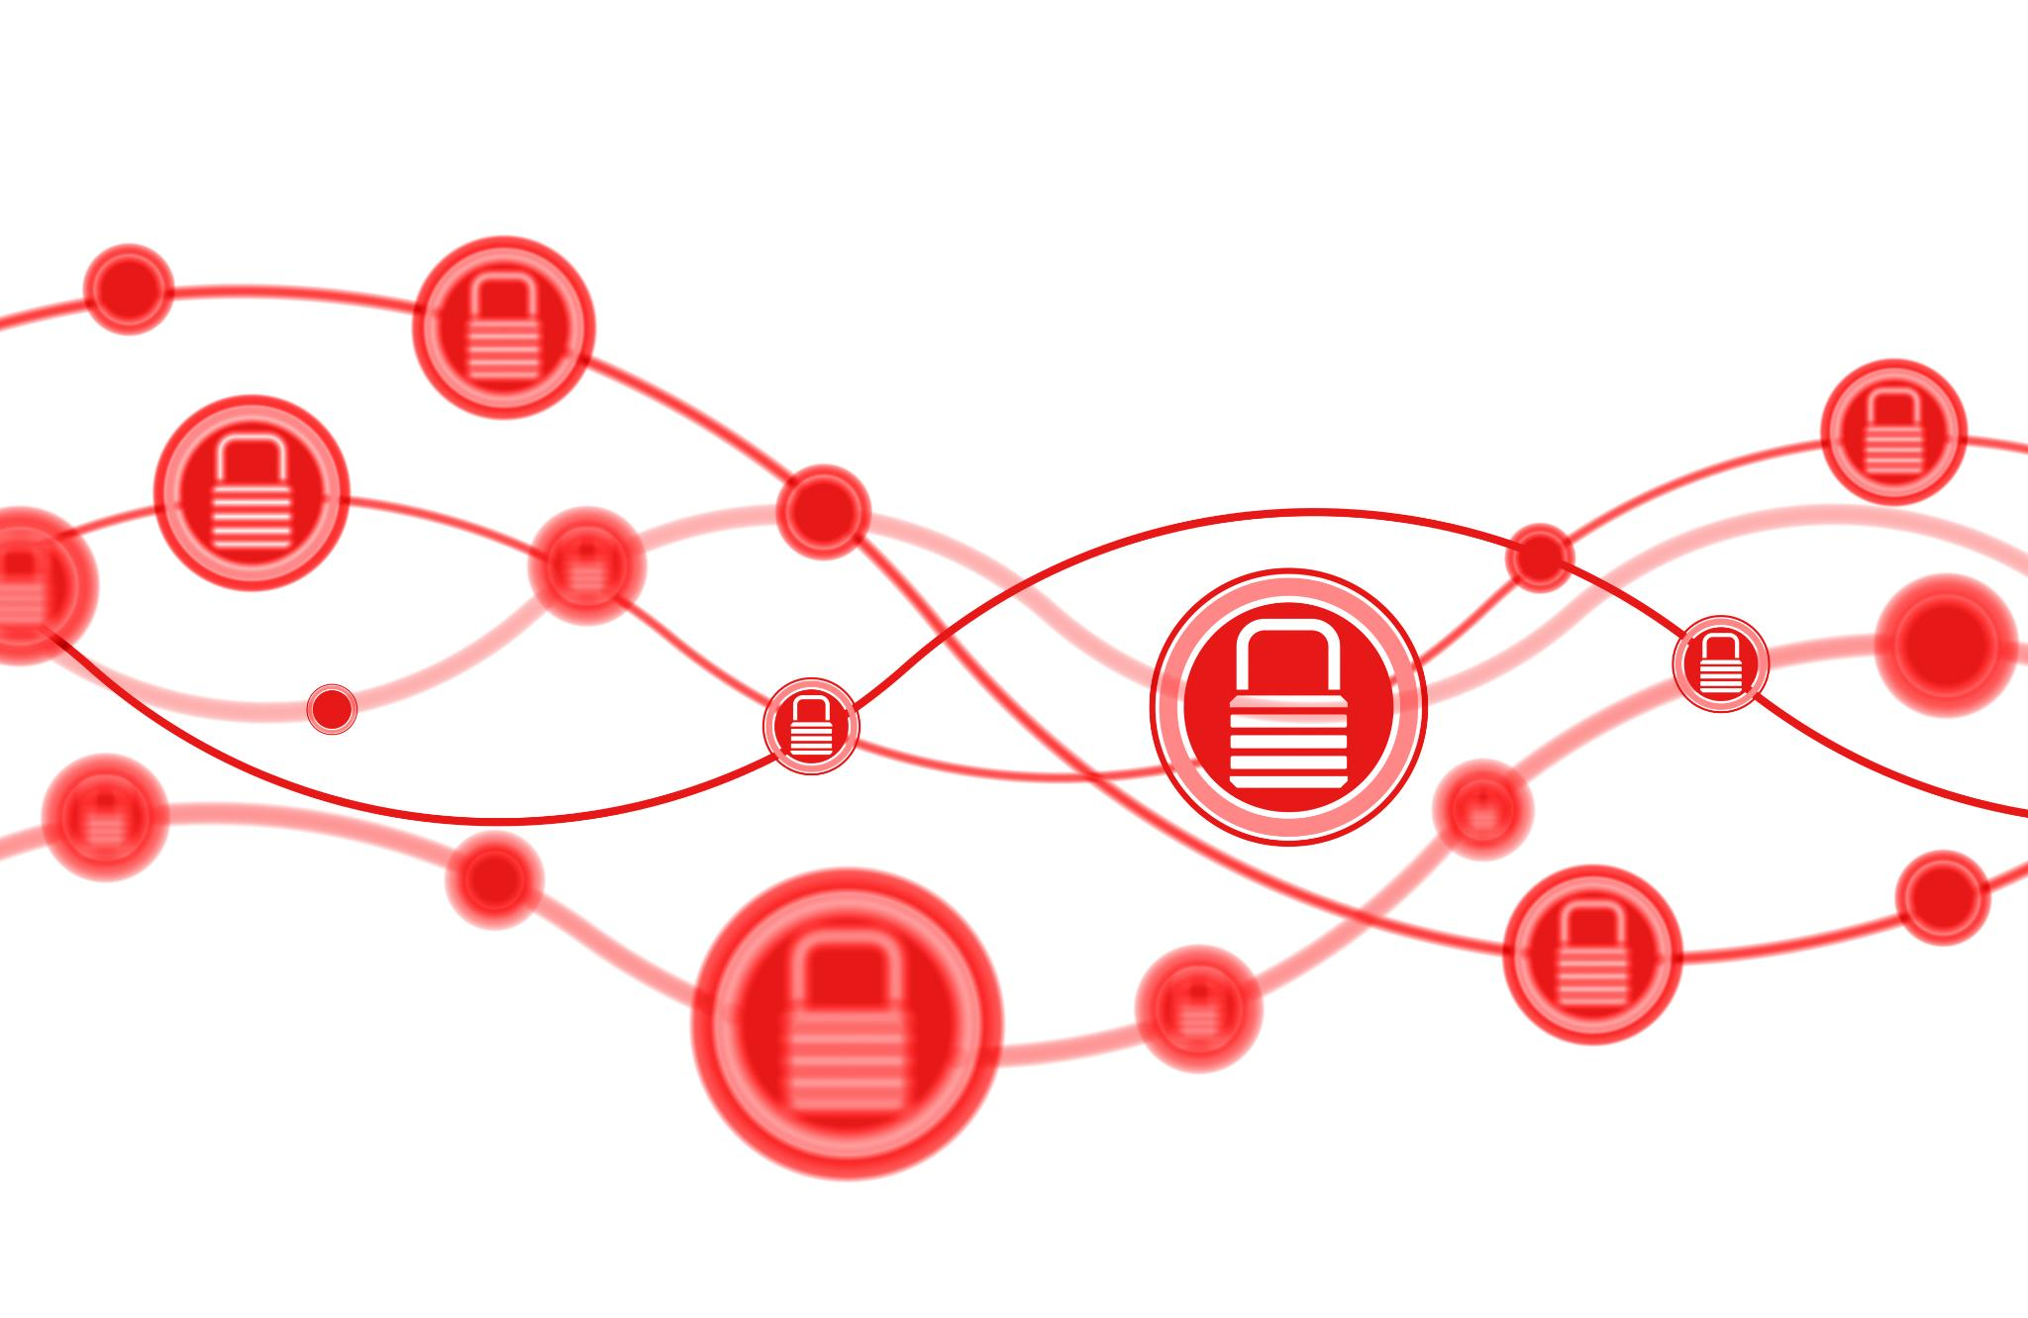
CORECONF Concept and Design Principles
Adaptation of RESTCONF
  CORECONF adapts RESTCONF principles for constrained devices using YANG models and CoAP transport.
Efficient Data Encoding
  CBOR encoding of YANG data reduces message size and parsing complexity critical for constrained environments.
Secure Network Operation
  CORECONF supports secure operation in constrained networks using DTLS or OSCORE protocols for protection.
Design Emphasizing Reuse
  The design mirrors RESTCONF’s datastore, URL, and CRUD concepts mapped efficiently onto CoAP methods.
Notes:
CORECONF is a management approach defined within the IETF CORE working group that adapts the principles of RESTCONF to constrained environments. Its primary objective is to enable configuration and state management of constrained devices using YANG data models, while relying on CoAP as the underlying transport protocol.
The design of CORECONF emphasizes reuse and alignment. Rather than defining new management semantics, CORECONF mirrors RESTCONF concepts such as datastore access, resource-oriented URLs, and CRUD operations. These concepts are mapped onto CoAP methods and URI paths in a way that preserves their meaning while remaining efficient.
A key design decision in CORECONF is the use of CBOR-encoded YANG data instead of XML or JSON. This significantly reduces message size and parsing complexity, which is critical for constrained devices. YANG-CBOR mappings define how YANG data trees are serialized into CBOR structures.
CORECONF is also designed to operate securely in constrained networks. It can be used in conjunction with DTLS or OSCORE, depending on deployment needs. By combining model-driven management with lightweight transport and encoding, CORECONF provides a practical solution for standardized device configuration in IoT environments.

Slide 13

How CORECONF Operations Work
Mapping YANG to CoAP
  CORECONF maps YANG data nodes to CoAP resources, enabling standard CoAP methods for data access and modification.
URI and Data Encoding
  Clients use URIs reflecting YANG paths with CBOR-encoded payloads for efficient data exchange in requests and responses.
Management Operations
  CORECONF supports configuration reading, updating, and operational state retrieval compatible with RESTCONF semantics.
Error Handling and Monitoring
  Error codes and CoAP reliability features enable status reporting and real-time monitoring without constant polling.
Notes:
CORECONF operations are based on mapping YANG-defined data nodes to CoAP resources. Each relevant portion of the YANG data tree is exposed as a resource that can be accessed using standard CoAP methods. For example, a GET request retrieves configuration or state data, while PUT or POST requests modify configuration values.
Clients construct URIs that correspond to YANG paths, similar to how RESTCONF uses URL paths derived from YANG models. The payloads of CoAP requests and responses carry CBOR-encoded representations of the YANG data. This approach allows clients to perform fine-grained operations on individual configuration elements or larger subtrees.
CORECONF supports typical management tasks such as reading configuration, updating parameters, and retrieving operational state. While constrained profiles may limit some advanced features, the core semantics remain consistent with RESTCONF. This consistency simplifies the development of management applications that can target multiple device classes.
Error handling and status reporting follow CoAP conventions, with response codes indicating success or failure. By leveraging CoAP’s reliability mechanisms and optional observation features, CORECONF can also support monitoring scenarios where clients are notified of state changes without continuous polling.

Slide 14
Comparison with NETCONF and RESTCONF
Protocol | Transport | Encoding | Target Devices
NETCONF | SSH | XML | Network infrastructure, servers
RESTCONF | HTTP/TLS | JSON or XML | Moderately capable devices
CORECONF | CoAP/DTLS or OSCORE | CBOR | Constrained IoT devices
Notes:
NETCONF, RESTCONF, and CORECONF all provide YANG-based management, but they target different classes of devices and networks. NETCONF typically runs over SSH and uses XML encoding, making it suitable for routers, switches, and other relatively capable network elements. RESTCONF uses HTTP and commonly JSON, providing a more web-friendly interface while still assuming moderate device capabilities.
CORECONF, in contrast, is optimized for constrained environments. By using CoAP over UDP and CBOR encoding, it minimizes protocol overhead and resource usage. This makes it feasible to deploy on devices with limited memory and processing power, where NETCONF or RESTCONF would be impractical.
Despite these differences, all three approaches share the same YANG modeling foundation. This allows operators to reuse models and maintain a consistent view of configuration and state across heterogeneous networks. In practice, this means that a single YANG model can describe both a powerful gateway managed via NETCONF and a constrained sensor managed via CORECONF.
The table below summarizes the key differences in transport, encoding, and target environments, highlighting how CORECONF complements rather than replaces existing management protocols.

Slide 15
YANG Tooling and Practical Workflows
Notes:
Using YANG in Constrained Environments, Tooling Required for YANG and CORECONF, Typical End-to-End YANG and CORECONF Workflow, Key Takeaways and Summary

Slide 16

Using YANG in Constrained Environments
Unified Data Modeling
  YANG provides a common modeling language across NETCONF, RESTCONF, and CORECONF for consistent device management.
Simplified Models for Constraints
  Profiling reduces complexity by limiting YANG features to fit constrained environments while preserving core concepts.
Structured Configurations
  YANG enables structured, machine-readable configuration and state data, supporting validation and automated tooling.
Standard Model Reuse
  Reuse of industry-standard YANG models ensures interoperability and alignment with broader network practices.
Notes:
YANG serves as the common data modeling language across NETCONF, RESTCONF, and CORECONF, enabling a unified approach to device management. In constrained environments, YANG models may be profiled or restricted to reduce complexity, but the fundamental modeling concepts remain the same.
Using YANG in this context allows developers to define configuration and state data in a structured, machine-readable way. This structure enables validation, automated tooling, and consistency across implementations. Even constrained devices benefit from this approach, as it reduces ambiguity and simplifies interoperability testing.
Profiles may limit certain YANG features, such as complex types or large hierarchies, to ensure that implementations remain lightweight. However, the reuse of standard and industry-defined YANG models, such as those from IEEE or IETF, remains a major advantage.
Overall, YANG provides the semantic foundation that makes CORECONF practical. Without a standardized modeling language, management over CoAP would risk becoming fragmented and vendor-specific. YANG ensures that constrained-device management remains aligned with broader network management practices.

Slide 17

Tooling Required for YANG and CORECONF
YANG Compilers and Validators
  Tools like pyang and yanglint verify syntax and semantics early in model development to ensure correctness.
CBOR Encoding Libraries
  Libraries supporting YANG-CBOR mappings enable efficient data serialization in constrained environments.
CoAP Client and Server Libraries
  These libraries manage message formatting, retransmissions, and security for CORECONF runtime communications.
Integration and Testing Tools
  Simulators and test harnesses validate model and protocol interoperability ensuring robust CORECONF deployments.
Notes:
Effective use of YANG and CORECONF relies on a set of well-established tools that support model development, validation, and deployment. YANG compilers and validators such as pyang and yanglint are essential for checking syntax, semantics, and compliance with modeling guidelines. These tools are used early in the development process to ensure model correctness.
For constrained environments, additional tooling is required to support CBOR encoding and decoding of YANG data. Libraries that implement YANG-CBOR mappings enable developers to serialize and parse data efficiently on both clients and devices. These libraries are a critical component of any CORECONF implementation.
CoAP client and server libraries are also required. These libraries handle message formatting, retransmissions, security integration, and URI handling. When combined with YANG-aware encoding, they form the runtime foundation for CORECONF management interactions.
Finally, integration and testing tools play an important role. Simulators, test harnesses, and interoperability events help validate that YANG models, encodings, and CoAP interactions work correctly together. This tooling ecosystem ensures that CORECONF deployments are robust, interoperable, and maintainable over time.

Slide 18
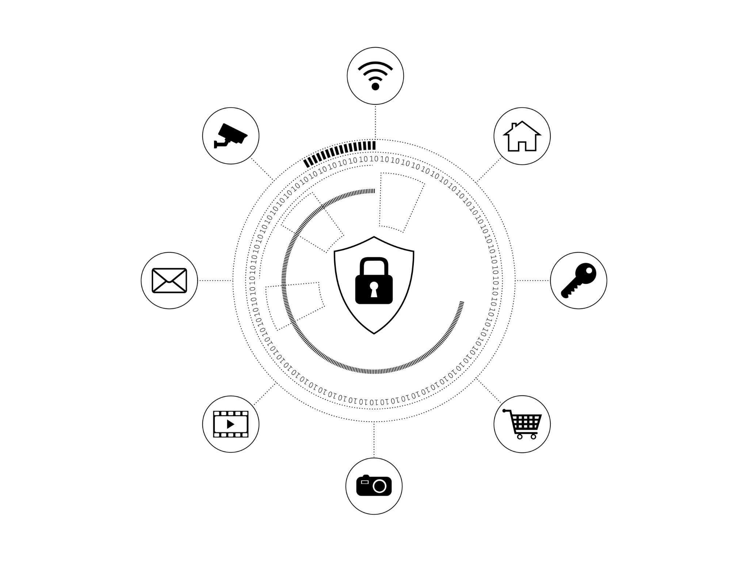
Typical End-to-End YANG and CORECONF Workflow
YANG Model Selection and Validation
  Selecting and validating YANG models from standards or vendors using tools ensures model correctness and compliance.
Processing for Constrained Devices
  Models are converted to efficient schemas and integrated into firmware for constrained device operation.
Device and Client Integration
  CoAP servers expose CORECONF resources with security; clients use YANG-aware encoders for management.
Testing and Unified Deployment
  Interoperability testing ensures consistent deployments; YANG models enable unified network management.
Notes:
A typical workflow for deploying YANG-based management using CORECONF begins with authoring or selecting appropriate YANG models. These models may come from standard bodies such as the IETF or IEEE, or they may be vendor-specific extensions. The models are validated using tools like pyang or yanglint to ensure correctness and compliance.
Next, the models are processed to support constrained operation. This may include generating CBOR schemas or code that maps YANG data nodes to efficient in-memory representations. Developers integrate these artifacts into device firmware and management applications.
On the device side, a CoAP server exposes CORECONF resources corresponding to the YANG data tree. Security is configured using DTLS or OSCORE as appropriate. On the client side, management applications use CoAP libraries and YANG-aware encoders to perform configuration and monitoring operations.
Finally, testing and deployment complete the workflow. Interoperability testing ensures that different implementations interpret models and encodings consistently. Once deployed, the same YANG models can be reused across NETCONF, RESTCONF, and CORECONF, providing a unified management strategy across the entire network.

Slide 19

Key Takeaways and Summary
Comprehensive IoT Management
  CoAP, IETF CORE, and CORECONF offer interoperable solutions for managing constrained IoT devices efficiently.
Protocol Reuse and Consistency
  CORECONF reuses YANG and RESTCONF semantics, ensuring consistency and protecting existing protocol investments.
Mature Tooling Ecosystem
  YANG validators, CBOR encoders, and CoAP libraries support real-world deployments with standardized workflows.
Scalable and Secure Management
  CORECONF adapts network management principles to IoT, enabling scalable, secure, and interoperable device control.
Notes:
CoAP, the IETF CORE architecture, and CORECONF together provide a comprehensive solution for managing constrained devices using standardized, interoperable technologies. CoAP delivers RESTful interactions with minimal overhead, making it suitable for low-power and lossy networks. CORE builds on this foundation with discovery, security, and efficient data representations.
CORECONF extends these capabilities into the management domain by reusing YANG and RESTCONF semantics in a form that constrained devices can support. This reuse ensures consistency across management protocols and protects existing investments in YANG modeling.
The required tooling—YANG validators, CBOR encoders, and CoAP libraries—forms a mature ecosystem that supports real-world deployments. By following structured workflows and leveraging standardized models, operators can manage diverse device populations efficiently.
Overall, CORECONF demonstrates how established network management principles can be successfully adapted to the IoT domain, enabling scalable, secure, and interoperable management of constrained devices.

