Slide 1
Introduction to IETF CoAP, CORE, and CORECONF
with YANG Tooling
Exploring protocols and tools for IoT network management — worked through a fleet of coffee makers.
NETCONF · XML/SSH
RESTCONF · JSON/HTTP
CORECONF · CBOR/CoAP
Running example: coffee-maker manager → CORECONF → fleet of coffee makers

Slide 2
PART 1
Context and Scope of the Presentation
IETF CoAP / CORE / CORECONF — coffee-maker fleet example
2

Slide 3
Presentation Goals and Technical Scope
What we cover — grounded in the coffee-maker fleet demo.
Introduction to IETF CORE
• The IETF CORE working group and the CoAP protocol as the foundation for managing constrained devices — here, networked coffee makers.
CORE Architecture & CORECONF
• CORE building blocks and CORECONF: YANG over CoAP with compact CBOR + numeric-SID encoding, driving the coffee-maker fleet.
Interoperability & YANG Reuse
• One example-coffee-maker YANG model reused across NETCONF, RESTCONF, and CORECONF for seamless integration.
Tools & Workflows
• YANG validation, SID assignment, CBOR encoding, and CoAP client/server libraries — the pieces used to build this demo.
IETF CoAP / CORE / CORECONF — coffee-maker fleet example
3

Slide 4
YANG and NETCONF: model vs. protocol
YANG defines WHAT the data is; NETCONF is HOW you move it.
YANG — the data modeling language (RFC 7950)
• Describes structure, types, constraints, defaults.
• Hierarchy of containers, lists, leaves — vendor-neutral.
• One model serves every protocol below it.
• Example: example-coffee-maker defines power, cups, state, brew.
NETCONF — the management protocol (RFC 6241)
• Operations get, edit-config, commit over a session.
• Datastores running / candidate / startup.
• Encoding XML, carried over SSH.
• Validates payloads against the YANG model.
YANG module
.yang
the single source of truth
drives
NETCONF
XML / SSH
RESTCONF
JSON / HTTP
CORECONF
CBOR / CoAP
same model → three wire formats
IETF CoAP / CORE / CORECONF — coffee-maker fleet example
4

Slide 5
NETCONF vs. RESTCONF vs. CORECONF
Same YANG models — different transports and encodings for different environments.
NETCONF
RESTCONF
CORECONF
RFC 6241
RFC 8040
draft-ietf-core-comi
Transport SSH / TCP
Encoding XML
Style session + datastores
Best for routers, data-center gear
Payload largest (verbose XML)
Transport HTTP / TLS
Encoding JSON or XML
Style RESTful CRUD on resources
Best for web / automation tooling
Payload medium (JSON)
Transport CoAP / UDP
Encoding CBOR + numeric SIDs
Style GET / FETCH / iPATCH
Best for constrained makers
Payload smallest (binary + SIDs)
Shared foundation: the SAME example-coffee-maker YANG module + the SAME datastore model (NMDA, RFC 8342)
IETF CoAP / CORE / CORECONF — coffee-maker fleet example
5

Slide 6
PART 2
IETF CORE and CoAP Fundamentals
IETF CoAP / CORE / CORECONF — coffee-maker fleet example
6

Slide 7
IETF CORE Working Group and Its Mission
Constrained RESTful Environments — why it exists.
Purpose of CORE WG
• Standardizes protocols for constrained devices that cannot run full web stacks — like a low-power coffee maker's controller.
Core Mission & Principles
• Adapts web principles (REST, stateless interactions) to unreliable, constrained networks.
Technology Integration
• Aligns with IPv6, UDP, and DTLS/OSCORE to ensure interoperability and clean network integration.
IoT Management Foundation
• Enables standardized monitoring, configuration, and control at scale — e.g. a whole building's fleet of coffee makers.
IETF CoAP / CORE / CORECONF — coffee-maker fleet example
7

Slide 8
Constrained Application Protocol (CoAP) Overview
A lightweight RESTful protocol over UDP (RFC 7252).
CoAP Protocol Basics
• Lightweight UDP-based protocol providing RESTful operations over constrained networks.
Message Format & REST Methods
• Compact binary message format supporting GET, PUT, POST, DELETE — CORECONF adds FETCH and iPATCH.
Reliability & Async Support
• Confirmable messages + retransmissions; asynchronous updates via the Observe extension (watch a maker go empty).
Security Features
• Secured with DTLS for channel security or OSCORE for end-to-end message protection of each command.
IETF CoAP / CORE / CORECONF — coffee-maker fleet example
8

Slide 9
Key CoAP Concepts and REST Mapping
Resources, methods, and response codes — applied to the fleet.
Resource Identification
• Single resource the fleet datastore lives at one URI: coap://host/c.
• A maker is a list entry keyed by id (kitchen, lobby, lab...).
CoAP Methods and Responses
• GET / FETCH read fleet state; iPATCH writes.
• POST invokes an action (brew / refill).
• Codes 2.05 Content, 2.04 Changed, 4.03 Forbidden.
Observe & Content Negotiation
• Observe clients get pushed updates when a maker runs low.
• Content-Format negotiates compact CBOR (id=sid).
Proxying & Caching
• Proxies bridge CoAP and HTTP for dashboards.
• Caching cuts transmissions over lossy links.
IETF CoAP / CORE / CORECONF — coffee-maker fleet example
9

Slide 10
PART 3
CORE Architecture and Management Motivation
IETF CoAP / CORE / CORECONF — coffee-maker fleet example
10

Slide 11
CORE Architectural Building Blocks
The pieces that make constrained management work.
CoAP Protocol Core
• The central RESTful transfer protocol enabling interoperable communication between the manager and each coffee maker.
Resource Discovery
• CoRE Link Format and Resource Directory dynamically find device functions — discovering makers as they join the fleet.
Security Components
• DTLS for transport and OSCORE for end-to-end object security (alice = operator, bob = viewer in the demo).
Efficient Data Encoding
• CBOR and YANG-CBOR give compact representations — a power toggle is ~21 B instead of ~285 B of XML.
IETF CoAP / CORE / CORECONF — coffee-maker fleet example
11

Slide 12
Why Device Management over CoAP Is Needed
The case for CORECONF on a fleet of constrained makers.
Constraints of Traditional Protocols
• NETCONF/SSH and RESTCONF/HTTP assume capable devices and reliable networks — too heavy for a cheap coffee-maker controller.
Need for Standardized IoT Management
• Operators need scalable, standard methods for configuration, firmware, and security across hundreds of makers.
Advantages of CoAP Management
• UDP + compact encoding cut protocol overhead, optimizing CPU, RAM, and radio use on each device.
CORECONF and YANG Integration
• CORECONF applies the example-coffee-maker YANG model for consistent, model-driven management of the whole fleet.
IETF CoAP / CORE / CORECONF — coffee-maker fleet example
12

Slide 13
PART 4
CORECONF and YANG-Based Management
IETF CoAP / CORE / CORECONF — coffee-maker fleet example
13

Slide 14
CORECONF Concept and Design Principles
RESTCONF ideas, shrunk for constrained coffee makers.
Adaptation of RESTCONF
• CORECONF adapts RESTCONF principles for constrained devices using YANG models and CoAP transport.
Efficient Data Encoding
• CBOR encoding of YANG data, keyed by numeric SIDs, slashes message size and parsing cost.
Secure Network Operation
• Supports secure operation with DTLS or OSCORE — so 'turn on the coffee maker' can't be read or forged.
Design Emphasizing Reuse
• Mirrors RESTCONF's datastore, URI, and CRUD concepts, mapped efficiently onto CoAP methods.
IETF CoAP / CORE / CORECONF — coffee-maker fleet example
14

Slide 15
How CORECONF Operations Work
manager → fleet: real CoAP/CBOR/SID exchanges on /c.
🤖
☕
Coffee Manager
Coffee Fleet
CORECONF client
GET /c
coap://host/c
2.05 Content {60010:{...makers}}
iPATCH /c {60010:{60020:[{60021:"lab",60023:true}]}}
2.04 Changed
POST /c brew 'lab'
Mapping YANG nodes → CoAP resources; URIs reflect paths, payloads are CBOR; error codes + CoAP reliability give monitoring without constant polling.
IETF CoAP / CORE / CORECONF — coffee-maker fleet example
15

Slide 16
Example: the coffee-maker fleet YANG model
example-coffee-maker@2026-10-18 — one model, shared by every protocol.
yang/example-coffee-maker@2026-10-18.yang
example-coffee-maker@2026-10-18.sid
container coffee-maker-manager {
leaf name { type string; }
leaf maker-count { type uint8; config false; }
list coffee-maker { key "id";
leaf id { type string; }
leaf power { type boolean; }
leaf cups { type uint8 { range "1..12"; } }
leaf strength { type enumeration {mild,medium,strong} }
leaf state { config false; identityref }
leaf water-level { config false; uint8 % }
leaf beans-level { config false; uint8 % }
leaf has-coffee { config false; boolean }
action brew { output {started, reason} }
action refill { in {beans,water} out {levels} }
}
}
# .sid file → numeric SIDs
coffee-maker-manager → 60010
coffee-maker (list) → 60020
id (key) → 60021
power → 60023
cups → 60024
strength → 60025
state → 60026
water-level → 60027
beans-level → 60028
has-coffee → 60029
brew (action) → 60032
refill(action) → 60035
SIDs replace long path
strings on the wire.
IETF CoAP / CORE / CORECONF — coffee-maker fleet example
16

Slide 17
Same operation, NETCONF wire messages
What the 'turn maker lab ON' + 'read fleet' exchanges look like in NETCONF/XML.
NETCONF — write (edit-config) ≈ 285 B
CORECONF — same write ≈ 21 B (CBOR/SID)
<rpc message-id="101"
xmlns="urn:...:netconf:base:1.0">
<edit-config>
<target><running/></target>
<config>
<coffee-maker-manager
xmlns="urn:example:coffee-maker">
<coffee-maker>
<id>lab</id>
<power>true</power>
</coffee-maker>
</coffee-maker-manager>
</config>
</edit-config>
</rpc>
iPATCH /c
{ 60010: { 60020: [
{ 60021: "lab", 60023: true }
] } }
NETCONF — read reply ≈ 1309 B
<rpc-reply><data>
<coffee-maker-manager ...>
<coffee-maker><id>kitchen</id>
<power>true</power> ...
... (repeats per maker)
Byte size of the SAME operations — NETCONF (XML) vs CORECONF (CBOR/SID)
write · NETCONF
285 B
write · CORECONF
21 B
read · NETCONF
1309 B
read · CORECONF
286 B
CORECONF is ~13× smaller on writes and ~4.6× smaller on the fleet read — same model, same semantics.
17

Slide 18
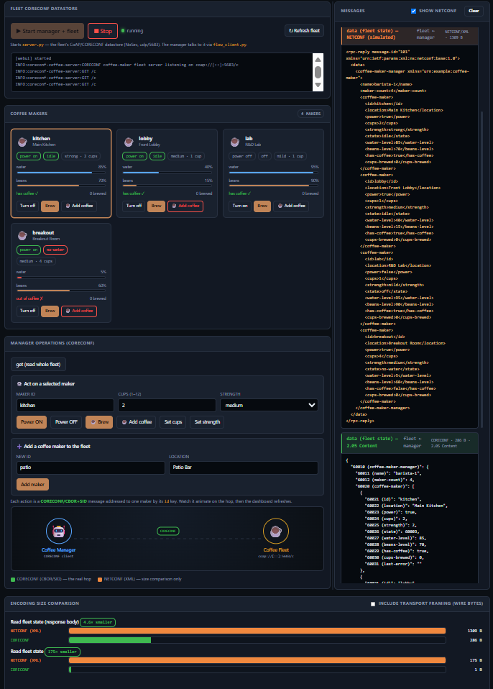
User Interface for
Coffee-Maker Demo
IETF CoAP / CORE / CORECONF — coffee-maker fleet example
18

Slide 19
PART 5
YANG Tooling and Practical Workflows
IETF CoAP / CORE / CORECONF — coffee-maker fleet example
19

Slide 20
Tooling Required for YANG and CORECONF
What built (and validates) the coffee-maker demo.
YANG Compilers & Validators
• pyang / yanglint verify the example-coffee-maker module's syntax and semantics before anything ships.
CBOR Encoding Libraries
• cbor2 (+ YANG-CBOR/SID mapping in coffee_sids.py) serialize the fleet payloads efficiently.
CoAP Client & Server Libraries
• aiocoap runs server.py (the fleet datastore) and the manager client — handling retransmits, Content-Formats, OSCORE.
Integration & Testing Tools
• The web console + flow_client.py act as a simulator/test harness, validating model and protocol interoperability.
IETF CoAP / CORE / CORECONF — coffee-maker fleet example
20

Slide 21
Typical End-to-End YANG and CORECONF Workflow
From model to a running, managed coffee-maker fleet.
1
2
3
4
Model Selection & Validation
Processing for Constrained Devices
Device & Client Integration
Testing & Unified Deployment
Author / pick example-coffee-maker; validate with pyang and assign SIDs in the .sid file.
Map the model to numeric SIDs and CBOR; embed the resulting schema into each maker's firmware.
server.py exposes the fleet at /c (optionally OSCORE-secured); the manager uses YANG-aware CBOR encoders.
The web console drives interoperability tests; the same model gives unified management across the fleet.
IETF CoAP / CORE / CORECONF — coffee-maker fleet example
21

Slide 22
Key Takeaways and Summary
CoAP + CORE + CORECONF, proven on the coffee-maker fleet.
Comprehensive IoT Management
• CoAP, IETF CORE, and CORECONF together manage constrained devices — a whole fleet of coffee makers — efficiently.
Protocol Reuse & Consistency
• CORECONF reuses the one YANG model and RESTCONF semantics, protecting existing investments.
Mature Tooling Ecosystem
• pyang, cbor2, and aiocoap support real deployments with standardized, repeatable workflows.
Scalable & Secure Management
• CBOR/SID keeps messages tiny (~13× smaller than XML) and OSCORE keeps commands private and authorized.
IETF CoAP / CORE / CORECONF — coffee-maker fleet example
22

