Slide 1
Explanatory Data Analysis of Employees Attrition
Case Study
prepared by: Sadik aman

Slide 2
Objective Of the Study
Objective:
Finding the major factors of Employees Attrition, the case of Frito Lay. So that Frito Lay will use the analysis and outcome of the study to implement different strategies and minimize employee's attrition.

Slide 3
Data sets used for Analysis
Three Data sets used for the study:
CaseStudy2_data
CaseStudy2CompSet No Attrition
CaseStudy2CompSet No Salary

Slide 4

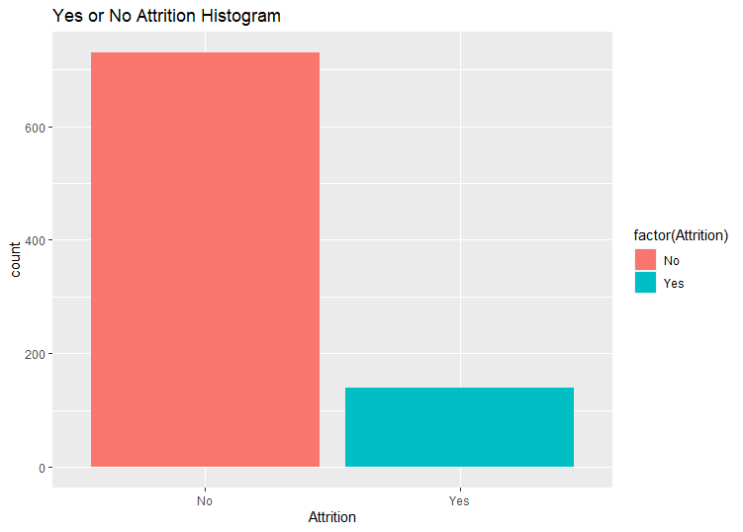
Attrition Count
No 730
Yes 140
84% Retained
16% Attritted

Slide 5
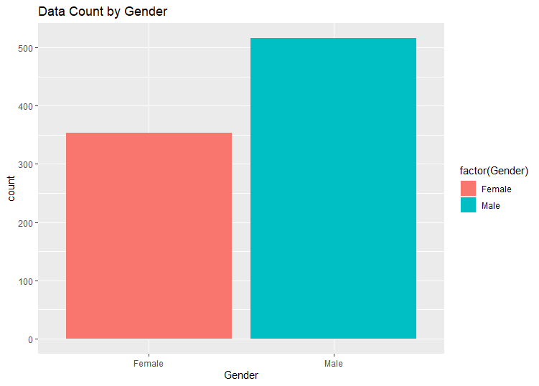
Data Count by Gender
Overall:
More than 500 are male.
350 Female

Slide 6
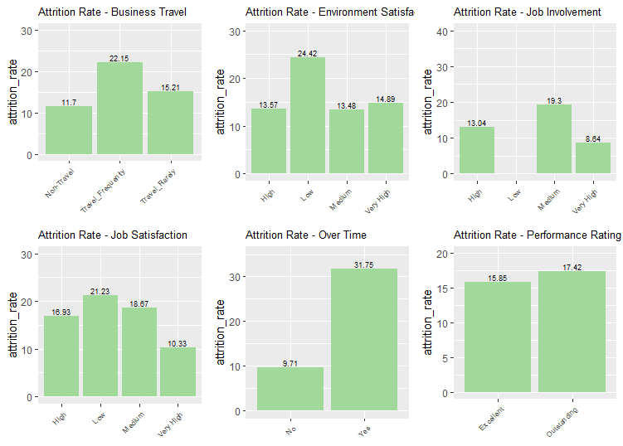
Attrition Rate of different factors
Factors with highest Attrition:
OverTime: 31.75
Low Environmental Satisfaction: 24.42
Frequently Travel: 22.15
Low Job Satisfaction: 21.23
5. Key finding: Outstanding performers have high rate, 17.42

Slide 7
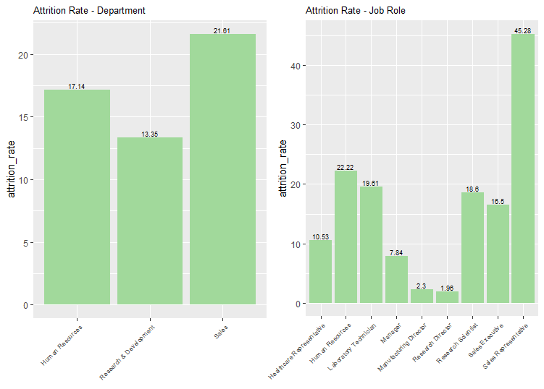
Attrition Rate by Job Role and Department
Factors with highest Attrition:
Job Role: Sales Representatives have highest rate 45.28
Sales Department has highest rate 21.61

Slide 8
Top Three Causes of Attrition
1. Job Role
2. Overtime
3. Environmental Satisfaction

Slide 9
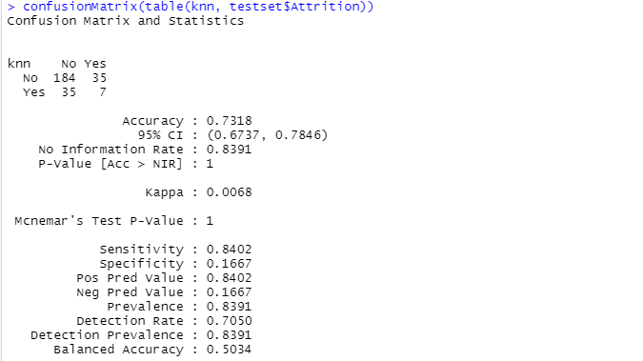
Prediction using KNN
Sensitivity : 84.02
Specify : 16.67

Slide 10
Top Three Causes of Attrition
1. Job Role
2. Overtime
3. Environmental Satisfaction

Slide 11
Root Mean square error /RMSE/ No Salary prediction
RMSE is 1669.874, which is less than $3000

