Slide 1

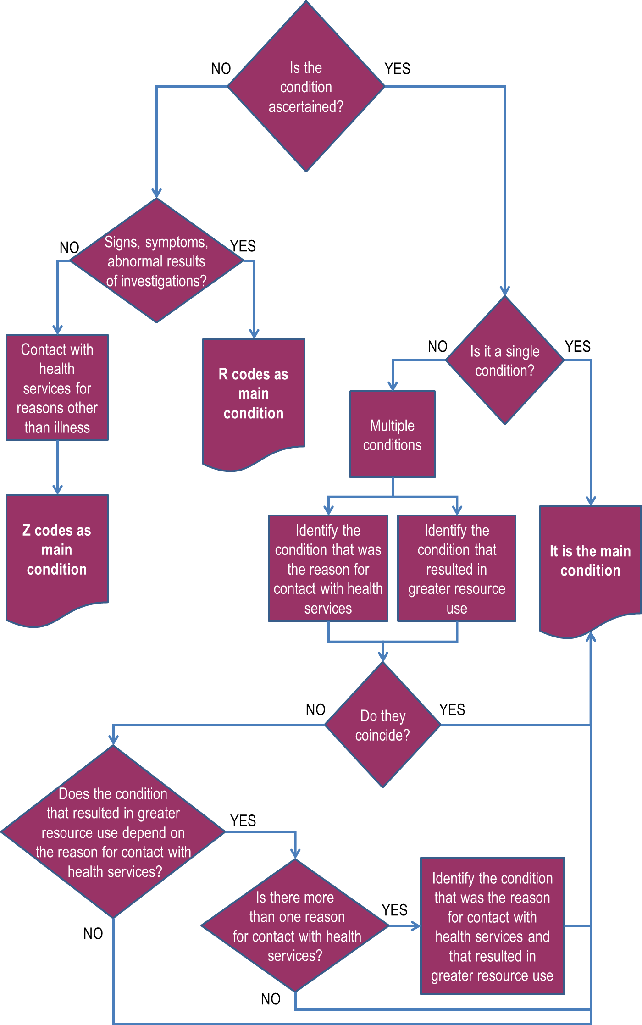

WHO - FAMILY OF INTERNATIONAL CLASSIFICATIONS NETWORK ANNUAL MEETING 2013
Identification and coding of the main condition using ICD: suggested workflows
12 – 18 October 2013
Beijing, China
Lucilla Frattura, Francesco Gongolo, Flavia Munari
Central Health Directorate, Classification Area, Friuli Venezia Giulia Region, IT WHO-FIC CC, Udine - Italy
Poster Number
WHO/CTS to insert
Abstract This poster presents an Italian proposal for the systematization of current knowledge in identification and coding of a condition introducing as well a revised workflow for the identification of the main condition.
Introduction
This lively and interesting discussion on the coding of the main condition in the hospital setting, is in contrast with the lack of any debate on main condition coding in the ambulatory setting. Our three trees (Figure 1, Figure 2, Figure 3) are a tentative systematization that takes into account both hospital and ambulatory settings and is compatible with some of the most common case-mix systems adopted in the world.
Figure 3: Decision tree 3 - identification of the main condition
Starting from a review of the documents produced at international level (1) and taking into account the work done by the Italian WHO-FIC Collaborative Centre (CC) within an inter-regional cooperation in the field of children and youth neuropsychiatry (2), we propose a new perspective on the coding rules to assign the main condition.
Methods & Materials
Figure 1: Decision tree 1 - identification of the condition
The main condition workflow produced by the Morbidity Reference Group (MbRG) in 2010 was taken as the starting point to develop three separate trees to identify the conditions, code them, and sort out the condition, recognized at the end of the episode of care, primarily responsible for the patient’s need for treatment or investigation (reason for encounter vs condition generating the greater use of resources). We adopted the perspective of clinicians who, while coding, are keen to keep their diagnosis-oriented approach. We verified the logic of our proposal by testing it against the coding guidelines adopted in Australia, Canada, Germany, and US.
Episode of care
NO
Is the condition ascertained?
YES
Obstetric
Uncertain diagnoses and symptoms?
YES
Of the newborn
NO
Conditions due to external causes
Abnormal results of investigations
Treatment of sequelae
Contact with health services for reasons other than illness
Symptoms and signs
Neither obstetric, nor of the newborn, nor due to external causes, nor due to treatment of sequelae
Results
Vaccination and prophylaxis
Social problems
The materials we examined showed that the definitions adopted in the above-mentioned Countries for hospital discharges, are different, although they all are specifications of the WHO definition, which has also been largely modified and updated during the course of the years.
Examinations and investigations (also admin. purposes, condition monitoring)
Specific treatments and procedures (attention to artif. openings, appl. of prosthetic devices, surgical follow-up, rehab. treatment, organ/tissue donors)
Surveillance of persons at risk because of personal or family history
The issue is relevant not only to achieve a more standardized and comparable use of ICD-10 but also to implement ICD-11 in the future, since the new revision of the International Classification of Diseases will easily allow customization for primary care settings. The end of the episode of care in the ambulatory setting is yet an open debate.
Contraceptive management, antenatal and postpartum care
Request for advice (also on behalf of a third party)
Figure 2: Decision tree 2 - coding of the condition
Conclusions
Episode of care
We propose a systematization of the WHO indications to code the main condition. The assignment rules for the main condition should remain valid not only in hospital settings and therefore it is highly desirable the engagement of other parties in testing our solution also in primary care.
NO
Is the condition ascertained?
YES
Obstetric
Of the newborn
Conditions due to external causes
Treatment of sequelae
Neither obstetric, nor of the newborn, nor due to external causes, nor due to treatment of sequelae
Uncertain diagnoses and symptoms?
Use Chapter XV
(O00-O99)
Use Chapter XVI
(P00-P96)
Use Chapter XX
(V01-Y98)
Use categories called ‘Sequelae of…’
NO
YES
Symptoms and signs
Abnormal results of investigations
Acknowledgements
Use Chapter XVIII
(R00-R99)
Use ‘All the rest …’
Thanks to L. Moskal (North American WHO-FIC-CC), Dr. G. Henriksson and Dr. O. Steinum (Nordic WHO-FIC CC) for the help in recollection of background materials.
Contact with health services for reasons other than illness
Vaccination and prophylaxis
Social problems
References
Examinations and investigations (also admin. purposes, condition monitoring)
Specific treatments and procedures (attention to artif. openings, appl. of prosthetic devices, surgical follow-up, rehab. treatment, organ/tissue donors)
Surveillance of persons at risk because of personal or family history
Rust J. Review of ICD-10 morbidity coding rules (WHO-FIC Network Annual Meeting, Seoul 2009 rev. Cologne 2010)
Frattura L, Gongolo F, Munari F. ICD-10 implementation in the health information system of the Piedmont Region (Italy) to overcome WHO multiaxial classification of mental disorders of children, WHO-FIC newtork annual meeting, Beijing 2013
III Blood & Immune D50-D89 Codes
V Mental
F Codes
VII Eye
VIII Ear
H Codes
X Respiratory
J Codes
XII Skin
L Codes
XIV Genitourinary
N Codes
Contraceptive management, antenatal and postpartum care
Request for advice (also on behalf of a third party)
IV Endocrine & Metabolic
E Codes
VI Nervous
G Codes
IX Circulatory
I Codes
XI Digestive
K Codes
XIII Musculoskeletal
M Codes
DIGITAL, MOBILE, NOW!
Use Chapter XXI
Scan this to get a digital version
Z00-Z13
Z20-Z29
Z30-Z39
Z50-Z54
Z55-Z65
Z70-Z76
Z80-Z99

