Slide 1
InfraMind AI
Executive Capability Statement
AI-Enabled EPC Operational Intelligence
June 2026
Confidential — For Intended Recipient Only

Slide 2
InfraMind AI — Executive Capability Statement
Executive Summary
InfraMind AI delivers practitioner-built AI operational intelligence systems for EPC megaprojects. Founded by Samanta Nayak — a 20+ year EPC infrastructure veteran and ICC Arbitration Fact Witness.
The Rarest Combination
Experience
20+ years EPC infrastructure
Domain
FIDIC contract administration, claims & dispute resolution
Technical
AI engineering, full-stack development
Credibility
ICC Arbitration Fact Witness
Deployment
Live on MAHSR T-3 (INR 3,142 Crore FIDIC Yellow Book)
Mission: Eliminate the information lag that transforms manageable risks into costly disputes.
Confidential — For Intended Recipient Only
https://inframind.ai

Slide 3
InfraMind AI — Executive Capability Statement
Product Portfolio
MAHSR T-3 Digital Twin
NCR Tracker
Operational Intelligence
Quality Intelligence
75% MIS reduction
40%+ faster closure
Production
Production
Contract Forensics
OCR Intelligence
Contract Intelligence
Document Intelligence
Weeks → Hours
98%+ accuracy
Demonstrable
Demonstrable
TCB Simulation
Programme Intelligence
Time-Cost-Buffer
In Development
Confidential — For Intended Recipient Only
https://inframind.ai

Slide 4
InfraMind AI — Executive Capability Statement
Four-Layer Architecture
Confidential — For Intended Recipient Only
https://inframind.ai

Slide 5
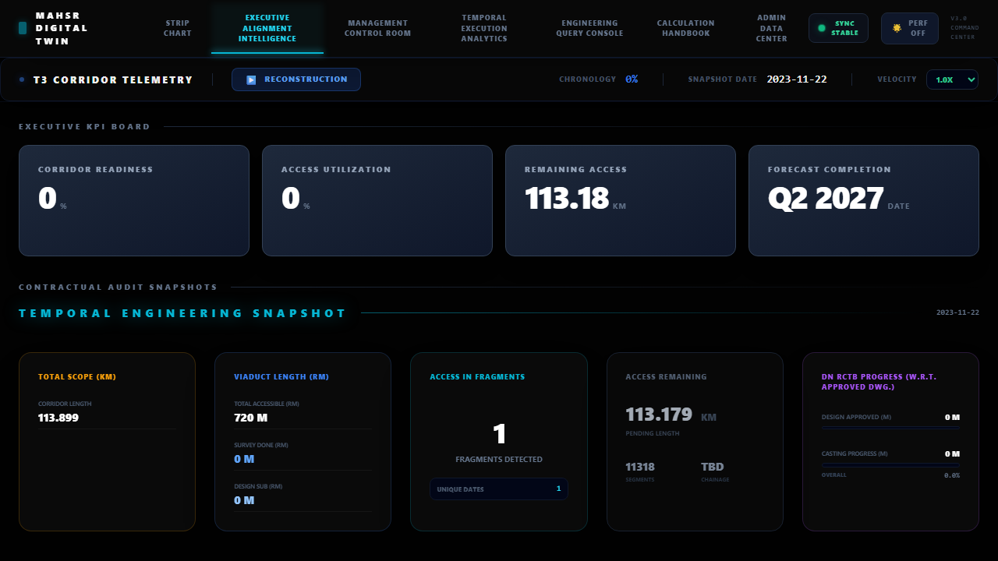
InfraMind AI — Executive Capability Statement
MAHSR T-3 Digital Twin
13
115.877 km
75%
Modules
Scope
MIS Reduction
Contract Value: INR 3,142 Crore | FIDIC Yellow Book | 115.877 km
Confidential — For Intended Recipient Only
https://inframind.ai

Slide 6
InfraMind AI — Executive Capability Statement
NCR Tracker
Confidential — For Intended Recipient Only
https://inframind.ai

Slide 7
InfraMind AI — Executive Capability Statement
Product Ecosystem
Confidential — For Intended Recipient Only
https://inframind.ai

Slide 8
InfraMind AI — Executive Capability Statement
EPC Intelligence Consulting
AI Strategy Consulting
Digital Twin Architecture
Contract Intelligence Design
Expert Advisory
Planning, Scheduling & Programme Controls
Delay Analysis, EOT & Claims Support
Confidential — For Intended Recipient Only
https://inframind.ai

Slide 9
InfraMind AI — Executive Capability Statement
Credentials
• 20+ Years EPC Infrastructure Experience — Manager, Contracts & Claims, L&T
• ICC Arbitration Fact Witness — Dispute resolution and expert testimony
• AI Generalist Certification — Outskill — Applied AI for business
• AIG Community Champion 2025 — AI community leadership
Confidential — For Intended Recipient Only
https://inframind.ai

Slide 10
InfraMind AI — Executive Capability Statement
Target Stakeholders
EPC Contractors
PMCs
Operational intelligence, reduced contractual exposure
Real-time project visibility, automated quality tracking
Infrastructure Owners
Government Authorities
Defensible records, dispute prevention
Compliance dashboards, audit-ready documentation
Rail Projects
Arbitration Support
Chainage-referenced corridor intelligence
ICC-grade evidence, expert testimony
Confidential — For Intended Recipient Only
https://inframind.ai

Slide 11
InfraMind AI — Executive Capability Statement
Vision
"To make operational intelligence the default state of EPC megaproject administration — eliminating the information lag that transforms manageable risks into costly disputes."
Contact
InfraMind AI — AI-Enabled EPC Operational Intelligence
https://inframind.ai
Confidential — For Intended Recipient Only
https://inframind.ai

Slide 12
InfraMind AI
https://inframind.ai
Digitise. Analyse. Decide.
Confidential — For Intended Recipient Only

