Slide 1



Power BI Driven Exhaustive Analysis on Indian Agriculture Sector

Slide 2
NAME - SOUGATA SAMANTA
AICTE Internship Student Registration ID - STU6672fd509aad21718811984
College Name - Guru Nanak Institute of Technology
Project GitHub Link - https://github.com/samantasougata/Final-Project.git

Slide 3

Learning Objectives
Understand agricultural production trends in India.
Analyze crop yield and state-wise production patterns.
Develop interactive Power BI dashboards for insights.
Identify top-performing crops and states using data visualization.
GOAL

Slide 4

Tools and Technology used
Tools: Power BI, Power Query Editor (PQE)
Technologies: Data Cleaning, Data Visualization, Filtering & Slicers
Data Source: CSV dataset.

Slide 5

Key Methodology
Data Collection - Import agricultural dataset into Power BI.
Data Preprocessing - Handle null values, rename columns, remove unnecessary data.
Data Visualization - Create slicers, charts, and interactive dashboards.
Analysis & Insights - Identify top crops, top states, and predict trends.

Slide 6
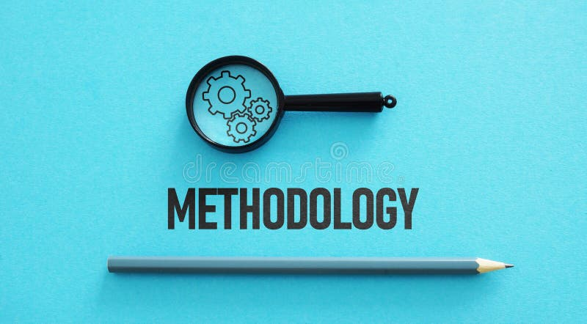
Methodology
Connecting to Data Source:
Import CSV file apy_1.csv into Power BI
Understand data structure (Rows: 73,827, Columns: 7)
Data Preprocessing in Power Query Editor (PQE):
Replace null values in Production column with 0
Rename Columns:
Area → Area (Hectares)
Production → Production (Tons)
Remove unnecessary columns

Slide 7
Dataset Overview
Original Dataset: 73,827 rows, 8 columns.
Processed Dataset: 7 columns, 73,827 rows.
Data Cleaning Steps:
Replaced null values in production column with 0.
Renamed columns for better clarity.
Removed unnecessary serial number column.

Slide 8

Problem Statement:
The Indian agriculture sector generates vast amounts of data.
Lack of structured insights affects decision-making.
Need for an interactive and visual analytics tool to analyze trends.

Slide 9

Solution:
Power BI used to structure and visualize large datasets.
Key performance indicators (KPIs) identified for analysis.
Various charts and dashboards created for insights.

Slide 10
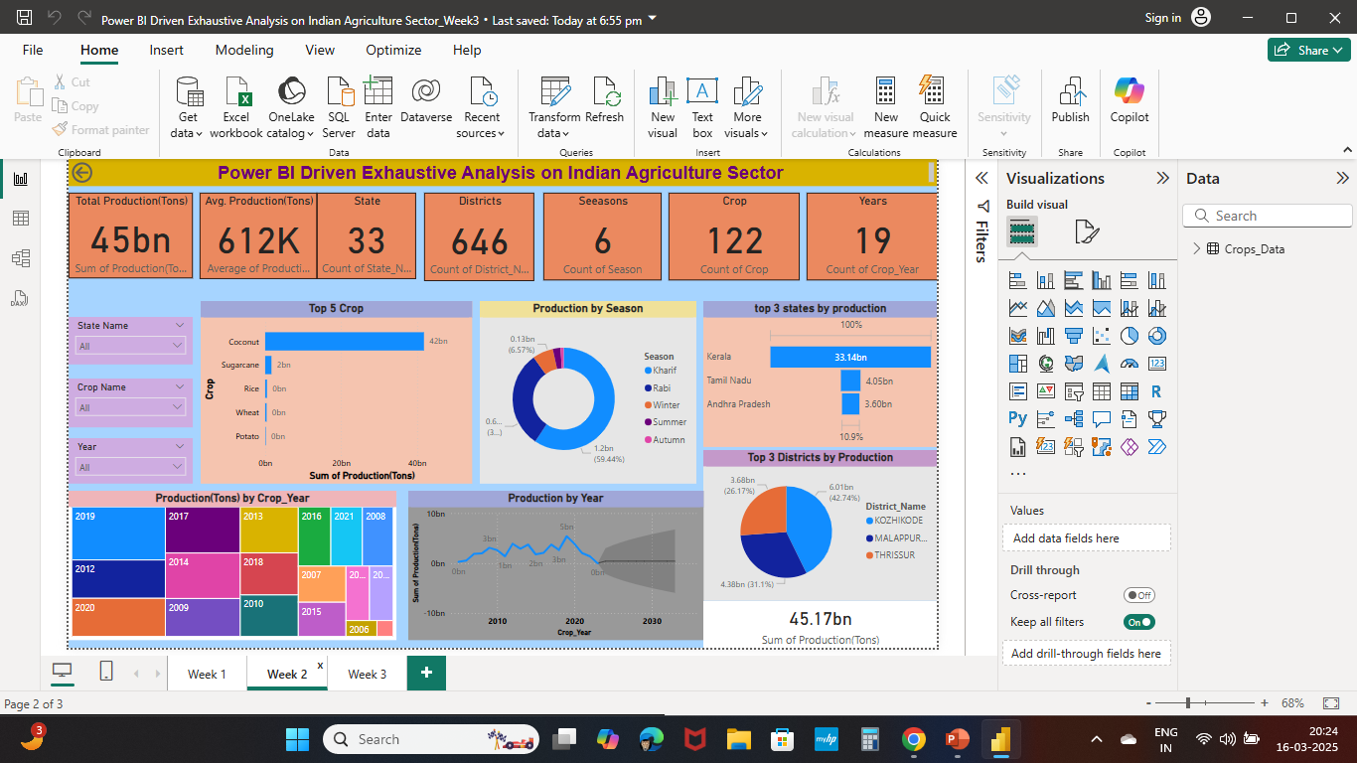
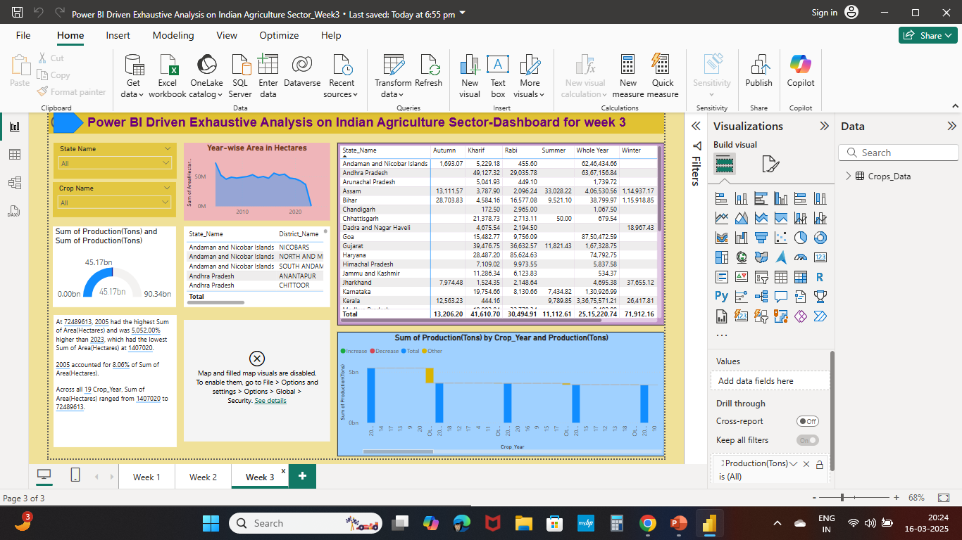
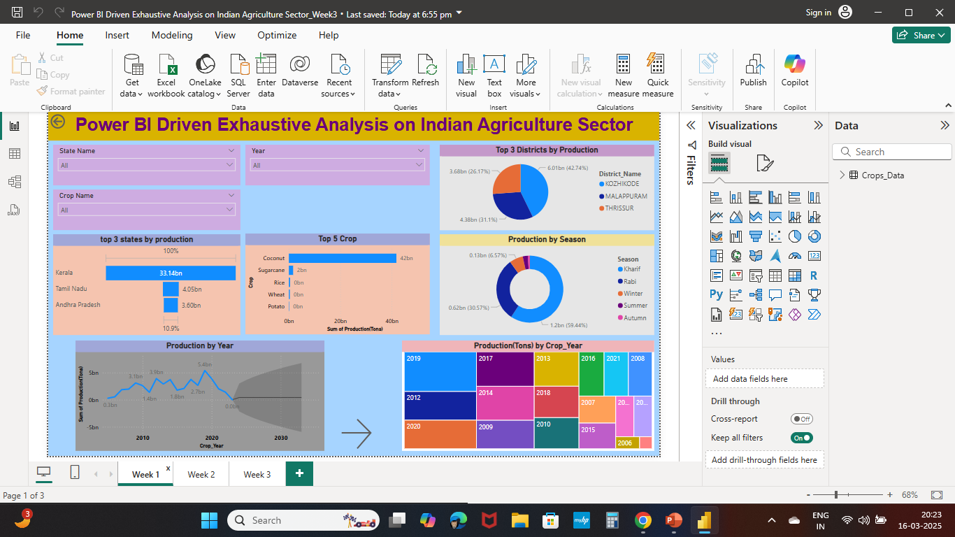
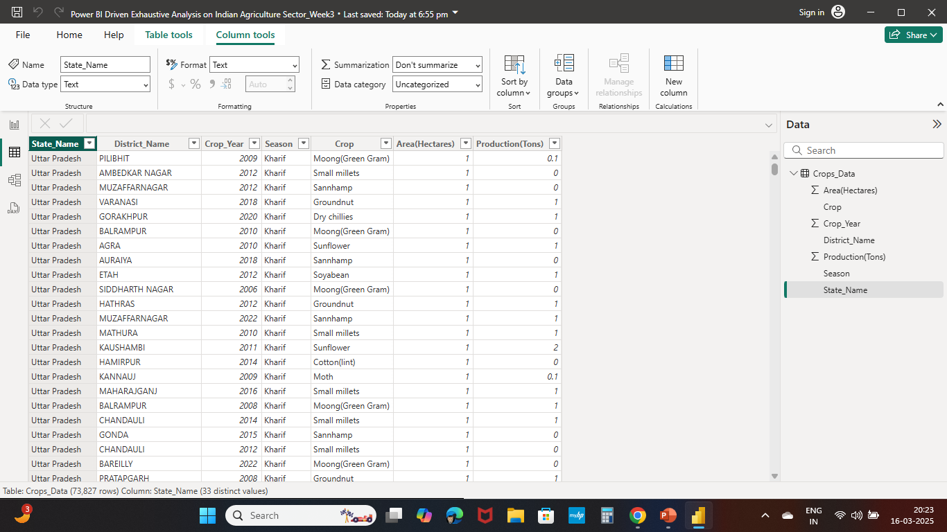
Screenshot of Output:

Slide 11
Conclusion:
Power BI provides a comprehensive view of agricultural data.
Enables data-driven decision-making for policymakers and stakeholders.
Potential for real-time updates and AI-driven future enhancements.

