Slide 1
Effect of Nutrition and Exercise Incentive on Weekly Weight Loss
Samantha Bothwell | BIOS 6624 | December 2nd, 2020

Slide 2
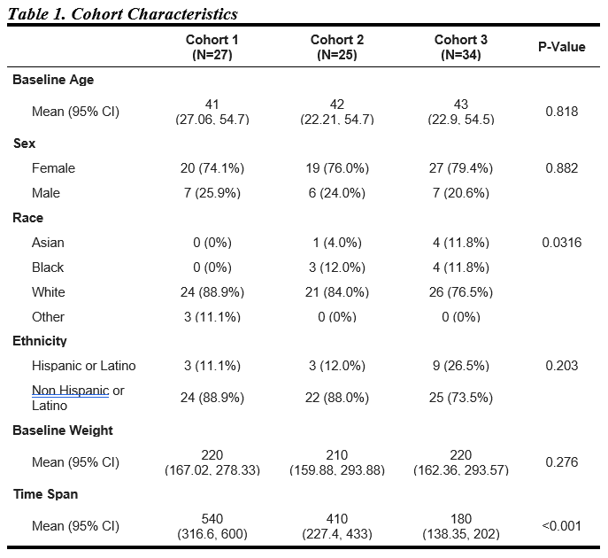
Data Summary
Individuals who classified as overweight or obese were enrolled into the study to understand factors that contribute to weight loss.
Participants were asked to step on a bluetooth scale once a day over the course of the study.
Within the study, there are 3 cohorts. These cohorts indicate participants who started the study around the same time.
This is an ongoing study so data for Cohort 3 is not complete.
Cohorts 2 and 3 overlapped with Covid. Cohort 1 was sampled completely before Covid.

Slide 3
Goals And Analysis
The research questions of interest are :
What is the trajectory of weight over the duration of time in the study?
Used Functional Principal Components Analysis to create smoothed functions of weight over time in the study
Is there a relationship between month of study and weight loss, when accounting for sex and race?
Fit a Linear Mixed Model, accounting for sex, race, age and month of study
Time points are equally spaced, so we used an AR(1) structure.
Random intercept for Participant

Slide 4
Data Cleaning
The data received was already cleaned for prior analysis.
Some subjects had family members use the scale. Values were removed if believed to be from a different person.
One participant was missing age, race and sex information and was removed.
All cohorts started at the same time but ended at different times. For consistency, we truncated data to a year.
Cohort 3 still does not have a full year of data due to Covid.

Slide 5
Missing Data
Some participants tried to measure weight once a week. We measure weight by week averages.
4 participants who had > 50% missing data were removed.
Once removed, the mean (sd) missing data per person 8.1% (11.9%).

Slide 6
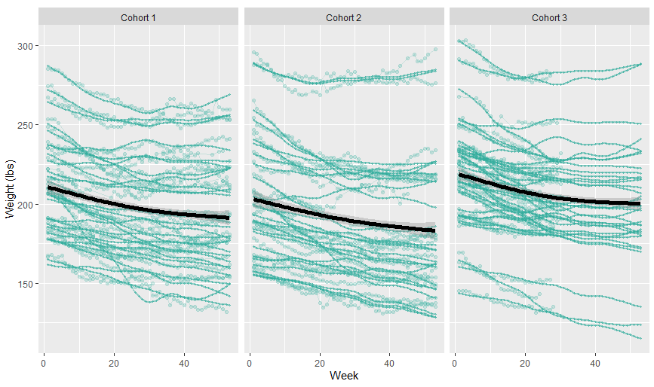
Weight Trajectories

Slide 7
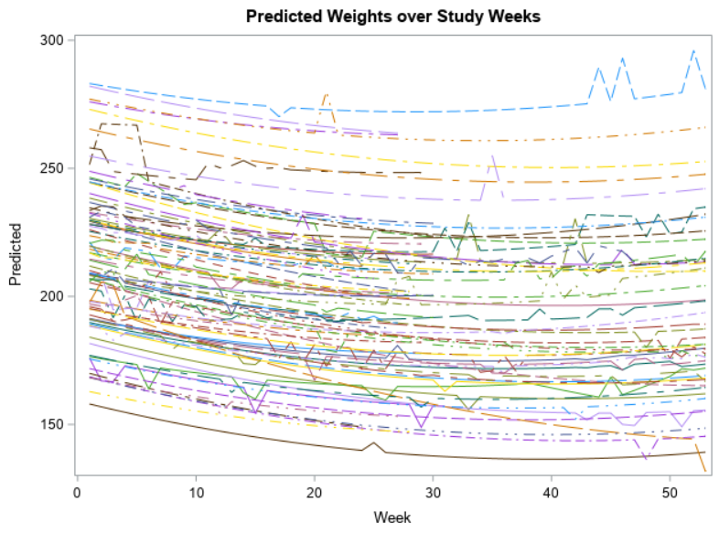
LMM Analysis
Effect | Estimate | Standard Error | DF | t Value | Pr > |t|
Intercept | 263.38 | 17.7715 | 78 | 14.82 | <.0001
Cohort
Cohort 1 | -9.9270 | 8.5340 | 3149 | -1.16 | 0.2448
Cohort 2 | -17.7647 | 8.1560 | 3149 | -2.18 | 0.0295
Sex = Female | -32.0494 | 7.8911 | 3149 | -4.06 | <.0001
Race
Asian | -34.4044 | 14.5890 | 3149 | -2.36 | 0.0184
Black/African American | 20.2079 | 12.4147 | 3149 | 1.63 | 0.1037
Other | -6.8846 | 18.8662 | 3149 | -0.36 | 0.7152
Week | -1.0985 | 0.05880 | 85 | -18.68 | <.0001
Week*Week | 0.01470 | 0.00097 | 3149 | 15.21 | <.0001
Effect | Num DF | Den DF | F Value | Pr > F
Cohort | 2 | 3149 | 2.40 | 0.0907
Sex | 1 | 3149 | 16.50 | <.0001
Age | 1 | 3149 | 0.82 | 0.3650
Race | 3 | 3149 | 3.11 | 0.0252
Week | 1 | 85 | 348.97 | <.0001
Week * Week | 1 | 3149 | 231.25 | <.0001

Slide 8
Challenges and Limitations
Missing data
The effect of age
We do not yet have intervention information
This is an ongoing study, so some data was incomplete

