Slide 1
Daily Weights
Samantha Bothwell | BIOS 6624 | December 2nd, 2020

Slide 2
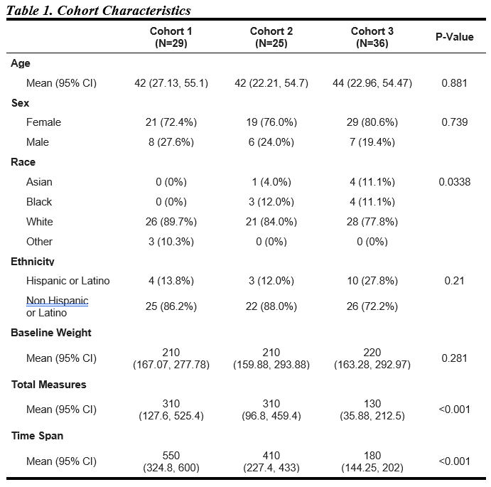
Data Summary
Individuals who classified as overweight or obese were enrolled into the study to understand factors that contribute to weight loss.
Participants were asked to step on a bluetooth scale once a day over the course of the study.
Within the study, there are 3 cohorts. These cohorts indicate participants who started the study around the same time.
This is an ongoing study so data for Cohort 3 is not complete.
Cohorts 2 and 3 overlapped with Covid. Cohort 1 was sampled completely before Covid.

Slide 3
Goals And Analysis
The research questions of interest are :
What is the trajectory of weight over the duration of time in the study?
Used Functional Principal Components Analysis to create smoothed functions of weight over time in the study
Is there a relationship between month of study and weight loss, when accounting for sex and race?
Fit a Linear Mixed Model, accounting for sex, race, age and month of study
Time points are equally spaced so we used an AR(1) structure.

Slide 4
Data Cleaning
The data received was already cleaned for prior analysis.
Some subjects had family members use the scale. Values were removed if believed to be from a different person.
One participant was missing age, race and sex information and was removed.
All cohorts started at the same time but ended at different times. For consistency, we truncated data to a year.
Cohort 3 still does not have a full year of data due to Covid.
To account for the effect of month on weight loss, we used the date variable to determine which month the measurement fell into.

Slide 5
Missing Data

Slide 6
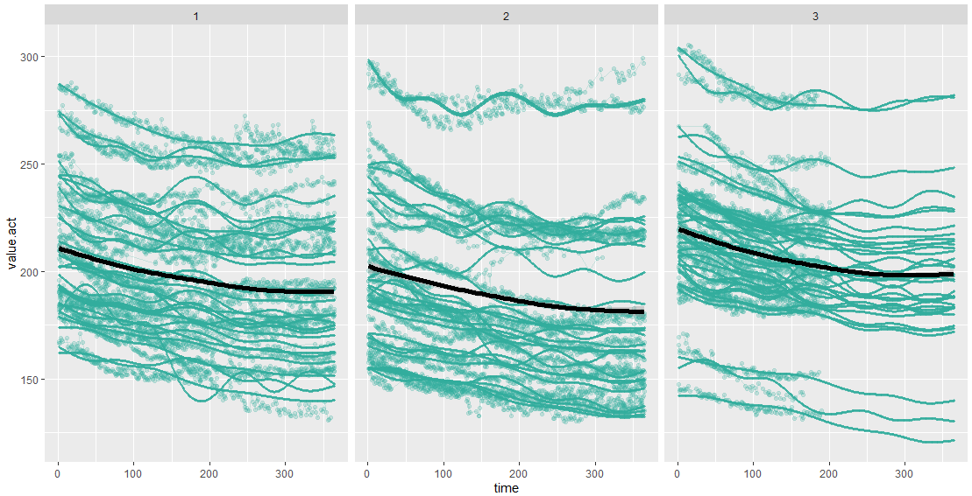
Weight Trajectories

Slide 7
Mixed Model Analysis
Effect | Estimate | Standard Error | DF | t Value | Pr > |t|
Intercept | 243.73 | 8.0060 | 83 | 30.44 | <.0001
Cohort
Cohort 1 | -6.6402 | 7.8774 | 83 | -0.84 | 0.4017
Cohort 2 | -13.5468 | 7.6993 | 83 | -1.76 | 0.0822
Sex = Female | -29.7363 | 7.3467 | 83 | -4.05 | 0.0001
Race
Asian | -35.0862 | 14.0876 | 83 | -2.49 | 0.0147
Black/African American | 22.1371 | 11.8563 | 83 | 1.87 | 0.0654
Other | -6.2564 | 17.7543 | 83 | -0.35 | 0.7254
Days in Study | -0.06345 | 0.0087 | 15E3 | -7.28 | <.0001
Month
Jan | 0.3610 | 0.2236 | 752 | 1.61 | 0.1068
Feb | -0.1148 | 0.2905 | 752 | -0.40 | 0.6927
Mar | -0.0625 | 0.3355 | 752 | -0.19 | 0.8524
Apr | -0.2761 | 0.3692 | 752 | -0.75 | 0.4548
May | -0.6381 | 0.4047 | 752 | -1.58 | 0.1153
Jun | -0.8124 | 0.4179 | 752 | -1.94 | 0.0523
Jul | -0.5340 | 0.4182 | 752 | -1.28 | 0.2020
Aug | -1.1282 | 0.4016 | 752 | -2.81 | 0.0051
Sep | -0.5131 | 0.3629 | 752 | -1.41 | 0.1579
Oct | -0.6813 | 0.2977 | 752 | -2.29 | 0.0224
Nov | -0.6385 | 0.2159 | 752 | -2.96 | 0.0032
Effect | Num DF | Den DF | F Value | Pr > F
Cohort | 2 | 83 | 1.55 | 0.2183
Sex | 1 | 83 | 16.38 | 0.0001
Race | 3 | 83 | 3.64 | 0.0160
Days in Study | 1 | 15E3 | 52.96 | <.0001
Month | 11 | 752 | 2.80 | 0.0014

Slide 8
What to do about Age?

Slide 9
Limitations
Missing Data
The effect of age

