Slide 1
Making Growth Charts with GAMLSS in R

Slide 2
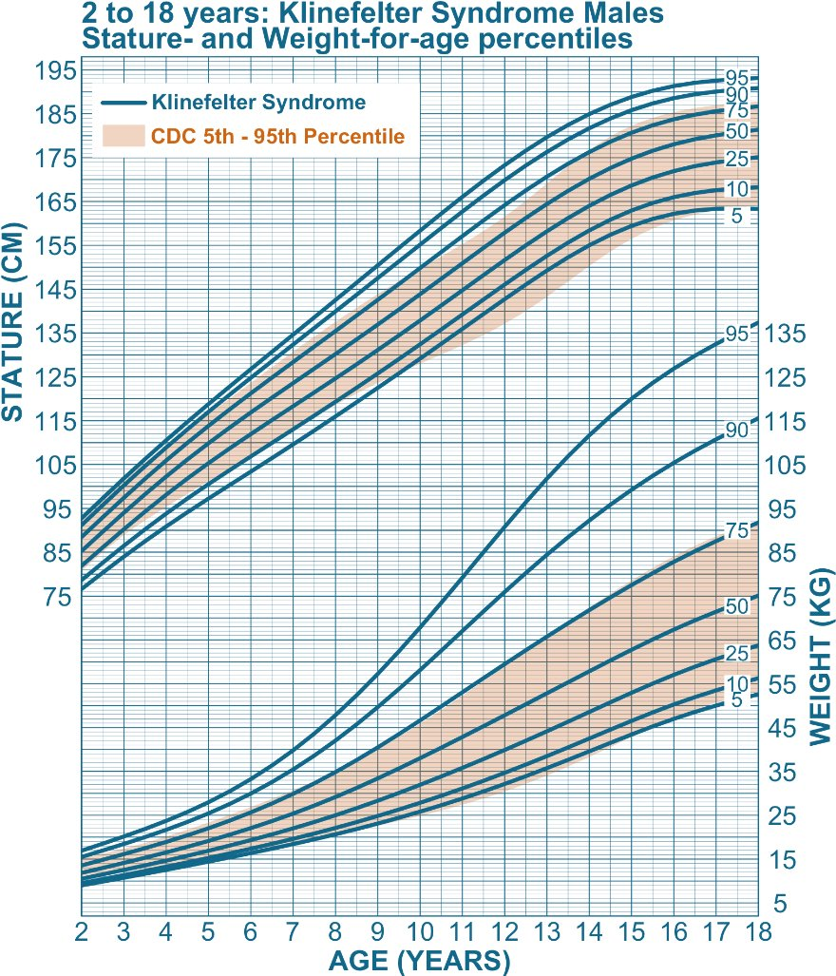

Slide 3
What are Generalized Additive Models (GAMs)
Flexible Regression Framework: Generalized Additive Models (GAMs) extend generalized linear models by allowing the inclusion of smooth, non-linear functions (splines) of predictors instead of forcing linear relationships.
Additive Structure: The model assumes the outcome depends on the sum of smooth functions of predictors, e.g.,
g(E[Y])=β₀+f₁(x₁)+f₂(x₂)+⋯+f_{k}(x_{k})
where g is a link function and f_{i} are smooth functions estimated from data.
Key Advantage: GAMs capture complex, non-linear relationships without requiring explicit parametric forms, improving model flexibility and interpretability compared to purely linear models.

Slide 4
What is GAMLSS
Beyond Mean Modeling: Generalized Additive Models for Location, Scale, and Shape (GAMLSS) extend GAMs by allowing not just the mean of the distribution, but also other parameters (e.g., variance, skewness, kurtosis) to depend on predictors through smooth or linear functions.
Distributional Flexibility: GAMLSS supports a wide range of parametric distributions (normal, skewed, heavy-tailed, zero-inflated, etc.), enabling fairly accurate modeling of data that depart from normality. (Note : If your data are non-normally distributed, it is worth exploring quantile regression as an alternative to GAMLSS)
Additive Structure for Multiple Parameters: Each distribution parameter (e.g., μ,σ,ν,τ) can have its own additive predictor:
g₁(μ)=η₁=X₁β₁+f₁(x),
g₂​(σ)​=η₂​=X₂​β₂​+f₂​(x), etc.​
giving rich flexibility for modeling heteroscedasticity and shape changes.

Slide 5
What Are Growth Charts?
Definition: Growth charts are statistical tools that show how measurements such as height, weight, or BMI vary across ages in a population. They are commonly presented as percentile curves (e.g., 5th, 50th, 95th) to illustrate typical growth patterns and variability.
Purpose: They help clinicians, researchers, and parents compare an individual child’s growth to a reference population, detect deviations from expected trajectories, and monitor health or nutritional status.
Construction: Growth charts are built using large datasets and statistical smoothing techniques (e.g., GAMLSS, LMS method) to estimate continuous centile curves across age while accounting for distributional changes in variability and skewness.

Slide 6
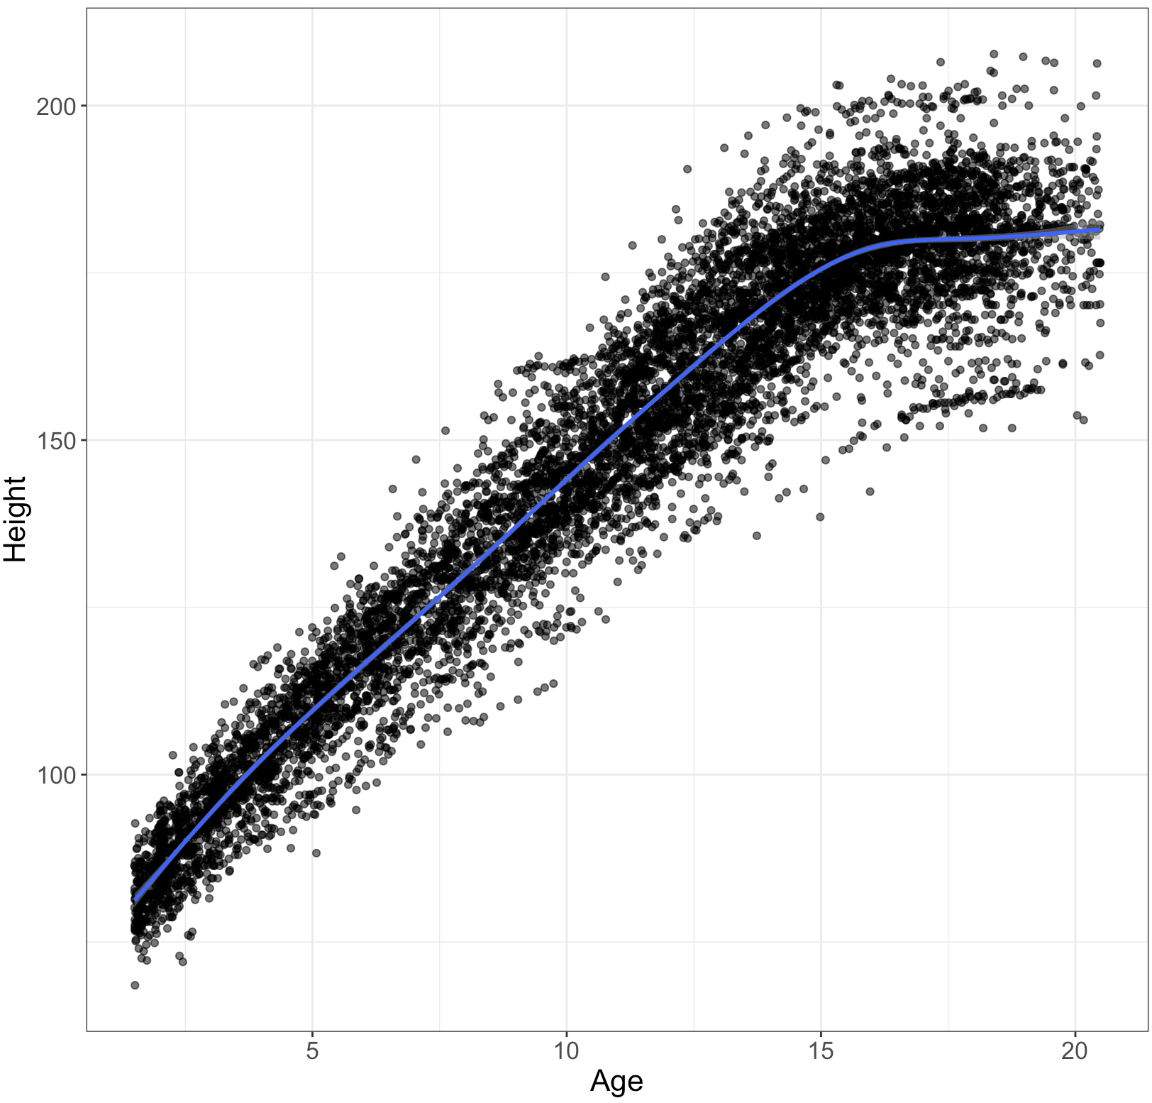
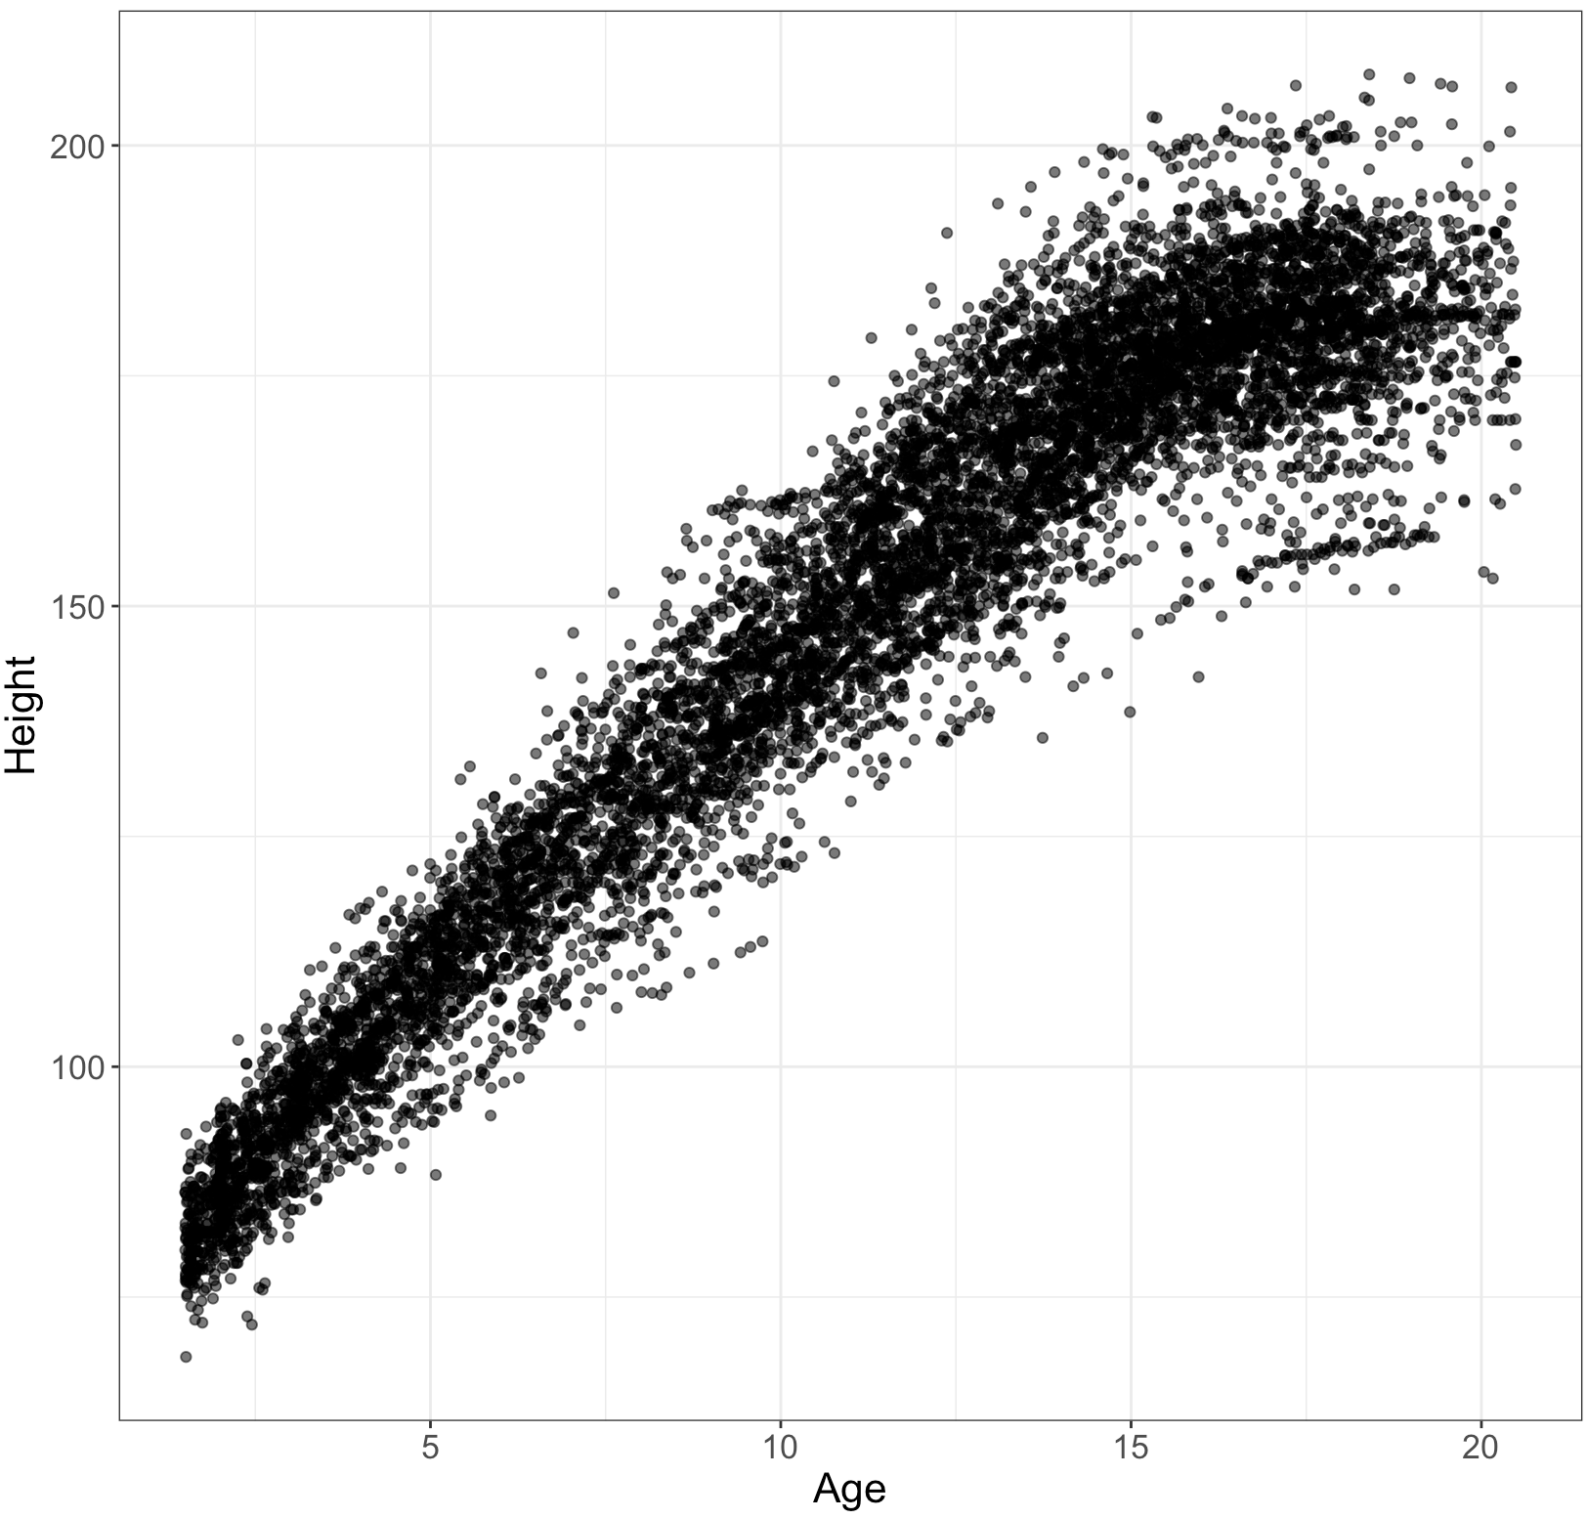
GAMLSS Example

Slide 7
Implementation in R
pb : penalized B-spline smoothing function of age with smoothing parameter λ=5.
This models a non-linear relationship between age and height.
library(gamlss)
mform_dt_hgt <- gamlss(
formula = height ~ pb(age, lambda = 5),
sigma.formula = ~ pb(age),
nu.formula = ~1,
tau.formula = ~1,
data = all_hgt,
family = BCCG()
)
Specifies a separate model for the scale parameter (σ, usually variance) as a function of age using a penalized spline.
This means the variability of height can change smoothly with age (heteroscedasticity).
Skewness
Kurtosis
Specifies the distribution for the response variable (height).
BCCG = Box-Cox Cole and Green distribution, often used for growth data.
Notes:
Kurtosis controls tail heaviness

Slide 8
Extracting Centiles
# 1. Prediction ages
ages <- seq(2, 18, by = 0.5)
# 2. Build newdata with all required covariates used in the model
newdata <- data.frame(age = ages)
# 3. Get predicted distribution parameters from the model
params <- predictAll(mform_dt_hgt, newdata = newdata)
# 4. Calculate centiles manually using the BCCG distribution quantile function
centiles <- c(5, 10, 25, 50, 75, 90, 95)
q_vals <- sapply(centiles / 100, function(p) {
qBCCG(p, mu = params$mu, sigma = params$sigma, nu = params$nu)
})
# 5. Create a dataframe of predicted centiles
lms_hgt <- data.frame(age = ages, q_vals)
colnames(lms_hgt)[-1] <- paste0("P", centiles)

Slide 9
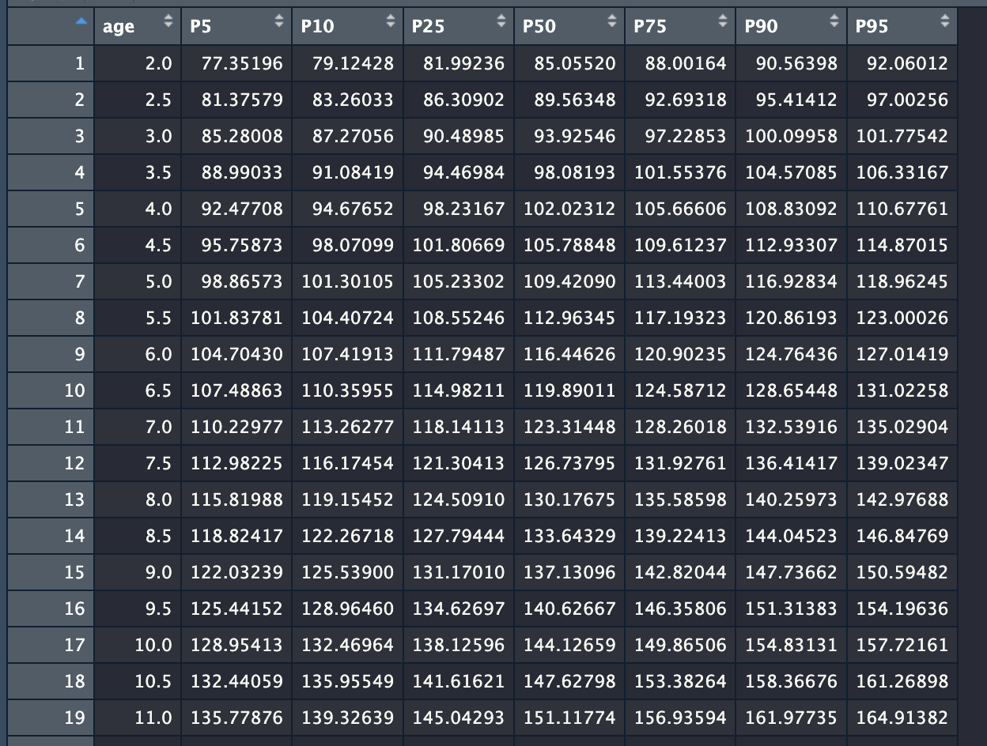
Resulting DataFrame

Slide 10
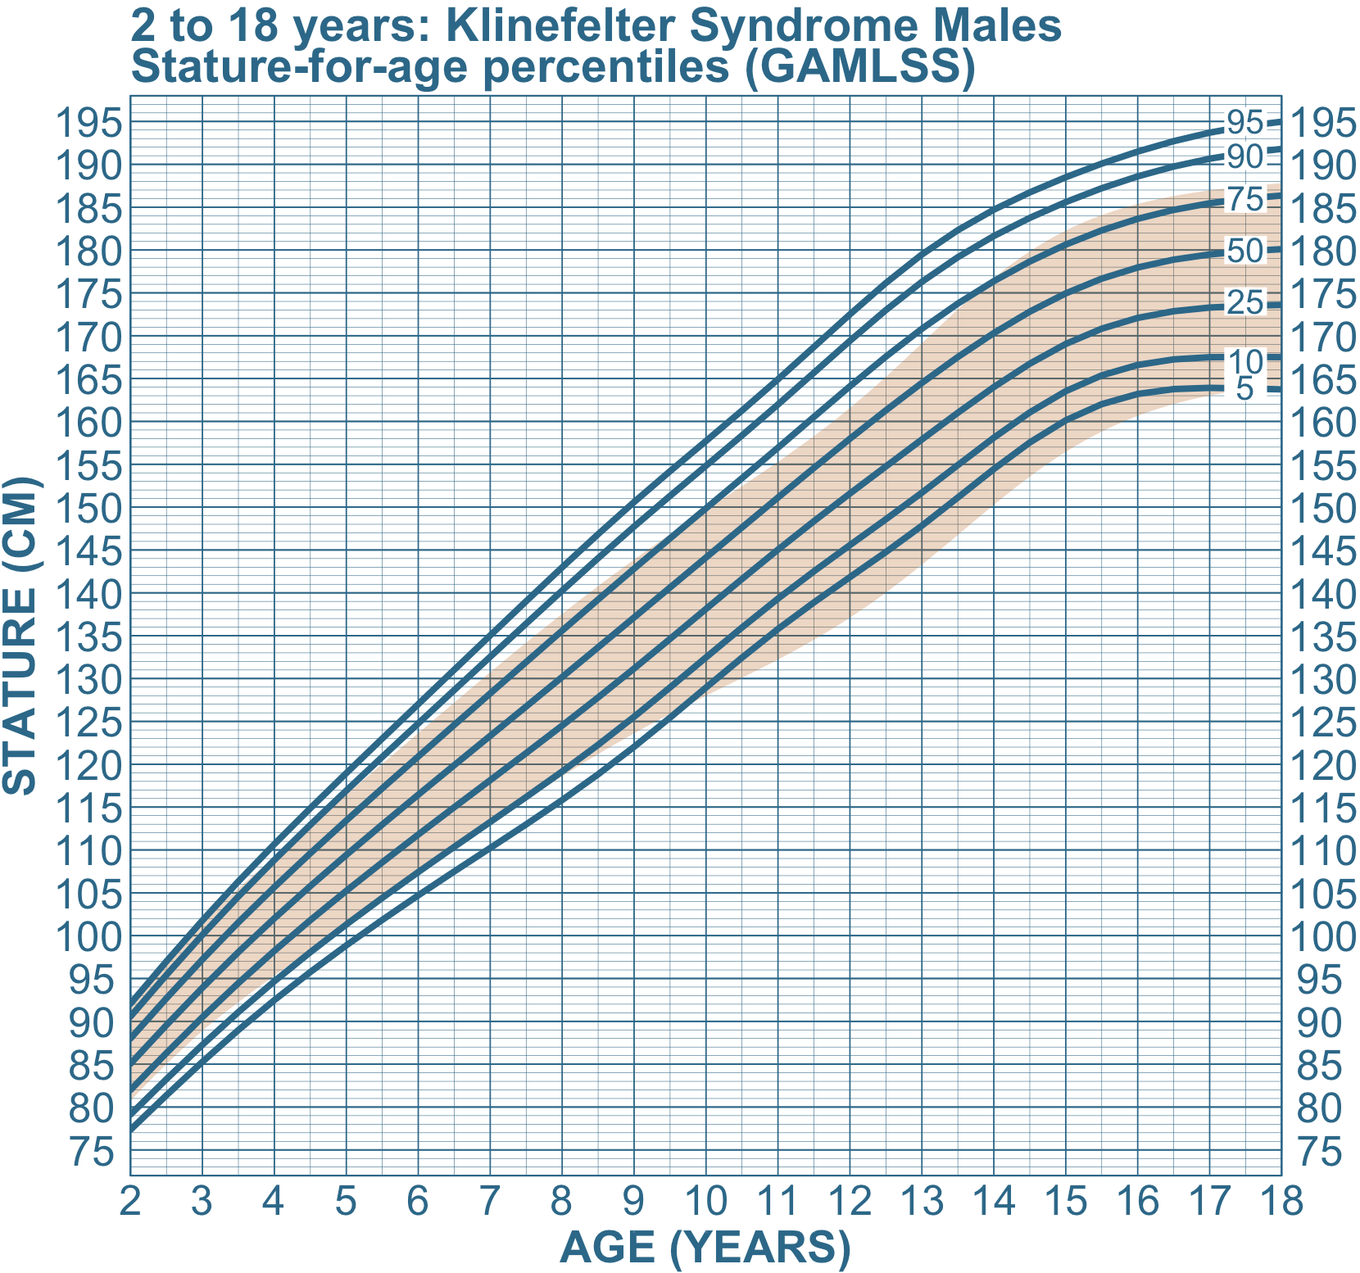
Plot it

