Slide 1
hey Otis
From rupture to repair.
A private AI guide for couples in conflict.
Samantha Ahhee · Founder, Hey Otis · Amsterdam · 2026

Slide 2
THE PROBLEM
Conflict isn't the problem. Silence is.
69% of relationship conflicts never fully resolve.
Couples wait six years before seeking help.
Most fights happen at 11pm — nine days from the next therapy session, if there is one.
When my own relationship hit that wall, I had nothing to reach for that wasn't a self-help book or a 3am text to a friend.

Slide 3
WHY NOW
Three things shifted in the last 24 months.
Models are ready.
LLMs crossed the threshold for emotional nuance without giving harmful advice.
Regulation is here.
The EU AI Act gives us a clear frame to build trustworthy mental-health AI on.
Demand broke open.
Dutch GGZ relatietherapie waitlists hit 6+ months. The gap is now structural.

Slide 4
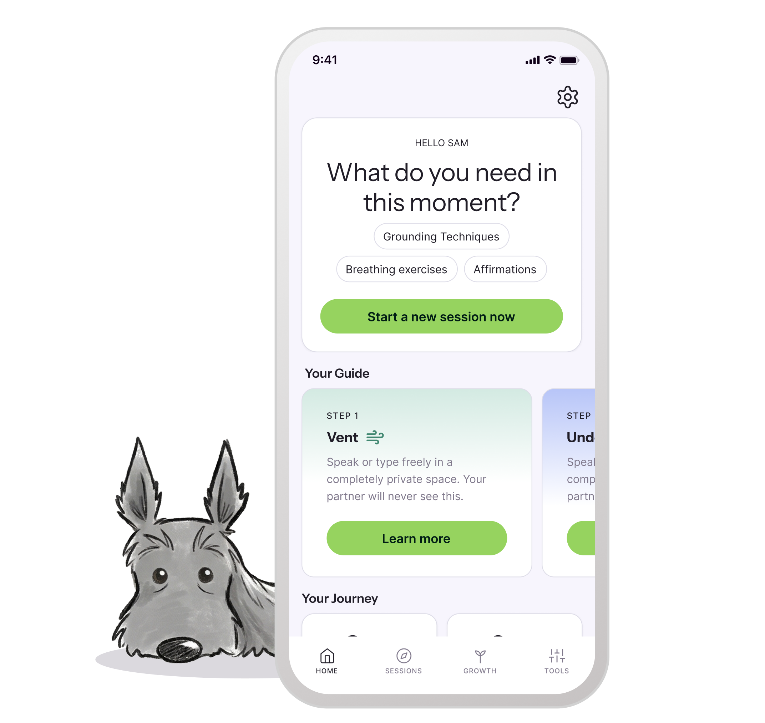
THE PRODUCT
A private space to use during conflict.
Open it after a fight. Walk through four steps. Arrive at a conversation.
Solo or synced with your partner. Voice or text input.
End-to-end private. We never train on user data. GDPR-native.
Available on iOS, Android, and web.

Slide 5
HOW IT WORKS
Four steps. One conversation at a time.
1
2
3
4
Vent
Understand
Prepare
Nurture
Say what you're feeling. Privately.
Find the unmet need underneath.
Frame what you want to say.
Walk through the actual repair.
Each step maps to peer-reviewed couples research: emotion regulation, attachment, NVC, Gottman softened start-up.

Slide 6
WEDGE & DEFENSIBILITY
Why ChatGPT won't eat this. Why BetterHelp can't.
Frameworks library
Memory flywheel
Brand trust
Validated by clinical advisor. 18 months to build, hard to clone.
Each session compounds. Generic chatbots forget you between chats.
EU-native, private by default. The category punishes any breach.
We are explicitly not a medical device. The clinical advisor on the team validates that boundary monthly.

Slide 7
THE MARKET
European-first. Bottoms-up.
47M
long-term couples in the EU
38M
are not in any form of therapy
0.5%
= 190k subs in 5 years × €15/mo = €34M ARR
Comparables: Replika (10M users, $80M ARR) · Paired UK ($9M Series A) · Headspace (€600M valuation, mental-wellness adjacency).
We start in NL + UK + DACH. US is Year 3, not Year 1.

Slide 8
BUSINESS MODEL
Subscription. Couple-tier is the unlock.
FREE
PLUS (SOLO)
COUPLES (BOTH)
€0
€14.99/mo
€22/mo
One guided repair per month
basic insights
Unlimited repairs, partner sync,
full assessment library
Both partners synced,
shared history, deeper insight
Assumptions: blended CAC €18 · 14-month tenure · 78% gross margin · LTV €185.
Couple subscription = built-in viral loop. One signup brings two users.

Slide 9
YEAR 1 GTM
Three channels. Honest CPA targets.
Reddit + Substack organic
CPA target: €4
Relationship subs, attachment-style writers. Already running.
Couples-therapist referrals
CPA target: €8
Clinicians give Hey Otis to clients between sessions.
Instagram Reels + creators
CPA target: €25
Short-form clinical-content partnerships. Brand-driven.
Channel 1 is already validated by the heyotis.app/research survey campaign.

Slide 10
TRACTION
Where we are today.
[X]
[X]
78%
WAITLIST SIGNUPS
SURVEY RESPONSES
SAID THEY'D TRY IT
heyotis.app, organic
primary research, real couples
from in-survey validation
Brand, marketing site, Supabase backend, payments, app prototype — all live.
Beta launching Q3 2026 in EN-speaking markets. Apple + Google submission ready.

Slide 11
TEAM
Two founders. Lived experience + commercial pedigree.
Samantha Ahhee
[Husband's name]
Hiring next
FOUNDER + CEO
CO-FOUNDER + GTM
CLINICAL LEAD
Designer + builder. Previously [your prior role]. Built the Hey Otis product, brand, and primary-research system end-to-end. Lives the problem.
[N] years bringing software products to market. Previously [his prior role at company]. Owns commercial strategy, partnerships, and scale.
Licensed couples therapist to validate frameworks, prompts, safety guardrails. In conversation with two candidates.

Slide 12
THE ASK
Raising [€XXX]K pre-seed
24-month runway. To launch publicly, hit 10,000 paying users,
validate Couples-tier LTV, and reach Seed milestones.
Plan to stack with WBSO R&D credit + RVO Innovation Credit
(targeting +6 months runway non-dilutively)
samantha.ahhee@gmail.com · heyotis.app

Slide 13
APPENDIX · WHY THIS INCUBATOR (DELETE THE OTHERS)
Why Antler NL
Antler's residency model and consumer-health portfolio fit Hey Otis precisely. We come in with the product, brand, and primary research already in market. We use the residency to (a) validate clinical co-investor relationships, (b) sharpen the EU-first GTM motion, and (c) close the clinical-lead hire. The category we're in — couples mental wellness — is brand-and-trust before it's anything else, and Antler portfolio peers have solved exactly that distribution problem.

Slide 14
APPENDIX · WHY THIS INCUBATOR (DELETE THE OTHERS)
Why Rockstart Health
Rockstart Health's clinician network is the unlock for our second GTM channel: therapist referrals. Hey Otis only works as a therapist-recommended tool if therapists know it exists. Your portfolio of companies bridging digital and in-person care gives us the peer group that has solved exactly this distribution problem. We'd also leverage your brand to accelerate insurance-reimbursement conversations in Germany, where the pathway exists.

Slide 15
APPENDIX · WHY THIS INCUBATOR (DELETE THE OTHERS)
Why TechLeap.nl
TechLeap is the validation layer that opens the next two doors: the RVO Innovation Credit (for clinical-validation work) and the EIC Accelerator at Horizon Europe (for EU-wide expansion). Both are non-dilutive and well-suited to our 18-month roadmap. A TechLeap stamp also accelerates the brand-trust conversation that drives our B2C unit economics. We'd use the TechLeap network to bridge into both grant pipelines and Rise programme alumni for hiring.

Slide 16
APPENDIX · WHY THIS INCUBATOR (DELETE THE OTHERS)
Why ACE Incubator
ACE's link to the University of Amsterdam — and the clinical psychology department specifically — gives Hey Otis the academic validation layer that consumer mental-health products usually have to build years in. A research collaboration with UvA on conflict-resolution outcomes would be the strongest defensibility moat we could build at this stage. ACE's local network also shortens the hiring loop for the clinical lead role.

